Slide 1
Larimer County 101

Slide 2
Overview of Larimer County

Slide 4
County Government Facts

Slide 5
County Government Services

Slide 12
Guiding Principles

Slide 13
2013-18 Strategic Plan https://www.larimer.org/about-larimer-county/2013-2018-strategic-plan

Slide 14
Significant Challenges on Horizon

Slide 15
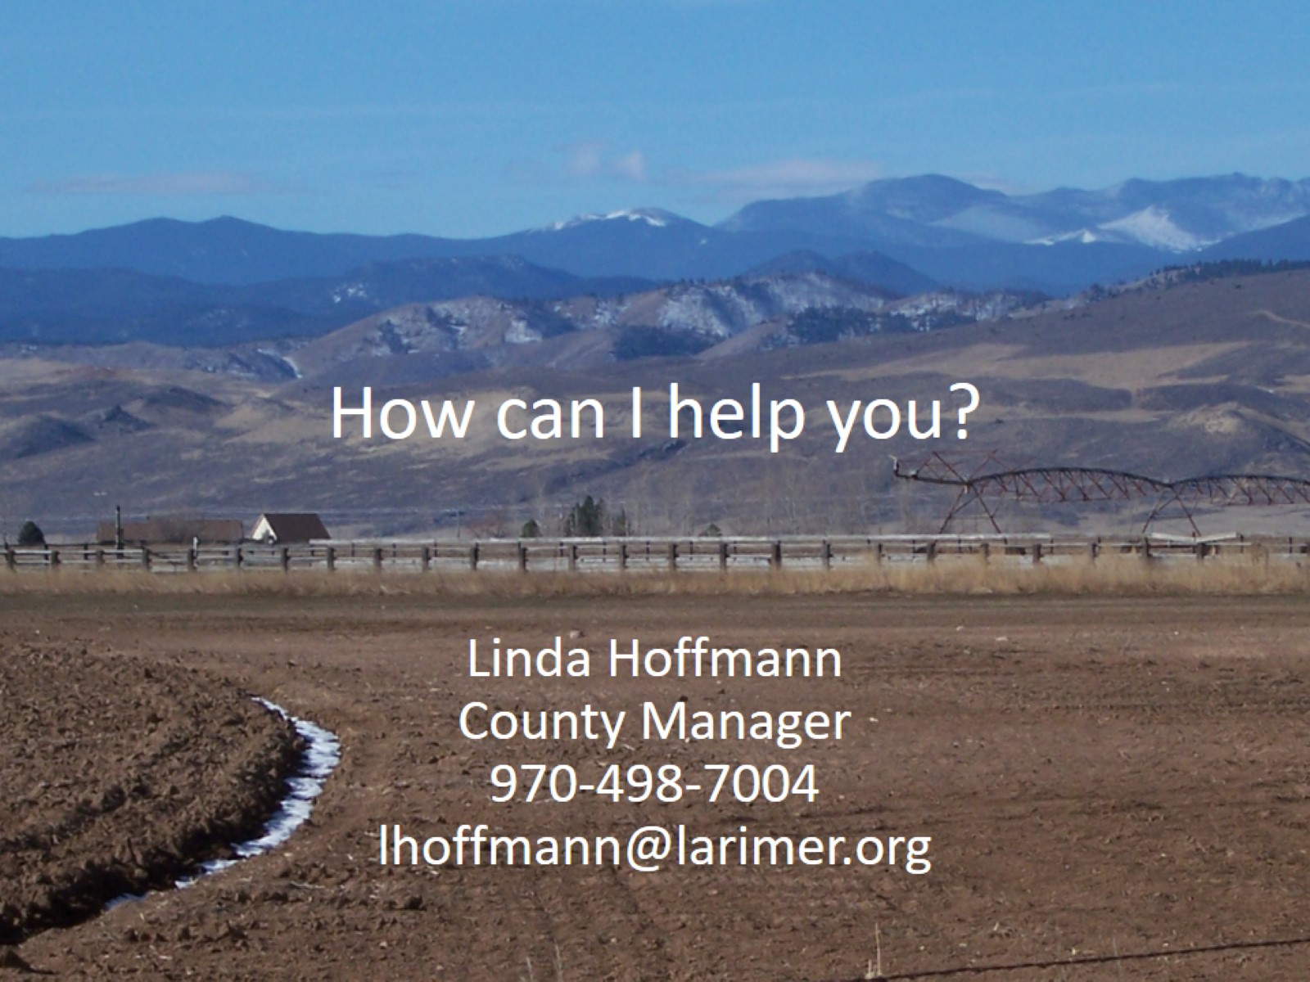
How can I help you?

Slide 16
Significant Challenges on Horizon

Slide 17
Significant Challenge on Horizon

