Slide 1
2022 Legislative Update

Slide 2
Pre-Trial, Trial, and Discovery

Slide 3
HB 1150 – Eliminate Signature Requirement Certain Citations
Some eligible offenses within Title 42 allow officers to issue a penalty assessment notice, even after arrest, allowing a defendant to admit guilt (i.e., misdos; pettys/misdo traffic) /or liability (e.g., infractions), but requiring a signature. The signature requirement is removed.
In situations where “ID” may be an issue before release of a defendant (i.e., no valid DL), the law removes the option for defendants to execute a “promise to appear”, or the option to admit guilt/liability and be transported to the nearest mailbox to mail penalty / surcharge amounts to Dept. of Revenue (DOR).
Notes:
This Bill was primarily promoted by the Colorado State Patrol (CSP)
Eligible Offenses within Title 42 to which this law would apply (per 42-4-1701(4)(a)):
Drivers license violations
Registration and taxation violations
Traffic regulations generally
Equipment violations, Emissions inspections; Size, weight and load violations; Signals, signs and marking violations; Rights-of-way violations; Pedestrian violations; turning and stopping; Driving, overtaking, and passing violations; speeding; parking; motorcycle violations; offenses by persons controlling vehicles; Certificates of Title; Proof of Financial liability; Uninsured Motorist ID database protection
- Under current law, a defendant is required to execute the defendant's signature on citations for a misdemeanor, petty offense, misdemeanor traffic offense, or traffic infraction to signify agreement to pay the penalties or appear in court. The act eliminates the defendant signature requirement.
(Note: This summary applies to this bill as enacted.)

Slide 4
SB 196 – Health Needs of Persons in Criminal Justice System
Early Intervention, Deflection and Redirection for the Criminal Justice System Grant Program ~ $60 million
Co-responder programs – law enforcement may apply for this purpose.
$4 million for DA diversion - $1.8 million only for DA’s offices that divert mental health cases.
Notes:
LE and maybe DA.
local law enforcement agencies are eligible for a grant only for the purpose of developing or expanding a co-responder community response program. In order to receive a grant, an applicant must offer a monetary contribution or in-kind contributions that directly support the services provided with the grant award. The BHA may waive the monetary or in-kind contribution requirement for applicants requesting a grant of less than $50,000.

Slide 5
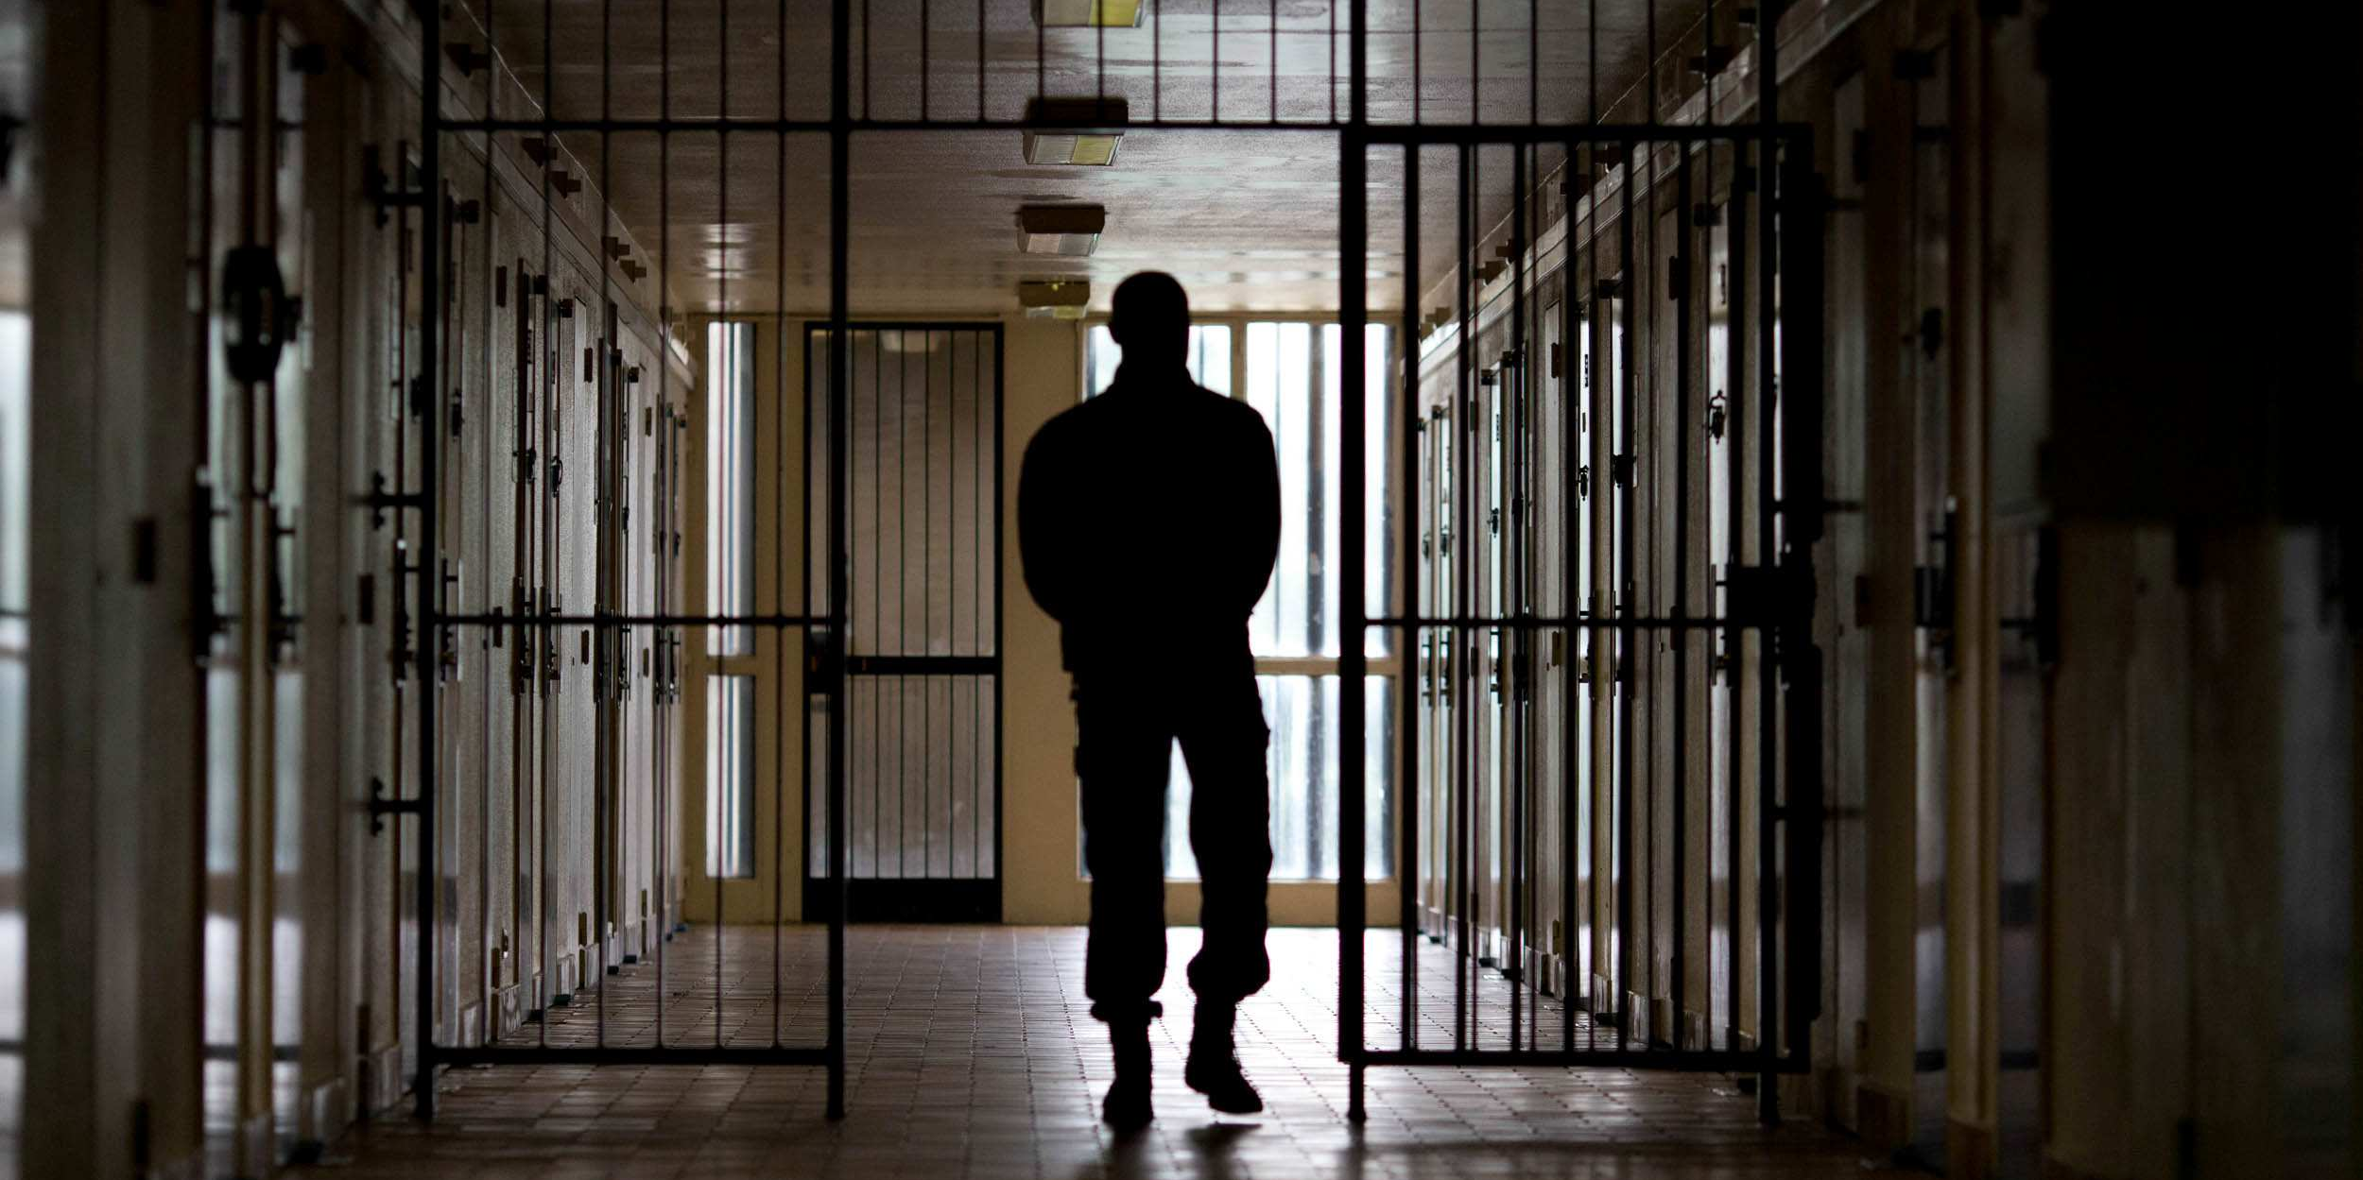
Crimes and Sentencing

Slide 6
HB 1041 – Privacy Protections for Protected Persons
Anti-Doxing and Privacy Protection statutes expanded to more individuals.
Reminder – doxing is only a crime if dissemination of the personal information (usually home address) poses an imminent and serious threat to the person’s safety, AND the defendant is aware of the danger. M1 crime

Slide 7
HB 1041 – Privacy Protections for Protected Persons
Protected Persons:
Educator
Code enforcement officer
Human services worker
Public health worker
Child representative
Health Care Worker
Officer or agent of state bureau of
animal protection
Animal control officer
Office of respondent parent’s counsel staff member
Judge
Peace officer
Prosecutor
Public defender
Public safety worker

Slide 8
HB 1086 – The Vote Without Fear Act
Creates 2 new Unclassified (M) offenses for openly carrying a firearm:
Within any polling location, or w/i 100 ft. of drop box or any polling location building
Within a central count facility, or w/i 100 ft. of any central count facility building, during any ongoing election administration activity related to an active election
Exceptions:
Private Property Owners; uniformed security; peace officers
Sentencing: 1st offense is max $250 fine/120 days jail; subsequent offense is max $1,000 fine/364 days jail
Notes:
Slight misprint in CDAC Leg. Update Booklet. The crimes created are in fact UNCLASSIFIED MISDEMEANORS, not an M1 and M2. DELETE 2nd bullet point on page 16 of Booklet and advise participants these are unclassified misdos
The two crimes created are both unclassified misdemeanors, and will be broken into two charge codes: 1 code for “polling location” and “drop box” violations (1-13-724(3)(a)); and a separate code for “central count facility” violations (1-13-724(3)(b)).
The sentencing on this offense is specifically written into the statute:
1st offense will have a max $250 fine / and 120 days in jail (M2’s thresholds are typically $750/120 days in jail. So sentencing is close to an M2, but not quite)
Any other offense will have sentencing of not more than $1,000 fine/364 days county jail. (this sentencing is consistent with M1).
There is no definitions for “Central Count Facility”, nor “Ongoing Election Administration Activity”
Election officials will need to ensure they post signage during the entire time individuals are allowed to vote, given Colorado’s mail -n ballot procedure and the extended period in which voting is permitted.

Slide 9
HB 1224 – Public Benefits Theft
Creates new subsection (f) in 18-4-401(1), prohibiting misrepresentation or withholding material fact in determining eligibility for public benefit
“Public Benefit” defined in law
Restriction: cannot charge the new subsection (f) with any other provision of the theft statute. But no limitation on charging conduct under other criminal offenses.
Notes:
Misprint in Leg Update Booklet. On page 17, 2nd bullet notes Title 19 provision. The new subsection is in Title 18 (criminal code), not in Title 19 (juvenile code)
The theft statute in ACTION has drop-down options for the multiple sections for charging purposes. A new drop-down option will be added to account for subsection (f). However, a CHARGE NOTE reminder will also be added reminding that other subsections of 18-4-401 cannot be charged with 18-4-401(1)(f). Attorneys and/or Staff preparing complaints will need to pay attention to charge limitation (see 18-4-401(12)).

Slide 10
HB 1257 – 2022 Criminal and Juvenile Justice Commission Recs.
New Class 6 Felony – practicing certain professions without a license and intentionally and fraudulently representing self as licensed.
Purposes of Probation – rewritten. Change to parole sanctions.
Public Benefit definition and value determination.
Additional Predicate Crimes for POWPO
Was just VRA felonies from 3/1 to 4/7 of 2022
Juvie POWPO change
Be mindful of the effective date. Signed on 4/7/22
Notes:
Da and LE

Slide 11
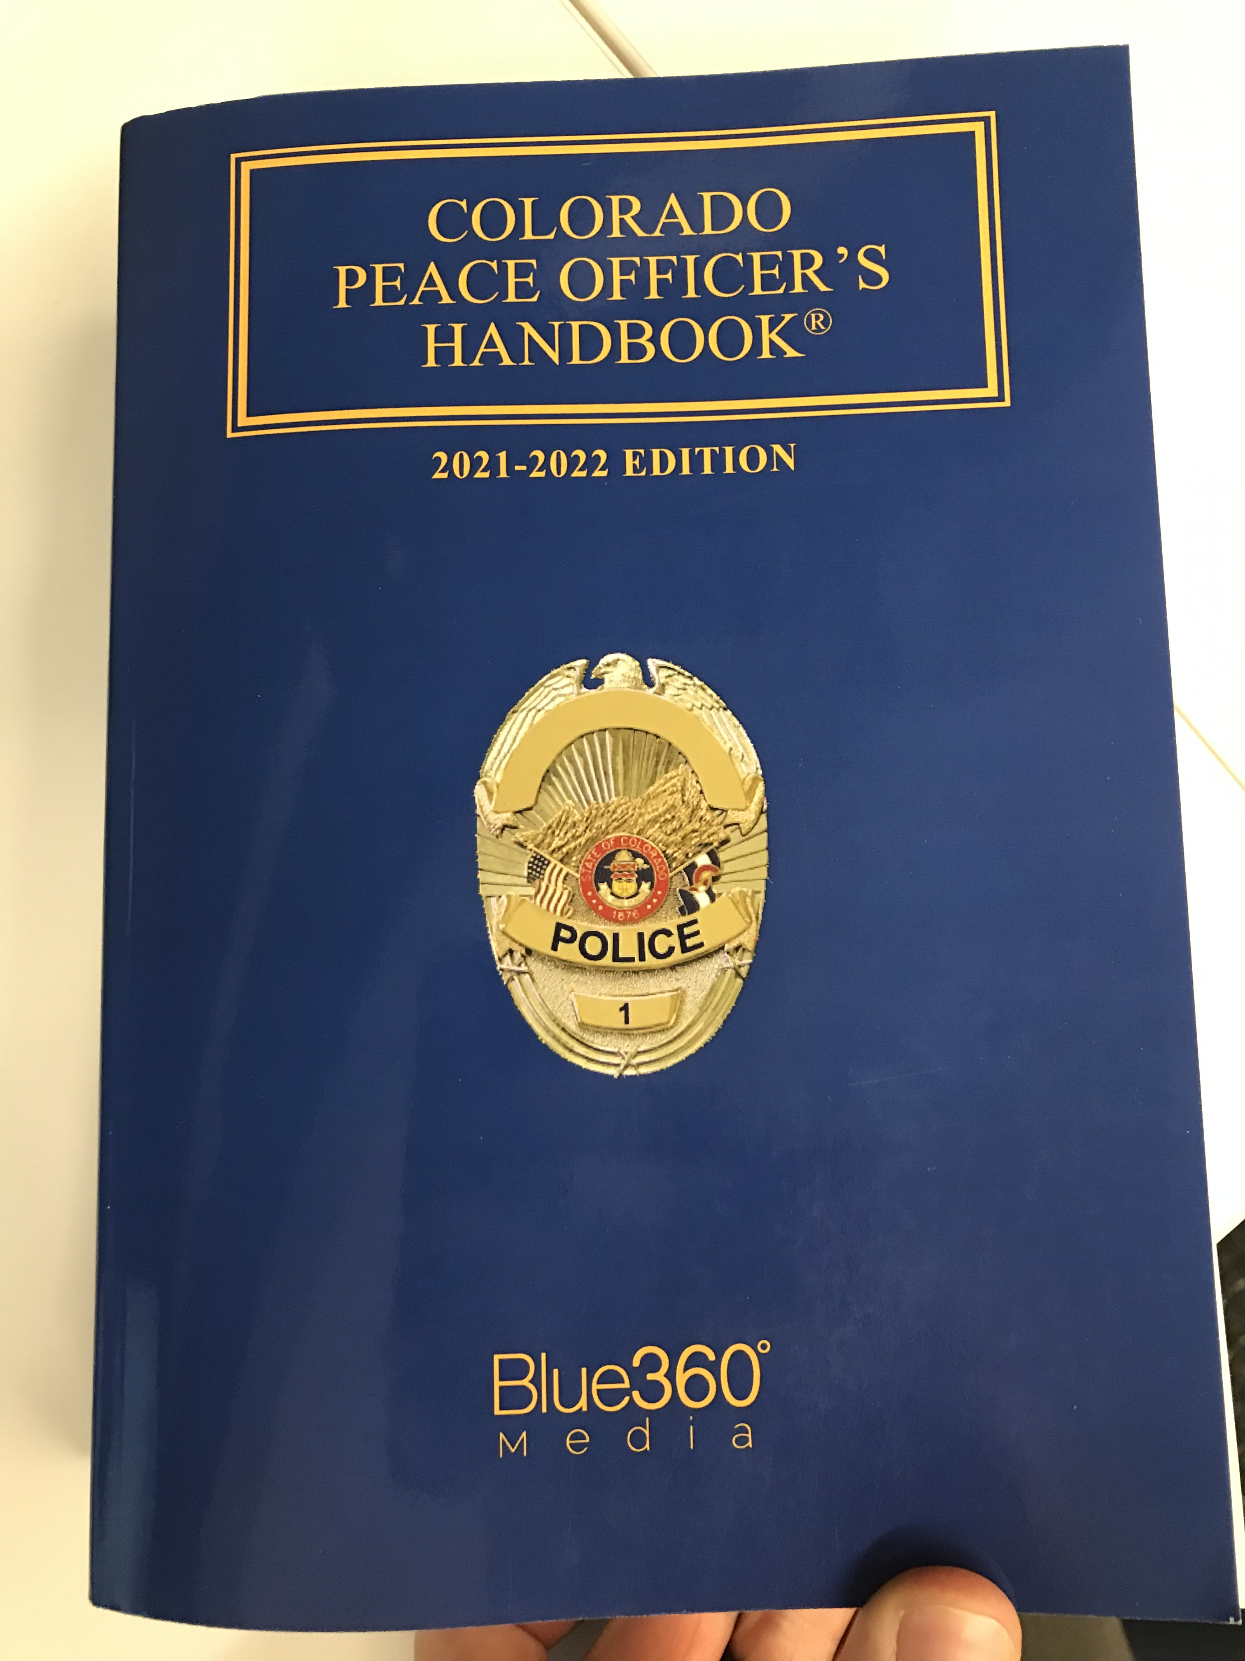
Notes:
For any officers that rely on this book – there is a big error regarding the crime level for POWPO
There was some rhetoric in the media that POWPO got reduced to a misdemeanor in 21-217, but that never happened.
While 217 limited what prior felonies were predicates, it actually increased the crime level to an F5 and made it mandatory if the weapon was used in the commission of another crime.

Slide 12
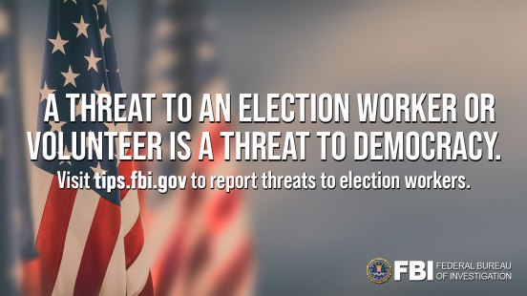
HB 1273 – Protections for Election Officials
Interference with Election Officials expanded to include threats and intimidation.
Creates anti-doxing crime specific for election officials.
Allows election officials to remove personal info from government records.
Notes:
DA and LE

Slide 13
HB 1324 – Definition of Pawnbroker
Makes amendment to definition of “pawnbroker” under 29-11.9-101(7), in response to 2019 Ct. of Appeals case Pro’s Closet, Inc. v. City of Boulder, 2019 COA 128
Distinguishes between “purchase transactions” and “contracts for purchase”
“Contract for Purchase” – advance of funds to customer with option to buy back property no sooner than 30 days (i.e., contract for purchase with option to cancel)
“Purchase Transaction” – broker outright buys customer’s property for resale
Businesses that solely engage in “purchase transactions” now excluded from definition
Notes:
Brief Facts of Pro’s Closet case:
Pro’s Closet is licensed as a secondhand dealer under the Boulder Revised Code. It sells used bicycles, bicycle parts, and bicycle gear. Though it has a warehouse in Boulder, Pro’s Closet does most of its business online.
In 2016, the Twentieth Judicial District’s District Attorney’s Office told the Boulder Police Department to treat Pro’s Closet as a "pawnbroker" under state law, meaning, among other things, that Pro’s Closet must hold used goods it buys for thirty days before reselling them instead of ninety-six hours as required by the Boulder Revised Code’s secondhand dealer ordinances. Pro’s Closet filed suit, seeking a declaratory judgment that it isn’t subject to state pawnbroker laws.
Both Pro’s Closet and the City moved for summary judgment. The district court granted the City’s motion, concluding that, since Pro’s Closet regularly makes "purchase transaction[s]", it is a pawnbroker under state law. Ct. of Appeals affirmed.
This law change came about in response to that case, to exclude businesses that solely make ‘purchase transactions” as pawnbrokers.
“Contract for Purchase” – advance of funds to customer with option to buy back property no sooner than 30 days (i.e., contract for purchase with option to cancel)
“Purchase Transaction” – broker outright buys customer’s property for resale

Slide 14
HB 1326 – Fentanyl Accountability and Prevention
The most controversial criminal justice bill debated this session (originally a more limited CDAC-initiated bill to address increasing penalties for distribution offenses)
Interest in bill took significant turn after 5 deaths in Commerce City on 2/20/22. Multiple legislative efforts coalesced into one large bill (73 pages)
Criminal Provisions / Increased Enforcement | Harm Reduction | Funding and Resources *DA Office eligibility (24-33.5-533 CRS) | Data Collection *DA 3-yr data collection (18-1-711(6)(b)) | Studies | Fentanyl Education and Treatment | Jail-Based Behavioral Health Services
$54.5 million in Appropriations
Notes:
Addressing Fentanyl was a CDAC legislative priority in 2022. Bill became more political after deaths of 5 people on Commerce City
Bill is too broad to cover in this training. Rest of slides focus just on the first category of the Bill (i.e., Criminal Provisions / increased enforcement)

Slide 15
HB 1326 – Fentanyl Accountability and Prevention
Creates new crime Thresholds for Possession, Distribution, and Distrib. + Death:
Possession 0-1 gm: DM1. 4th/Subs. DM1 conviction= DF4.
Possession 1-4 gm: DF4. (If Def. shows reasonable mistake of fact in knowledge that drug contained Fentanyl, matter submitted to fact-finder via interrogatory. Possible reduction to DM1).
Possession of any quantity with 60% total composition: DF2. (*TBD on testing capability)
Sentencing Options/Consequences:
DF4 = no DOC jurisdiction/no Parole. 2 years probation & up to 180 days jail. Wobbler eligible; sealable; no basis for future predicate offense habitual charging.
DF4 (3rd/subsequent) = Up to 364 days jail as probation condition. $1,000 fine. Possible alt. sentencing (jail alternative or Comm Corr).

Slide 16
HB 1326 – Fentanyl Accountability and Prevention
Creates new crime Thresholds for Possession, Distribution, and Distrib. + Death:
Unlawful Distribution, etc. 0-4 gm: DF3
Unlawful Distribution, etc. 4-50 gm: DF2
Unlawful Distribution, etc. 50+: DF1
Sentencing Options:
Standard DF sentencing grid
But, DF3 (0-4 gm) - No mandatory sentencing allowed. Offense is probation eligible.

Slide 17
HB 1326 – Fentanyl Accountability and Prevention
Creates new crime Thresholds for Possession, Distribution, and Distrib. + Death:
Distrib. and Death Results 0-4 gm: DF1 (8-32 yrs.; no min mand./prob. elig.)
Distrib. and Death Results 4-50 gm: DF1 (8-32 yrs.; mand. 8 yrs.)
Special Offender: Distrib. and Death Results 50+ gm: DF1 (12-32 yrs.; minimum mandatory 12 yrs.)
Special Offender: Distribution w/Pill or Tab manufacture equipment: DF1
Special Offender: Introduction/Importation of more than 4 gm: DF1
Exceptions:
Possible Good Samaritan Immunity provision = applies to only Distrib. of 0-4 gm and Death Results (DF1) offense.
And DF1 (0-4 gm) - No mandatory sentencing allowed; probation elig.
Notes:
Possible misprint: Page 23 of leg booklet: 3rd black bullet. Good Samaritan Immunity Provision for any DF1 (not DF3)

Slide 18
SB 024 – Intimidating a Witness Changes
Adds new provisions to “Intimidating a Witness or Victim” crime – 18-8-704
Covers threats, harassment or harm/injury to:
A person the defendant believes may have information relevant to criminal proceeding
A person the defendant believes may be able to exert influence on witness or victim
A person who actually testifies (not just who may be called to testify)
Covers influence of the witness, victim, or any other person with relevant knowledge of information to withhold or provide false info to L/E, Def. Atty. or Def. Investigator
Notes:
CDAC-initiated bill (i.e., one of our top legislative priorities in 2022)
The provision that applies to “influence of any other person with relevant knowledge to withhold from, or provide false information to law enforcement, defense attorney, or defense investigator” still requires that the initial act involve a threat, act of harassment, or an act of harm or injury to any person or property.
The inclusion of Defense Attorneys and Defense Investigators was a negotiated provision to get the defense community to go neutral (i.e., not oppose) on the bill

Slide 19
SB 153 – Internal Election Security Measures
Creates or amends 4 crimes related to elections:
M1 – Willfully interferes or willfully refuses to comply with the rules, orders, or acceptable use policy for the statewide vote registration system of the Secretary of State – (note potential constitutional concerns)
M2 – Interfering with someone reporting a violation of above crime.
F5 – Accessing, tampering with, or facilitating the unauthorized access/tampering with any voting equipment or system before, during, or after an election.
F5 – Publishing passwords or other confidential information related to a voting system.
Notes:
DA and maybe LE

Slide 20
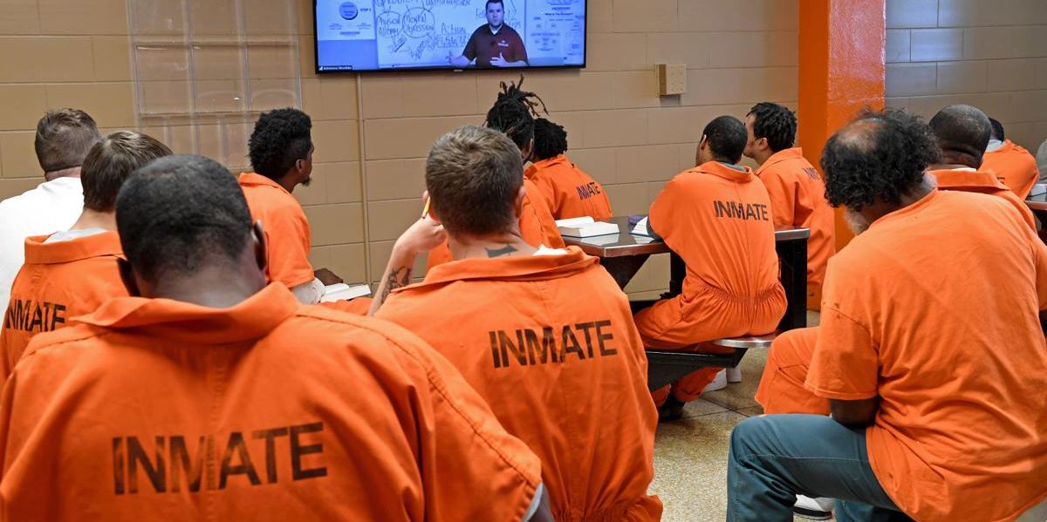
DOC/Community Corrections and Parole/Probation

Slide 21
HB 1208 – Jail Data Collection Clean-up
Current law requires the “keeper of the jail” to report
quarterly to the Division of Criminal Justice (DCJ)
demographic, offense, and confinement data on inmates
X
Reporting
until 2023
Ongoing

Slide 22
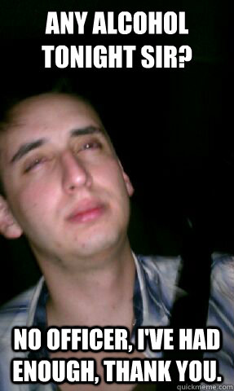
SB 055 – Alcohol Monitoring for Impaired Driving Offenders
Allows for early reinstate of DL, at any time, with interlock
Defines “continuous alcohol monitoring” (e.g., SCRAM units)
DUI Felony (probation) – mandatory 90 days of monitoring
2nd offenders – optional sentencing requirement
3rd/subsequent offenders – mandatory 90 days of monitoring
Notes:
Mothers Against Drunk Driving (MADD) organization-initiated bill
MADD argued there are better outcomes when not delaying the reinstatement of a license if a person is willing to install an interlock ignition device within a vehicle. If so, no reason to have a delayed waiting period of one month before reinstatement
Continuous Alcohol Monitoring for 2nd and 3rd time offenders was proposed in order to prevent defendants from getting into the felony stage (i.e., 4 offense). With continuous monitoring for a minimum of 90 days, the research demonstrated better outcomes for offenders.

Slide 23
Victims and Witnesses

Slide 24
SB 043 – Restitution Services for Victims
Clarifies that restitution can be ordered for:
Long term medical expenses
Lost wages
Childcare
Insurance deductibles
Damaged property
DOC can intercept economic stimulus government payments to pay outstanding restitution debts.
Notes:
What didn’t get in the bill – fix for 90 day rule and adverse supreme court decisions.

Slide 25
SB 049 – Victim Rights Act
Adds two new crimes to the VRA – FIRST DEGREE ARSON and CRIMINAL INVASION OF PRIVACY.
Deceased victims – can be represented by more than one person.
Bond modification requests on VRA crimes must have a hearing.
Prosecutors must explain to victim that a defendant may not serve all of a DOC sentence.
Trial sequestration: DA “must undertake best efforts to prioritize timing of victim’s testimony and minimize the amount of time the victim is sequestered from the critical stages in the case”
Defendant must be present in court (or virtual) for sentencing to hear victim impact.

Slide 26
SB 049 – Victim Rights Act
SDT for privileged victim records under 13-90-107 or victim’s compensation records:
Must file with court and serve opposing party.
Must include a certificate stating that the party has a “good-faith belief that there is a lawful basis for issuing the subpoena.”
Copy of written notice served on the subject of the SDT stating that they may not release the records until ordered by the court at the hearing.
A motion stating the lawful basis for the subpoena, and if subject to a claim of privilege, a good-faith claim that the victim has expressly or impliedly waived any privilege.

Slide 27
SB 049 – Victim Rights Act
SDT process for privileged victim records under 13-90-107 or victim’s compensation records:
Court shall quash request for privileged records unless court finds that victim has expressly or impliedly waived privilege.
If so, then the court must determine:
Likelihood records exist, are evidentiary and relevant;
Cannot be reasonably procured in other ways;
Party cannot properly prepare for trial without records;
Application to review records was in good faith.
Court must hear from victim at hearing.
If granting SDT – 7 days for party to arrange production of records to the court.

Slide 28
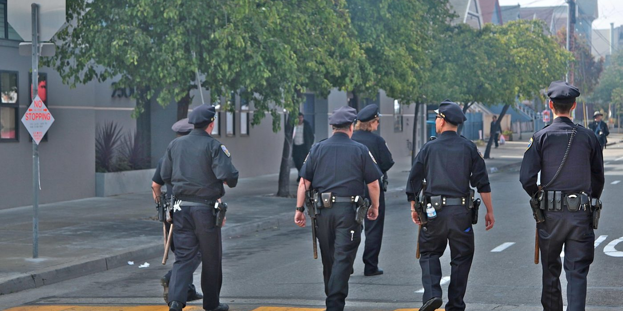
Peace Officer/POST

Slide 29
SB 095 – Improving Missing Person Investigations
Removes jurisdictional barriers for L/E agencies to accept missing person reports. LEAs shall accept report for person missing anywhere in CO. Telephone/ electronic/ other media reports acceptable, if consistent with agency policies and practices.
Removes 24-hour restriction. CCIC entry required within 8 hours after report received, and within 2 hours if missing person is under 18.

Slide 30
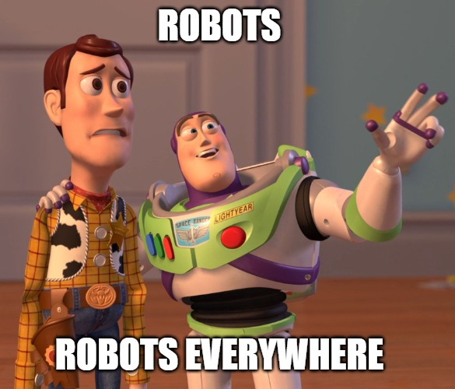
SB 113 – Artificial Intelligence Facial Recognition
Creates multi-year Task Force (2022-2027) to study and consider A/I and policies
Defines membership/terms and definitions/scope of T/F work, data collection requirements and reporting obligations
Specific prohibitions by L/E on use of FRS
Exceptions:
Warrant
Necessary to develop leads in an investigation
PC
Court order to locate missing/ID deceased persons
Notes:
Heavily amended bill. Complete “strike-below” (i.e., complete rewritten version) introduced halfway through the legislative process when this Senate Bill made its way over to the House
The bill went to a Conference committee and was amended even further.
Very broad restrictions on the use of FRS (Facial Recognition Service)
Misprint in the book: Page 50 ,5th black bullet down (1st clear bullet): Strike “exigent circumstances exist” and replace with “SUCH USE IS NECESSARY TO DEVELOP LEADS IN AN INVESTIGATION”

Slide 31
Motor Vehicle and Traffic

Slide 32
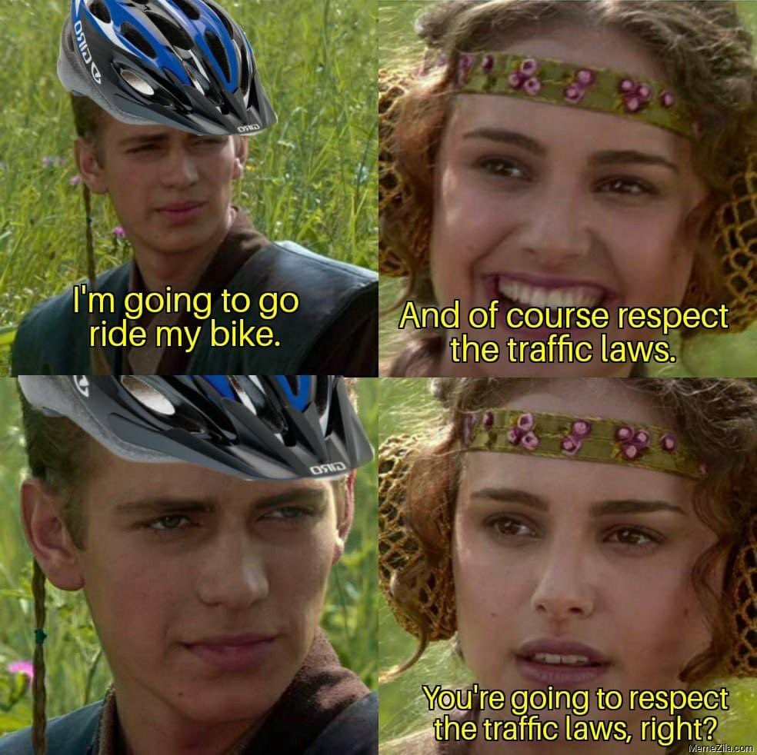
HB 1028 – Statewide Regulation of Controlled Intersections
Allows for “safety stop” for bicyclists at intersections.
Notes:
LE only

Slide 33
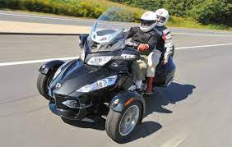
HB 1043 – Motorcycle and Autocycle Definitions
Which is a motorcycle and which is an autocycle under Colorado law?
Notes:
NOT IN BOOK
Easiest way to tell the difference is if it has a steering wheel or handlebars
Pic on left is an “autocycle” - Polaris Slingshot. Pic on right is a three wheel motorcycle – Can-Am Spyder
Autocycle does not require motorcycle endorsement. Both still require eye protection.

Slide 34
SB 009 – Recertification and Theft of Catalytic Converters
Purchases of Commodity Metals in Article 13 of Title 18
Catalytic Converters are now specifically included in the regulations and crimes.
Chop Shop Activity crime – 18-4-420
Catalytic Converters are now included in the definition of “major component vehicle part.”

Slide 35
Juvenile

Slide 36
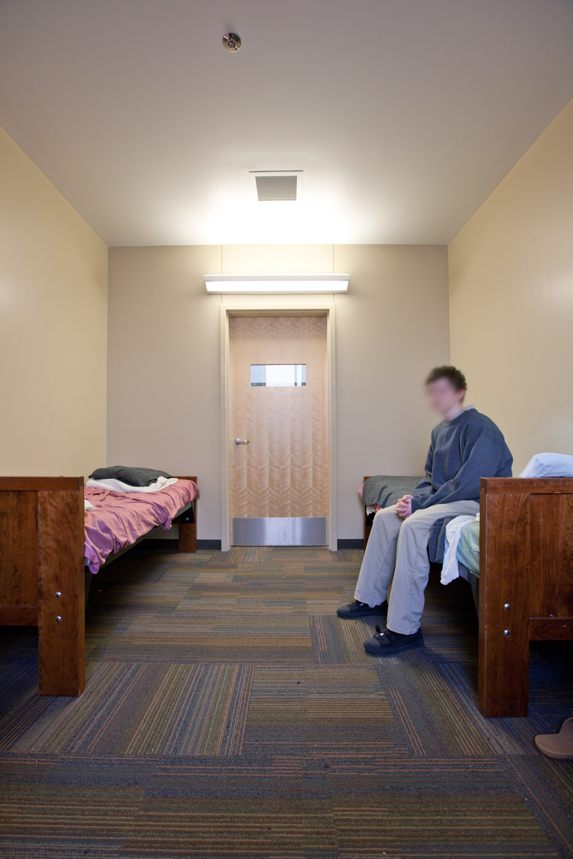
HB 1056 – Emergency Temporary Care for Children
Implements Juvenile Code provisions that allow for placement of juveniles in temporary shelter in lieu of detention, but which does not currently exist
Defines “temporary shelter”; Requires allocation of resources to fund up to 5 night (voluntary) stay in licensed facilities within each judicial district
Formula funding model created by DHS– July 1, 2022
Implementation plans due by each JD – Sept. 1, 2022
Resources distributed – Nov. 1, 2022
Legislature to review progress – Jan. 2024
Notes:
Bill came about by efforts of 17th and 18th JD District Attorneys Offices, after 21 of 22 DAs wrote State DHS a letter in the Summer of 2021 about no availability of Shelter Beds for Juveniles

Slide 37
HB 1131 – Reduce Justice Involvement for Young Children
CO minimum age of prosecution = 10 years of age
Major effort to “raise the floor” to age 13, and limit transfers
of juvenile felony cases to adult court
Bill amended to create Pre-Adolescent Services Task Force
to examine gap in services if age was raised to age 13
Report due to Legislature December 2022

Slide 38
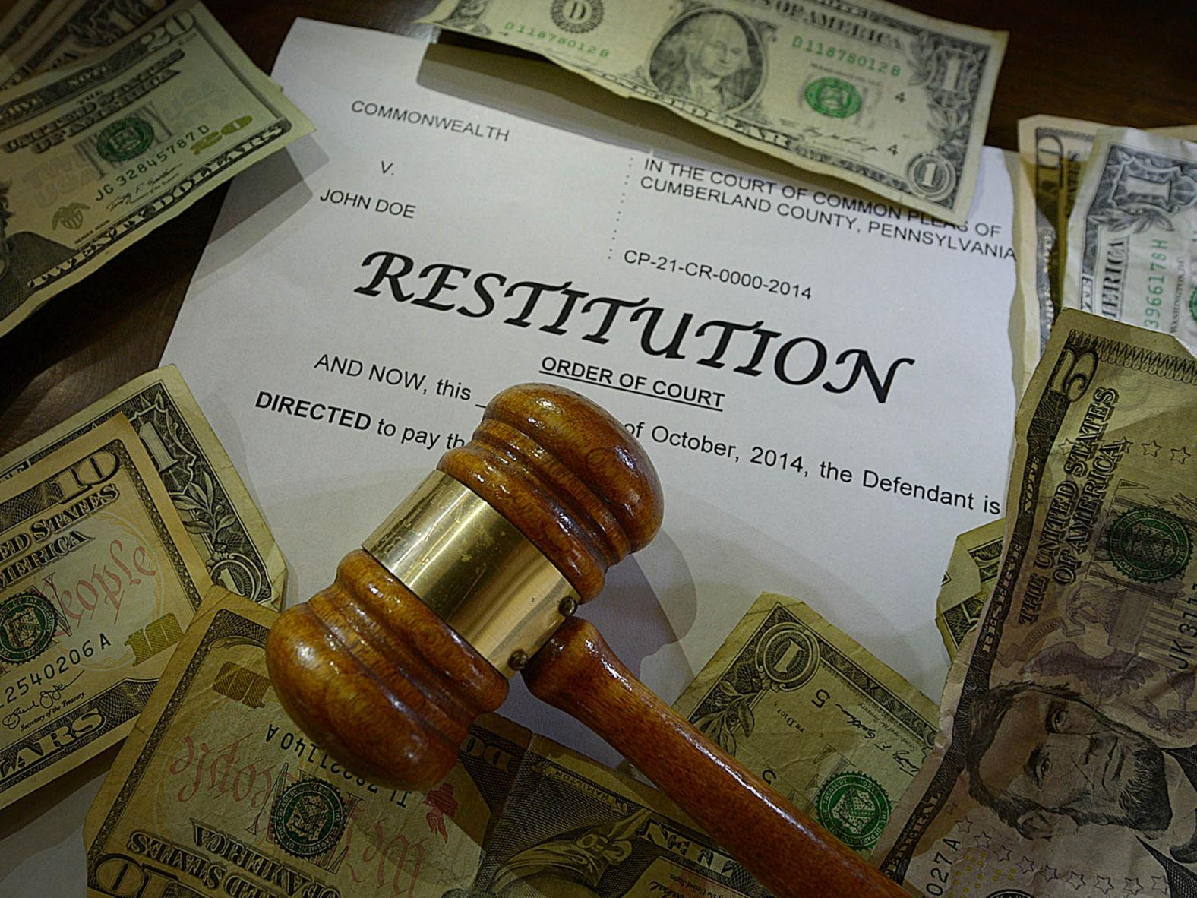
HB 1373 – Court-ordered Restitution Paid by Juveniles
Prohibits a court from ordering a juvenile to pay restitution to an insurance company
Limits payments to victims for pecuniary losses not covered by certain insurance policies
An insurance company is not considered a “victim” for purposes of juvenile restitution
Notes:
This bill does not have a clause that indicates it applies to offenses committed on or after the implementation date. Thus, it’s likely it has retroactive application.

Slide 39
Sex Offenses and Related Bills

Slide 40
HB 1169 – Prohibit Sexual Act Without Consent
Bill replaces current language for felony sexual assault under 18-3-402(1)(a)
“the actor causes sexual intrusion or sexual penetration knowing the victim does not consent”
Notes:
DA and LE

Slide 41
HB 1288 – Safe Reporting Assaults Suffered by Sex Workers
Immunity for the petty offense crimes of Prostitution, Soliciting Prostitution, and Prostitute Making Display, if:
They seek assistance from law enforcement, 911, or a medical provider, and
Is a victim or witness to any of the following:
Murder or other homicide related crimes
Assault at any degree, menacing, reckless endangerment
1st or 2nd degree kidnapping or false imprisonment
Sex assault, SAC, USC, internet luring, human trafficking
Stalking
Note: not grounds for suppression or prohibit prosecution for other crimes.
Notes:
TIM
DA and LE

Slide 42
Other Bills of Interest

Slide 43
HB 1229 – Senate Bill 21-271 Clean-up
Civil Infraction procedure
Mirrors the procedure for traffic infractions
Fixed certain crimes that were missed or handled incorrectly like Obstructing Government Operations and DUI.
Careful on effective date
The act repeals those provisions and replaces them with new procedures for handling civil infractions. The act makes conforming amendments related to civil infractions. The act makes clean-up changes to other provisions to conform to changes made to criminal sentencing provisions during the 2021 session. (Note: This summary applies to this bill as enacted.)
Notes:
LE and DA – need to add more for LE presentations
Bill says it applies to crimes on or after 3/1/2022. But governor did not sign until 4/7.

Slide 44
HB 1256 – Modifications to Civil Involuntary Commitment
Large scale rewrite of the Title 27-65 civil commitment laws
For LE:
M-0.5 – Transportation holds
Authorizes the court to order a law enforcement agency to transport someone on an M-1 or M-3 hold.
Grants LE the discretion to take someone to a treatment facility on an M-1 hold even if they have an active warrant if “it is in the best interests of the person.”
States that anyone who files a false or malicious petition for civil commitment is subject to criminal prosecution.
Notes:
LE – I’d be careful on how much info/advice you give on this bill. It is very long, and this is only a small part of the entire package.
The bill gives money to the BHA to provide statewide trainings to law enforcement on all the changes to the civil commitment laws.
Encourage your law enforcement to attend these trainings.
Also encourage them to reach out to their police legal advisors for advice as this is civil in nature.

Slide 45
HB 1256 – Modifications to Civil Involuntary Commitment
Changed M-1 Hold standard under 27-65-106 for law enforcement purposes to read:
“When a certified peace officer has probable cause to believe a person has a mental health disorder and, as a result of the mental health disorder, is an imminent danger to the person’s self or others or is gravely disabled, the certified peace officer may take the person into protective custody and transport the person to the facility designated by the commissioner for an emergency health hold. If such facility is not available, the certified peace officer may transport the person to an emergency medical services facility. The certified peace officer may request assistance from a behavioral health crisis response team for assistance in detaining and transporting the person or an emergency medical services provider in transporting the person.”
Notes:
The bill gives money to the BHA to provide statewide trainings to law enforcement on all of the changes to the civil commitment laws.
Encourage your law enforcement to attend these trainings.
Also encourage them to reach out to their police legal advisors for advice as this is civil in nature.

Slide 46
SB 099 – Sealing Criminal Records (Clean Slate Law)
National effort to allow defendants to automatically seal criminal records. Applicable to potentially 1.5 million cases dating back to 2000.
Staggered implementation to address workload: low-level and drug offenses in 2024; and non-drug felony level offenses in 2025
DA maintains ability to object to sealing of major non-drug felony cases where public interest/public safety outweigh privacy interest of, or adverse consequences to, Def.
Limits credit reporting agency usage
Expands 2021 sealing law, to provide mechanism for expedited review and processing by Courts/DAs/CBI
Prohibits sealing of cases with:
1) non-sealing plea conditions; 2) cases with no final disposition; and 3) cases where there is intervening judgment or conviction during waiting periods

Slide 47
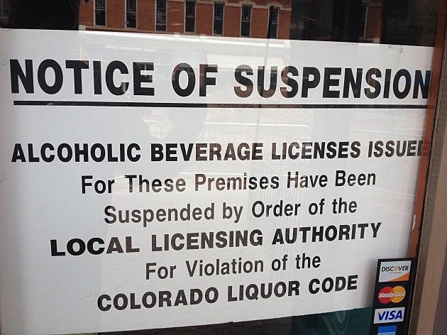
SB 157 – Information Sharing for Consumer Protection Investigation
Grants DA access to records of licensing authorities to investigate complaints.

