Slide 1
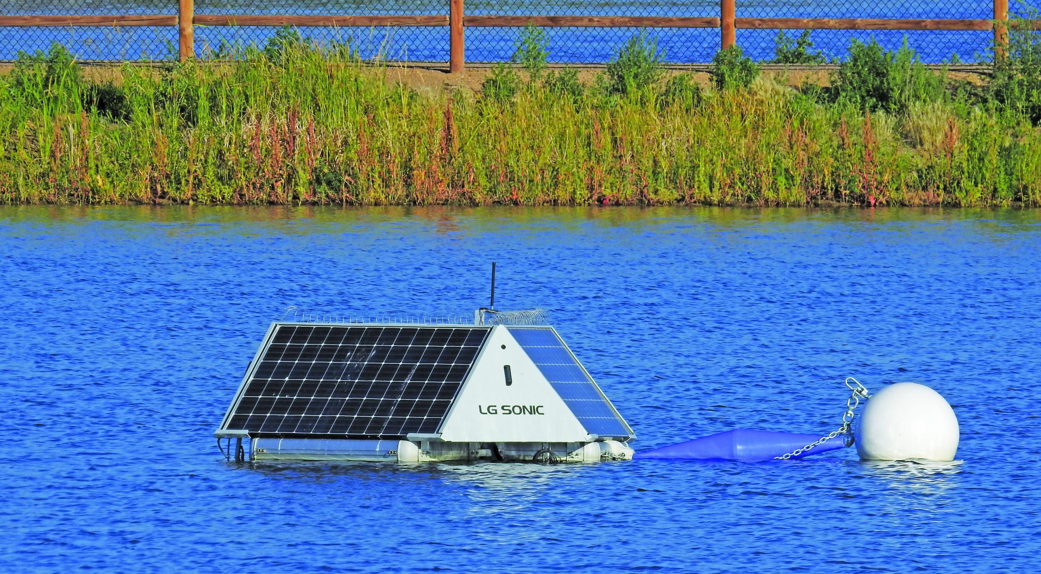
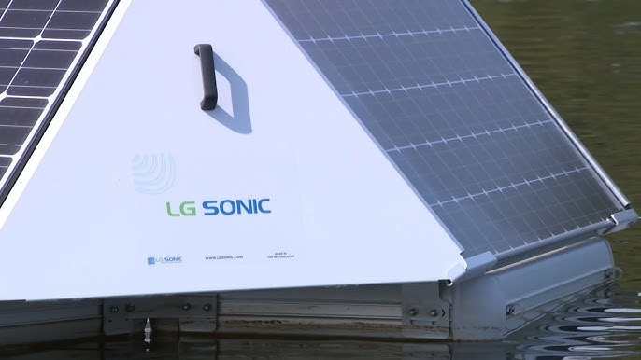
Larimer County Immediate Need Grant

Slide 2
To improve water quality in Berthoud Reservoir and taste and odor of finished drinking water
Prevent dangerous algae blooms
Cost effective solution, avoid chemical treatment and mixing
A method that has proven long-term algae control

Slide 3
Solution: Ultrasonic Treatment
Eco-friendly Ultrasonic Treatment for algae control
Blocks the algae’s access to sunlight and nutrients
Maintains real-time drinking water quality monitoring with specific data points (water conditions, algae species, seasons, etc)
Larimer County Immediate Needs Grant - $35,000

Slide 4
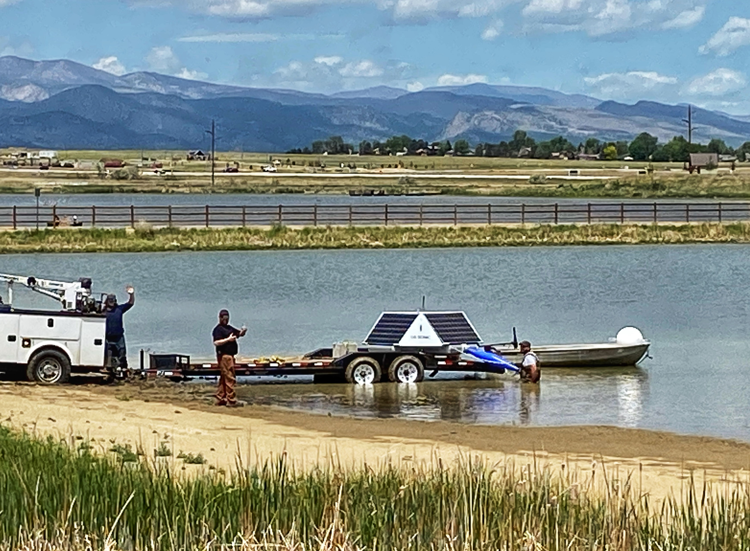

Slide 6
