Slide 1
Larimer County 401(a) Retirement Plan Employee Survey Highlights

Slide 2
Survey Participation Rate: 41.4% (759 out of 1,834 Employees Responded)

Slide 3
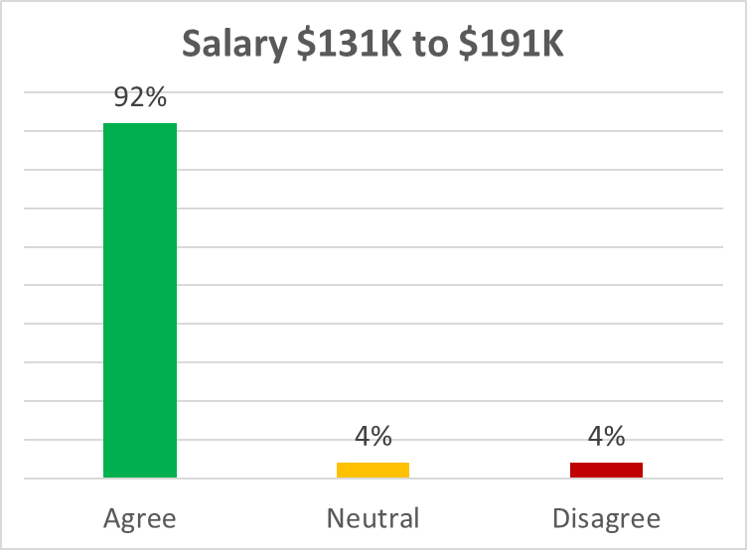
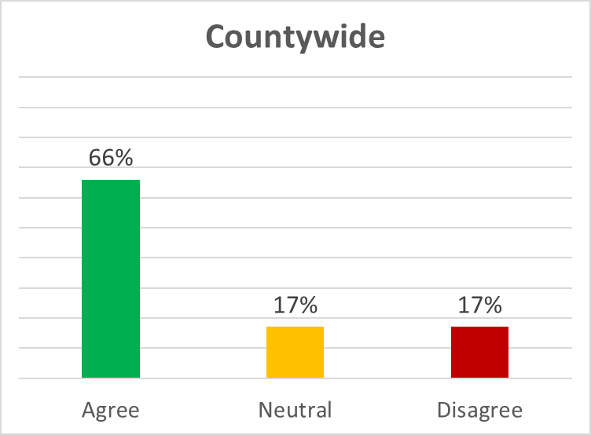
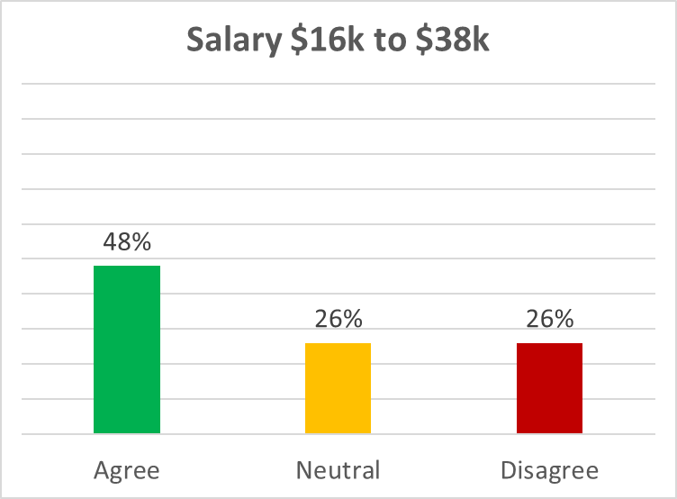
I am familiar with the details of the Larimer County 401(a) retirement plan. I understand who is eligible, my responsibilities and rights as a plan participant, and I know how to find information on how to change my investments within the plan.

Slide 4
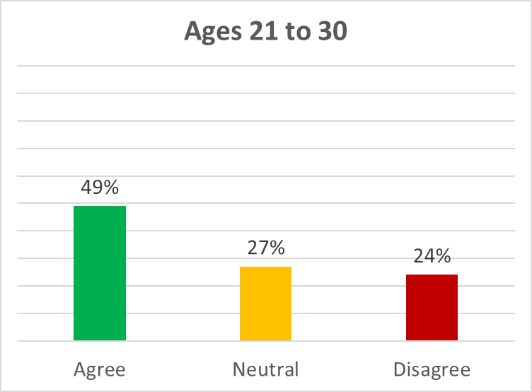
I am familiar with the details of the Larimer County 401(a) retirement plan. I understand who is eligible, my responsibilities and rights as a plan participant, and I know how to find information on how to change my investments within the plan.

Slide 5
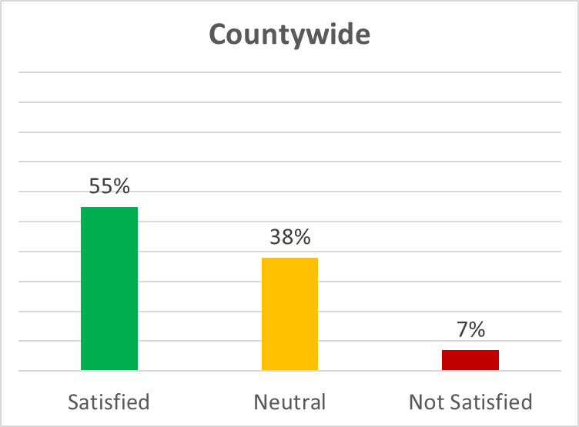
Are you satisfied with the menu of investment options available?

Slide 6
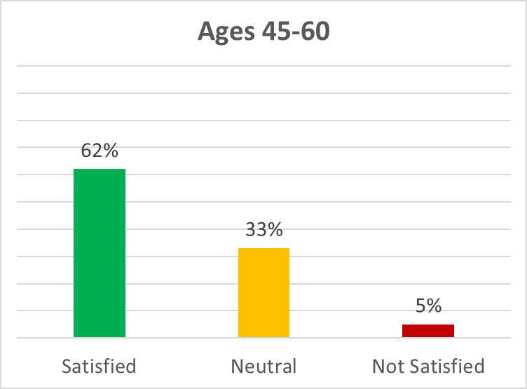
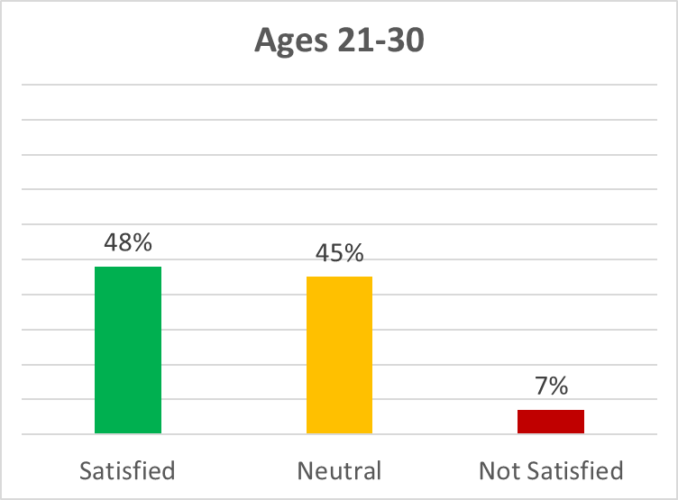
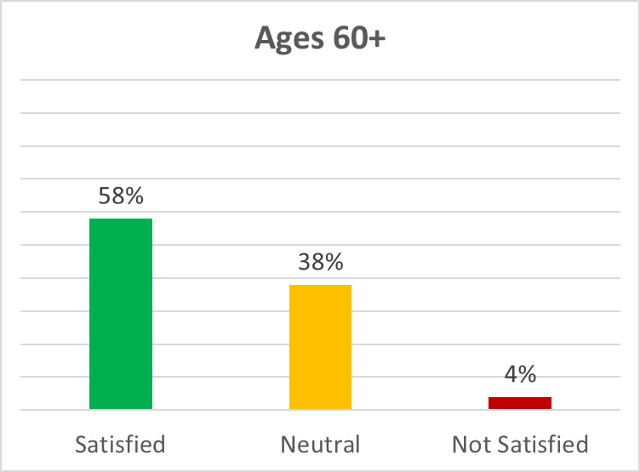
Are you satisfied with the menu of investment options available?

Slide 7
Share your thoughts on investment options:
NOT FAMILIAR
“I didn't even realize there were so many options.”
“I have not spent the time to make choices.”
“I'm unsure what they mean. I would love an online training that is available for me to watch whenever I have time in my schedule”
“Had no idea these existed until seeing this.”
“Is there a way to shift my money from more aggressive funds to/from less aggressive funds?”
WANT MORE
“Too Limited”
“My advisor tells me they need more.”
I don't find there to be enough diversified options within particular categories.
“I WOULD PREFER MORE OPTIONS OF MUTUAL FUNDS AND BE ALLOWED TO INVEST IN ETF'S IF POSSIBLE.”
“I'd like to some tech funds and some REIT options.”
“We need more index funds and ETFs.”
MORE ESG OPTIONS
“I like the idea of socially, environmentally responsible stocks.”
“Want a decent return for retirement but would also like to not retire on a wasted planet with climate chaos, there are no options but 100% aggressive stocks. What should I tell my children: "Here's some funds, kids, sorry we screwed up your future"? Not even one moderately aggressive, secure or mixed fund that is climate-neutral if not climate-positive? Come on, we can do better than this!
“I'd like more portfolio options that don't include investments in fossil fuel industries.”
LOWER FEES
“The index funds available carry high fees.”
“I want lower expense fee ratios. Under .05% would be preferred.”
“I would like to see more Vanguard funds available for investment. Vanguard is a not-for-profit company, and their expense ratios are some of the lowest out there.”

Slide 8
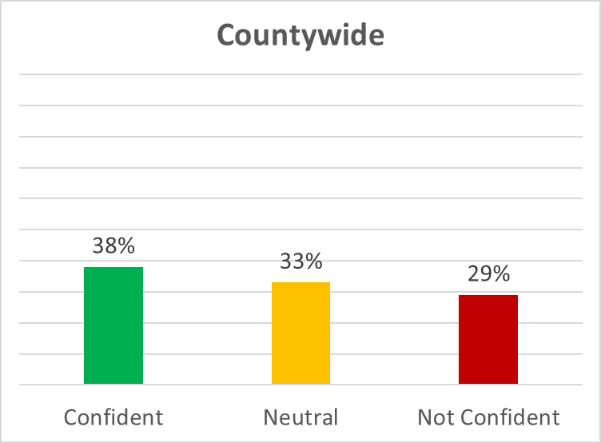
How confident are you that you will have enough saved to retire when you reach retirement age?

Slide 9
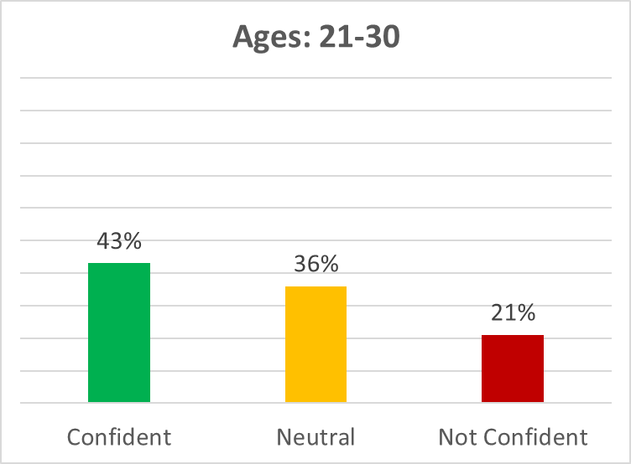
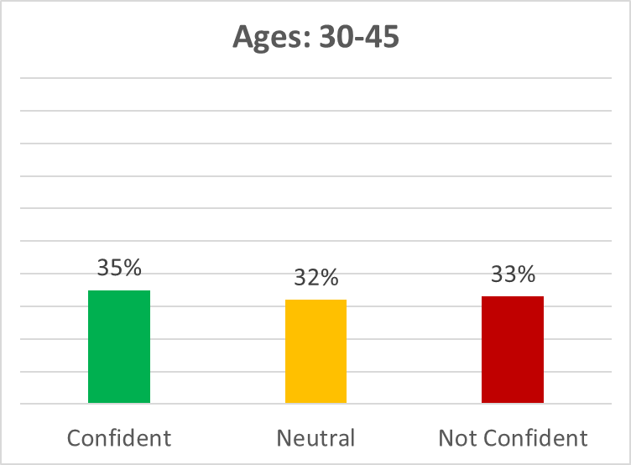
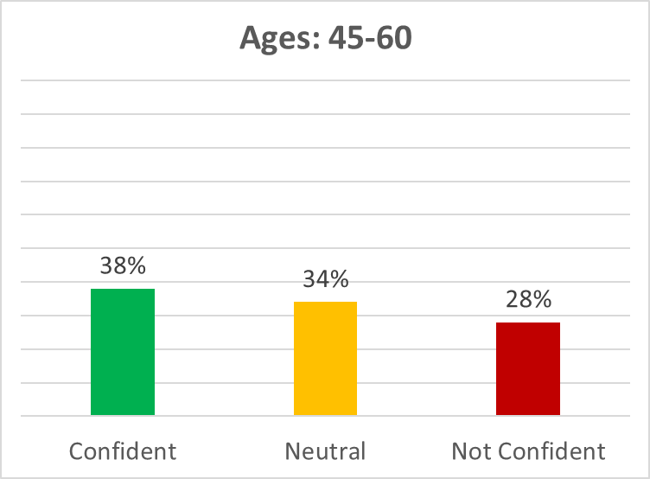
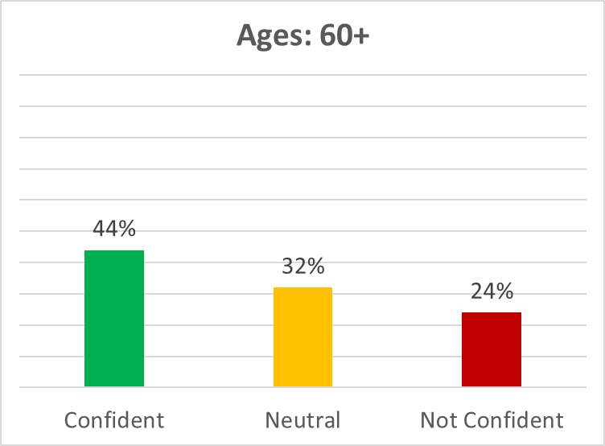
How confident are you that you will have enough saved to retire when you reach retirement age?

Slide 10
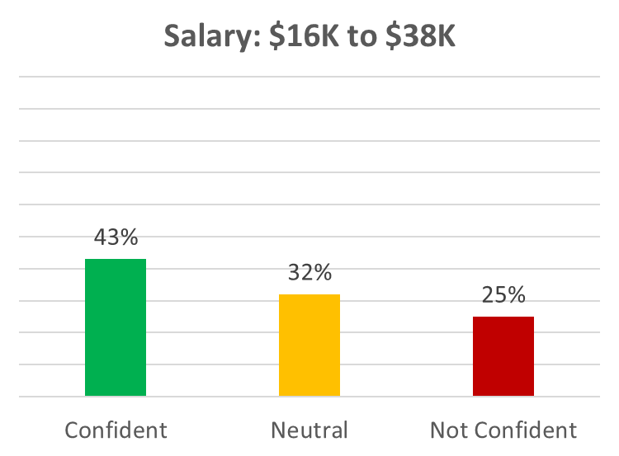
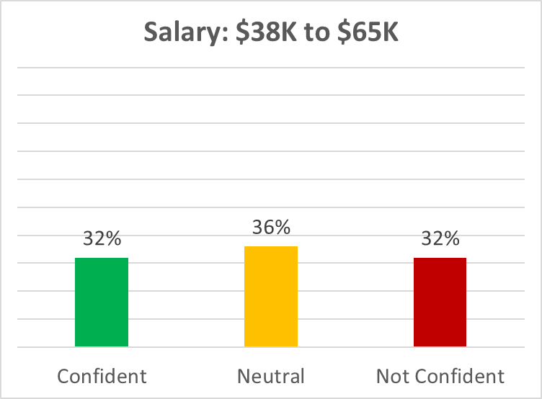
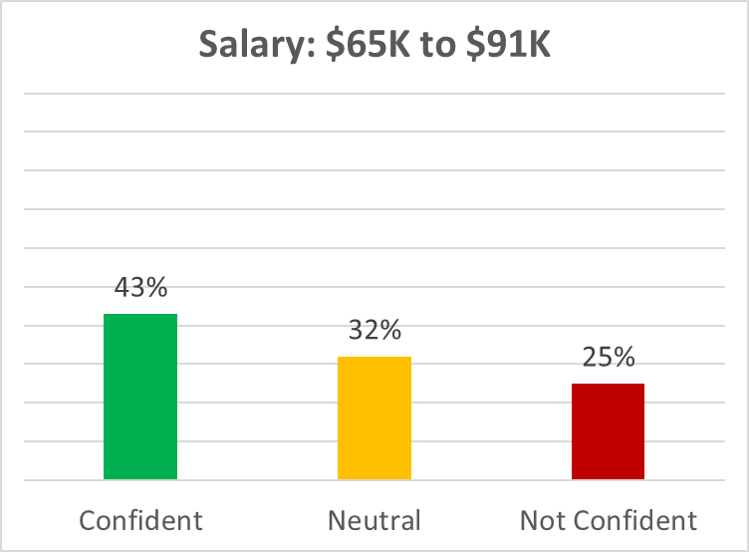
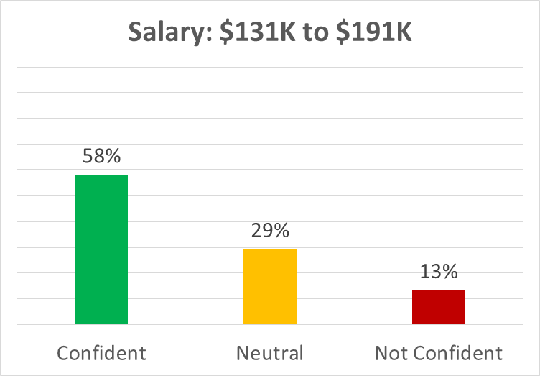
How confident are you that you will have enough saved to retire when you reach retirement age?

Slide 11
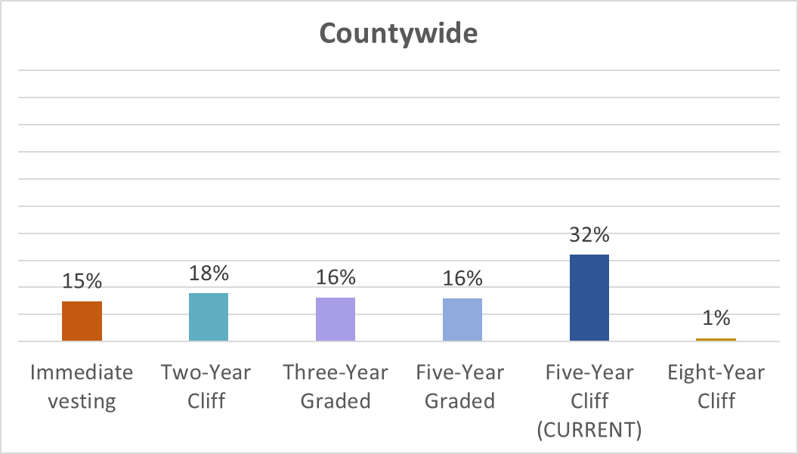
In your opinion, which of these vesting schedule options is best?

Slide 12
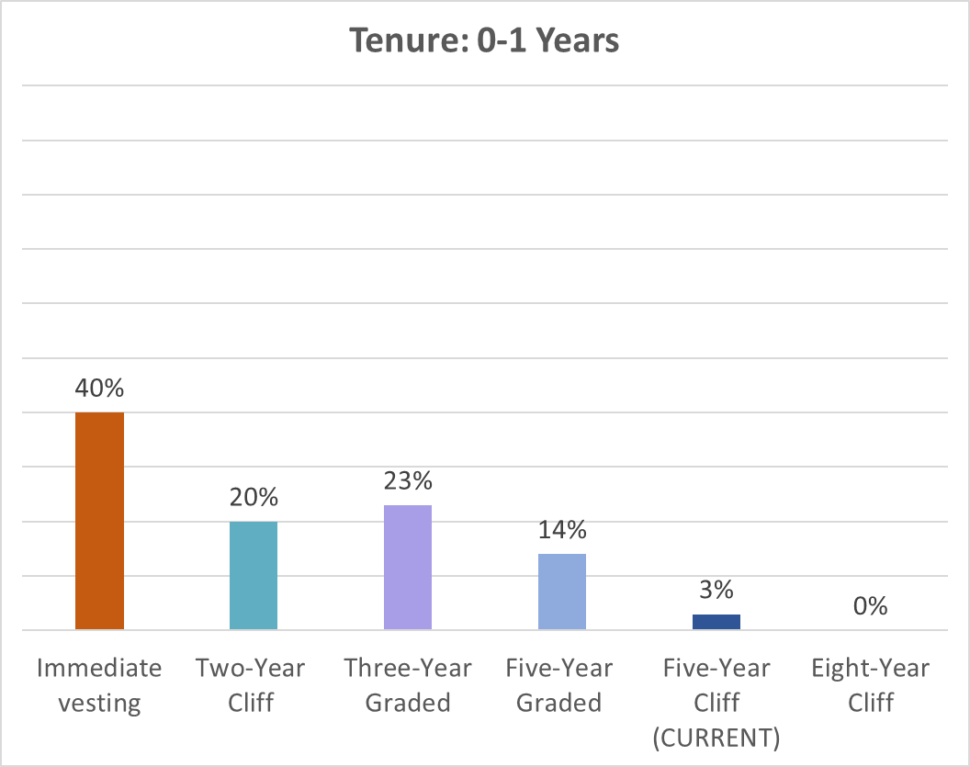
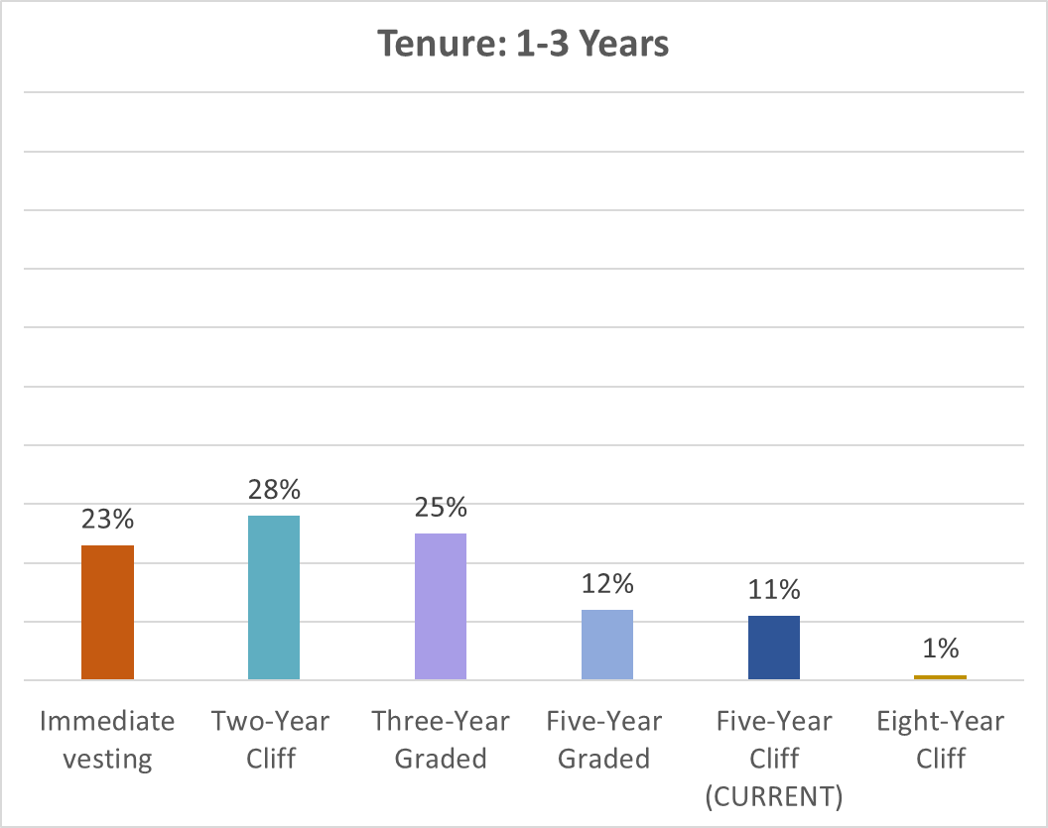
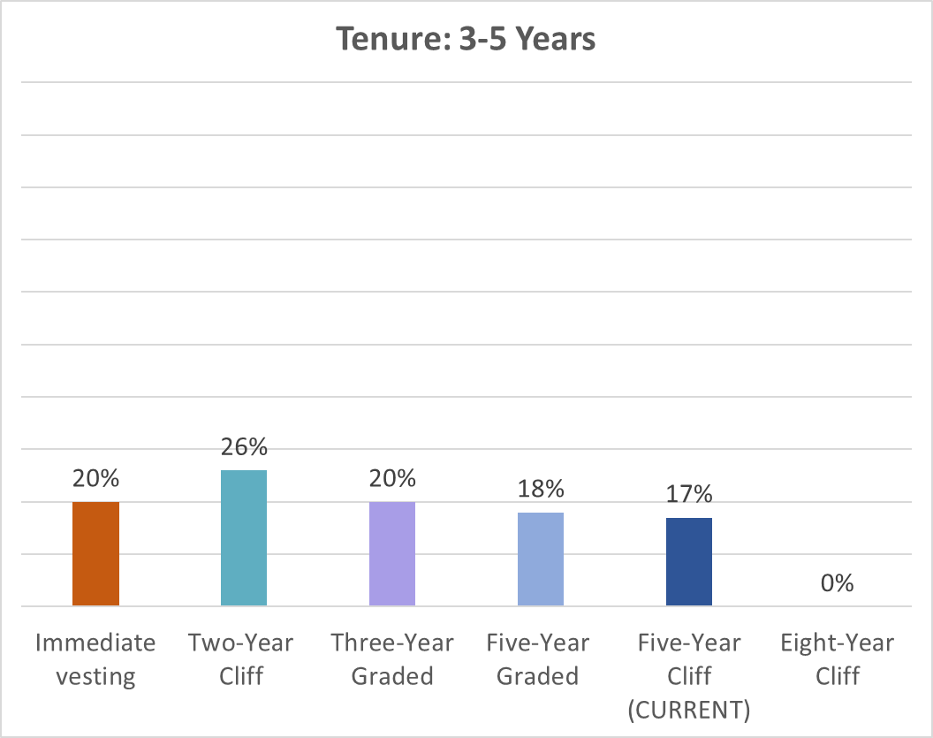
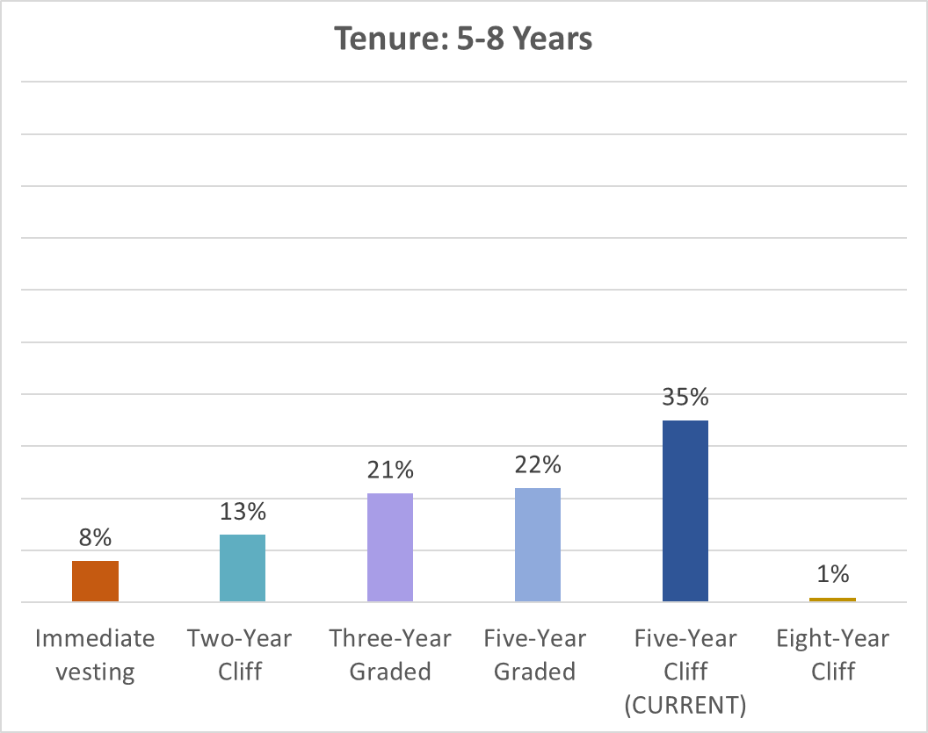
In your opinion, which of these vesting schedule options is best?

Slide 13
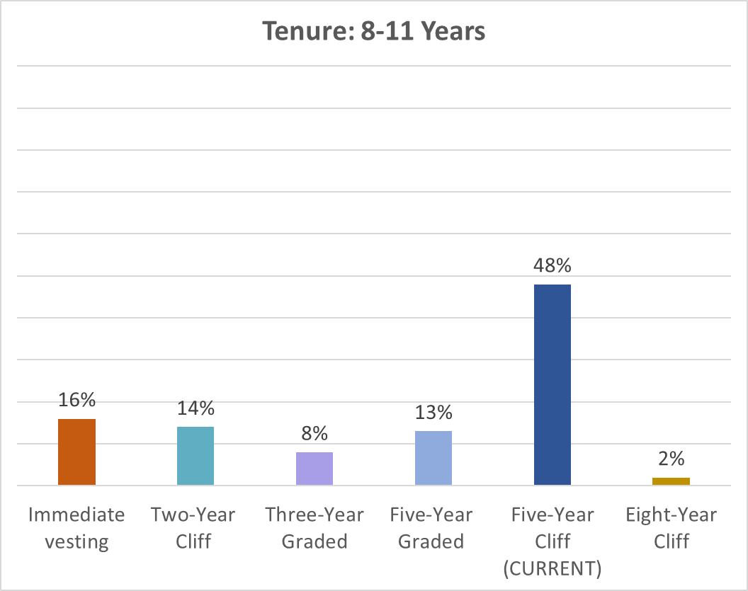
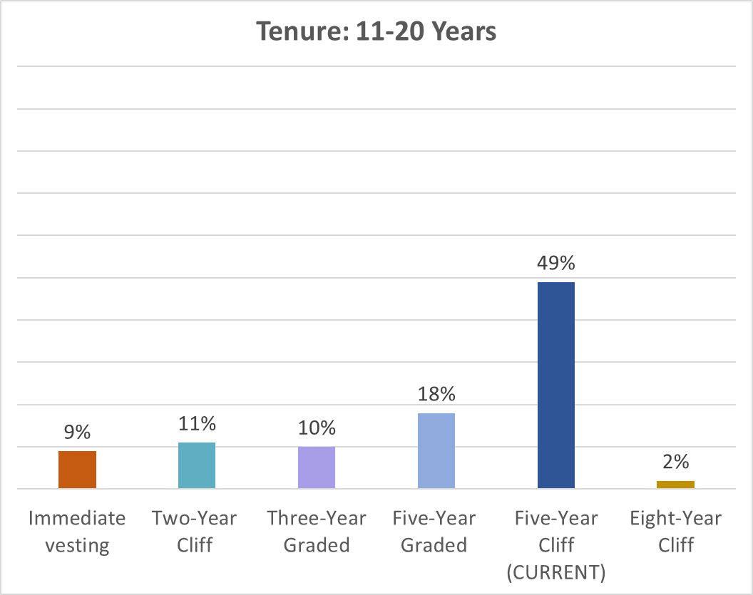
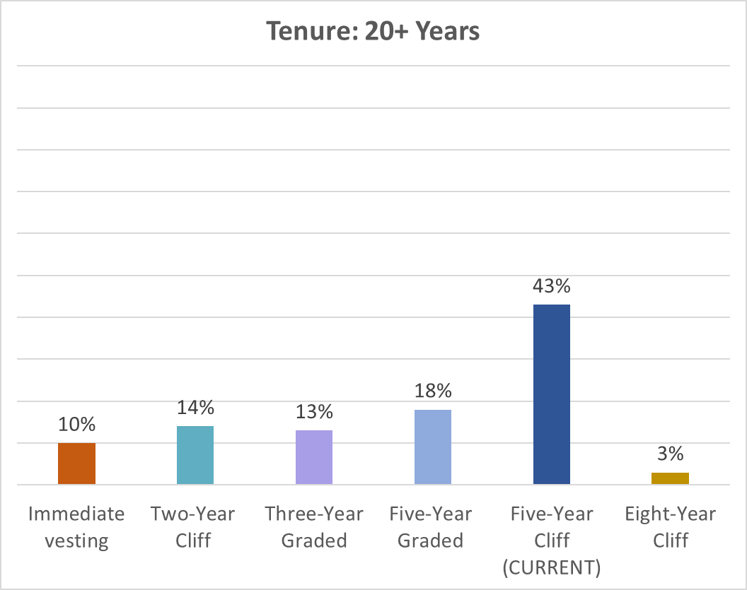
In your opinion, which of these vesting schedule options is best?

Slide 14
Share your thoughts on vesting schedules:
SHORTER PLEASE
“0% until 5 years feels punitive.”
“Five years is hard when working in Child Protection and to stay fully invested in the job. 2 years is more realistic.”
“I like having a graduated schedule. I don't believe someone who puts in work for four years should be declined all the employer match.”
“Allowing employees to be vested sooner may help with retaining employees.”
“A new hire shouldn’t have to wait that long to become vested
“Employer matching should begin immediately. It would improve retention. A 5-year schedule makes it seem like the county is not interested in employees who have been employed <5 years.”
“For younger workers, the 5 year cliff seems harsh. Recommend the 2 year cliff. BTW, I'm was hired less than 2 years ago but I am over 55 so qualify for immediate vesting. A very good recruiting carrot for older workers.”
LEAVE IT ALONE
“5 years seems fair”
“A longer vesting period encourages employee retention. Five years is pretty standard.”
“A lot of thought and work went into establishing the 5 year cliff. This was a major improvement from where it was prior. And, YES, some people feel that the employer contributions are "held hostage" for five years, but the more time an employee dedicates to the organization the more valuable they become. This IS a realistic incentive to stay.”
“I feel that the current vesting schedule is fair and appropriate”
THOUGHTFUL COMMENT
“I had a hard time deciding between 100% vesting or one of the graded vesting plans and that is because I don't know what our philosophy as an organization is, which causes me to feel a little sad. We don't have a clear vision on how we want to treat or value our employees. I wound up going with 100% vesting because I felt that is most generous and unique, meaning not many other employers do that, and so it could be a good recruiting & retention tool that shows we care about and value our employees now and in the future. We want them to save and have as much as possible for their retirement. And hopefully in most cases, of course not all, employees will feel valued and cared for which will cause them to stay long term. I know there is way more to why an employee chooses to stay with an employer than just a vesting plan. I also know that employees look at our benefits and how we treat them to decide whether they are truly a priority or a business investment. Ultimately, I feel that employees should feel valued from day one (which is more inclusive) and not feel like they have to "earn it" or "prove it", so I went with immediate vesting. However, I recognize that a graded system is more common and a smaller expense to the organization. I'd ultimately feel that is a step in the right direction from what we currently have. I do not care for or support our current vesting.”
GO WITH GRADUATED
“A gradual percentage vesting model would be more in line with the private sector.”
“Would like to have gradual credit for time worked.”
“I like having a graduated schedule. I don't believe someone who puts in work for four years should be declined all the employer match. Invest in your people. A graduated schedule helps incentivize employees to stay without completely denying them retirement funds if they come up short on their vested time.”

Slide 15
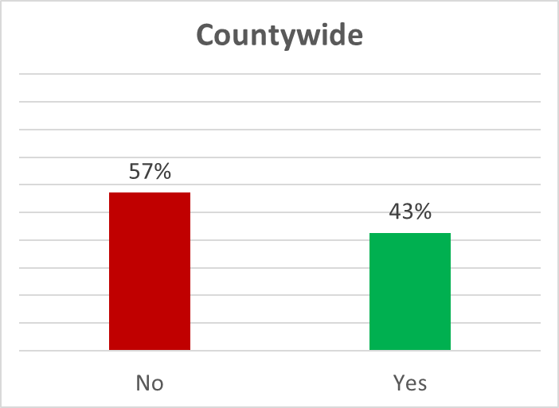
Have you ever met with a TIAA advisor?

Slide 16
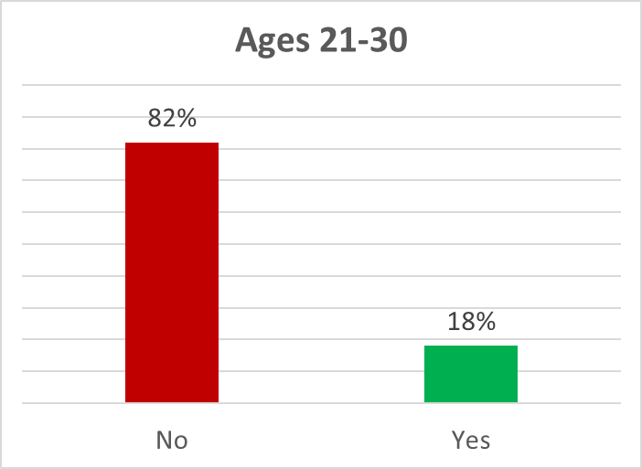
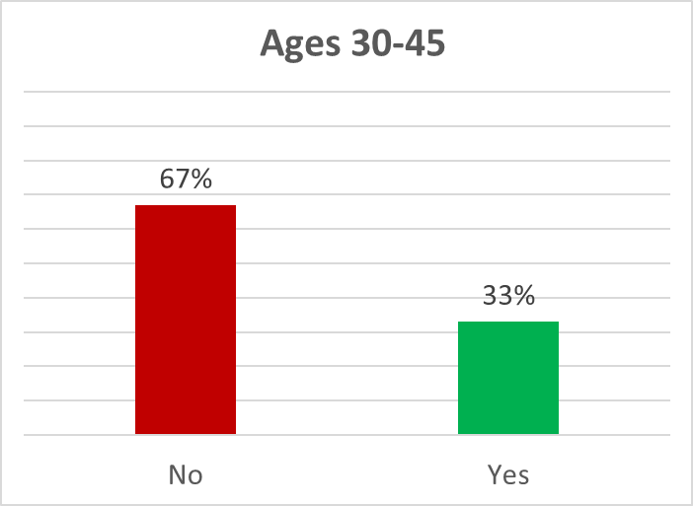
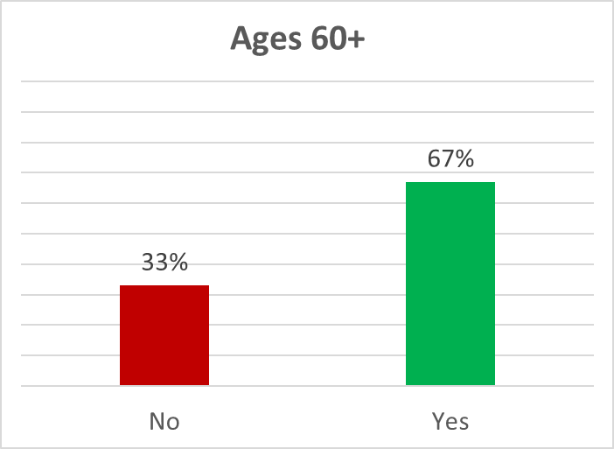
Have you ever met with a TIAA advisor?

Slide 17
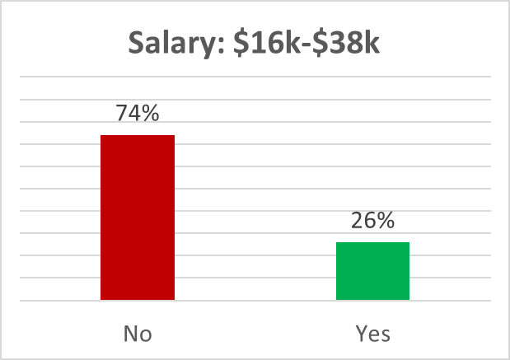
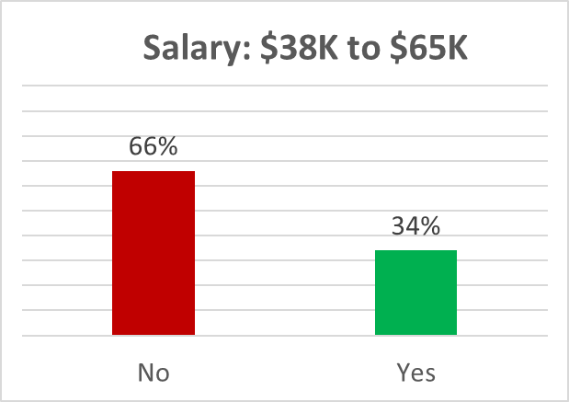
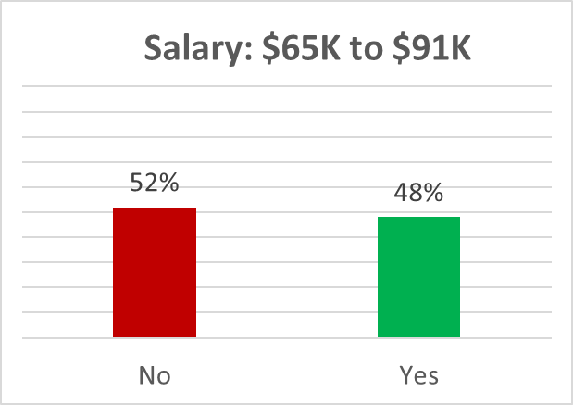
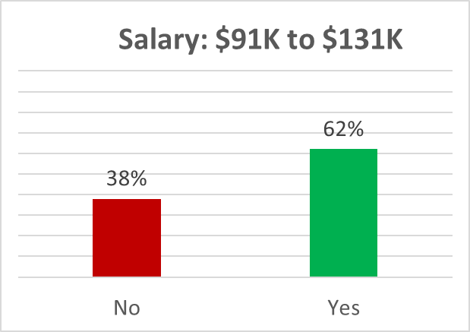
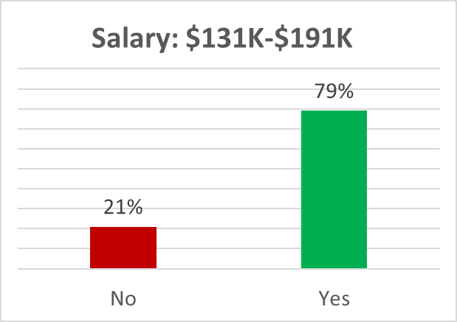
Have you ever met with a TIAA advisor?

Slide 18
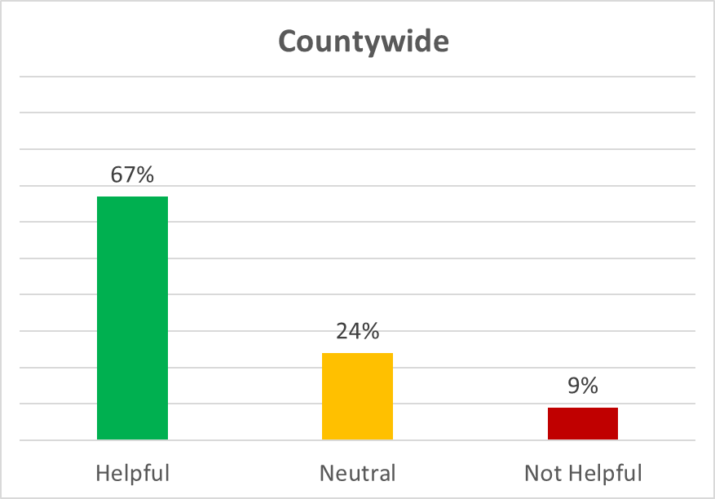
If yes, how helpful was the planning session?

Slide 19
What could improve the TIAA one-on-one advisement service?
BETTER INFORMATION
“Actual advice that pertains to you, your income, and your hopes in retirement. And, HELP you sign up, or change things, or whatever... not just give you a checklist and slide it over and say "good luck".”
“First meeting was difficult to follow. Need to simplify explanation.”
“I did not know anything about investing really and they didn't explain it well for me to understand. Had very short answers.”
“I needed more time and I needed for the consultant to use plan language.”
“I was rolling over another account into the county's and had to shepherd and stay on top of it through the whole process - all the while starting a new job. It was a little overwhelming!”
MORE MEETINGS
“Annual check in's with the advisor, initiated by the advisor.”
“Not sure, Their meeting times and classes seem to be during work hours and I'm not able to attend.”
“If the employees could meet with the reps on county time more often than once a year.”
“More appointment slots available when they are onsite.”
“More time slots. There is often very limited availability or a very long wait (months out) for an appointment.”
“More available dates for employees”

Slide 20
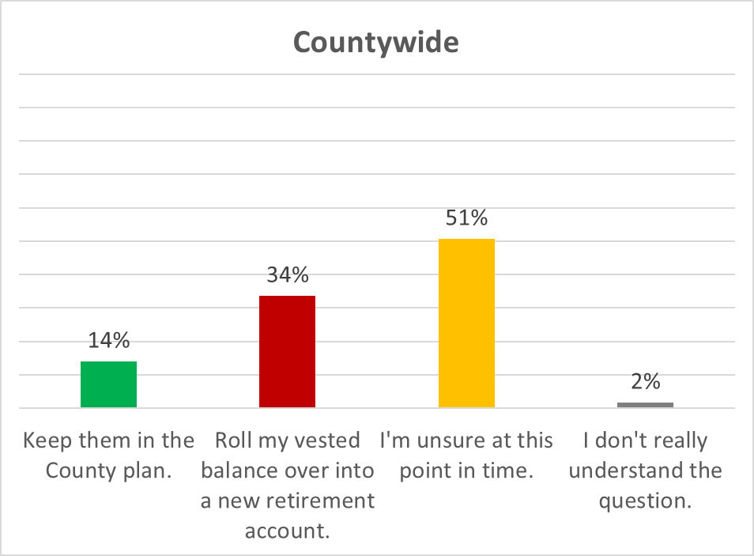
If you were to leave county employment, do you think you would roll over your investments into a new IRA or employer-sponsored plan, or keep them with the county 401(a) plan?

Slide 21
What factors would influence your decision to rollover your money or leave it with the Larimer County 401(a) Plan?
WHAT MY FINANCIAL ADVISOR SAYS
“I already have an established retirement account with a financial advisor, and it is easier to continue working with one financial advisor for all my accounts.”
“I am currently working with a financial advisor & she would help me roll my 401a balance over”
“I have my own financial advisor.”
“My mom has a financial advisor who has made a lot of money for her and I would work with him after retirement.”
“The recommendations of my financial advisor.”
RETURN ON INVESTMENT
“Fees and fund investment opportunities.”
"Best return on my investment"
"How the investments were being managed and any fees involved."
"how well this plan is gaining and what benefits I would be getting at the new job."
"How well this plan would do if I rolled it over into my current investment/retirement account I started with my past employer."
“Fees and level of confidence in the manager”
“Fees to keep the plan here, investment returns here vs a new employer or other retirement account.”
CONVENIENCE
"Convenience.“
"How easy it would be to maintain a new employer retirement plan while also maintaining the 401a with Larimer County.“
"I already have a 401k from a previous employer, it would be easier to keep it all together“
"Being in control of money I earned.“
"I didn't roll over from my previous employer and sometimes wish I had. Now I've got more accounts to worry about."

Slide 22
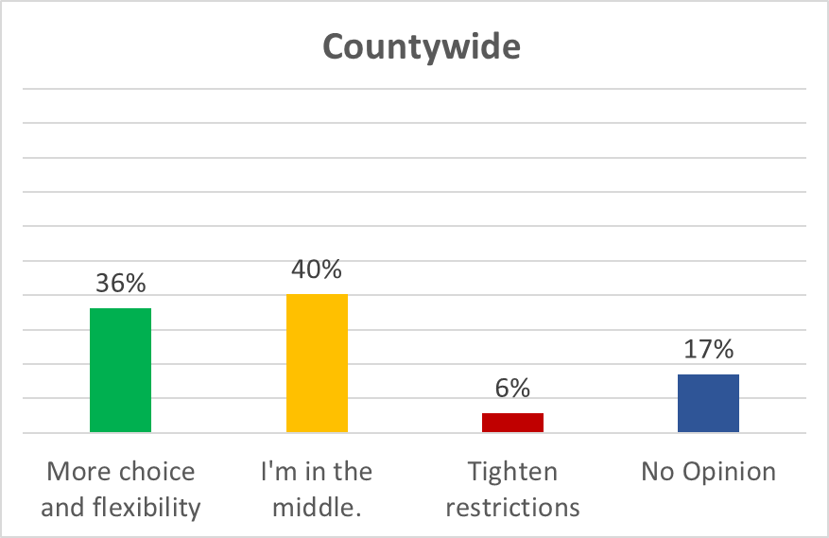
Some employers allow early withdrawals under specific conditions or during times of hardship. Our plan allows participants to loan themselves money out of their vested retirement balance for the purchase of a primary residence. Which phrase best describes your feelings towards allowing withdrawals or loans outside of retirement?

Slide 23
Is there anything else you want to share with the 401(a) Retirement Board?
“If there are online classes or resources on 401A (other than meeting with a representative) , it would be helpful if they were posted or "advertised" on the county BBoard.”
“As a young individual, I would love emails that address certain topics at a time. I do not enjoy bulk information overload. I prefer information in categories and being able to assess and work on/learn a few things at a time.”
“Several years ago when we went to TIAA there was an investing questionnaire that really helped me pick investments I was comfortable with.”
“Thank you!”

