Slide 1




SUPPORTED FAMILIES,
STRONGER COMMUNITY
QUARTERLY EVALUATION UPDATES
Contact Us
Deb DeLuca-Forzley & the Larimer County Prevention Team
delucadr@co.Larimer.co.us
Katie Golieb & the CSU Social Work Research Center
Katie.Golieb@colostate.edu
JANUARY 2023
AGENDA
Referral Tracking:
  # of referrals since launch and expansion
  Comparison of 2021-2022 Quarterly RET’s and Referrals
  # of referrals this fiscal year
  Comparison of referrals by month in 2021 and 2022
  # of referrals by zip code
  Maps of zip code boundaries with highest # of referrals
  # of referrals by agency – since launch and fiscal year
  # of referrals by family need & Interactive service map
  Trend in Concrete Support Referrals
Protective Factors Survey Results:
  # pre- and follow-up-PFS administered
  Average survey scores by protective factor
  Referral alignment with PFS scores
Navigation Team Case Management:
  # of referrals and families served - since launch and fiscal year
‘Since launch’ refers to all data collected since launch on April 1, 2021;
‘Since expansion’ refers to all data collected since the expansion of the eligibility criteria on January 1, 2022;
‘This fiscal year’ refers to all data collected since October 1, 2022.
All data is reported as of December 31, 2022

Slide 2



Forms and Tracking of Referral Episodes and Protective Factors Survey
Referral Episode Tracking (RET)
Collects total number of organizations/agencies that a family member is referred to
Captures referral information – where the referral came from, where it’s going to
Captures how each referral episode aligns with the Protective Factors (e.g. ‘Please select which protective factor(s) you made this referral for’)
PFS and RET Web-based Qualtrics forms go directly to CSU
The five protective factors in the PFS assesses family protective factors
Completed with family at baseline (e.g., initial referral) and every 3 months thereafter with those continuing to receive case management
A mean (average) is calculated for each of the five protective factors which can range from 1-4 (4 indicating a strong presence of that protective factor)
The PFS provides agencies with a snapshot of the families they serve and measures change over time
Reminder: The Referral Episode Tracking form is a tracking mechanism that is distinct from referrals to the SFSC navigation team and from an actual referral to another agency
SUPPORTED FAMILIES, STRONGER COMMUNITY JANUARY 2023 CCT UPDATES
PAGE 2

Slide 3

How many referrals have been submitted since launch?
Referral Episode Tracking Forms (RET)
964
1,711
Referral Episode Tracking Forms submitted since launch
Referral episodes across all forms
An average of 1.78 referrals are submitted per form
Goal: > 560 annual referral episodes
Referrals by Month Since Launch
2021
2022 (Project Expansion)
SUPPORTED FAMILIES, STRONGER COMMUNITY JANUARY 2023 CCT UPDATES
PAGE 3

Slide 4
Comparison of 2021-2022 Quarterly RET’s and Referrals
The numbers of submitted tracking forms and referral episodes continued to increase (often more than doubling) across quarterly comparisons from 2021 and 2022.
2021-2022 Monthly Comparison
Paired month
Paired month
Paired month
Paired month
SUPPORTED FAMILIES, STRONGER COMMUNITY JANUARY 2023 CCT UPDATES
PAGE 4

Slide 5
How many referrals have been submitted this fiscal year?
Referral Episode Tracking Forms (RET)
188
345
Referral Episode Tracking (RET) Forms submitted this fiscal year (FY)
Referral episodes submitted across all forms
560 Referrals
Progress to Goal
33%
An average of 1.84 referrals are submitted per form
Referrals by Month this Fiscal Year
SUPPORTED FAMILIES, STRONGER COMMUNITY JANUARY 2023 CCT UPDATES
PAGE 5

Slide 6
How many referral episode tracking forms (RETs) have been submitted based on family members’ zip code?
Legend
Original zip code
Expanded zip code
Reminder: All families that reside in any zip code that intersects with Larimer County are now eligible to participate in this Initiative
SUPPORTED FAMILIES, STRONGER COMMUNITY JANUARY 2023 CCT UPDATES
PAGE 6

Slide 7
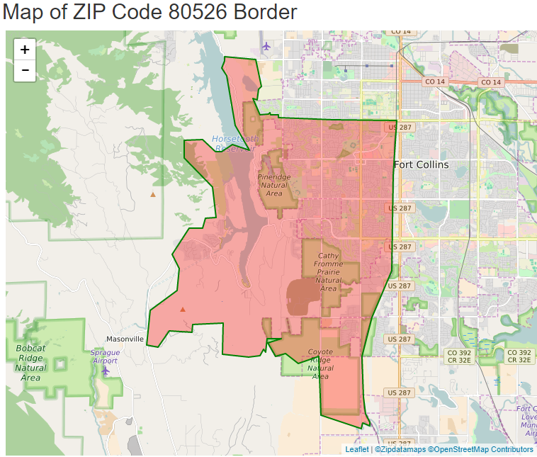
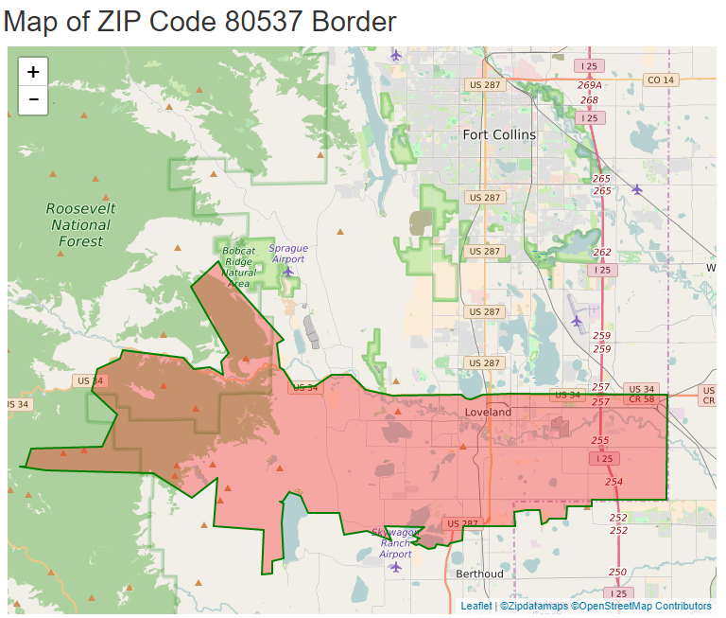
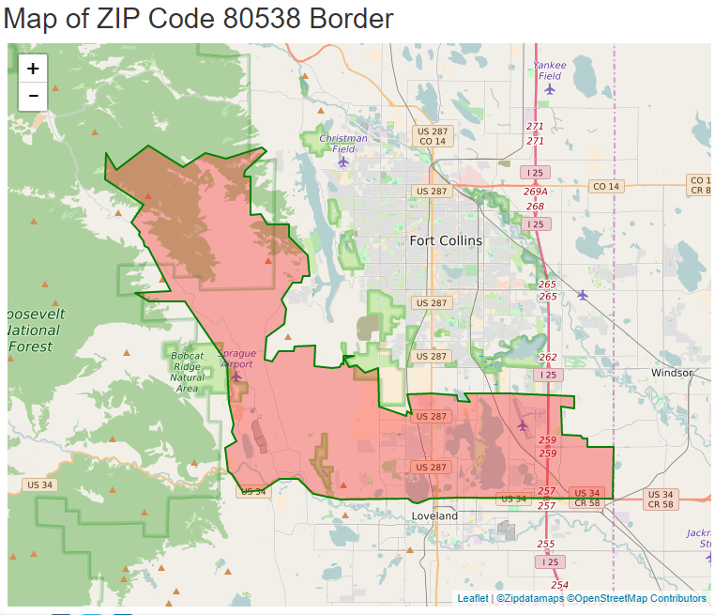
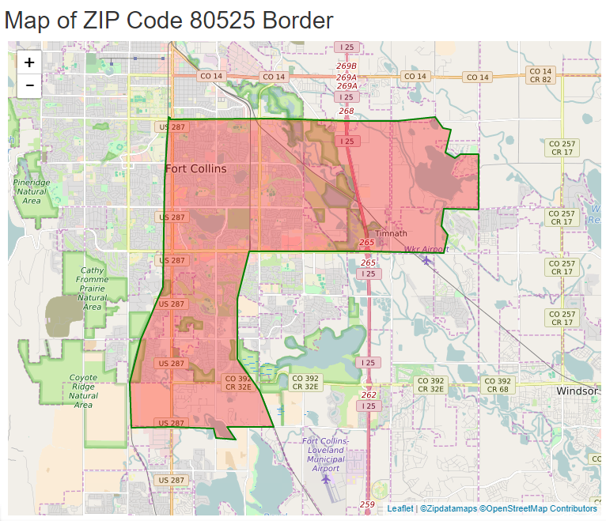
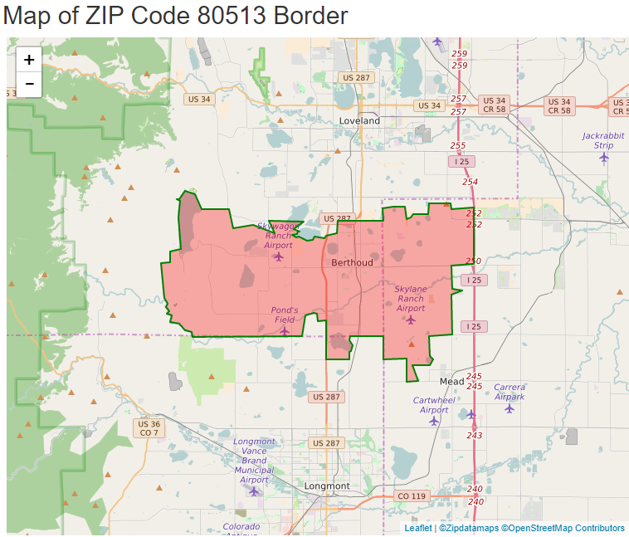
Maps of Zip Codes with Highest Referral Form Submissions
Highest # of RET’s by Zip Code
80538: 183
80513: 141
80525: 142
80526 (Original Zip Code): 133
80537 (Original Zip Code): 115
SUPPORTED FAMILIES, STRONGER COMMUNITY JANUARY 2023 CCT UPDATES
PAGE 7
Notes:
80537 and 80526 – original zip codes
Zip Code 80537: 91
Zip Code 80526: 102
Zip Code 80538: 159 (maximum)
Zip Code: 80525: 123
Zip Code 80513: 104

Slide 8
How many RETs have been submitted by each agency type since launch and this fiscal year?
Since Launch
85%
of Onboarded Agencies Have Submitted at least one Referral Episode Tracking (RET) Form since launch
Goal: >70% of agencies submit >1 RET annually
This Fiscal Year
69%
of Agencies Have Submitted at least one Referral Episode Tracking Form (RET) this fiscal year
70% of agencies
Progress to Goal
SUPPORTED FAMILIES, STRONGER COMMUNITY JANUARY 2023 CCT UPDATES
PAGE 8

Slide 9
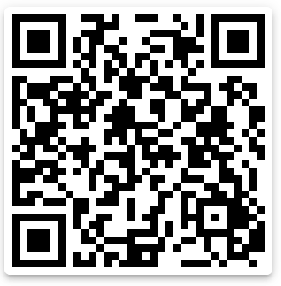
Which needs have staff been addressing when making referrals since launch?
Protective Factor(s) Selected by Agency Staff for Each Referral Episode
1,269
Concrete Supports
Families’ perception of formal services and supports available for basic needs (i.e., financial and housing support, food stamps)
728
Family Functioning & Resilience
Families’ perception of adaptive skills and strategies to navigate times of crisis
336
Social Supports
Families’ perception of informal support systems (i.e., friends, family and community members)
Interactive Service Mapping Platform
http://rebrand.ly/sfscmap
This map is updated monthly by the SWRC team with the most recent referral data. All data since launch is included in this map., We recommend bookmarking the link so that you can check back for updates!
197
Perceived strength of emotional connection between parent or caregiver and child(ren)
Nurturing & Attachment
136
Caregiver & Practitioner Relationship
Knowledge of effective child management techniques
72
Unsure
Legend
Number of times that protective factor
was selected across all referral episodes
Protective factor selected
SUPPORTED FAMILIES, STRONGER COMMUNITY JANUARY 2023 CCT UPDATES
PAGE 9

Slide 10
Review of Concrete Support Referral Trends
During the last CCT meeting our discussion circled around concrete support needs in the community.
The table below tracks the number of concrete support referrals in the past two years’ quarterly reports.
What is surprising? What do we expect to see moving forward?
For next slide: As we continue to collect post-PFS data, are we seeing improvement from baseline to post?
SUPPORTED FAMILIES, STRONGER COMMUNITY JANUARY 2023 CCT UPDATES
PAGE 10

Slide 11
How many PFS have been submitted since launch and what do the scores show?
130
Initial PFS have been submitted
45
Follow-up PFS have been submitted
50%
Of agencies have submitted >1 PFS
27
# of 3-Month PFS submitted since launch
16
# of 6-Month PFS submitted since launch
2
# of 9-Month PFS submitted since launch
Submitted at least 1 PFS
Have not submitted any PFS
Goal: >70% of agencies submit >1 PFS annually
Average PFS Scores at Baseline
and at Post
Significant increases from pre to post!
SUPPORTED FAMILIES, STRONGER COMMUNITY JANUARY 2023 CCT UPDATES
PAGE 11

Slide 12
How do families’ needs and referrals made by agency staff align?
Average Initial PFS Scores (n=130) and # of Referrals Targeting Each Protective Factor since launch
Legend
# referrals made for that protective factor
Average PFS score
Data Interpretation Note: The lower the average score for the protective factor, the greater number of referrals we expect to see, which is what we are finding. In other words, the data show that Larimer County families have the greatest need for concrete supports, which is the protective factor receiving the most referrals.
SUPPORTED FAMILIES, STRONGER COMMUNITY JANUARY 2023 CCT UPDATES
PAGE 12

Slide 13
Who are the SFSC Community Navigators and what is their role in this Initiative?
The four SFSC Community Navigators – Rod, Tomas, Mary, and Elise – have a range of backgrounds and experiences and were hired as part of the grant to support families across Larimer County
SFSC Navigation Team
Referrals to the SFSC Navigators are made by emailing Deb or the navigators directly with a completed referral form. These referrals are also entered into the Referral Episode Tracking form in Qualtrics for tracking purposes
Referrals to Navigators
The navigators may work with families in various ways: service connections and referrals for less than 30 days (‘community connections’), or opening a light or high intensity case, meaning working with the family for a period greater than 30 days
Service Navigation &
Case Management
SUPPORTED FAMILIES, STRONGER COMMUNITY OCTOBER 2022 CCT UPDATES
PAGE 13

Slide 14
How many referrals have been submitted to the navigators since launch and what happens after a referral?
Flow of families after being referred to SFSC navigators
294
Referred to SFSC Community Navigation Team
267
Screened in
239
Successfully Contacted
57
66
73
61
High intensity SN/CM
Light Intensity SN/CM
Community connections
No referrals
Data Interpretation Note: The numbers of the bottom 4 funnels (high intensity, light intensity, communication connections, and no referrals) do not add up to the number of families successfully contacted, as at any point in time there are families who are in the early stages of support and have not yet been assigned a service tier.
Goal: Each year, 100 families receive community connections, 100 receive light intensity case management and 75 receive high intensity case management.
SUPPORTED FAMILIES, STRONGER COMMUNITY JANUARY 2023 CCT UPDATES
PAGE 14

Slide 15
How many referrals have been submitted to the navigators this fiscal year and what happens after a referral?
Flow of families after being referred to SFSC navigators
65
Referred to SFSC Community Navigation Team
57
Screened in
51
Successfully Contacted
43
11
14
9
High intensity SN/CM
Light intensity SN/CM
Community connections
No referrals
Progress to Goal
High intensity
1%
75 families
Light intensity
11%
100 families
Community Connections
14%
100 families
SUPPORTED FAMILIES, STRONGER COMMUNITY JANUARY 2023 CCT UPDATES
PAGE 15

Slide 16

Thank you for everything that you do to support this Initiative and families across Colorado!
For more resources and information about the SFSC Initiative and evaluation, please e-mail Katie or Deb at anytime, and remember to check out our new website!
https://www.larimer.gov/humanservices/cyf/supported-families-stronger-community

