Slide 1
2021 Legislative Update
Brian Hardouin, Sr. DDA Laura Hinojos, Sr. DDA
(970) 498-7222 (970) 498-7170
hardoubj@co.larimer.co.us hinojola@co.larimer.co.us

Slide 2
Legislature 2021
Legislature typically a 120-day session, starting Jan and ending in May. For 1st post-COVID session, General Assembly started 30-days late due to delay in vaccine availability (Feb to June)
For 2021, 623 bills introduced, 502 passed. 81% passage rate. Fewer bills than pre-COVID era, but still very active session
CDAC tracked close to 15% of the bills introduced, falling into potential criminal law category

Slide 3
Bill Categories
Pre-Trial, Trial, and Discovery
Crimes and Sentencing
Victims and Witnesses
Peace Officer/POST
Juvenile
Sex Offenses and Related Bills
Other Bills of Interest

Slide 4
Pre-trial, Trial & Discovery

Slide 5
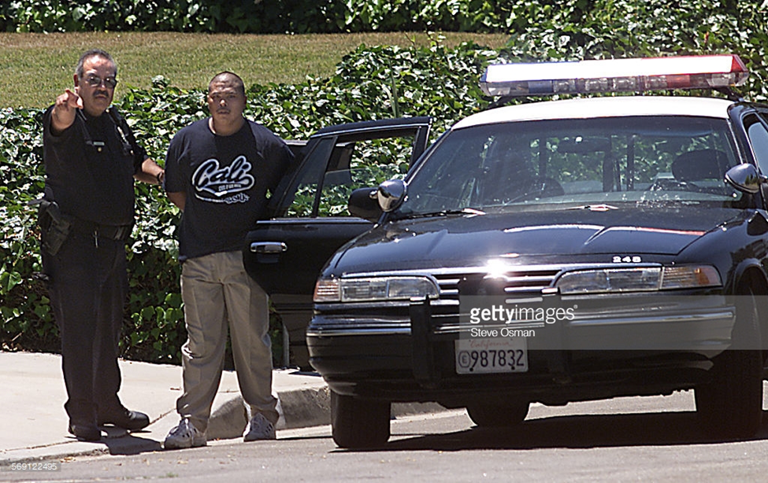
HB 1142 – EYEWITNESS IDENTIFICATION SHOWUP REGULATIONS
Case law: “showup identifications
are inherently suggestive.”
Bill limits use of showups and
mandates certain procedures.
Failure to comply “shall be considered by the court with respect to any challenge to the admissibility of the identification”
Notes:
DA & LE

Slide 6
HB 1142 – EYEWITNESS IDENTIFICATION SHOWUP REGULATIONS
Showup identifications may only be used if:
Suspect detained within minutes of the commission of the crime and near the location
A live lineup or photo array are not reasonable
The eyewitness believes that they can make an identification.
Also allowed if purpose is to confirm identity of familial or intimate relations.
Notes:
“within minutes” is not defined any more clearly. I’d argue that it means anything less than an hour.

Slide 7
HB 1142 – EYEWITNESS IDENTIFICATION SHOWUP REGULATIONS
Rules:
If multiple (eyewitnesses or subjects) – keep them separate at all times
Location must be “as well lit as practicable” with unobstructed view
Nothing suggestive – comments, computer screen, other
Don’t require subject to do anything to mimic
No handcuffs or back of patrol car – unless necessary

Slide 8
HB 1142 – EYEWITNESS IDENTIFICATION SHOWUP REGULATIONS
Rules continued:
Photograph or video subject and location. If wearing bodycam – keep it on the entire time
Officer shall read the “substance” of the admonition (best practice to read it verbatim)
If an ID made, ask if witness is “confident,” “somewhat confident,” or “not confident”
Document witness’s statements in their own words
Notes:
Read the admonition during the training
Tell officers and supervisors to consider creating a card for the officers (one side with a list of requirements directly from statute – the other side with the admonition to be read). Denver already does this.
For DAs – remember: Failure to comply “shall be considered by the court with respect to any challenge to the admissibility of the identification”

Slide 9
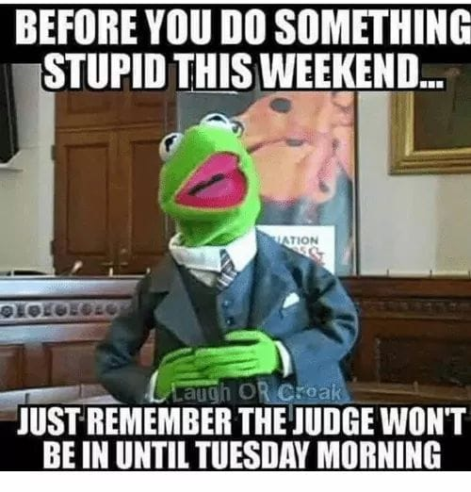
HB 1280 – PRE-TRIAL DETENTION REFORM
By April 1, 2022 – bond hearing must be held within 48 hours of the arrestee’s arrival at jail. This means weekend court in all jurisdictions
Statewide “bond hearing officer” available for 10 jurisdictions
Notice to DA about any bond hrg.
Notes:
DA & LE
10 jurisdictions currently planning to use the statewide bond hearing officer – 3, 5, 6, 9, 11, 12, 13, 14, 16, 22.
For DAs – some funding was provided in grant format for DAs office to comply with the requirements. $150,000 in first year to CDAC through Dep of Law. 2nd year plan is for
“All costs and expenses” to comply with this law for DAs are “reasonable and necessary expenses required to fully discharge the official duties of office” – this is important language for DAs at their budget meetings with commissioners.

Slide 10
HB 1280 – PRE-TRIAL DETENTION REFORM
Jail administrators should read the bill carefully.
Repeals requirement that sheriff must allow bond posted within 2 hours
However, defendants who have posted bonds or are on PR bonds must be released within 6 hours or document reason for delay
Jail must post a notice found in 16-4-102(2)(h) on website, in inmate handbooks, at booking counter, and provide to anyone inquiring about posting bond
Other notices required to be posted in public areas of jail
Notes:
Probably just LE only for this slide

Slide 11
Must include information on process to complain about violations
Please don’t use this:
Notes:
Just LE

Slide 12
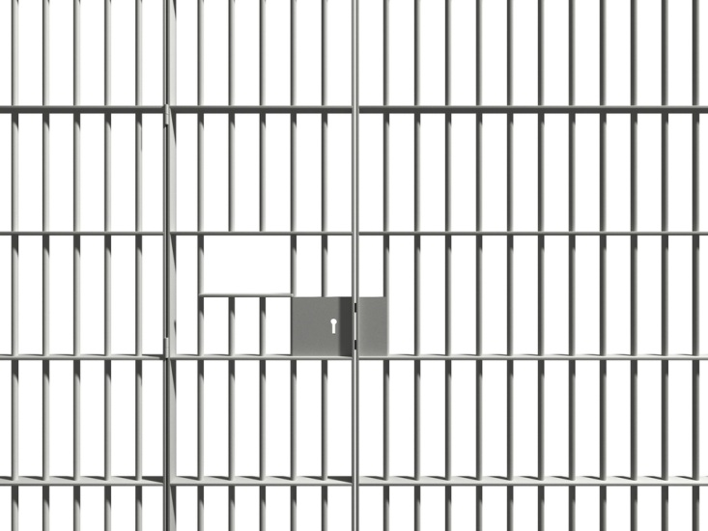
Crimes & Sentencing

Slide 13
HB 1015 – SECURITY PROTECTIONS CRIMINAL JUSTICE PERSONNEL
§ 18-9-313 prohibits “doxing” of law enforcement, judges, prosecutors, and human services employees.
Now protects:
DOC employees
Non-certified deputies and detention officers, &
Public defenders.
Also allows for application to remove personal info.
Notes:
DA & LE
Requires that the dissemination of personal information both poses and imminent and serious threat to the protected person of family, and that the defendant was aware of the threat – necessary to have this language in order to not violate 1st amendment free speech protections.

Slide 14
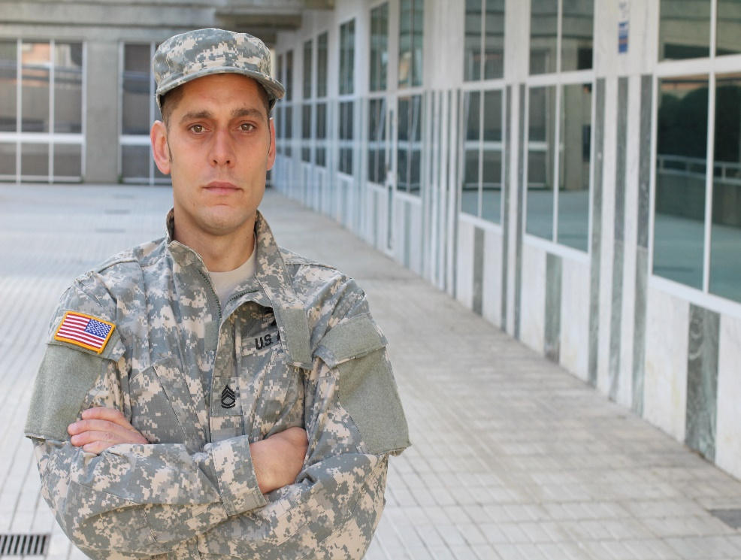
HB 1016 – TRANSFER JURISDICTION TO VETERAN’S SPECIALITY COURT
Requires advisements to vet/active duty ’s in JDs with no VTC of possible transfer of prob/sentence to JDs with VTCs
❒ must be suffering from MH condition related to service
DA consent required (and V’s consent in VRA cases)
Receiving JD VTC judge and DA must
consent, w/ resources to support transfer
Probation revo motions handled in receiving JDs; Revoke with resentencing
handled in sending JDs
Notes:
DA

Slide 15
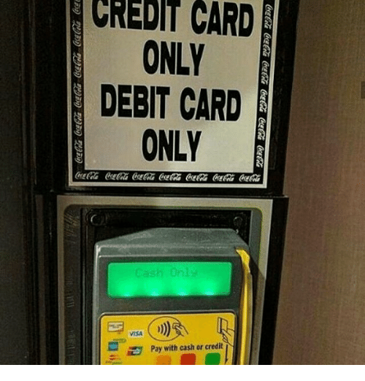
HB 1048 – RETAIL BUSINESS MUST ACCEPT CASH
New class 2 Petty Offense
“Failing to accept US currency from a buyer” at an in-person retail establishment
Notes:
DA & LE

Slide 16
HB 1057 – EXTORTION OF IMMIGRANTS ENGAGING IN LAWFUL ACTS
§ 18-3-207(1.5), prohibits extorting from a victim money or an item of value under threat of reporting to L/E the immigration status of the victim or another person
Amends the statute to also prohibit a person from inducing a victim against their will to perform an act or refrain from performing a lawful act (e.g., testifying, filing claims, reporting crimes)
Notes:
DA & LE

Slide 17
HB 1090 – CRIMINAL MARIJUANA OFFENSES
OVER 21? NOW LAWFUL TO POSSESS UP TO 2 OZ. (REPEALS DPO FOR POSSESSION UP TO 2 OZ.)
AMENDS MIP STATUTE – 18-13-122, FROM 1 OZ. OR LESS, TO NOW 2 OZ. OR LESS
ELIMINATES DA’S ABILITY TO OBJECT TO SEALING OF MJ POSSESSION OFFENSES IF  MEETS CRITERIA
s CAN PETITION TO SEAL CERTAIN (F3) MJ CULTIVATION CRIMES PREVIOUSLY INELIGIBLE FOR SEALING
Notes:
DA & LE

Slide 18
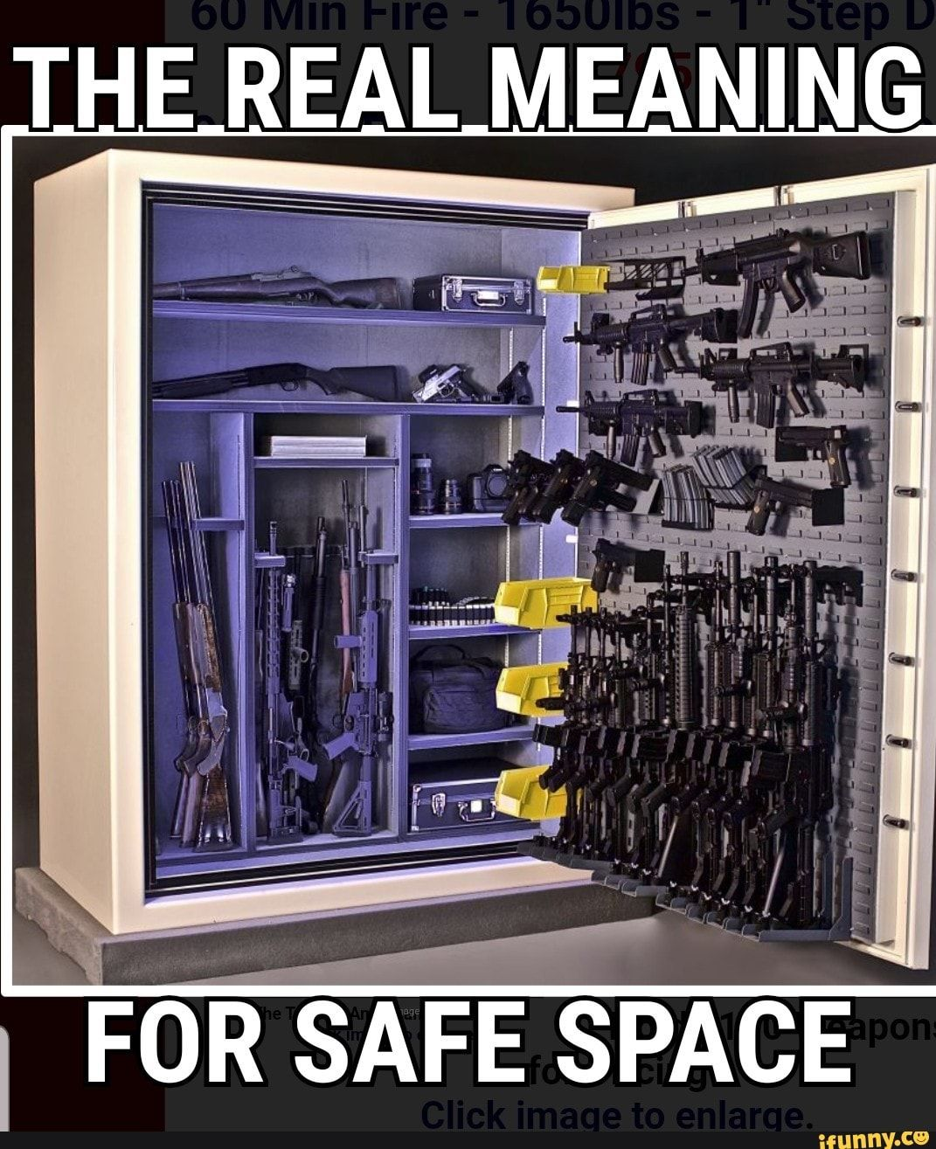
HB 1106 – SAFE STORAGE OF FIREARMS
“Responsibly and securely stores a firearm” if: Carrying it, gun safe, locking device, or personalized firearm
New M2 if:
Person fails to responsibly store; and
Knows or should know that a juvenile or an unauthorized person can gain access
Gun stores – new M if sale without lock or notice of safe storage requirements
Notes:
DA & LE
Unauthorized is an adult who is legally banned from possessing a firearm.
Affirmative defense – if juvenile uses gun in self defense, make my day, or defense of livestock.

Slide 19
HB 1107 – PROTECTIONS FOR PUBLIC HEALTH DEPARTMENT WORKERS
Companion bill to HB 1015 regarding “doxing”
Adds public health department employees
Notes:
DA & LE
Threats and doxing occurred for health department officials after they created covid and mask rules during covid. In particular in La Plata County.

Slide 20
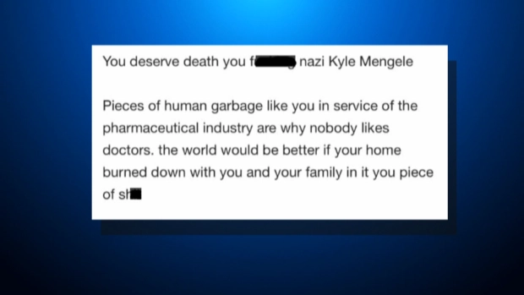
SB 64 – RETALIATION AGAINST AN ELECTED OFFICIAL
Retaliation of a judge statute contains a prohibition against making a credible threat as retaliation or retribution
Expands the statute to also apply to elected officials
Class 6 felony (*for judges it is an F4)
Notes:
DA & LE
Threats to Rep. Kyle Mullica regarding a vaccine bill in 2020: One of the emails was from a dad who accused Mullica of purposefully wanting his son dead. In another email, a woman threatened “death by hanging.” And, an anonymous person wrote, “The world would be better if your home burned down with you and your family in it.”

Slide 21
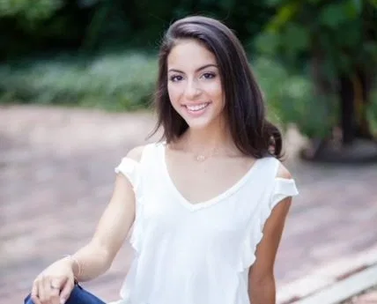
SB 78 – LOST OR STOLEN FIREARMS
If “reasonable cause to believe” a firearm is lost or stolen, the owner must report to LE within 5 days
Failure to do so is a Civil Infraction with $25 fine. 2nd offense is unclassified M with fine up to $500
Isabella Joy Thallas
Notes:
DA & LE
Isabella Joy Thallas Act – Isabella (pictured) was killed in LoDo while walking her dog. The AK-47 used in the murder was stolen from a police officer who never reported it stolen.
- DAs – there will likely be a 5th amendment argument about compelled speech when this crime is combined with 1106. Reporting the stolen firearm may necessarily result in an admission of not securely storing the firearm. If so, look to hit and run case law.

Slide 22
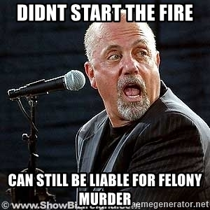
SB 124 – CHANGES TO FELONY MURDER
Moves “FELONY MURDER” from 1st Degree Murder to 2nd Degree Murder
Now a class 2 Felony COV - 16-48 years
“death caused by anyone” changed to “caused by any participant”
Removes 2 elements from the affirmative defense
Notes:
DA & LE

Slide 23
SB 135 – PROHIBIT EXOTIC ANIMALS IN TRAVELING PERFORMANCES
Creates the “Traveling Animal Protection Act”. New Unclassified Misdemeanor (M) for violations of Act ($250-$1000 fine for each violation)
Shall not cause a ‘Performance’ of certain classes of animals
“Performance” means Animal Act, Circus, Ride, Carnival, Parade, Race, or similar undertaking in which animals perform tricks / give rides / participate as accompaniments for entertainment / amusement / audience benefit / photographic purposes
Notes:
DA & LE

Slide 24
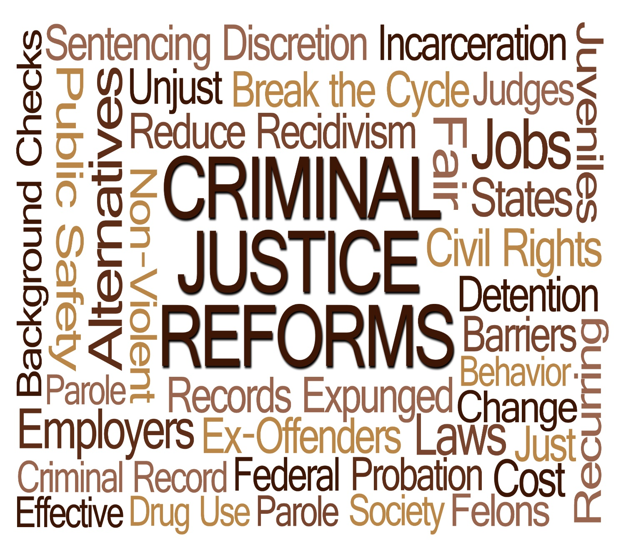
SB 271 – MISDEMEANOR REFORM
Creates
Notes:
DA & LE

Slide 25
SB 271 – MISDEMEANOR REFORM
CCJJ Reform per Gov. directive
Delayed implementation until March 1, 2022
Compresses Misdemeanor Grid to two classes of (M) and 1 class of Petty Offense (PO)
General guidelines:
Person crimes – M1s
Property crimes – M2s
No change to DUI grid, except W/R and alternative sentencing
Notes:
DA & LE

Slide 26
SB 271 – MISDEMEANOR REFORM
New Misdemeanor Grid:
Offense Class | Sentence | Fine
Misdemeanor 1 | Up to 364 days jail | Fine up to $1,000 Treatment Options Useful Public Service
Misdemeanor 2 | Up to 120 days jail | Fine up to $750 Treatment Options Useful Public Service
Petty Offense | Up to 10 days jail | Fine up to $300 Useful Public Service
Infraction or Unclassified Misdemeanor | n/a | Fine up to $100 Useful Public Service
The maximum consecutive sentence to county jail for misdemeanor crimes in a single case is 24 months
Notes:
DA & LE
Also limits the amount of credit a jail can give to a maximum of 10 days per 30 days of sentence

Slide 27
SB 271 – MISDEMEANOR REFORM
Major Offense changes
Vehicular Assault/DWAI – F5
Vehicular Homicide/DWAI – F4
POWPO –
Limited to possession, use, or carry of a firearm after conviction for felony VRA only
2nd Degree Burg. is now VRA, and thus a qualifying predicate conviction
NOT probation eligible if  used or threatened use of firearm in commission of new crime. DOC required.
Applies to juveniles with a 10 year limit following (F) VRA adjudication
All violations are (F5)
Notes:
DA

Slide 28
SB 271 – MISDEMEANOR REFORM
Major Offense changes
Restructure Criminal Impersonation crimes: (F6)/(M)
New crime of “Providing False Info to Law Enforcement” (M2)/(F6)
(Attempt to Influence a Public Servant becomes a (M))
Reclassifies Identify Theft Offenses: (F4)/(M2)/(F6)
Restructures Contributing to the Delinquency of a Minor: (F4)/(M1)
Restructures Giving False Information to Pawnbroker, consistent with Theft thresholds. Also, Criminal Mischief to match Theft thresholds.
Reclassifies Menacing: (M1)/(F5)
Reclassifies Possession of Burglary Tools: (M2)/(F5)
Notes:
DA & LE

Slide 29
SB 271 – MISDEMEANOR REFORM
Major Offense changes
Bond Violation Offense restructuring:
On Bond for underlying (F) and FTAs  (F6)
On Bond for any offense an FTAs for proceeding with Vs/Ws appearing in court  (M2)
Shall not brought against  if charged with traffic, petty, and municipal offenses with certain exceptions (i.e., traffic involving death/SBI; eluding; circumventing interlock; muni offenses substantially similar to state (M) offenses)
Notes:
DA & LE

Slide 30
SB 280 – BIAS-MOTIVATED CRIMES
Amends Harassment (§ 18-9-111) and Bias-Motivated Crime (§ 18-9-121) statutes, to clarify that bias-motivation need only be part (i.e., “in whole or in part”) of ’s motivation in committing crime
Adds the crime of Harassment, if bias-motivated, to the Victims Right Act list of crimes per § 24-4.1-302
Notes:
DA & LE

Slide 31
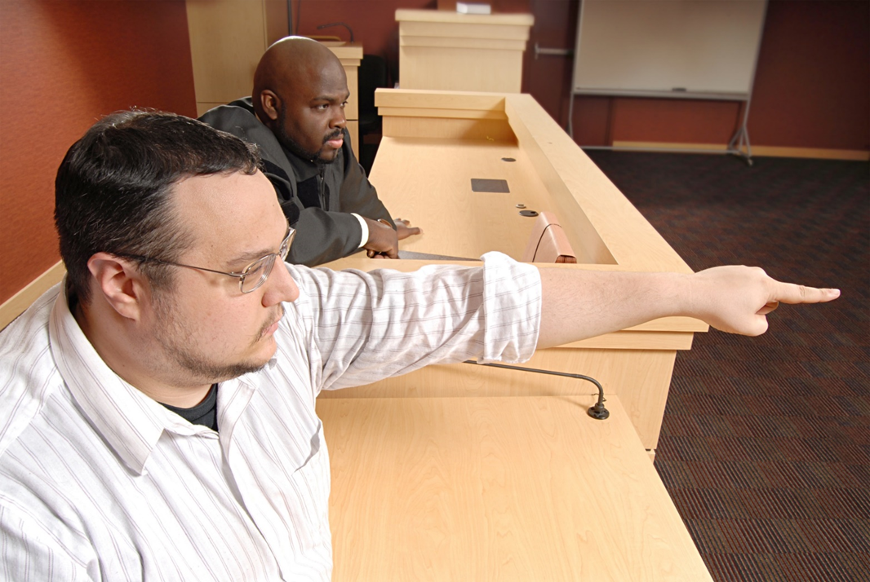
VICTIMS AND WITNESSES

Slide 32
HB 1060 – U VISA CERTIFICATION REQUIREMENTS
Creates U-Visa petition/review requirements
Defines terms, including “certifying agency”, “certifying official”, “qualifying criminal activity”, and “victim of qualifying criminal activity”
Sept 1, 2021 and June 30, 2022  120 days response time, with 60-day exceptions
After July 1, 2022  90 days response time, with 30-day exceptions
Confirms signers are not sponsors/decision-makers of ultimate U-Visa issuance
Data collection requirements reports to DCJ
Notes:
DA & LE
Warn LE that the proponents want to follow up with legislation allowing lawsuits against LE for not following.

Slide 33
HB 1143 – PROTECT SURVIVORS’ RIGHTS TO RAPE KIT EVIDENCE
SANE notifications…
New VRA pamphlet
Submission, results/CODIS match, 60-day warning of destruction, rights to object, change in status.
What if a victim objects to destruction?
Notes:
LE & DA
SANE notifications: right to Victim Advocate – anonymous community-based advocate if victim chooses to not report to LE.
Right to preservation and right to be notified prior to destruction.
V Objects? Must be preserved 10 years.

Slide 34
HB 1255 – PROTECTION ORDER ISSUED AGAINST DOMESTIC ABUSER
Amends Civil and Criminal Protection Order requirements for firearm relinquishment
Respondents/Defendants must complete affidavit with court w/in 7 days stating:
Number of Firearms in immediate possession/control
Make and Model of each Firearm
Any reason why still in possession
Location of each Firearm
Creates
Establishes “compliance hearings” to ensure follow-through:
Civil – 8-12 days after order
Criminal – initial hearing and 8-12 days after sentencing
Provides Immunity to defendants against use of any testimony or compelled info. (Perjury charge exception)
Notes:
DA & LE

Slide 35
HB 1255 – PROTECTION ORDER ISSUED AGAINST DOMESTIC ABUSER
Firearm transfers to:
Private Parties, except household members
Firearms Dealers
Law Enforcement entities (which may now contract with one-another for storage)
Limited Immunity granted to storage facilities
LEA must obtain search warrant prior to examining firearm if believe item was used in crime (does not apply to routine examination for storage purpose)
Court required to order compliance in DV cases as a condition of bond per § 18-1-1001
Courts may issue search warrants upon PC to believe  failed to relinquish firearms
Notes:
DA & LE

Slide 36
Peace Officer/POST

Slide 37
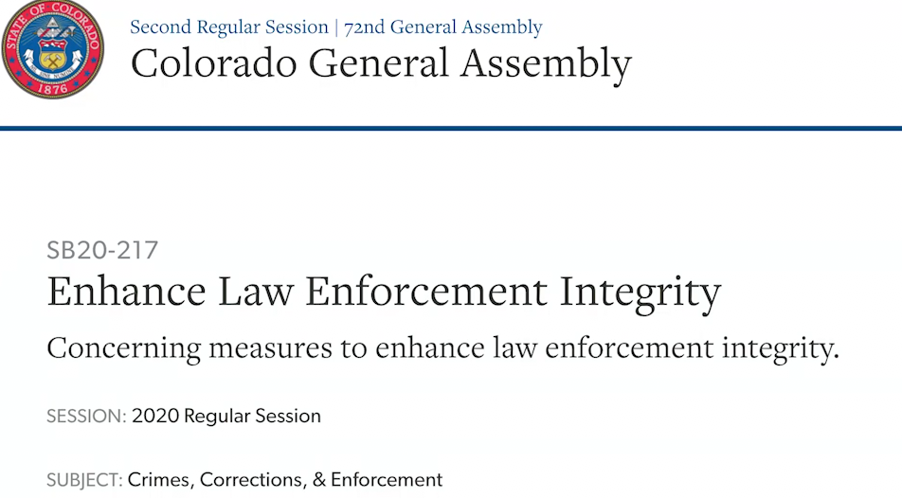
HB 1250 – MEASURES TO ADDRESS LAW ENFORCEMENT ACCOUNTABILITY
Last year, SB 217 passed in the wake of the murder of George Floyd and subsequent protests in the last 9 days of session
1250 promised as a “clean up” bill
217 – 20 pages long
1250 – 31 pages long

Slide 38
HB 1250 – MEASURES TO ADDRESS LAW ENFORCEMENT ACCOUNTABILITY
Bodycams and dashcams
Effective date changes
“tampers with” – effective now
“fails to activate or turns off” – 7/1/22
Each agency must provide to their officers – 7/1/23
When must the bodycam be activated
Consequences?
Bodycam release requirements – when:
Complaint of peace officer misconduct, and
Requested
Notes:
DA & LE
If failure to comply -> potential consequences – (1) permissive inference that missing footage would reflect misconduct by the officer, and (2) any unrecorded statements or CONDUCT sought to be introduced by prosecution through officer are “rebuttable presumed” to be inadmissible.
Ways to rebut – from similar Maryland law - The presumption may be rebutted by a showing that (1) the BWC was not activated due to a malfunction of the camera; (2) the police officer was not aware of the malfunction or was not able to repair the malfunction prior to the incident; and (3) the law enforcement agency’s documentation shows that the officer checked the camera’s functionality at the beginning of the officer’s shift; or (4) it was unsafe, impractical, or impossible for the law enforcement officer to activate the BWC.

Slide 39
HB 1250 – MEASURES TO ADDRESS LAW ENFORCEMENT ACCOUNTABILITY
Reporting requirements:
Clarifies effective date to Jan 1, 2022
DCJ and CBI mandated to create a simplified process for data collection
Additional requirements
Peace Officer Certification Discipline:
Reduces POST discipline for incidents not resulting in death or SBI
Administrative law judge to conduct hearings
Notes:
LE
Discipline – 217 mandated revocation of cert for excessive force or failing to intervene. 1250 changes that to suspension of at least a year if not resulting in SBI or death.

Slide 40
HB 1250 – MEASURES TO ADDRESS LAW ENFORCEMENT ACCOUNTABILITY
Whistleblower Protections:
Prohibits retaliation for officers that disclose danger to public health or safety, or violations of law or policy by another officer
Each LEA must provide training and post notice by Jan 1, 2022
Civil Action for Deprivation of Rights:
Expands to CSP and other POST certified state officers
Prohibits pre-emptive declaration of “good faith”
Notes:
LE

Slide 41
HB 1250 – MEASURES TO ADDRESS LAW ENFORCEMENT ACCOUNTABILITY
Critical Incident Review Team (CIRT) expansion:
Any death resulting from use of force – not just shootings
§ 18-1-707 Affirmative Defense – Use of Force by Peace Officer:
True cleanup
Duty to Report Use of Force / Duty to Intervene § 18-8-802:
Limits to defined peace officers
Other cleanup
Notes:
DA & LE
18-1-707 had imminent risks backwards in 217. Risk of death or sbi necessary for use of force. Only risk of injury necessary for deadly force – woops.

Slide 42
HB 1250 – MEASURES TO ADDRESS LAW ENFORCEMENT ACCOUNTABILITY
Other:
Must check with AG database prior to hiring new officer
Cannot avoid database by resigning/retiring prior to completed investigation
Must report officer with credibility violations to POST (see also SB 174). Failure to report = fine.
Clarifies from 217 what a “legal basis” is for contacting a person.
Radio Encryption – must have policy to provide access to media.
2 new study groups: “no-knocks” and police “best practices”
Notes:
LE
“Legal basis” for contacting a person now defined as: “any basis authorized by statute or that the Colorado Supreme Court or United States Supreme Court has determined is lawful pursuant to section 7 of article II of the state constitution of the Fourth Amendment to the United States Constitution.”

Slide 43
HB 1251 – APPROPRIATE USE OF CHEMICAL RESTRAINTS ON A PERSON
Provides guidance to EMS personnel on administration of Ketamine whenever L/E is present at scene of emergency. EMS shall not base medical decision exclusively on info by peace officer.
Prohibits Peace officer from using, directing, influencing use of ketamine on another, or compelling, directing, or unduly influencing EMS provider. EMS to confidentially report to POST w/i 10 days for violations.
Notes:
DA & LE

Slide 44
HB 1251 – APPROPRIATE USE OF CHEMICAL RESTRAINTS ON A PERSON
Defines “undue influence”
Dually trained Peace Officer/certified EMS individual must rely on EMS training and experience to decide administration of drug
L/E witnessing other peace officers using or directing use of ketamine must intervene and/or report unlawful administration. Two new (M) crimes created for failing to intervene or failing to report as required.
DAs must issue report on filing/no-filing against officer and others on- scene; POST to suspend/revoke certification based on case issues
Notes:
DA & LE
Unduly influence: “improper use of power or trust in a way that deprives a person of free will and substitutes another’s objective.”

Slide 45
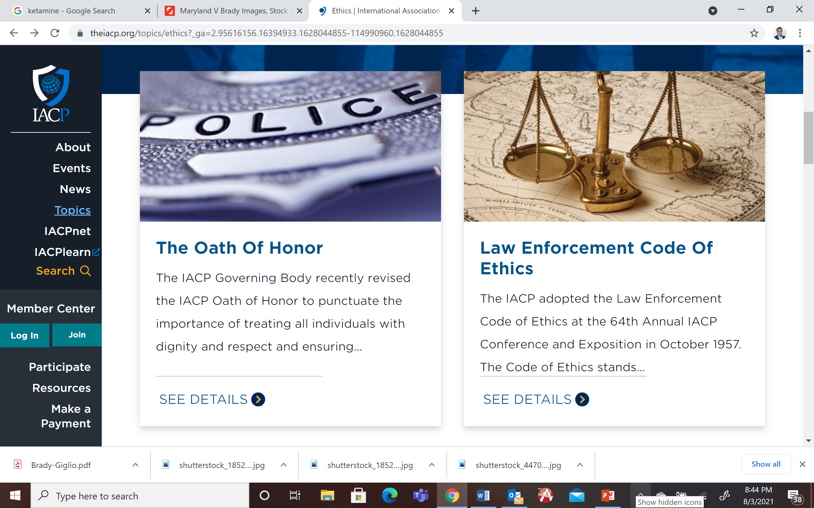
SB 174 – POLICIES FOR PEACE OFFICER CREDIBILITY DISCLOSURES
Creates the Peace Officer Credibility Disclosure Notification Committee
Committee to create statewide policy by December 1, 2021. By Jan. 1, 2022, LEAs to adopt and implement model policy for credibility disclosures.
Policy must address Brady, sustained finding re: untruthfulness, dishonesty, crime, bias, and other issues, including removal from list.
Notes:
DA & LE

Slide 46
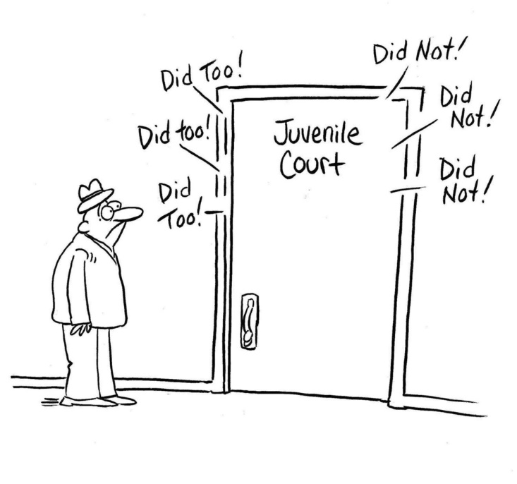
Juveniles

Slide 47
HB 1064 – UPDATED PROCESSES JUVENILE SEX OFFENDER REGISTRY
Auto-termination and easier petition eligibility – 7 years or age 25
No more lifetime juvenile registration
Increased discretion for judge to except a juvie from requirement to register.
Prohibits CBI from notifying the public of juvenile registration status of someone
EXCEPTIONS
NEW: unclassified misdo
LE – cannot release juvenile SO information.
Notes:
DA & LE
Easier term eligibility: allows people with multiple JD sex offenses to petition, extends to any JD sex offense (not just USC/exploit/posting). Exceptions to public info: victim and people who sign a doc promising not to post the info or use it to harass/blackmail. LEO/DHS, etc are exempted. UM is for people who violate the information request. $$ for LEO - cannot exceed $15, indigent waiver allowed

Slide 48
Sex Offense and Related Issues

Slide 49
HB 1069 – ENFORCEMENT OF SEXUAL EXPLOITATION OF A CHILD
New definitions – expands the law to align with technology
Bott/Abad fix!
No more 20+ aggravator… see above.
NEW! ER for:
under 12,
or a child subjected to physical force/violence,
or subjected to sexual intercourse/intrusion/sadomasochism
Lifetime registration exception – due to Bott fix.
NEW Surcharge – to fund CBI for new program designed to assist local LEO with experts and resources
Notes:
DA & LE
Definitions: livestream and access or access with intent to view
Legislative post enactment review to look at charging decisions for potential DA overcharging.

Slide 50
SB 17 – ABUSE OF PUBLIC TRUST BY AN EDUCATOR
New M1 Crime – but NOT a sex offense.
Elements
Pre-K through 12th grade teacher
Subjects a student to sexual intrusion/penetration
Student over 18
Teacher 4+ years older
Not spouse
Loopholes?
School advisement and employment
Notes:
DA & LE
Consent not defense
Intrusion/penetration only – other sexual acts not included
Must be a student at the same school – coach or teacher at another school or former school then not a crime

Slide 51
OTHER BILLS OF INTEREST

Slide 52
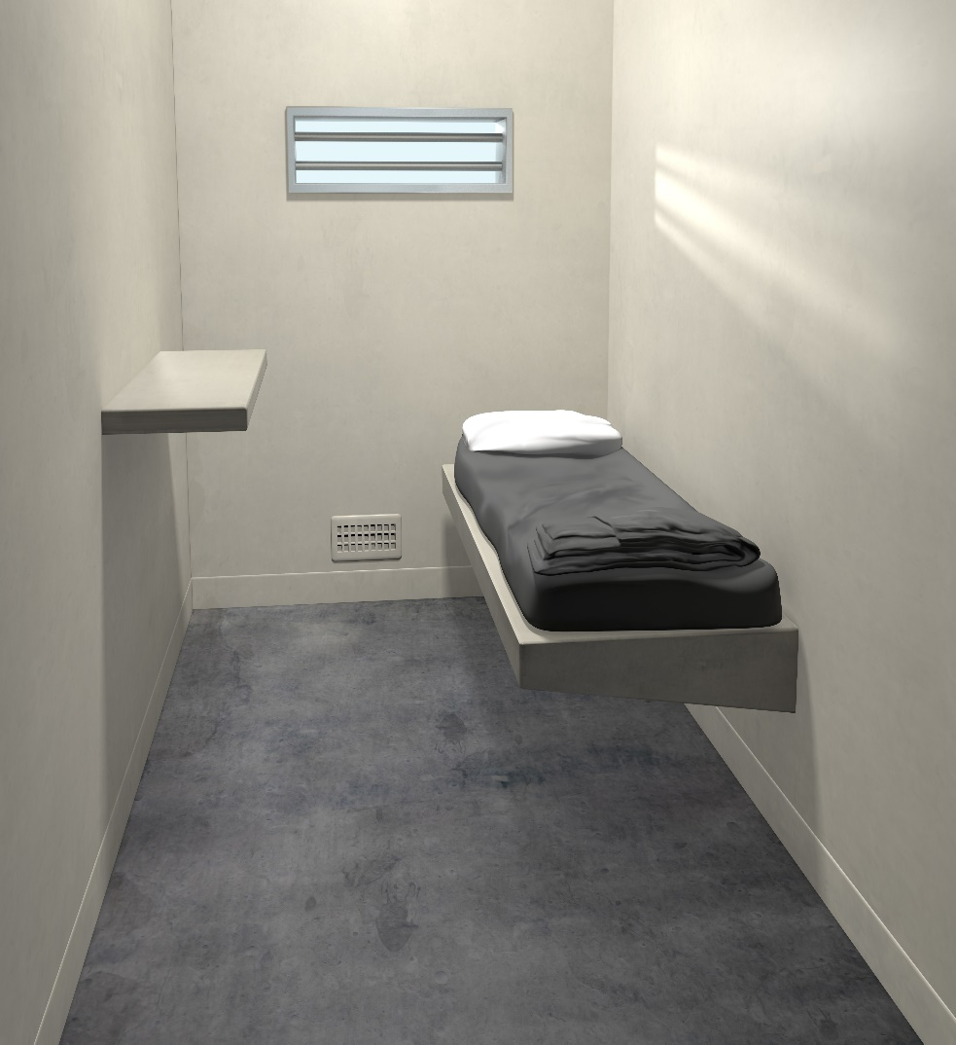
HB 1211 – REGULATION OF RESTRICTIVE HOUSING IN JAILS
Creates a comprehensive set of guidelines for curtailing restrictive housing in local jails, defined as jails with more than 400 beds, as of July 1, 2022
Mandates protocols and documentation procedures that jails must follow with respect to inmates who exhibit indications of psychological distress
Notes:
LE

Slide 53
HB 1211 – REGULATION OF RESTRICTIVE HOUSING IN JAILS
Prohibits the use of restrictive housing, and requires mental health observations, unless no other less restrictive options are available and the inmate is not responding to de-escalation techniques
Requires all jails to collect data and report quarterly to DCJ concerning their use of restrictive housing, beginning Jan. 1 2022, and thereafter
Notes:
LE

Slide 54
HB 1214 – RECORD SEALING COLLATERAL CONSEQUENCES REDUCTION
Expands eligibility for s to file motions for relief from collateral consequences to include retroactive applications
Creates automatic sealing process for arrest records where no charges were filed. Requires CBI to seal arrest records after a year has passed. (Felonies with SOL longer than 3 years are ineligible for auto sealing)
Exempts offenses eligible for sealing, to include:
All class 1, 2, and 3 felonies, DUIs, felony VRA crimes, sex offenses, traffic offenses and infractions; special offender drug offenses, DV offenses, and identify theft.
Notes:
DA

Slide 55
HB 1214 – RECORD SEALING COLLATERAL CONSEQUENCES REDUCTION
Number of Offenses Eligible for Sealing
Highest Charge | How many convictions may be sealed
Petty Offense | 5 cases
Class 2 or 3 Misdemeanor or Drug Misdemeanor | 4 cases
Class 1 Misdemeanor or Eligible Felony | 3 case
Timeline for Sealing Offenses
Highest Charge | How long after last conviction (release from Supervision) before  can file motion to seal
Petty Offense | 2 Years
Misdemeanor or DF4 | 5 years
Eligible Felony | 10 Years
Notes:
DA
New ability to seal multiple convictions

Slide 56
SB 81 – MEASURES TO PREVENT THE MISUSE OF Safe2Tell
Permits AG to disclose Safe2Tell info to LE if necessary to prevent imminent physical harm.
LE or DAs can request production of records from Safe2Tell if:
PC exists that person used S2T for False Report of an Emergency, &
Balancing test supports piercing the anonymity.
Notes:
DA & LE
Safe2Tell was created in response to the Columbine HS shooting. Intended to be a safe space to report threats and suicidal ideations while remaining anonymous.
One student council president testified that while the program is immensely important and helpful, their school has been shut down multiple times due to false reports and students have been “swatted.” He said the program is sometime nicknamed “safe to lie.”

Slide 57
Other Bills of Interest
Gun stuff:
HB 1298 – Expand Firearm Background Check Requirements
HB 1299 – Office of Gun Violence Prevention
SB 256 – Local Regulation of Firearms
Law Enforcement:
HB 1085 – Secure Transportation Behavioral Health Crisis
HB 1122 – First Responder Interactions Persons with Disabilities
Notes:
1298 – A person cannot pass a background check to purchase a firearm if conviction in last 5 years of certain misdemeanors (including 3rd Deg assault, VPO, Cruelty to Animals, Bias motivated, providing handgun to juvenile, etc.). Only prohibits passing background check for purchase. Does not prohibit possession or expand POWPO. Also, creates a crime for a gun shop to sell without waiting for results of background check (closes loophole).
1299 – creates office to study possible measures to confront gun violence and educate.
256 – allows local government to more restrictively regulate firearms
1085 – statewide effort to license entities to provide transport for mental health crisis patients instead of law enforcement.
1122 – Creates commission in AG’s office to study and implement new training for peace officers for dealing with persons with disabilities.

Slide 58
Brian Hardouin, Sr. DDA Laura Hinojos, Sr. DDA
(970) 498-7222 (970) 498-7170
hardoubj@co.larimer.co.us hinojola@co.larimer.co.us

