Slide 1
LARIMER COUNTY BUDGET OFFICE
2024 PROPOSED BUDGET HEARING
November 6, 2023

Slide 2
2024 PROPOSED BUDGET HEARING – November 6, 2023
Today’s Agenda
Budget Calendar
Fiscal Factors
Ballot Items
Key Decisions
Budget Overview
General Fund Balance Projection
Public Feedback

Slide 3
2024 PROPOSED BUDGET HEARING – November 6, 2023
Budget Calendar
When | What
April | SWOT Analysis
May | Commissioners Review Forecast and Set Initial Budget Targets
June-August | Departments and Elected Offices Develop Proposals
July & August | Commissioners Review Compensation
August | Budget and Capital Improvement Plans are Submitted
September | County Manager Reviews Proposals
Late September | Budget Retreat & Direction

Slide 4
2024 PROPOSED BUDGET HEARING – November 6, 2023
Budget Calendar
When | What
October 15 | 2024 Proposed Budget Complete
October 18 | Work Session with Commissioners
November 6 @ 6 pm | Public Hearing on 2024 Budget & Landfill Rates
November 7 | Election Day
Mid-November | Final 2024 Budget Retreat & Direction

Slide 5
2024 PROPOSED BUDGET HEARING – November 6, 2023
Budget Calendar
When |  | What
HH Doesn’t Pass | HH Passes | What
Dec. 10 | Dec. 29 | Final 2024 Certification of Values
Mid-December |  | Review Changes from 2024 Proposed to Adopted Budget at Administrative Matters
December 14 @ 2 pm |  | 2024 Budget Adoption
Dec. 15 | Jan. 5 | Taxing districts certify mill levies to commissioners
Dec. 22 | Jan. 12 | Commissioners certify levies
December 31 | Mid-December | State Budget Adoption Deadline

Slide 6
2024 PROPOSED BUDGET HEARING – November 6, 2023
Fiscal Factors
2023 Projects Completed
Community Justice Alternatives Women’s Facility
Jail Improvement Project
Behavioral Health Facility
Human Services Renovation

Slide 7
2024 PROPOSED BUDGET HEARING – November 6, 2023
Fiscal Factors
Rising Costs
Inflation: Technology, Construction, Steel
Personnel
Unfunded Mandates

Slide 8
2024 PROPOSED BUDGET HEARING – November 6, 2023
Property Tax Ballot Items
Proposition HH
Initiative 50

Slide 9
2024 PROPOSED BUDGET HEARING – November 6, 2023
Property Tax Ballot Items
Responding to Property Tax Ballot Items
Hiring freeze from June – August
Required Reduction Proposals
$7 million reviewed; over $2 million included in the 2024 Proposed Budget
Proposed Budget Assumes HH Passes

Slide 10
2024 PROPOSED BUDGET – October 18, 2023
Key Decisions: Reductions
Reductions | Amount
Damage Assessments | ($15,000)
Clerk and Recorder Personnel | ($300,000)
Commissioners Outreach | ($25,000)
Data Reporting, Software Licensing | ($75,000)
Emergency Management Projects | ($20,000)
Code Compliance Personnel to Building Fund | ($75,000)
End North Range Behavioral Health Contract | ($57,364)
Local Funding for State Wellness Court Coordinator | ($38,600)
Coroner Vehicle Reduction | ($10,000)
County Attorney Admin | ($25,000)
District Attorney IT Projects, Fleet Vehicles | ($59,710)

Slide 11
2024 PROPOSED BUDGET – October 18, 2023
Key Decisions: Reductions
Reductions | Amount
Workforce Development Grant Matches | ($50,000)
Building Component Replacement Plan | ($225,000)
Eliminate Bag Fee Administration | ($5,700)
Health and Environment Internships and Water Association Dues | ($37,500)
Repurposed Senior Tax Work Off Funds | ($30,000)
Human Services General Assistance Funding | ($50,000)
Technology Reductions | ($150,000)
Natural Resources General Fund Support | ($75,361)
Sheriff Personnel | ($265,000)
General Fund Support for The Fair | ($180,000)
Treasurer Projects | ($300,000)

Slide 12
2024 PROPOSED BUDGET HEARING – November 6, 2023
Key Decisions: Service Proposals
Service Proposals
$3.5 million of $18 million in requests included in 2024 Proposed Budget
Criteria: Inflation, State Mandates, Existing Contracts, Criticality of Service

Slide 13
2024 PROPOSED BUDGET HEARING – November 6, 2023
Key Decisions: Service Proposals
Service Proposals | Amount
Proposition HH Implementation | $50,000
Emergency Management Software | $15,200
Climate Smart Program Coordinator | $90,000
Data Analytics Training | $15,000
Humane Society Contract Renewal | $19,768
Oil and Gas Regulation Consulting | $50,000
Pretrial Case Manager | $65,390
Juvenile Offender Transport | $226,760
Veterans Service Office Staff Reclassifications | $80,009
Boxelder Dam Maintenance | $15,000
Accounting Position Shortfall | $24,780

Slide 14
2024 PROPOSED BUDGET HEARING – November 6, 2023
Key Decisions: Service Proposals
Service Proposals | Amount
Election Worker Payroll Costs | $59,000
Sheriff Property and Casualty Renewal | $386,945
Inmate Food and Medical Costs | $2,312,520
Ammunition Budget Shortfall | $100,000
457(b) Deferred Compensation Plan Audit | $15,360

Slide 15
2024 PROPOSED BUDGET HEARING – November 6, 2023
Key Decisions: Unfunded Requests
Service Proposals* | Amount
Community Development Character Area Plans | $55,000
Coroner Family Advocate | $86,760
Domestic Violence Prosecution Team | $334,432
Fire Mitigation Grant Program | $50,000
Transportation Master Plan Update | $450,000
Eviction Prevention | $275,000
Cybersecurity Analyst | $133,800
Sheriff – Civil Unit Sergeant | $279,670
*Not comprehensive.

Slide 16
2024 PROPOSED BUDGET HEARING – November 6, 2023
Budget Overview
Revenue Category | 2023 Revised | 2024 Proposed | % Change
Property Taxes and Assessments | $159,451,328 | $179,460,114 | 12%
Sales, Use & Other Taxes | $89,557,757 | $91,635,552 | 2%
Intergovernmental | $123,115,561 | $103,318,534 | (16%)
Licenses & Permits | $16,738,216 | $12,217,102 | (27%)
External Charges for Service | $55,103,758 | $59,727,958 | 8%
Interest Earnings | $9,288,722 | $10,367,571 | 12%
Internal & Other Revenue | $127,218,681 | $121,840,889 | (4%)
TOTAL – ALL REVENUES | $580,474,023 | $578,567,720 | (0%)

Slide 17
2024 PROPOSED BUDGET HEARING – November 6, 2023
Budget Overview
Expense Category | 2023 Revised | 2024 Proposed | % Change
Personnel | $233,841,203 | $245,384,007 | 5%
Operating | $297,151,182 | $266,525,427 | (10%)
Capital Outlay | $114,995,860 | $52,646,016 | (54%)
Certificate of Participation | $6,499,881 | $6,490,686 | 0%
Other Financing Uses | $51,837,839 | $39,240,253 | (24%)
TOTAL – ALL EXPENSES | $704,325,965 | $610,286,389 | (13%)

Slide 18
2024 PROPOSED BUDGET HEARING – November 6, 2023
General Fund Balance Projection
Proposition HH Passes
Improved Economic Outlook
Lower Inflation
Lower Property Value Growth
Continued Legislative Uncertainty

Slide 19
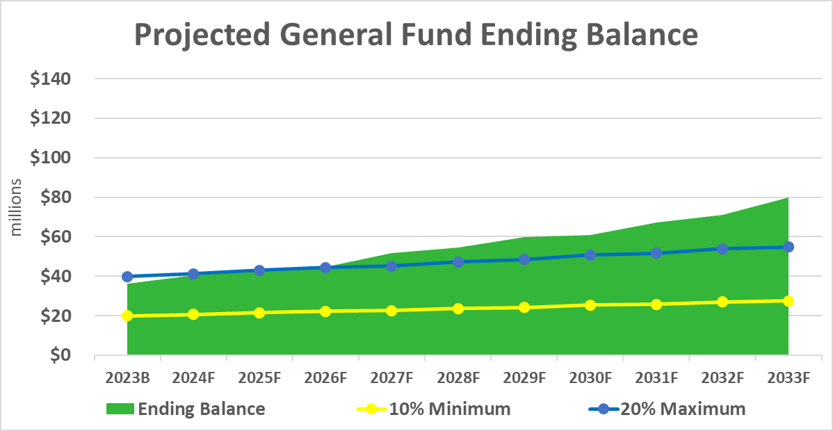
2024 PROPOSED BUDGET HEARING – November 6, 2023
General Fund Balance Projection

Slide 20
2024 PROPOSED BUDGET HEARING – November 6, 2023
Public Feedback
View/Explore the Budget: www.larimer.org/budget
Listening Sessions
Community Survey
American Rescue Plan Act Work Sessions
Proposed Budget Hearing
Budget Adoption Hearing on December 14th @ 2 pm

Slide 21
2024 PROPOSED BUDGET – October 18, 2023
Questions and Public Comment

