Slide 1
Search Warrants in the Modern Age
DDA Brian Hardouin – Filing / Warrant Review
Email: warrants@co.larimer.co.us
Email: hardoubj@co.larimer.co.us
Office: (970) 498-7222
Cell: (303) 547-4665

Slide 2
Where Are We Going?
Back To Basics
Process, Process, Process
Digital Evidence
State of the Law

Slide 3
The State of the Law – In the Modern Age

Slide 4
Riley v. California, 573 U.S. 373 (2014)
“Cell phones differ in both a quantitative and a qualitative sense from other objects that might be kept on an arrestee’s person.”
“These cases require us to decide how the search incident to arrest doctrine applies to modern cell phones, which are now such a pervasive and insistent part of daily life that the proverbial visitor from Mars might conclude they were an important feature of human anatomy.”

Slide 5
Riley v. California, 573 U.S. 373 (2014)
“Indeed, a cell phone search would typically expose to the government far more than the most exhaustive search of a house: A phone not only contains in digital form many sensitive records previously found in the home; it also contains a broad array of private information never found in a home in any form—unless the phone is.”

Slide 6
Carpenter v. U.S., 138 S.Ct. 2206 (2018)
“First, cell phones and the services they provide are “such a pervasive and insistent part of daily life” that carrying one is indispensable to participation in modern society.”
In the context of CDR: “Apart from disconnecting the phone from the network, there is no way to avoid leaving behind a trail of location data. As a result, in no meaningful sense does the user voluntarily “assume[ ] the risk” of turning over a comprehensive dossier of his physical movements.”

Slide 7
The Impact

Slide 8
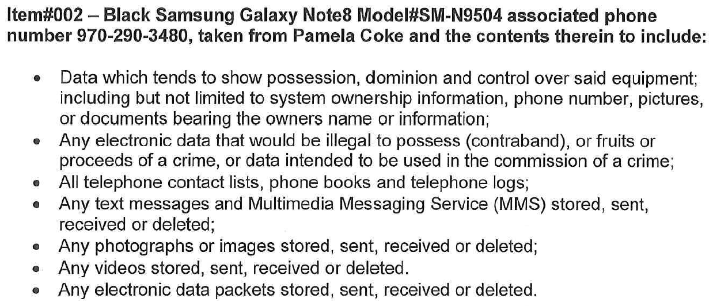
People v Coke, 461 P.3d 508 (Colo. 2020)
“[T]he warrant at issue here contains no particularity as to the alleged victim or to the time period during which the assault allegedly occurred. Rather, it permitted the officers to search all texts, videos, pictures, contact lists, phone records, and any data that showed ownership or possession. We conclude that such broad authorization violates the particularity demanded by the Fourth Amendment. Because it authorized a general search of Coke's phone, it was also unreasonable under the Fourth Amendment.”
*Cell Phones are not one big container but lots of little contains PC to search each

Slide 9
Back to Basics

Slide 10
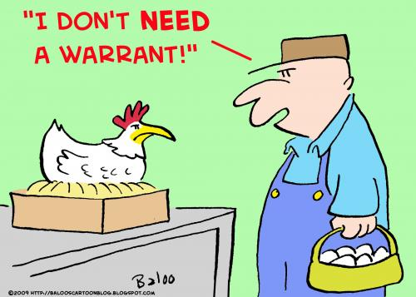
Do I Need a Warrant?
“It is a bedrock principle of search and seizure jurisprudence that searches and seizures without a warrant are presumptively unreasonable.”
The burden of overcoming this presumption rests with the People, who must show that the facts and circumstances surrounding the search constitute one of the exceptions to the warrant requirement.
People v. Bursting, 307 P.3d 1073 (Colo. 2013)

Slide 11
Fourth Amendment - For a Valid Search Warrant
Particularity in the location to be searched
01
Particularity in the items to be seized
02
Probable cause to believe that the items to be seized are in the location to be searched
03

Slide 12
Particularity in the location to be searched
The requirement that warrants shall particularly describe the location to be searched prevents the search of one thing under a warrant describing another.
Marron v. United States, 275 U.S. 192 (1927)

Slide 13
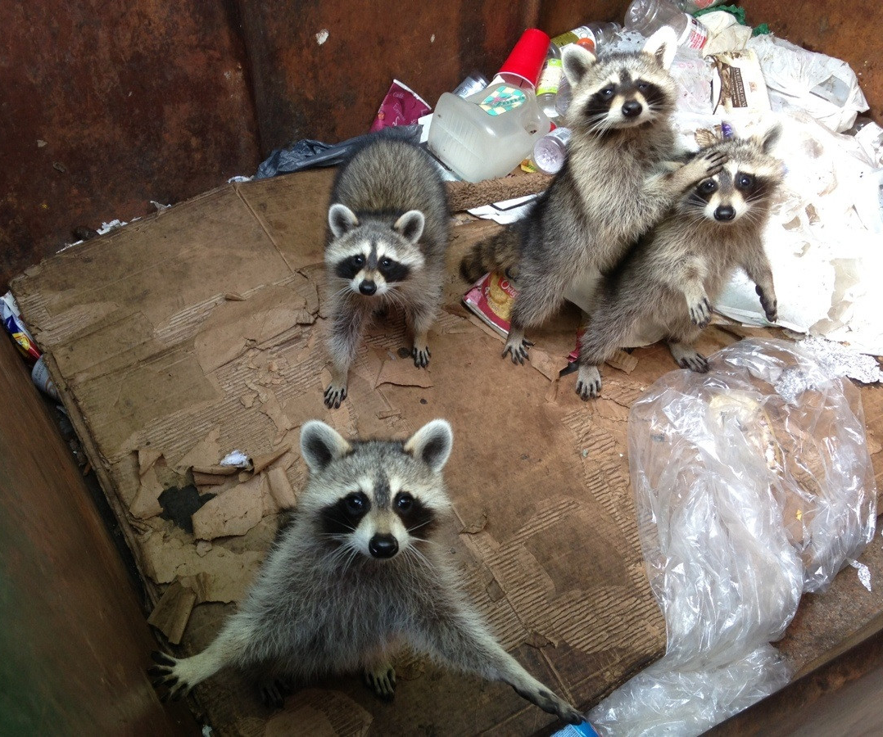
Particularity in the items to be seized
So-called “general warrants,” which permit “a general, exploratory rummaging in a person’s belongings,” are prohibited.
To prevent general, exploratory searches, the Fourth Amendment requires a particular description of the things to be seized.
People v. Coke, 461 P.3d 508 (Colo. 2020)

Slide 14
Probable cause to believe that the items to be seized are in the location to be searched
Commonly referred to as Nexus
Probable cause for a search exists when the affidavit in support of the warrant alleges sufficient facts to cause a person of reasonable caution to believe that contraband or other evidence of criminal activity is located at the place to be searched.
Whether an affidavit satisfies the constitutional standard of probable cause requires analysis of the totality of the circumstances.
Henderson v. People, 879 P.2d 383 (Colo. 1994)
*“Four corners” includes any attachments so long as they are referenced in the affidavit. May suggest language like, “… see attachment 1, which is incorporated by reference into this affidavit”
Fact
Fact
Evidence

Slide 15
Searching Digital Evidence
Probable Cause to Search Device or Account, ie Nexus
Specific Reference to Device
Particularity
Orders to Electronic Service Providers (ESPs)
Devices

Slide 16
Nexus Between Phone and Crime
Victim tells police
She rode around with D and friends
D gave everyone drugs
They went to a party and someone sexually assaulted her
Officer seeks warrant for D’s phone
For evidence of drug and sex crimes
Training and experience: people have evidence on their phones

Slide 17
Nexus Between Phone and Crime
One viewpoint
State v. Moats, 168 A.3d 952 (Md. Ct. App. 2017): The warrant was properly issued. Although the application was “devoid of specific facts linking the crimes and the cell phone,” the court noted the prevalence of cell phones, “the expertise and experience of the affiant police officer,” and the fact that “by definition,” the crime of drug distribution requires at least two participants and communication between them.

Slide 18
How Often Do You Use Your Phone on the Toilet?

Slide 19
Nexus Between Phone and Crime
However:
United States v. Lyles, 910 F.3d 787 (4th Cir. 2018). Police found three marijuana stems and rolling papers in the defendant’s trash can. They obtained a search warrant for the defendant’s house. It authorized the seizure of computers and cell phones among other items. The court ruled that the trash pull did not provide probable cause for a search of the house. It also criticized the breadth of the warrant, stating that “the warrant application lacked any nexus between cell phones and marijuana possession,” and emphasizing the intrusiveness of a cell phone search.

Slide 20
Nexus Between Phone and Crime
Direct evidence that the phone or service was used to commit or to document the crime
Nature of the offense
Whether the offense involved more than one perpetrator (Co-Defendant)
The applicant’s training and experience
Technology habits of the suspect

Slide 21
Probable Cause to Search The Service, ie Nexus
Probable cause supports a search warrant when the affidavit demonstrates “a fair probability that contraband or evidence of a crime will be found in a particular place.” Illinois v. Gates, 462 U.S. 213 (1983)
For the requisite nexus to exist, the affidavit in support of the search warrant must establish why the government believes that relevant evidence may reside on the particular suspect's account.

Slide 22
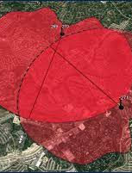
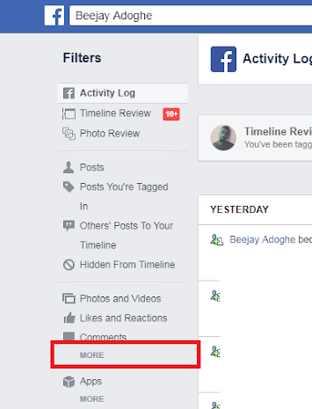
Nexus To The Type and Scope of Data
Not enough just to say a service (Facebook, Snapchat, CDRs) is relevant
Nexus to each type of data
Nexus to the date range of data
Explicitly draw out the reasonable inferences you are asking the court to make

Slide 23
Searching Digital Evidence
Probable Cause to Search Device or Account, ie Nexus
Specific Reference to Device
Particularity
Orders to Electronic Service Providers (ESPs)
Devices

Slide 24
Particularity
Ideas to Consider
Limit the types of data to be searched
Limit the timeline of the data to be search
Communications between specific parties
A search warrant seeking electronically stored information must be limited either to evidence of specific crimes or to specific types of material. U.S. v. Christie, 717 F.3d 1156 (10th Cir. 2013).
The Tenth Circuit cases have turned on whether the examiner employed a reasonable search method when reviewing the data. U.S. v. Loera, 923 F.3d 907 (10th Cir. 2019)
Prove identity of the user: “The government is certainly entitled to search for this information to a reasonable extent; for example, the registered user, email addresses, birth date, telephone number, physical address, and IP addresses associated with the account are likely to show ownership and control of the account.”

Slide 25
Searching Digital Evidence
Probable Cause to Search Device or Account, ie Nexus
Specific Reference to Device
Particularity
Orders to Electronic Service Providers (ESPs)
Devices

Slide 26
Lack of Specific Reference to Devices
Officers suspect D of selling drugs from his home
Officers obtain search warrant
Allows search of home
Includes “ledgers”
Does not refer to devices specifically
Officers seize and search D’s phone and find evidence

Slide 27
Lack of Specific Reference to Devices
United States v. Fulton, 914 F.3d 390 (5th Cir. 2019). A cell phone was properly seized under a warrant that included “ledgers” because a phone may contain “records and documentation of .. . drug activity,” and so is the “functional equivalent” of a ledger.
. . . withdrawn and replaced by 928 F.3d 429 (5th Cir. 2019). “There was nothing in the . . . warrant suggesting that anything similar to computers or even electronics was to be seized. . . . Though a ledger can serve one of the myriad purposes of a cellphone, we do not extend the concept of ‘functional equivalency’ to items so different, particularly one as specific, distinguishable, and anticipatable as a cellphone.”

Slide 28
Searching Digital Evidence
Probable Cause to Search Device or Account, ie Nexus
Specific Reference to Device
Particularity
Orders to Electronic Service Providers (ESPs)
Devices

Slide 29
Orders to ESPs: Non-Disclosure
Stored Communications Act (“SCA”) 18 U.S.C. § 2701-2713
Default Rule: Electronic Service Providers can, and often will, notify an account holder of legal process served on an account
18 U.S.C. § 2705(b) courts may prevent notification “for such period of time as the court deems appropriate” if notification will:
Endanger life of physical safety of an individual
Flight from prosecution
Destruction of or tampering with evidence
Intimidation of potential witnesses
Otherwise seriously jeopardizing an investigation or unduly delay a trial

Slide 30
Orders to ESPs: Preservation Requests
18 U.S.C. § 2703 (f) - Requirement To Preserve Evidence
(1) In general.— A provider of wire or electronic communication services or a remote computing service, upon the request of a governmental entity, shall take all necessary steps to preserve records and other evidence in its possession pending the issuance of a court order or other process.
(2) Period of retention.— Records referred to in paragraph (1) shall be retained for a period of 90 days, which shall be extended for an additional 90-day period upon a renewed request by the governmental entity.
Notes:
ESPs Examples = Facebook, Whatsapp, Instagram, Google, Dropbox, Kik Messenger

Slide 31
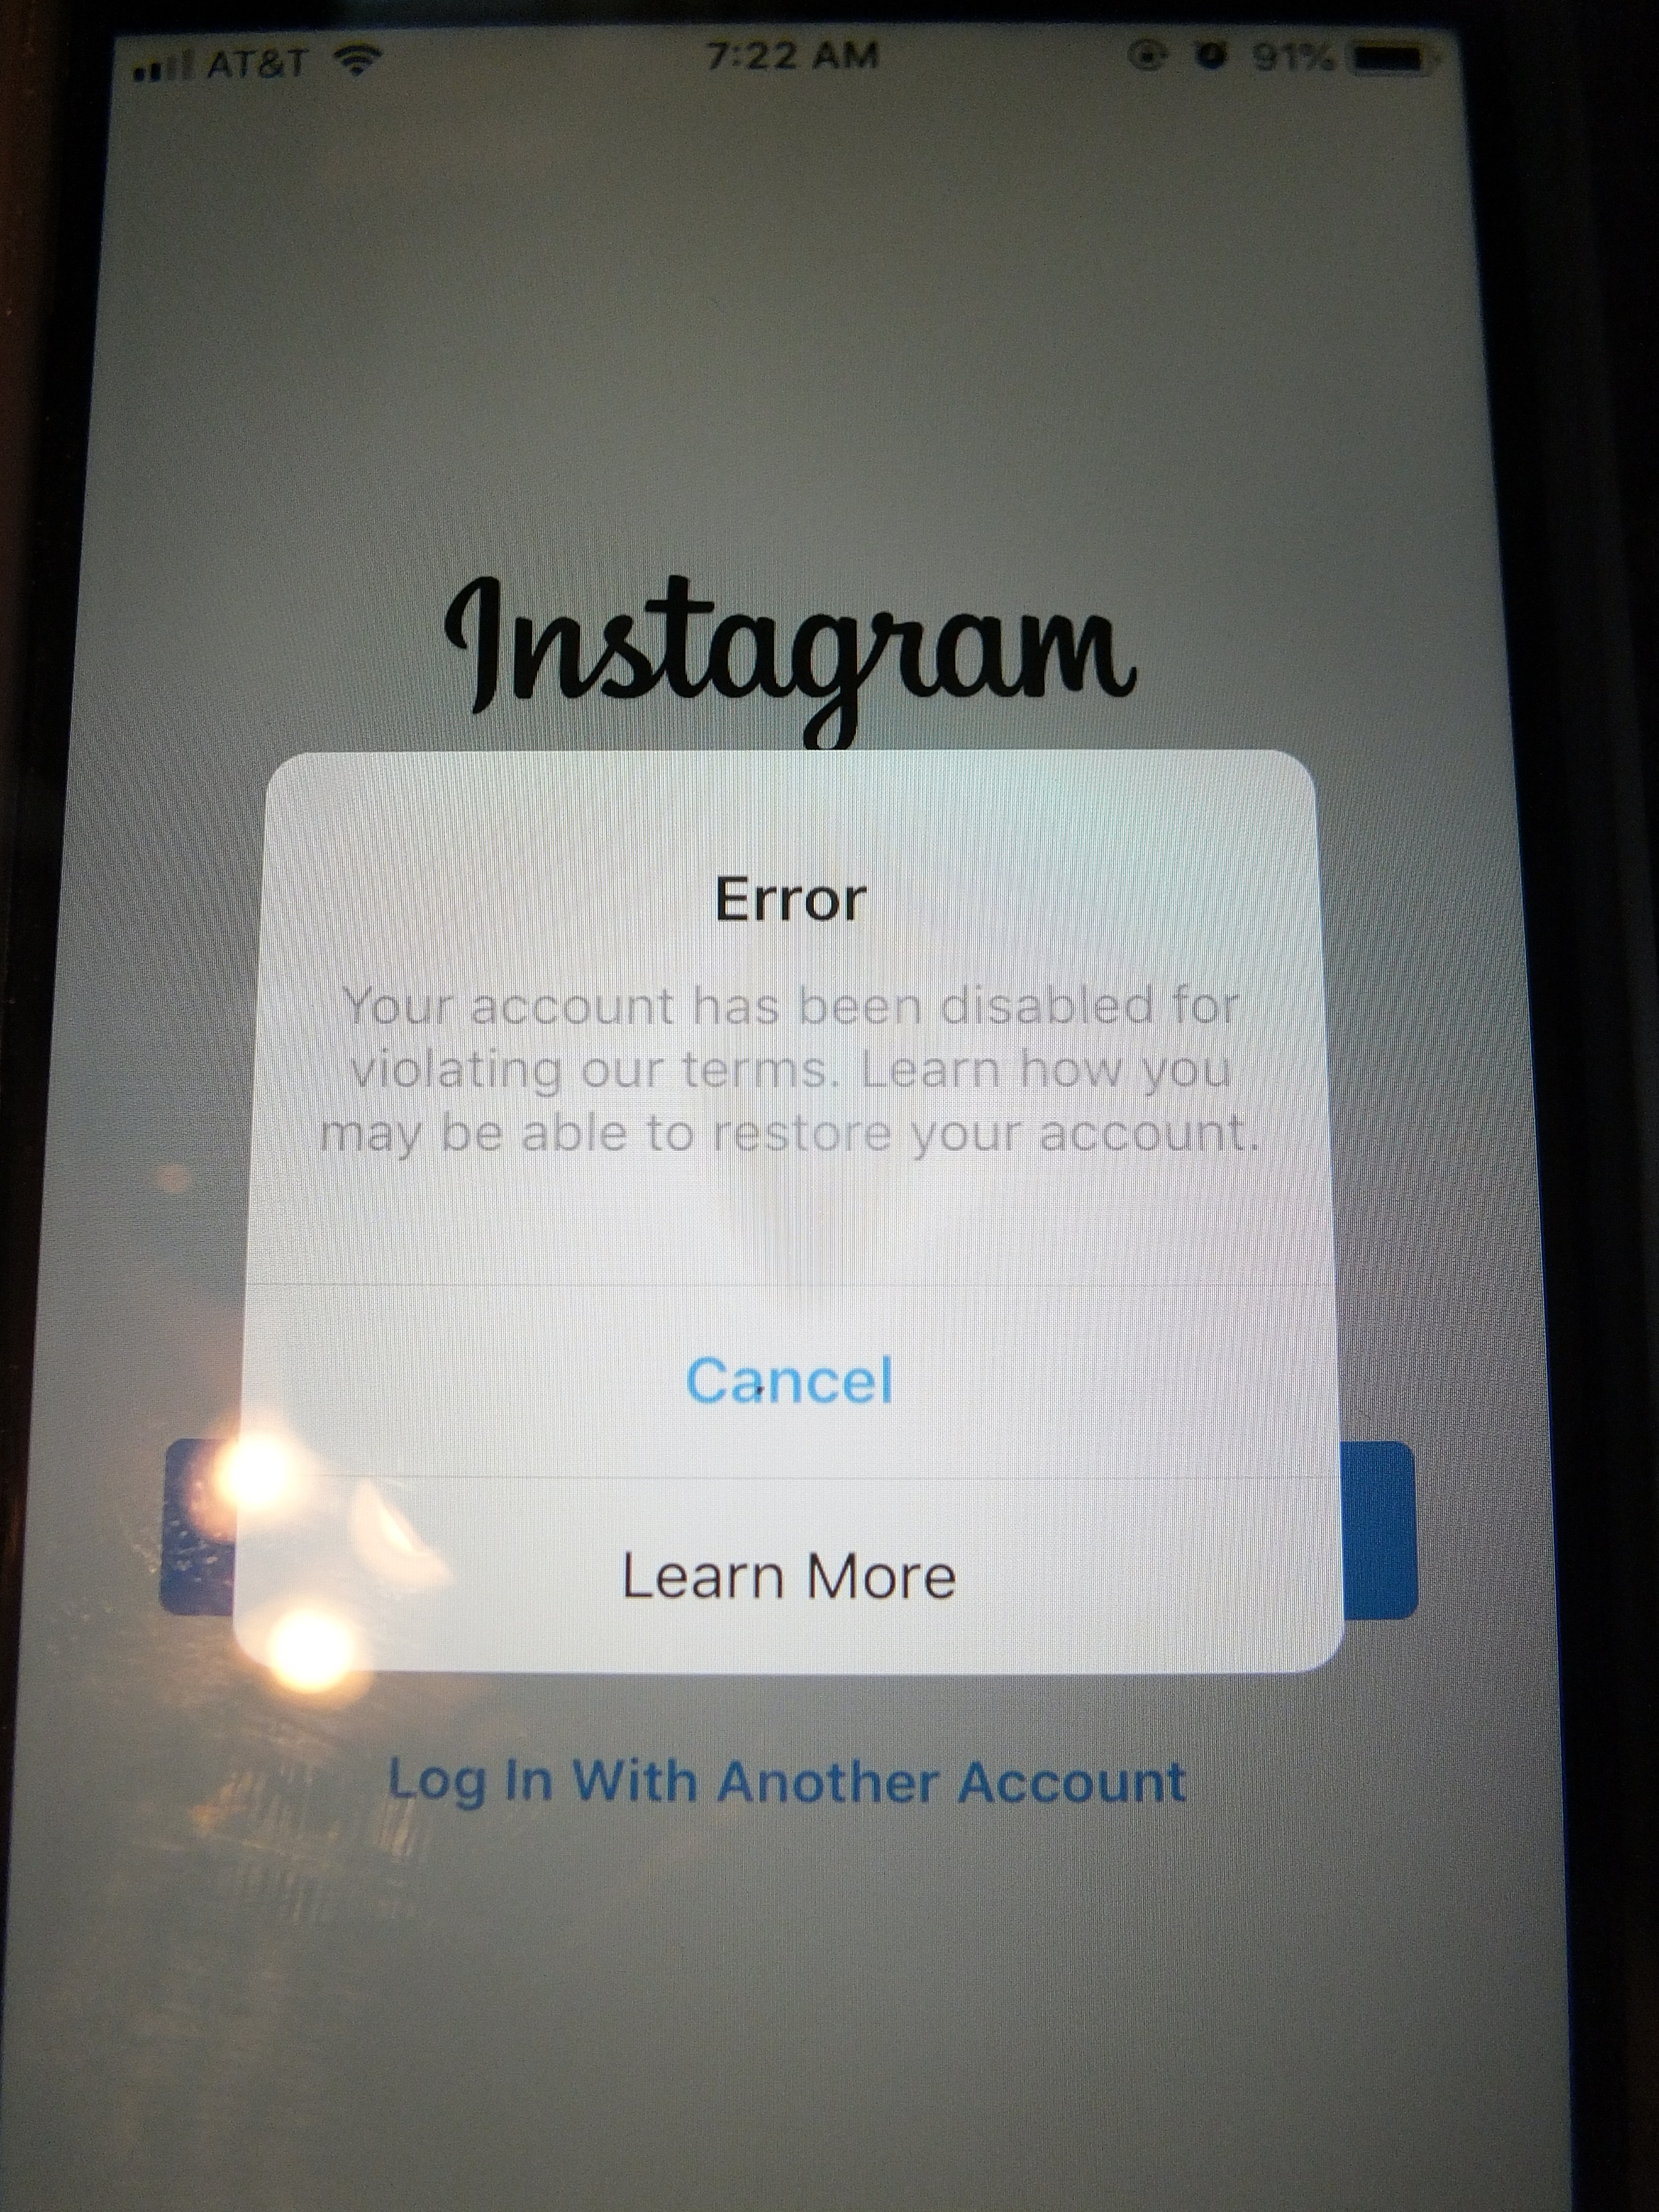
Orders to ESPs: No Adverse Action
Under Crim. P. 41(d)(2) and §16-3-304(2), a court issuing a search warrant can enter “such other and further orders as the judge deems necessary to comply with the provisions of a statute, charter, or ordinance, or to provide for the custody or delivery to the proper officer of any property seized under the warrant, or otherwise to accomplish the purposes of the warrant.”
A similar provision is contained in the production of records statute as well. See §16-3-301.1(4)(b).
Theory: “No adverse action” order is permissible under the above provisions because during an ongoing investigation it is important to maintain the status quo. If the account is closed or disabled, the target will most likely know that he is being looked at and may take efforts to hide or destroy evidence, including delete online data.

Slide 32
Searching Digital Evidence
Probable Cause to Search Device or Account, ie Nexus
Specific Reference to Device
Particularity
Orders to Electronic Service Providers (ESPs)
Devices

Slide 33
Specific Considerations Regarding Devices
Exigent Seizure
Seized the phone, now what
Device in the Warrant?
Plain View or Second Warrant

Slide 34
Hierarchy of Privacy Interest
Cavity Search
*Cell Phone*
Home
Vehicle
Abandoned Property

Slide 35
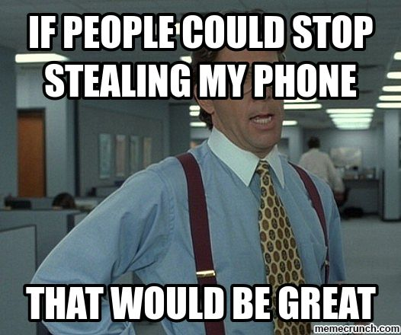
Exigent Seizure of Phones
Warrantless seizure based on probable cause and exigency:
Imminent risk of destruction of evidence
A threat that puts police or public in danger
Hot pursuit of a suspect, or
Suspect likely to flee before police can obtain a warrant
Georgia v. Randolph, 547 U.S. 103 (2006)
*Exigency may justify initial seizure only long enough to get a search warrant
Segura v. U.S. ,468 U.S. 796 (1984)
*General rule of thumb, warrant within 48 hours
Notes:
Examples ???

Slide 36
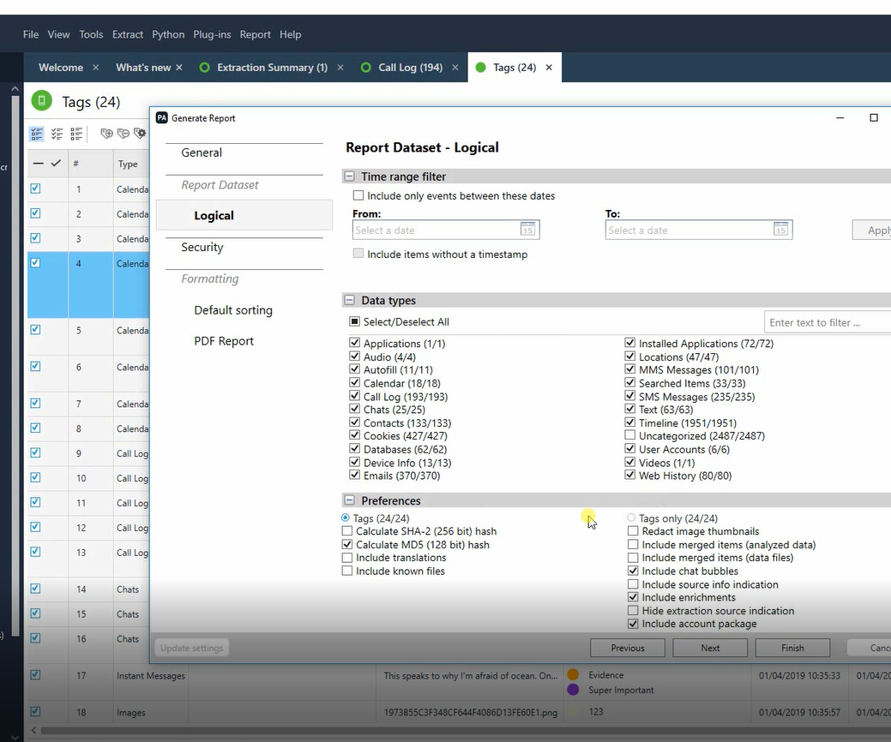
Comply with the Warrant
Received Warrant
Examined Phone
The end product needs to meet what the Court authorized
Does the report match the date range
Does the report match the categories of data
End Question: Has law enforcement reasonably carried out the Court’s Order
Notes:
Examples???

Slide 37
Plain View vs. Second Warrant
Two requirements for applying the plain view exception searches:
(1) the government observes from a lawful position
(2) the incriminating nature of the evidence is immediately apparent
Horton v. CA, 496 U.S. 128 (1990)
In the Digital Realm: During a lawful search of a device for evidence of one crime, police may find in plain view evidence of another crime.
Issue: Must not extend search beyond authorized scope.

Slide 38
Plain View vs. Second Warrant
Search warrant: officers may search D’s computers and media for evidence of fraud
Officer is examining files on a CD and finds child pornography
Officer continues searching for evidence of fraud, and continues to finding more child pornography

Slide 39
Plain View vs. Second Warrant
United States v. Carey, 172 F.3d 1268 (10th Cir. 1999): An officer executing a narcotics search warrant stumbled on child pornography, then spent hours looking for and finding additional 200+ images. The officer’s “suspicions changed” after opening the first illicit image; he “expected to find child pornography and not material related to drugs”; and he “temporarily abandoned” his search for drug evidence while conducting a warrantless search for child pornography. Such a search required a new warrant.
United States v. Loera, 923 F.3d 907 (10th Cir. 2019). “[O]fficers do not have to stop executing a search warrant when they run across evidence outside the warrant’s scope.” Officer A’s continued search was not directed at child pornography but was “reasonably direct[ed] . . . toward evidence specified in the warrant” and was therefore permissible.
Moral of the Story: Get a second warrant!

Slide 40
Process, Process, Process
Law Enforcement Portal
Templates
District Attorney Review
Urgent ?

Slide 41
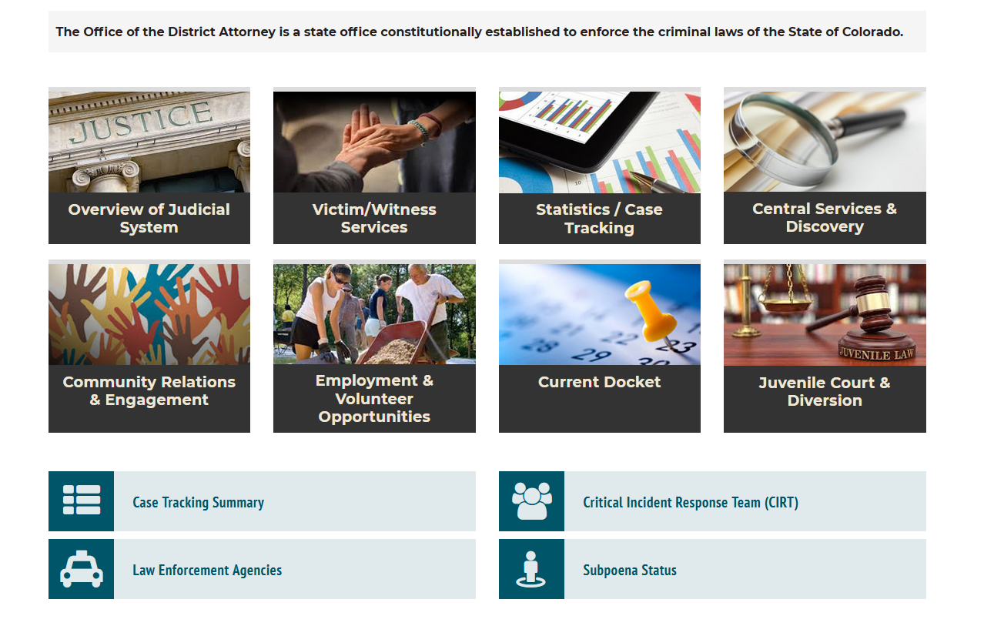
Law Enforcement Portal
https://www.larimer.org/da

Slide 42
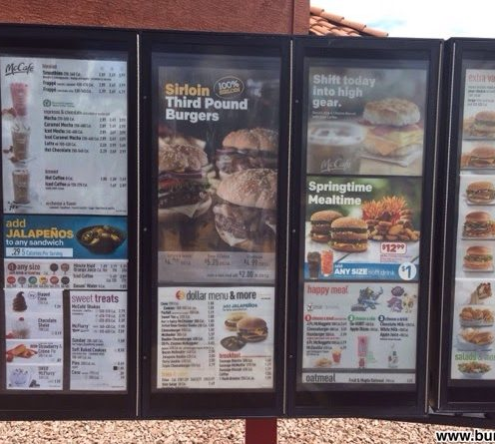
Templates
Provides a framework for drafting a warrant
Kept up to date with proper statutory citations
You are swearing to what is contained in the affidavit, make sure you can do that
Feel free to edit, change and improve

Slide 43
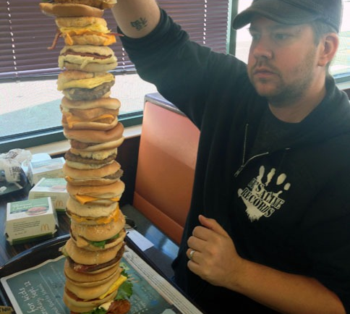
Templates – Avoid This
Don’t just copy and paste everything in the template
Be prepared to defend the list of the requested items
Does the “Four Corners” of the affidavit support the request
Proposed affidavit language should be tailored to your case and training/experience

Slide 44
Templates – Growing and Changing
Don’t feel constrained to the templates in this database
Please keep us advised on what is working and not working
If you attend a training or receive a template or template language, please share
If you have templates that have worked well in the past, pass them along

Slide 45
DA Review Process *Starts July 1, 2021
Non-urgent warrants: Please email warrant to warrants@co.larimer.co.us. Include officer contact info in the body of the email and the DDA assigned that day to warrant review will review the warrant and then reach out.
Urgent warrants during business hours (8am-5pm): Still email warrant to warrants@co.larimer.co.us and include officer contact info in the body of the email. Mark subject line with "URGENT" and state reason for urgency in body. Call DA Front Desk (970 498 7200) and ask to be connected to a DDA assigned to warrant review.
Urgent warrants after hours (5pm-8am): Please call the normal DA On Call Phone (970 214 5500).
Special circumstances: If a detective is already working with a specific DDA on a case (ie. a sex assault) or a DDA has already been called out (ie. a homicide), continuing working with those DDAs as practicable. Given timing and workload, that DDA may need to refer officers through the normal process.

Slide 46
DA Review Process
Submit Warrant
Day Urgent Warrants: warrants@co.larimer.co.us
Night Non-Urgent Warrants: warrants@co.larimer.co.us
Confer
DA will review warrant
Call or Email, discuss changes or edit
Final Approval
DA must review final draft
Night Urgent Warrants: Contact On Call DA
Inform DA, if warrant has previous been submitted
Advise Court of DA review
Final affidavit language, 1) is accurate and within officer’s knowledge and 2) officer can defend if they are ever examined in court.
Aftermath
Let DA know what happens
If rejected, contact DA to discuss changes
If rejected, let DA know what comments the Judge made
Blood Draw Warrants (N/A)

Slide 47
Urgent or Not Urgent, That is the Question
Urgent = Ready to take immediate action once the warrant is signed
Not Urgent – My shift is about to end, and I want it signed before I go home
Not Urgent – My sergeant told me to get this done last week and I want him to stop yelling at me
Not Urgent – Domestic Violence on its own
Notes:
Social media or cloud storage almost never urgent, send a preservation request

Slide 48
The Ultimate Goal
Not to just convince a Judge/Magistrate to sign it
Have a Judge uphold it when it matters in Court and on appeal

Slide 49
Common Issues
Search Items in Warrant match list in Affidavit
Affidavit points to each category of items requests
Avoid conclusionary statements
I know this telephone number belongs to so and so
Image qualifies as exploitative
The affidavit needs to contain enough so that the Court can make their own independent evaluation
Be careful of copy and paste
Does it make sense to someone that is not involved in the investigation

Slide 50
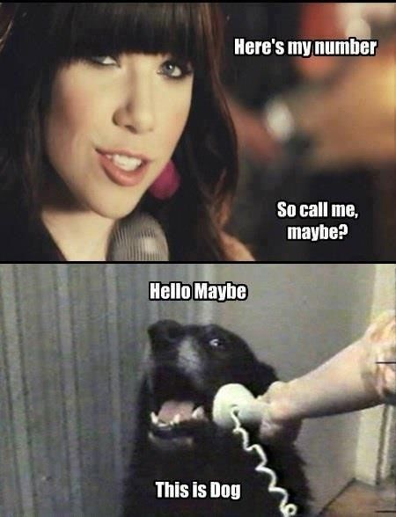
On Call DA
Homicides
Child fatalities and SBI
Motor Vehicle fatality with potential of charges
After hours warrant review
*Except arrest or blood draw
After hours officer questions

Slide 51
Vertical Filing
All Warrantless Arrest
*Starting June 7, 2021
Contact DA’s Office
Provide Contact Information and Availability
DDA will contact you to screen/file case

Slide 52
Sealing Court Documents (Crim. P. 55.1)
Arrest Warrant Language
Search Warrant Language
Order to seal is needed to serve the substantial interests of avoiding 1) the possibility of flight 2) security risks to arresting officers or named witnesses, and 3) any possible tampering or intimidation of named witnesses.
Such limited public access constitutes the least restrictive means existing to protect the substantial interests above, and public access to the records will be restored without undue delay.
The substantial interests override the presumptive public access to the records for the above reasons.
Sealed until a date or event certain

Slide 53
Contact Information
DDA Brian Hardouin – Filing / Warrant Review
Email: warrants@co.larimer.co.us
Email: hardoubj@co.larimer.co.us
Office: (970) 498-7222
Cell: (303) 547-4665

Slide 54
