Slide 1
LARIMER COUNTY BUDGET
Larimer County 101
March 22, 2018

Slide 2
CONTENTS
What does the Budget Office Do?
What is the Budget?
How is the Budget Developed?
What Funds the County Budget?
Where does Your Tax Money Go?
What did You Think the County Budget Should Fund?
What does the County Budget Actually Fund?
Questions?

Slide 3
What does the Budget Office Do?
Develop the Annual Budget
Advise BOCC on Budget Targets
Review Budget Requests
Assist County Manager in developing Proposed Budget
Assist BOCC in Adopting Budget

Slide 4
What does the Budget Office Do?
Monitor the County’s Finances
Review Last Year
Monitor, Amend and Project the Current Year
Project Future Years

Slide 5
What is the Budget?
It’s a lot of Numbers:
The County will receive about $486 million in 2018:
The County will spend about $486 million in 2017:
Outside Revenues | $334 million
Internal Revenues | $152 million
Direct Services | $258 million
Internal Charges & Non-Operational Accounts | $96 million
Disaster Recovery | $45 million
Capital Projects | $87 million

Slide 6
What is the Budget?
Those Numbers:
Show how much money (resources) are available to spend
Set limits on how much money may be spent
Allow for employees to be hired
Show how much a service or a program costs
Cover a Calendar Year

Slide 7
What is the Budget?
The Budget is also a Statement of Priorities
On what MUST the money be spent?
On what CAN the money be spent?
On what will the money NOT be spent?
Who will pay?
How much will they pay?

Slide 8
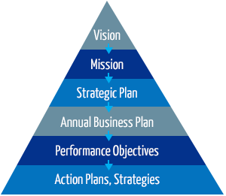
What is the Budget?
The Budget is also a Business Plan
What results are we purchasing?
How much service will be provided
How well will the service be provided?
How will this impact the community?
Does this advance our Strategic Plan?

Slide 9
How is the Budget Developed?
April: SWOT Analysis, 5 & 20 Year Projection
May: Develop County Support (General Fund) Targets
July: Compensation Determined
End of August: Elected Offices & Divisions Turn in Requests

Slide 10
How is the Budget Developed?
September & October: Review Budget Requests
October 15: County Manager Proposed Budget due to BOCC
Early December: Assessor Certifies Taxable Values
By December 22: BOCC Adopts Budget & Certifies Mill Levies

Slide 11
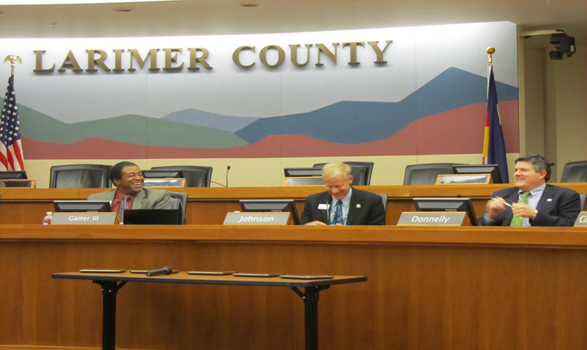
How is the Budget Developed?
Federal & State Mandates
Voter Approvals/ Expectations
Economics, Projections & Plans
Department Requests

Slide 12
What Funds the County Budget?
Four Primary Sources:
Larimer County and Visiting Taxpayers
The State of Colorado or the Federal Government
People who Use our Services
The County Itself

Slide 13
What Funds the County Budget? 2018 Revenues by Category (in millions)

Slide 14
What Funds the County Budget?
Property Taxes – 25% of the County’s Revenue
Governed mainly by TABOR and Gallagher Amendment
Gallagher Amendment: Requires that property taxes on residential property not exceed 45% of total Statewide
Residential Property taxed at 7.2% of value (RAR), all others 29%

Slide 15
What Funds the County Budget?
Budget Year | RAR | County Mill Levy
1990 | 15.0% | 18.974
1995 | 10.4% | 21.571
2000 | 9.7% | 21.571
2005 | 8.0% | 21.571
2010 | 8.0% | 21.571
2017 | 8.0% | 21.571
2018 | 7.2% | 21.571
2020 | 6.1%* | 21.571
* = To Be Determined; final rate proposed by April 2019

Slide 16
What Funds the County Budget?

Slide 17
Where Does Your Tax Money Go?
Larimer County Receives About 25%* of your Property Taxes
Larimer County Receives About 7%* of your Sales Taxes
* = City of Fort Collins, Poudre School District
* = City of Fort Collins

Slide 18
What did You Think the Budget Should Fund?
Service Category | Group Low | Group High | Group Average
Public Safety | $0 | $100 | $27
Community Planning, Resources & Infrastructure | $0 | $60 | $24
Human & Economic Health | $0 | $100 | $24
Public Records & Information | $0 | $23 | $12
Strategic Leadership & Administrative Services | $0 | $20 | $13

Slide 19
What does the County Budget Actually Fund?
Service Category | Group Low | Group High | Group Average | Real Amount
Public Safety | $0 | $100 | $27 | $28
Community Planning, Resources & Infrastructure | $0 | $60 | $24 | $21
Human & Economic Health | $0 | $100 | $24 | $28
Public Records & Information | $0 | $23 | $12 | $6
Strategic Leadership & Administrative Services | $0 | $20 | $13 | $12

Slide 20
What does the County Budget Actually Fund?? 2018 Expenditures by Service Category (in millions)

Slide 21
What does the County Budget Actually Fund? 2018 Expenditures by Type(in millions)

Slide 22
Questions?
Thank You!

