Slide 1
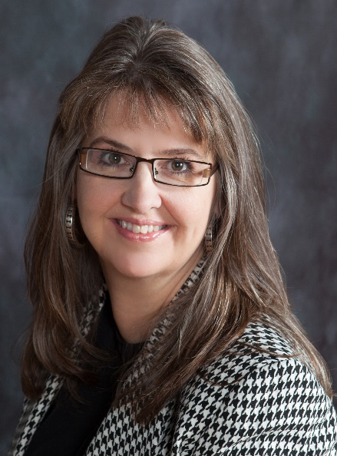


Angela Myers
Larimer County: clerk & recorder
Larimer county 101
APRIL 19, 2018

Slide 2


Lc101 – ANGELA MYERS, clerk & recorder
RECORDING
Record and Go!
EASY ACCESS
  E-Certification
  www.larimer.org/easyaccess
  Direct Poll

Slide 3

Lc101 – ANGELA MYERS, clerk & recorder
ElECTIONS
Primary Election – Important Dates
  May 29th Last day to change/withdraw party affiliation
  June 4th Ballots mailed this week
  June 18th Voter Service and Polling Centers (VSPCs) Open
  June 18th Last day to register to vote and receive a ballot by mail
  June 26th Polls open 7am – 7pm
  Unaffiliated Voters
    FAQs
    Mail Ballot Packets
    Voting Your Ballot
    DIRECT POLL

Slide 4
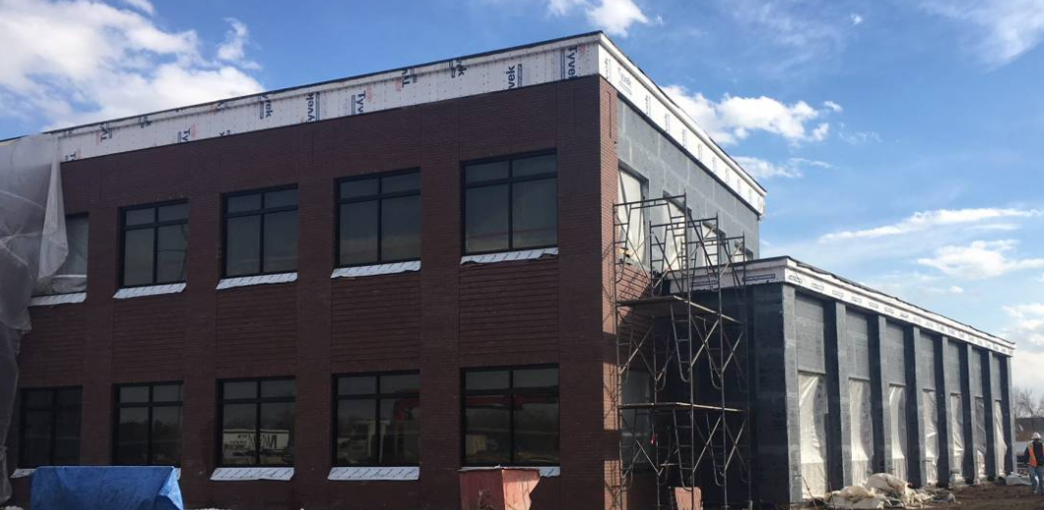
Lc101 – ANGELA MYERS, clerk & recorder
VEHICLE LICENSING
LARIMER COUNTY LOVELAND CAMPUS
System Upgrades – DRIVES
  Conversion – August 1-3
  Reduced Wait Times
  Up to the Minute Information
  E-Services
  Cross-County Kiosk
  Loveland Facility
    DIRECT POLL
200 Peridot Ave - NW Corner of East 1st St & Denver

Slide 5

Angela Myers
Larimer County: clerk & recorder
Larimer county 101
APRIL 19, 2018

