Slide 2

mission
“The Natural Resources Department manages Larimer County's great outdoor places, including open spaces and water-based recreation areas, and fosters responsible land stewardship through weed management and healthy forest practices.”
Notes:
Mission provides good overview of department
Seal embodies mission – “Excellence in Conservation and Recreation Since 1954”
Department founded in 1954 to manage recreation on reservoirs created by Colorado-Big Thompson Project, resulting in 4 reservoir parks

Slide 3
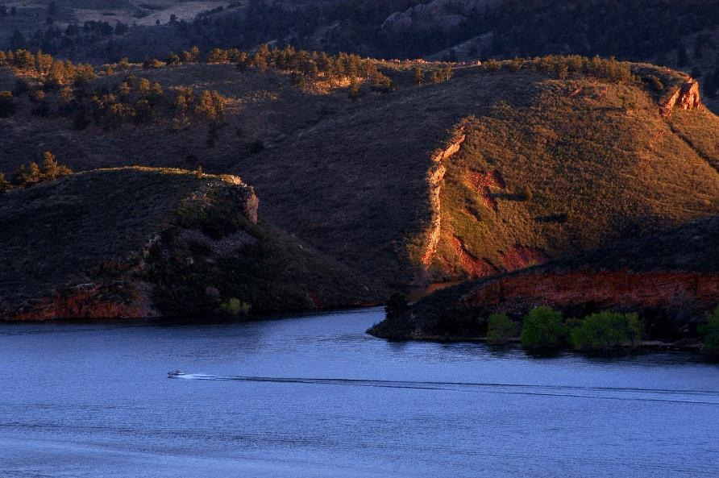
Department by the numbers
4 reservoir parks
Horsetooth, Carter Lake, Flatiron and Pinewood
Notes:
Department manages parks at 4 C-BT reservoirs: Horsetooth, Carter Lake, Flatiron and Pinewood
Additional County Parks created over last 60-plus years, with several in Big Thompson Canyon, as well as Bingham Hill Park north of Horsetooth

Slide 4
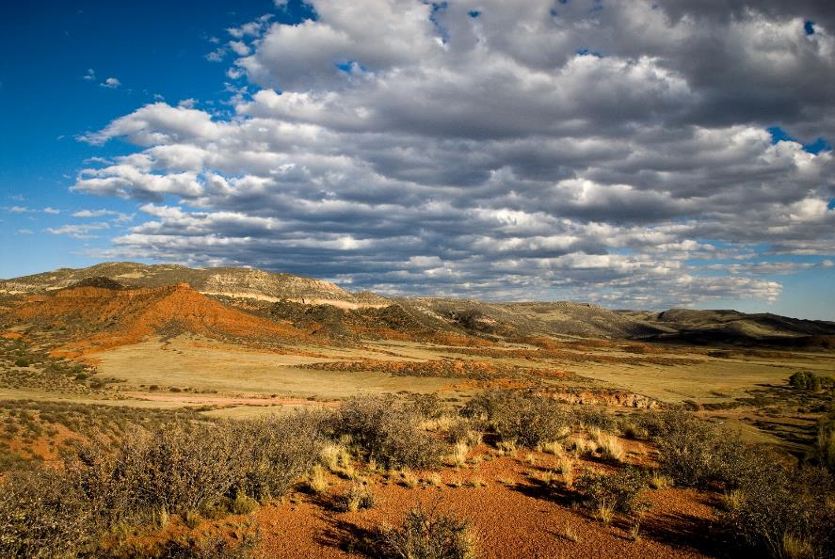
Department by the numbers
13 open spaces, from prairies to mountains
10 open spaces currently open to public
Notes:
Open Space acquisitions began in 1982 with HTMOS and then again in 1996 as a result of the Help Preserve Open Spaces sales tax
Department has acquired 13 open spaces over last 20-plus years, using open spaces tax funds, partnerships and grants across all areas of Larimer County
10 open spaces currently open to public
Department manages parks and open spaces for conservation and recreation

Slide 5
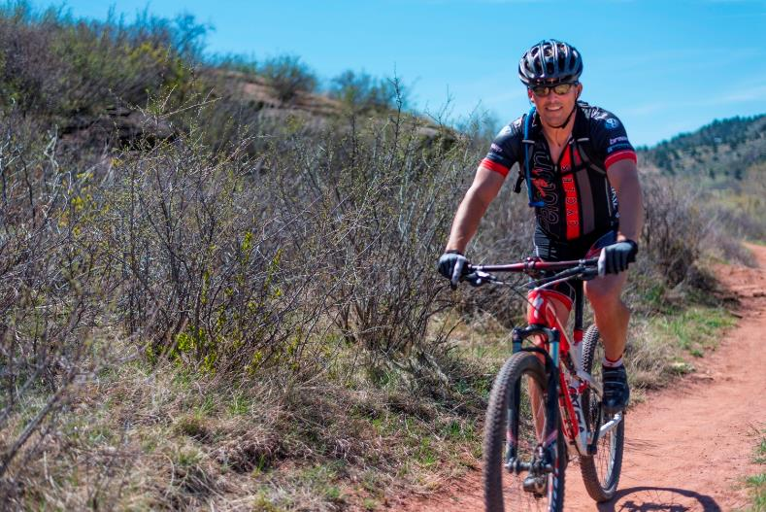
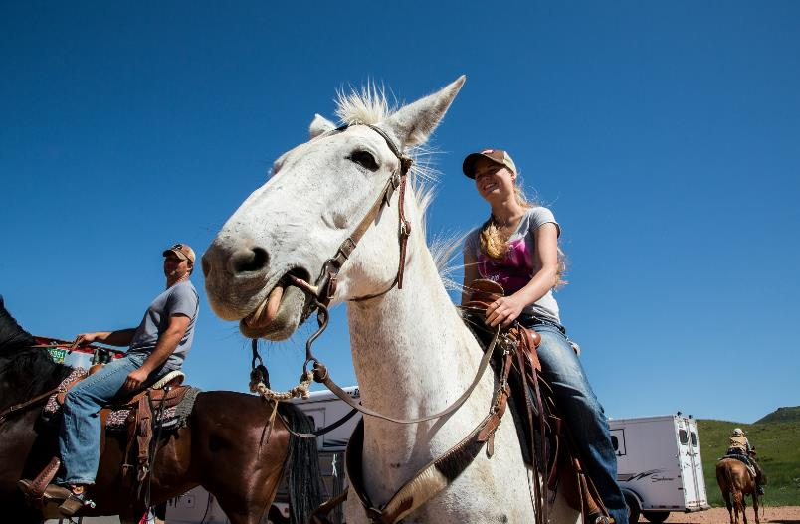
Department by the numbers
95+ miles of natural surface trails
Regional trail connection along the Poudre River and between Fort Collins and Loveland
Notes:
Extensive network of trails (95-plus miles and growing) exists on parks and open spaces
Department also develops and manages regional paved trails on open spaces and unincorporated parts of Larimer County
Pleasant Valley Trail at Lions Open Space and Poudre River Trail at River Bluffs Open Space

Slide 6
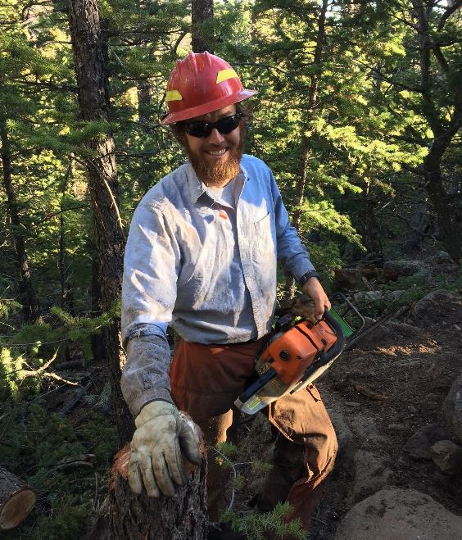
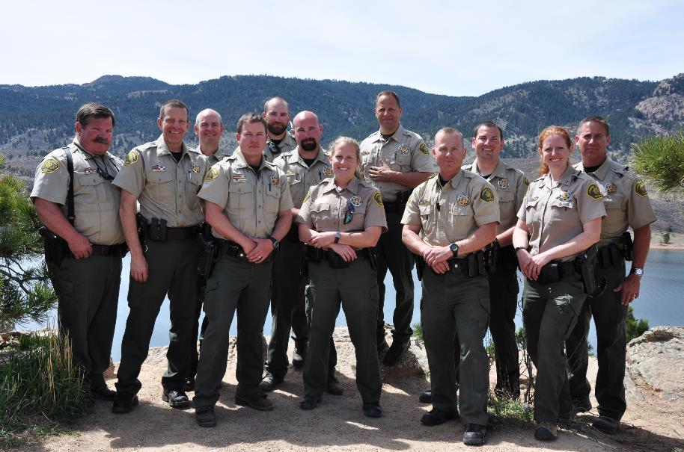
Department by the numbers
46 staff members year-round
150 seasonal staff from spring to fall
Notes:
Dedicated staff of 46 makes it all happen!
Rangers, resource managers, ecologists, accountants, educators, reservations specialists, maintenance workers and more!
Overall staffing grows to over 150 from spring to fall, during peak season for recreation
Trail crew, weeds crew, rangers, maintenance, visitor services support, ANS inspectors and more!

Slide 7
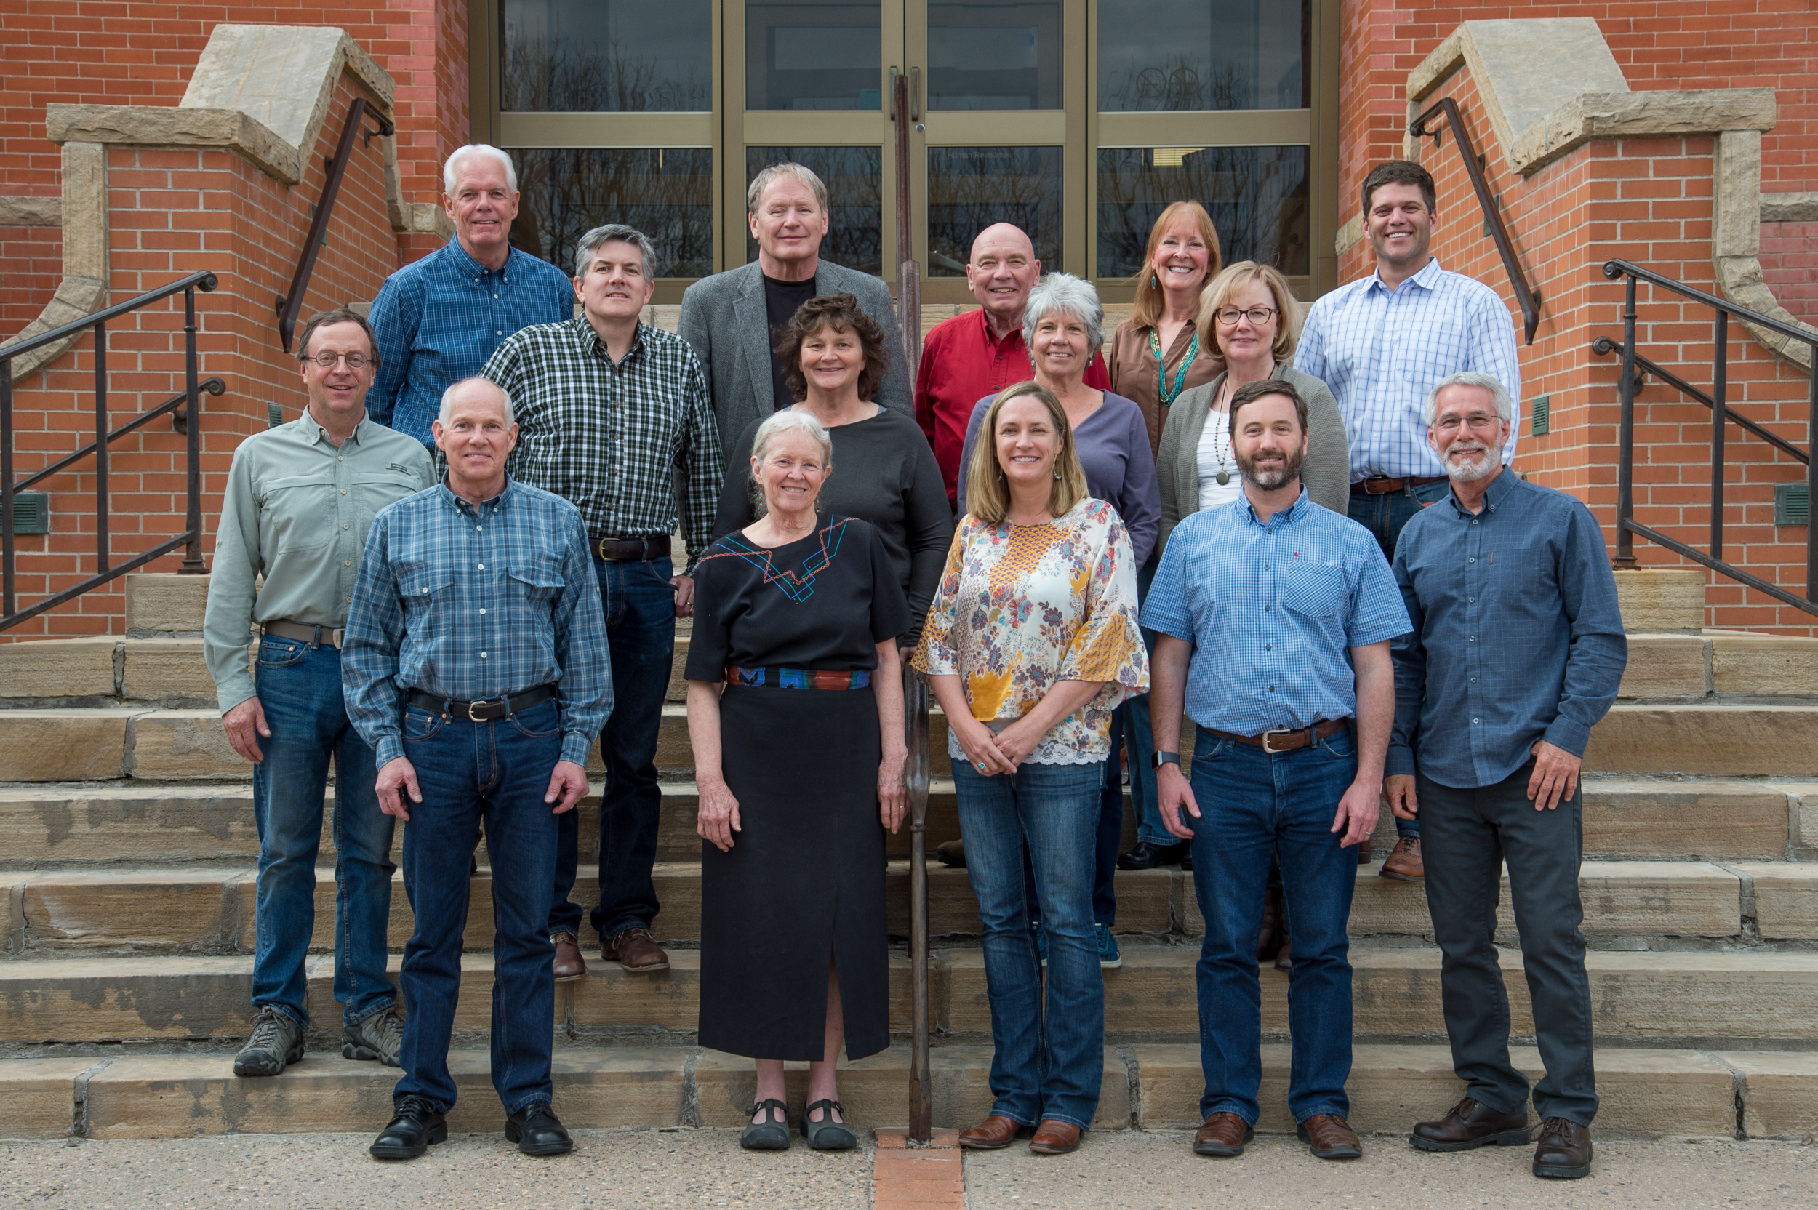
Department by the numbers
3 citizen advisory boards
Open Lands, Parks and Land Stewardship
Notes:
Citizens play a big role in helping department make decisions through 3 citizen advisory boards: open lands, parks and land stewardship

Slide 8
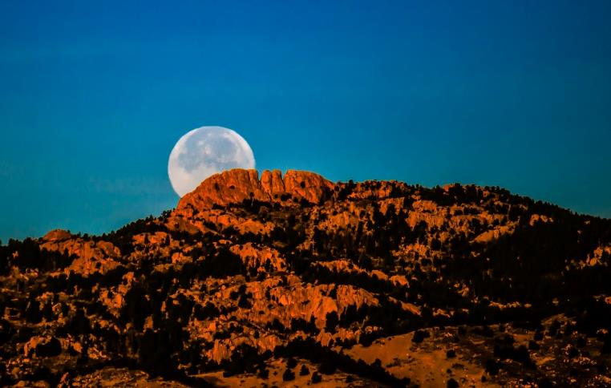
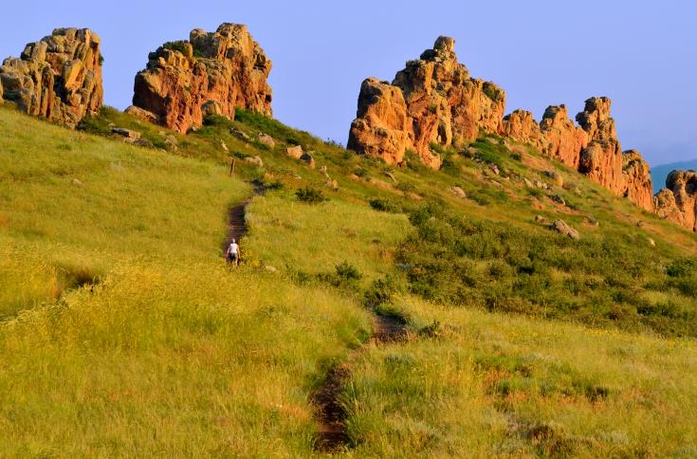
Diverse parks & open spaces
Iconic Landmarks
Horsetooth Mountain Open Space
Devil’s Backbone Open Space
Notes:
Today, the Department of Natural Resources manages a diverse group of parks, open spaces and trails across Larimer County
Department manages several iconic geographic landmarks:
Horsetooth Rock at Horsetooth Mountain Open Space west of Fort Collins
Devil’s Backbone at Devil’s Backbone Open Space west of Loveland

Slide 9
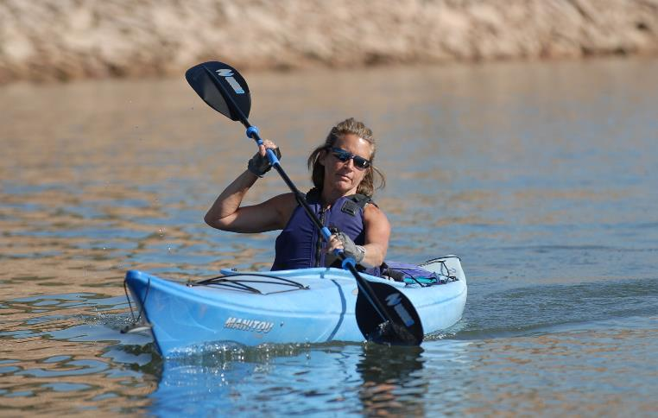
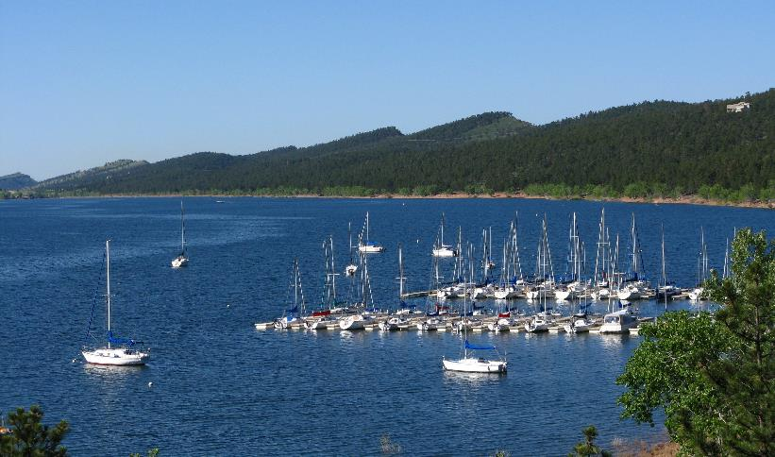
Diverse parks & open spaces
Reservoirs
Horsetooth Reservoir
Carter Lake
Notes:
Department manages 4 reservoir parks for water-based and other forms of recreation:
Horsetooth Reservoir west of Fort Collins
Carter Lake west of Berthoud

Slide 10
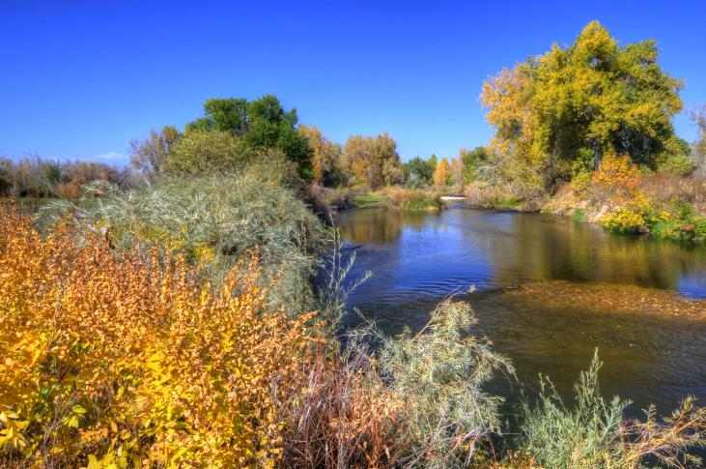
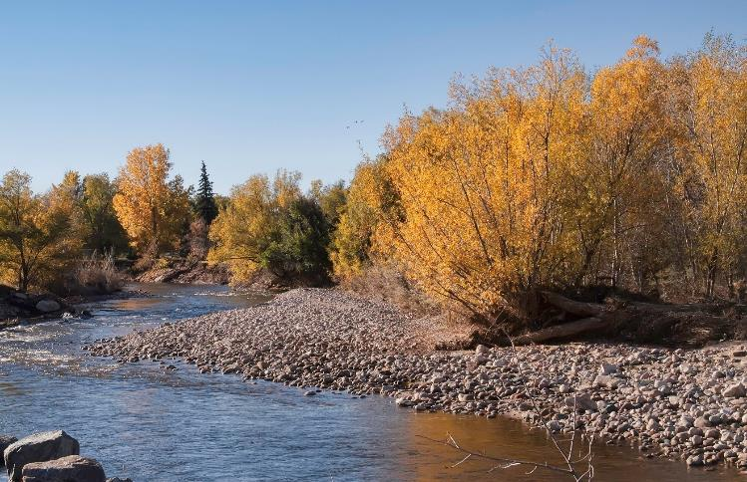
Diverse parks & open spaces
Rivers
River Bluffs Open Space
Lions Open Space
Notes:
Department manages open spaces along the Cache la Poudre River and several parks along the Big Thompson River:
River Bluffs Open Space near Windsor
Lions Open Space near Laporte

Slide 11
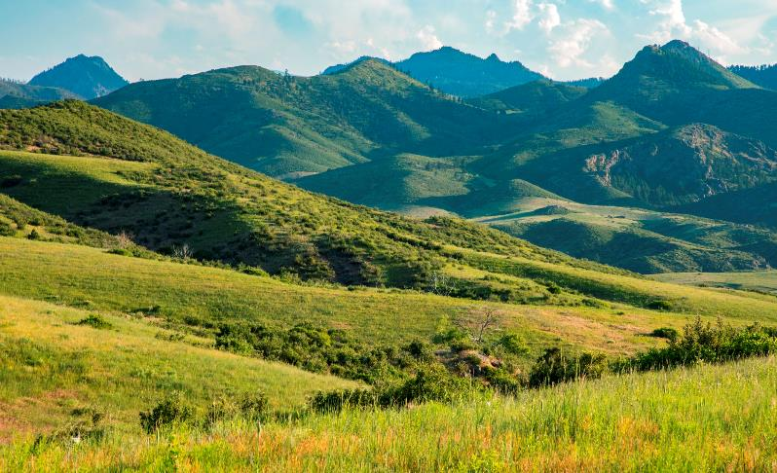
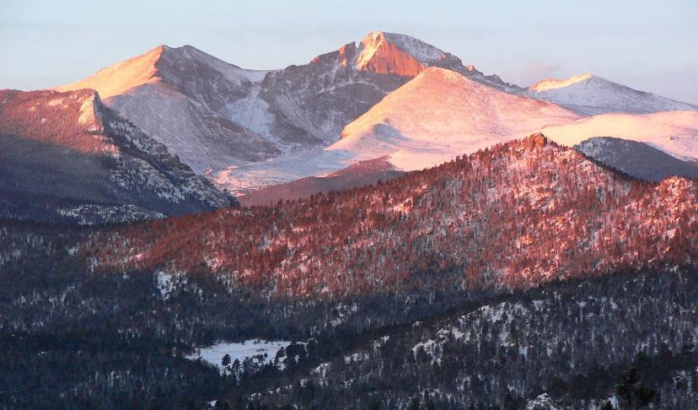
Diverse parks & open spaces
Foothills and Mountains
Eagle’s Nest Open Space
Hermit Park Open Space
Notes:
Department manages several open spaces in the mountains of Larimer County:
Eagle’s Nest Open Space near Livermore
Hermit Park Open Space near Estes Park

Slide 12
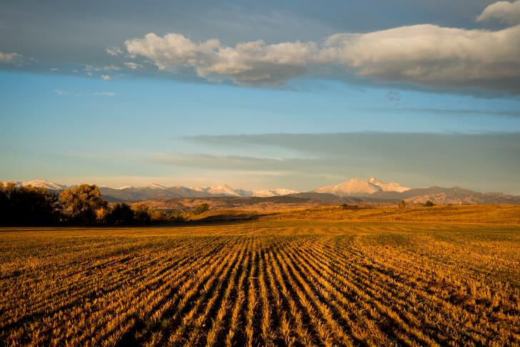
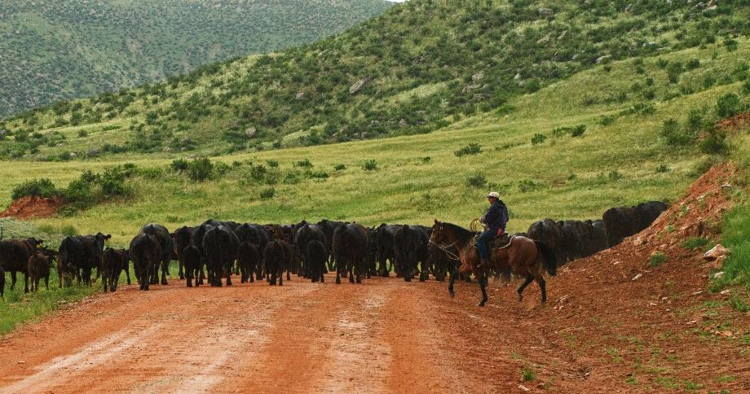
Diverse parks & open spaces
Agricultural Land
Little Thompson Farm Open Space
Red Mountain Open Space
Notes:
Department manages open spaces to support farming and ranching in Larimer County, along with recreation and conservation of other resources:
Little Thompson Farm Open Space south of Berthoud
Red Mountain Open Space near Colorado-Wyoming border
Cattle grazing takes place alongside recreation

Slide 13
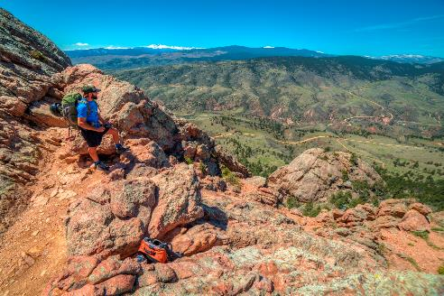
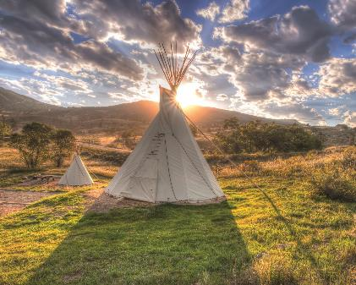
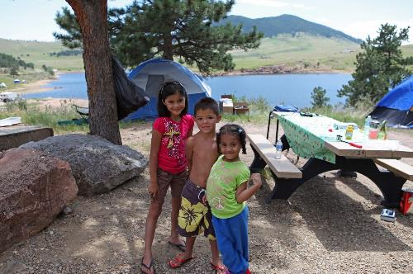
Lots to do outdoors!
On Land
Hiking, Biking, Horseback Riding, Rock Climbing, Birding, Picnicking, Hunting
Tents, RVs, Cabins and Tipis
Notes:
Parks and open spaces offer lots to do outdoors!
On land: Hiking, Biking, Horseback Riding, Rock Climbing, Birding, Picnicking, Hunting

Slide 14
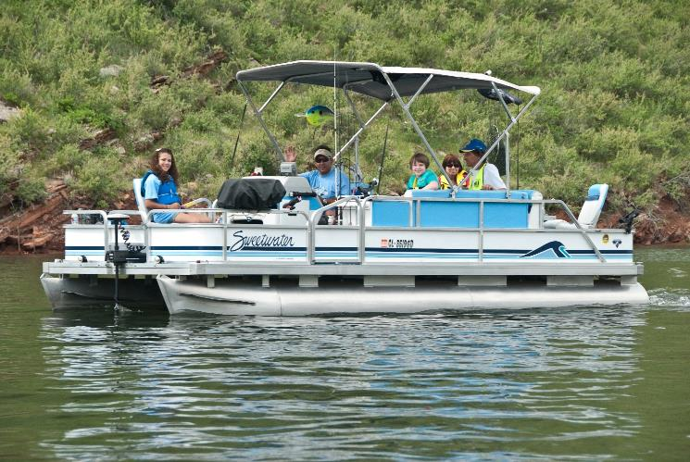
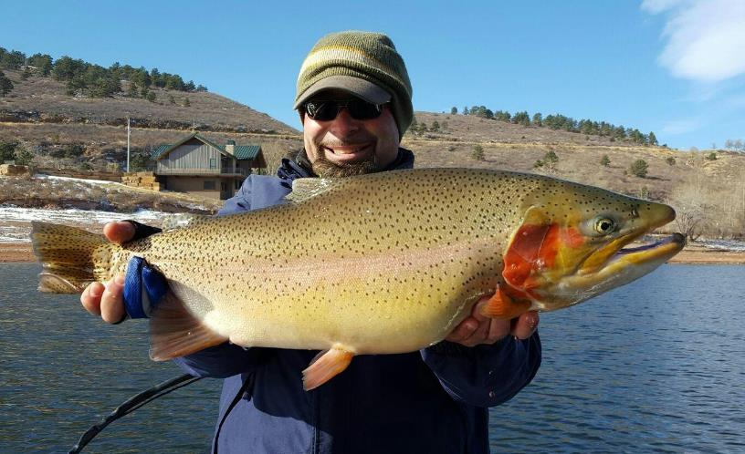
Lots to do outdoors!
On Water
Boating, Water Skiing, Fishing, Paddleboarding, Swimming, Scuba Diving
Notes:
On the water: Boating, Water Skiing, Fishing, Paddleboarding, Swimming, Scuba Diving

Slide 15
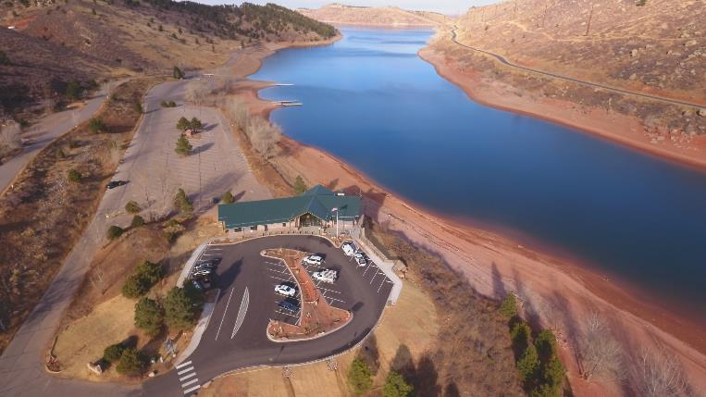
Department offices
Offices Across Larimer County
Administrative Offices
Horsetooth Area Information Center
Hermit Park Office
Weed/Forestry Office
Notes:
Four main offices where public can visit:
Administrative Offices in Loveland area
Horsetooth Area Information Center in Fort Collins area
Hermit Park Office in Estes Park area
Weed District Office in Fort Collins area
Other smaller offices exist

Slide 16
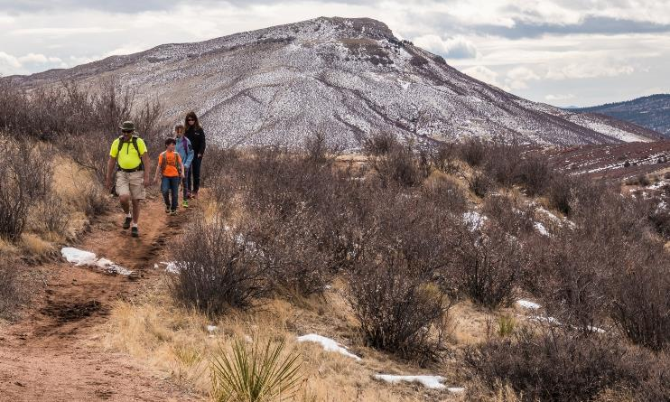
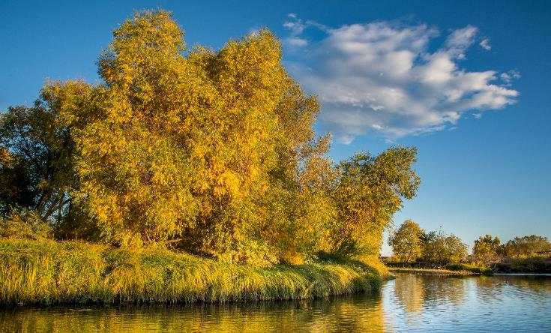
Land acquisitions
Acquire land through fee simple purchases and conservation easements
50,000+ acres conserved since 1996
Red Mountain Open Space (fee simple)
3 Bell (conservation easement)
Notes:
Open Lands Program uses open spaces tax funds and other funding sources to acquire land through:
Fee simple purchases (County owns land and associated rights)
Conservation easement (County owns development rights)
More than 50,000 acres conserved since 1996

Slide 17
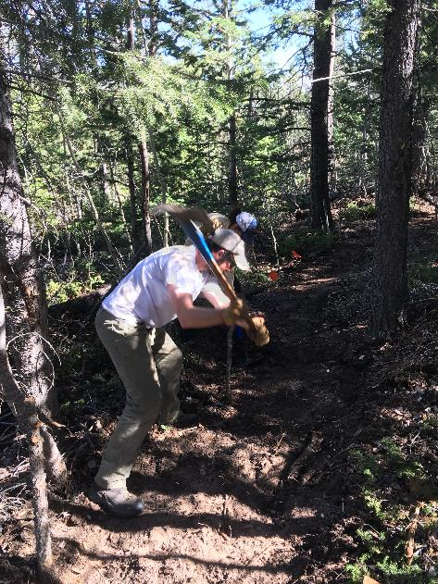
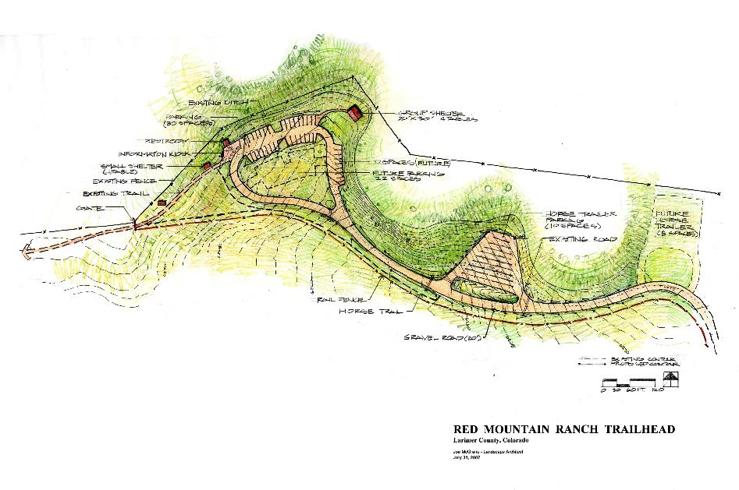
Planning & Resource management
Oversee development of department master & property management plans
Trail construction and maintenance
Conservation easement monitoring
Notes:
Resource Management Program oversees planning, development and land stewardship
Writes and implements management plans for parks and open spaces
Coordinates regional trail development
Builds and maintains natural surface trails
Manage vegetation, wildlife and cultural resource values

Slide 18
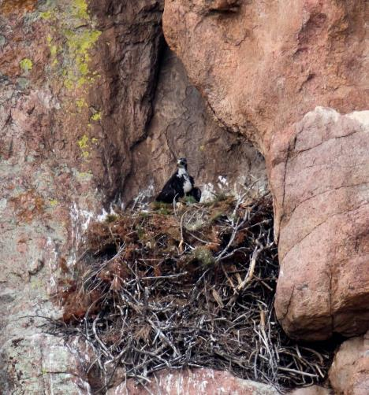
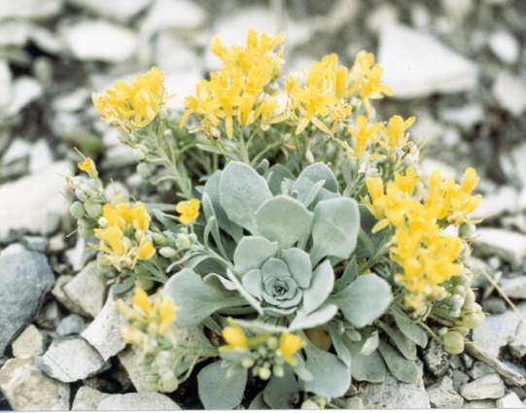
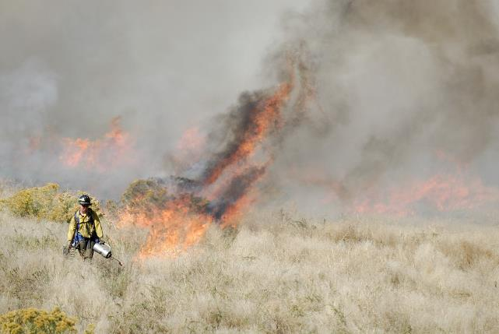
Resource management
Vegetation (restoration, rare plants) & wildlife management
Cultural resource management
Notes:
Manage vegetation, wildlife and cultural resource values

Slide 19
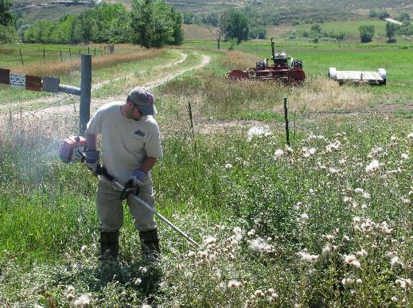
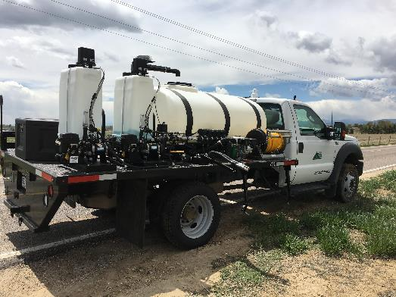
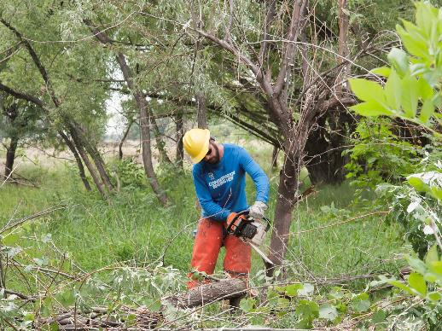
Resource management
County-wide Weed and Forestry Programs
Assist landowners with weed & forest management
Enforce Colorado Noxious Weed & Forest Pest acts
Notes:
Weed District is part of Land Stewardship and overall Resource management program. The Weed District:
Assists landowners with noxious weed problems
Manages weeds on County lands
Promotes weed education and awareness
Enforces Colorado Noxious Weed Act

Slide 20
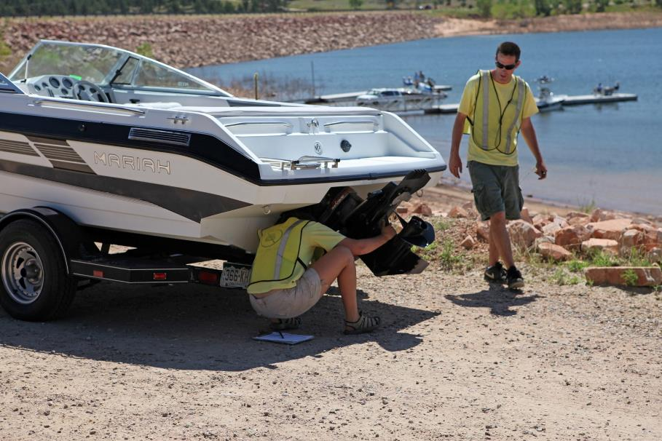
Visitor services
Oversees operations of parks and open spaces
Ranger & Maintenance Staff
Notes:
Visitor Services Program oversees park and open space operations:
Manages campground reservations
Collects park, permit and camping revenue
Maintains facilities and grounds
Coordinates Aquatic Nuisance Species program
Protects safety of park visitors

Slide 21
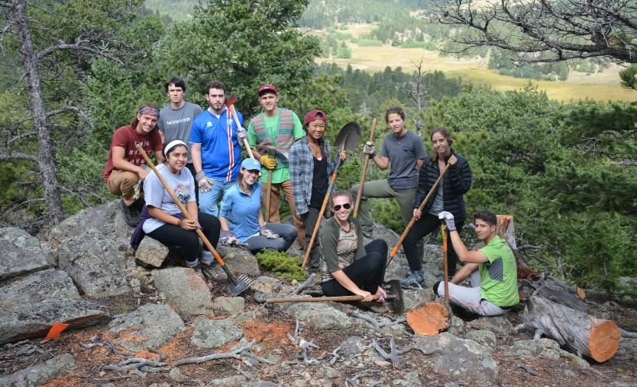
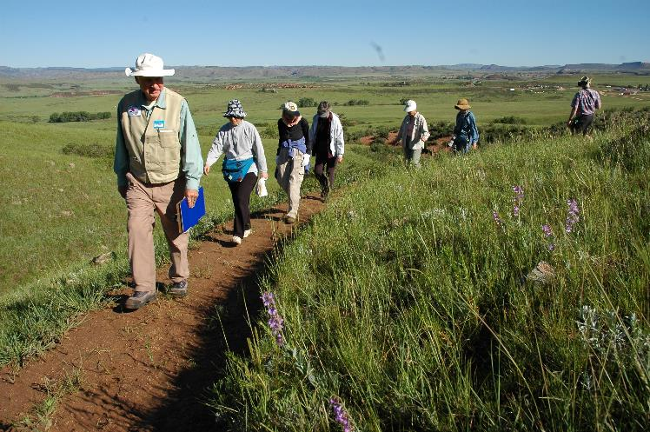
Education and VOLUNTEERS
Offers opportunities for people to connect with nature through Education and Volunteer programs
Notes:
Open Lands Program provides opportunities for people to connect with nature
Education programs include: guided hikes, outdoor programs, school field trips, campground programs and more!
Volunteer programs include: naturalists, ranger assistants, photographers, project team members, resource monitors and more!

Slide 22
accounting & administration
2016 Finances
Revenues = $21M, Expenses = $23M
Revenue Sources
Taxes
Fees and service charges
Inter-government
General County fund
Grants and other

Slide 23
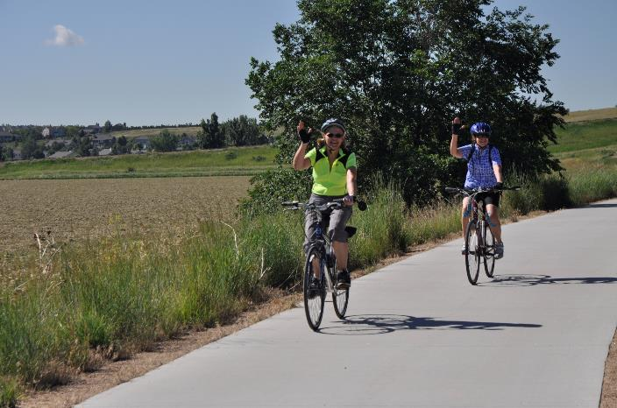
Thank you!
Gary Buffington, Director
gbuffington@larimer.org
(970) 619-4560
Get outdoors and enjoy your parks and open spaces!

