Slide 1





Solid Waste Infrastructure Master Plan
  Planning Commission Meeting
December 19, 2018

Slide 2
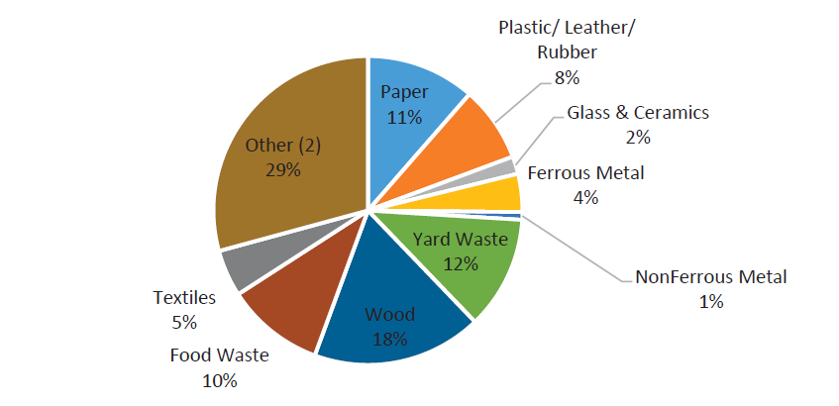
Larimer Co. 2016 Waste Composition & Characterization Analysis
Percent by Weight, All Wastes Delivered to Landfill (Other = construction and demolition debris and other materials)

Slide 3
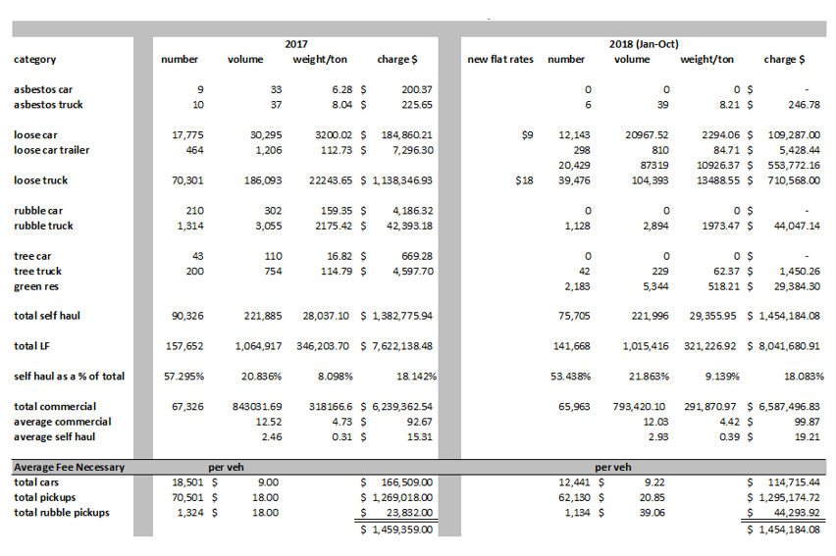
Self Haul Volumes Continue to Increase

Slide 4
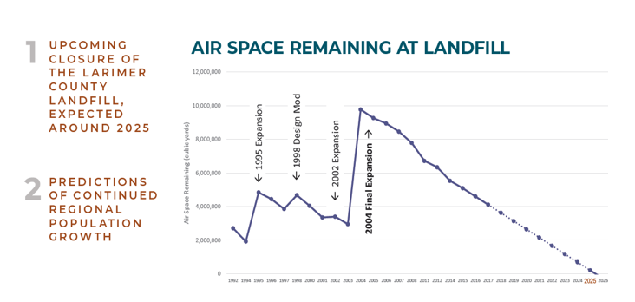
Why is a new system needed?

Slide 5
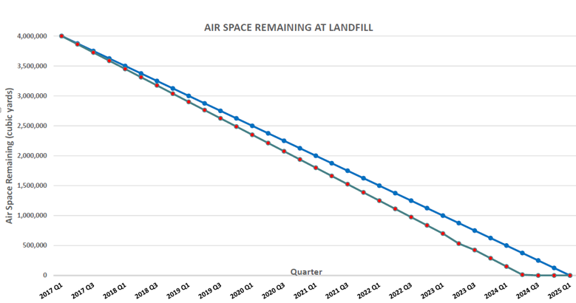
Air Space Remaining at Landfill

Slide 6
Solid Waste Challenges
Increasing Volume of Solid Waste Material
Need for Consistent Goals and Programs
Anticipated Closure of County Landfill
Balancing Economic, Environmental and Social Costs

Slide 7
Coalition History
2015
Coalition Formed
Initial Planning Began
2016
County-wide Survey
Spring & Fall Waste Characterization Study
2017
Formulated Broader Planning Process
Phase 2 Scope of Work
Stakeholder Forum
Phase 1 Study Complete
Four (4) Public Forums
Hired Consultant
Formed Phase 2 Stakeholder Group

Slide 8
Policy Advisory Committee
Define Coalition Objectives & Provide Strategic Direction
Establish Attainable Goals for Solid Waste, Recycling and HHW Management
Evaluate Alternatives and Recommendations from TAC
Establish Unified Vision for Future Solid Waste Practices and Infrastructure
Larimer County
Steve Johnson
City of Fort Collins
Wade Troxell
Ross Cunniff
City of Loveland
Leah Johnson
Town of Estes Park
Ken Zornes
Wendy Koenig*

Slide 9
Technical Advisory Committee
Larimer County
Todd Blomstrom
Stephen Gillette
Ron Gilkerson*
City of Fort Collins
Honore Depew
Susan Gordon
Caroline Mitchell
City of Loveland
Mick Mercer
Tyler Bandemer
Town of Estes Park
Frank Lancaster
Facilitation
Martin Carsasson - CSU
Evaluates Existing and Future Wasteshed Service Demands
Collects and Review Technical and Financial Data
Identifies Potential Alternatives for Solid Waste Management
Conducts Studies and Prepares Summary Reports
Provides Technical and Financial Recommendations to Policy Committee

Slide 10
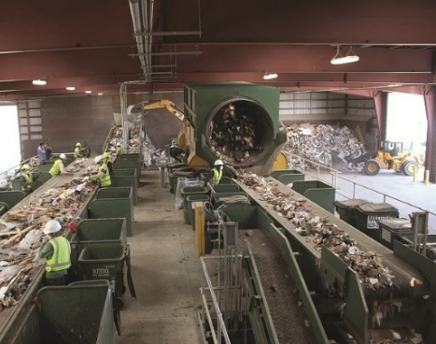
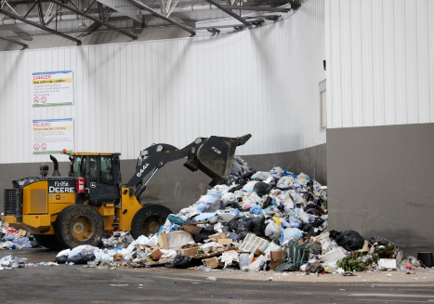
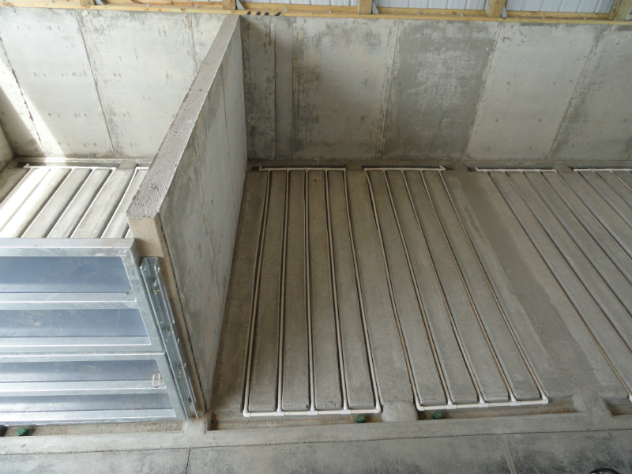
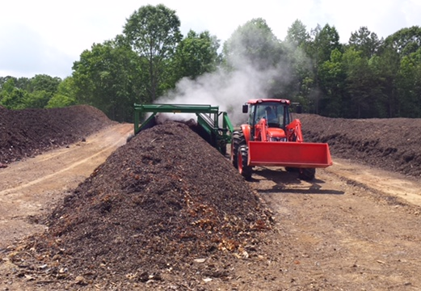
Eleven Infrastructure Options Evaluated
Status Quo
Central Transfer Station
New County Landfill
Material Recovery Facility (Clean)
Yard Waste Organics Processing Facility
C&D Processing Facility
Energy from Waste Facility (Direct Combustion)
Mixed Waste Processing (Dirty MRF)
Aerobic Composting Including Food Waste
Anaerobic Digestion
Refuse Derived Fuel (RDF) Processing
Notes:
Relist all options under consideration.

Slide 11
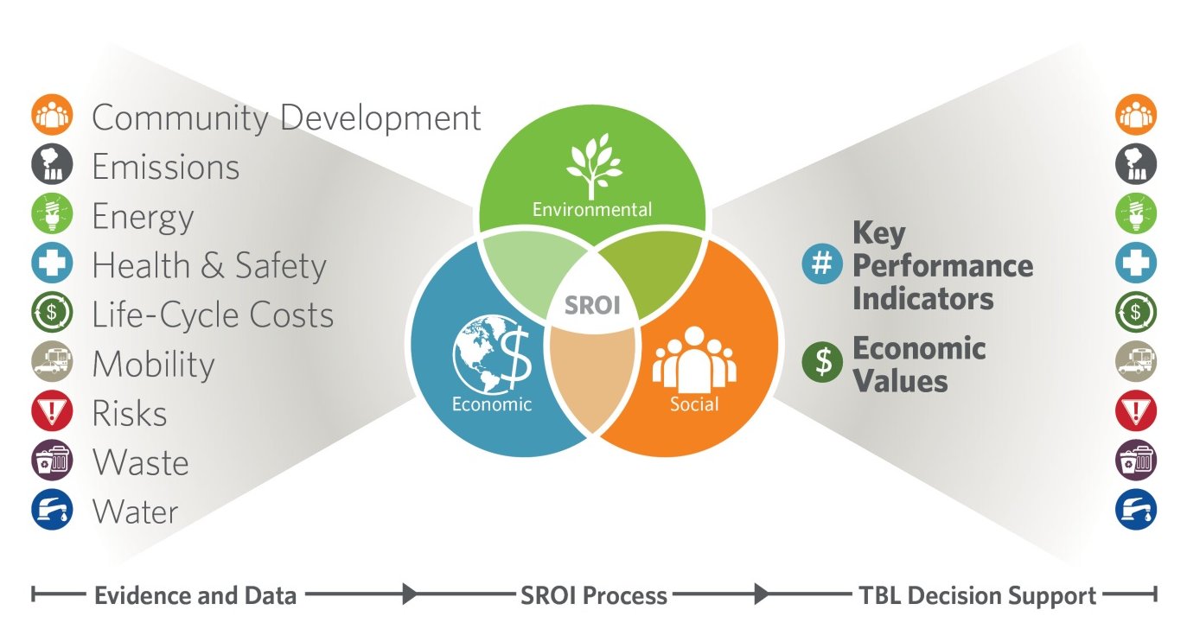
Sustainability Value Assessment (SVA) Services - A Better Approach
“Sustainability Value”

Slide 12
Initial Tier Recommendations
TIER RECOMMENDATIONS | SROI CRITERIA BENEFIT / COST RATIO | POTENTIAL SCHEDULE
 |  | Local Siting Approval | Permitting/Design | Construction | In Service
Tier 1
Central Transfer Station | 0.36 | 2018 | 2020 | 2021 | 2022
New County Landfill | 0.75 | 2018 | 2020 | 2022 | 2023
Yard Waste Composting | 2.75 | 2018 | 2019 | 2020 | 2020
C & D Processing | 1.03 | 2019 | 2020 | 2022 | 2022
Existing Single Stream Recycling Center | - | - | - | - | -
Tier 2A
Clean MRF/Upgrade | 1.15 | 2019 | 2021 | 2022 | 2023
Anaerobic Digestion (Commercial Source Separated Organics to WWTP) | 4.56 | 2019 | 2021 | 2022 | 2023
Tier 2B
Food Waste Composting – Static Aerated Bin (Residential Source Separated Organics) | 1.81 | 2019 | 2023 | 2025 | 2026
Tier 3
Waste to Energy (Direct Combustion) | 0.41 | 2019 (Additional investigation) | 2024 | 2026 | 2028
RDF Processing | 0.07 | 2019 (Additional investigation) | 2024 | 2026 | 2028
Dirty MRF | 0.33 | 2019 (Additional investigation) | 2022 | 2024 | 2025
Anaerobic Digestion | 4.56 | 2019 (Additional investigation) | 2024 | 2026 | 2026

Slide 13
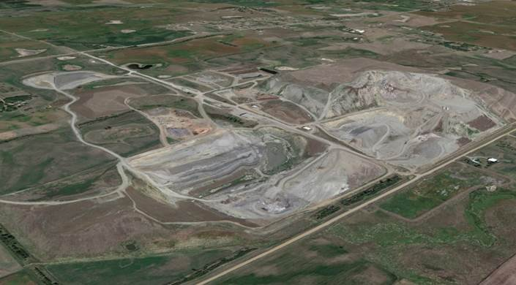
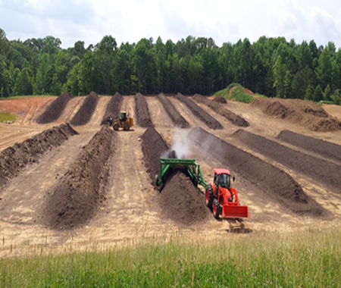



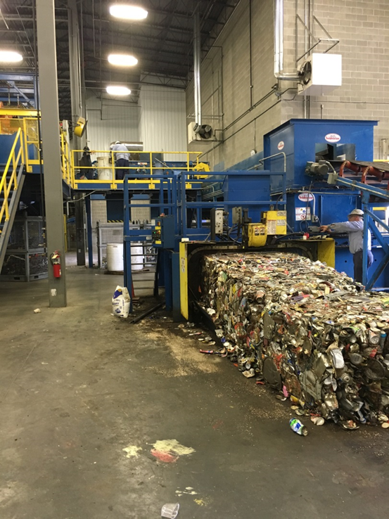
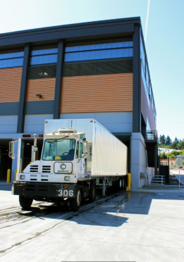
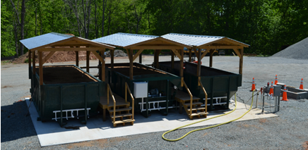

Recommended Infrastructure Options
New County Landfill
Yard Waste Organics Processing Facility
Construction & Demolition (C&D)Processing Facility
Existing MRF Transfer
Central Transfer Station
Aerobic Composting Including Food Waste
Notes:
Stephen

Slide 14
Costs of Recommended Facilities
Public Landfill | $11.7M (Equity – 1st Phase)
Central Transfer Station | $15.8M (Equity)
Yard Waste & Food Waste Composting Facilities | $11.8M (Finance)
Construction & Demolition Debris Processing Facility | $13.7M (Equity)
Recycling Center Upgrades | $3.0M (Finance)
Total: | ~$56M
Notes:
Stephen

Slide 15
Public & Private Landfill
Advantages/Disadvantages
PUBLIC
PRIVATE
Control and stability for waste disposal
No capital costs for construction
Ability to direct waste to new or evolving resource recovery options
No Operations & Management costs
Potential cost savings measure as tip fees can be negotiated
Tip fees set by local government / competitive rates
Environmental liability is partially mitigated
Increased service quality and flexibility
Loss of control and stability
Competitive market could reduce volumes resulting in higher tip fee
Volume or type of waste increases or decreases over time impacting pricing
Capital costs for construction & equipment
Potentially discourages resource recovery
Increased traffic to new landfill
Contract disputes if terms are not clear
No current guarantees property is suitable for landfill use
Notes:
Font too small

Slide 16
Public/Private – Private/Public
Transition Times
Transition from Public Landfill to Private Landfill
Transition from Private Landfill to Public Landfill
Three to Five Years
Six to Twelve Months

Slide 17
Main Policy Controls
Mixed loads
10-year term
Jobsite convenience
Market development
Flow Control
Construction & Demolition Debris
Flow Control
Mixed Recyclables
Organics
Yard and Food Waste
“Single-stream” recyclables
Residential and commercial
Assured volumes attract investment
Community driven diversion policies
Readily recyclable at multiple sites
Generate finished compost

Slide 18
Stakeholder Engagement Highlights
MAY 2017 | JUNE 2017 | AUGUST 2017 | OCTOBER 2017 | JANUARY 2018 | MARCH 2018 | AUGUST 2018
30 comments were provided, in addition to discussion, to guide the confirmation of the North Front Range Regional Wasteshed final Goals & Objectives | 86% of stakeholders agreed that the Coalition identified all appropriate infrastructure options for review | 95% of stakeholders agreed the solid waste volume data presented was detailed enough to support the next phase of the project | 91% of stakeholders agreed they would support the implementation of process controls/ordinances for the handling of construction & demolition waste in order to increase rates of diversion 78% of stakeholders would support process controls/ordinances for yard and food waste organics | 96% of stakeholders provided consensus to move forward with the five Tier 1 Recommendations | 90% of stakeholders agreed to the proposed solid waste process controls and limited flow controls for construction & demolition debris generated in Larimer County 100% of stakeholders agreed to the proposed process controls for yard waste and single stream recycling | 70% of stakeholders support a publicly owned landfill with a focus on having control

Slide 19
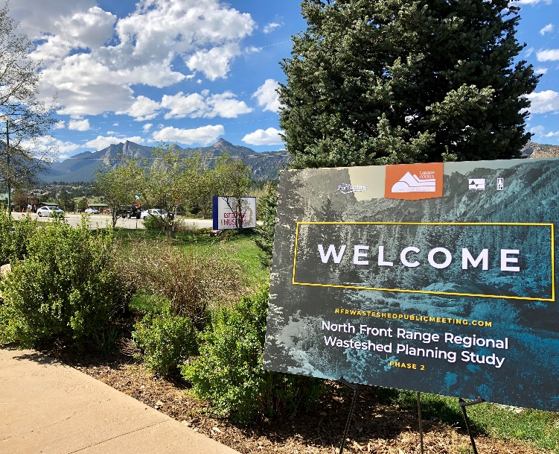
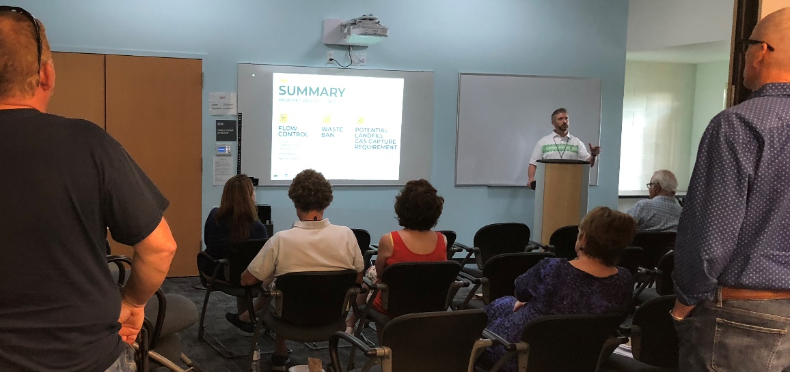
Public Informational Meetings
Four public meetings held around Larimer County for members of the public to:
  Learn more about the future of solid waste in the region
  Provide feedback on the draft regional master plan concepts for waste recovery and disposal
11 Informational boards set up in an open-house format, and included an overview presentation
Over 100 participants attended and provided valuable feedback via in-person comments and comment forms
Town of Wellington Meeting Scheduled for November 29, 2018
nfrwasteshedpublicmeeting.com

Slide 20
Facility Development Timeline
 | 2019 | 2020 | 2021 | 2022 | 2023 | 2024
Central Transfer Station (Jan 2019 – Jan 2023)
Public Landfill (Jan 2019 – Jan 2024)
Yard Waste Composting Open Windrow (Jan 2020 – Jan 2023)
Construction and Demolition Waste Processing (Jan 2020 – Jan 2023)
Food Waste Composting Static Aerated Bin (Oct 2023 – Feb 2025)

Slide 21
Timeline & Next Steps
2018 – Q4
  Larimer County to adopt SWIMP
  TAC to develop Intergovernmental Agreement
  Development of detailed process controls
2019 – Q1
  PAC meeting
  Execute IGA with municipalities
  Initiate process controls implementation
  Implementation of infrastructure options

Slide 22
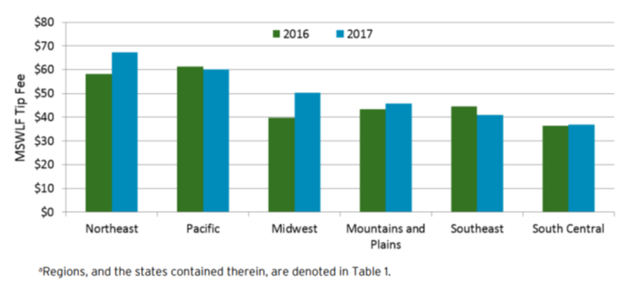
Municipal Solid Waste
Landfill Tip Fees 2016-2017

Slide 23
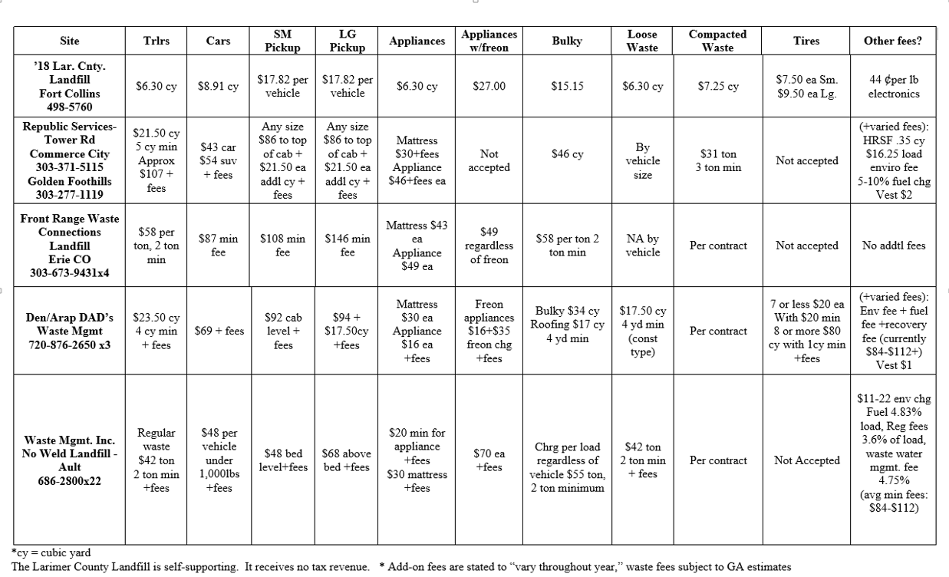
Northern Colorado Landfill Comparisons
July of 2018

Slide 24
Tier 1 Recommended Options
Solid Waste Process Control Assumptions Adopted
Estimated Tipping Fees including Overhead Expenses
 | Capital Costs (2017 $) | Tons Captured (2025) | Tipping Fee (2017 $)
New Landfill | $11.7M (1st Phase) $11.7M (Equity) $0.0M Finance | 344,800 | $14.09 / Ton
Central Transfer Station (Transferred Materials/Direct Haul Zone) | $15.8M $15.8M (Equity) $0.0M Finance | 321,600 | $29.29 / Ton
Construction & Demolition (C&D) Processing | $13.7M $13.7M (Equity) $0.0M Finance | 150,000 | $37.17 / Ton
Yard Waste & Food Waste Composting | $11.8M $0.0M (Equity) $11.8M Finance | 72,200 | $37.92 / Ton

Slide 25
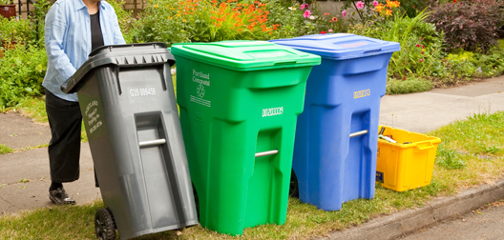
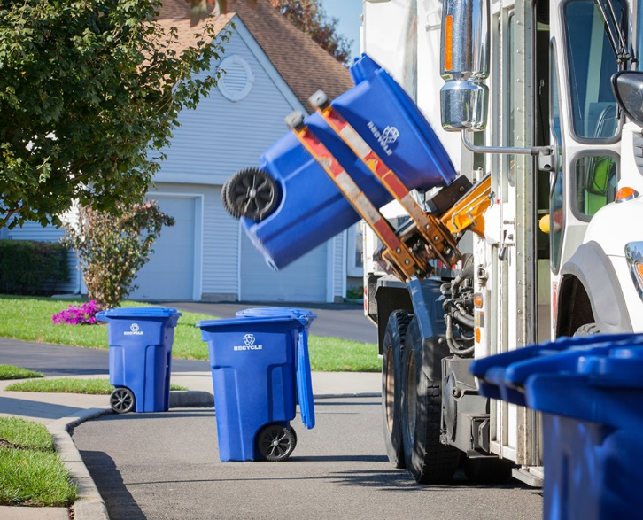
ESTIMATED Residential Cost Per Household Impact (Example)
Current monthly fee:
  17-gallon cart: $3.25 per mo.
  35-gallon cart: $6.50 per mo.
  65-gallon cart: $13.00 per mo.
  95-gallon cart: $19.50 per mo.
Maximum monthly increase:
  $3.45 per mo. (20¢ increase)
  $6.90 per mo. (40¢ increase)
  $13.80 per mo. (80¢ increase)
  $20.10 per mo. ($1.20 increase)
  6.2% Overall Increase

Slide 26
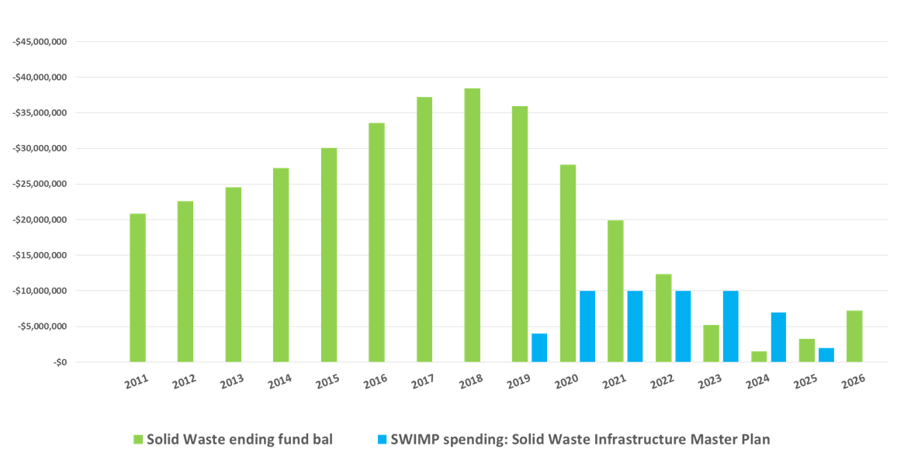
Solid Waste Fund Balance

Slide 27
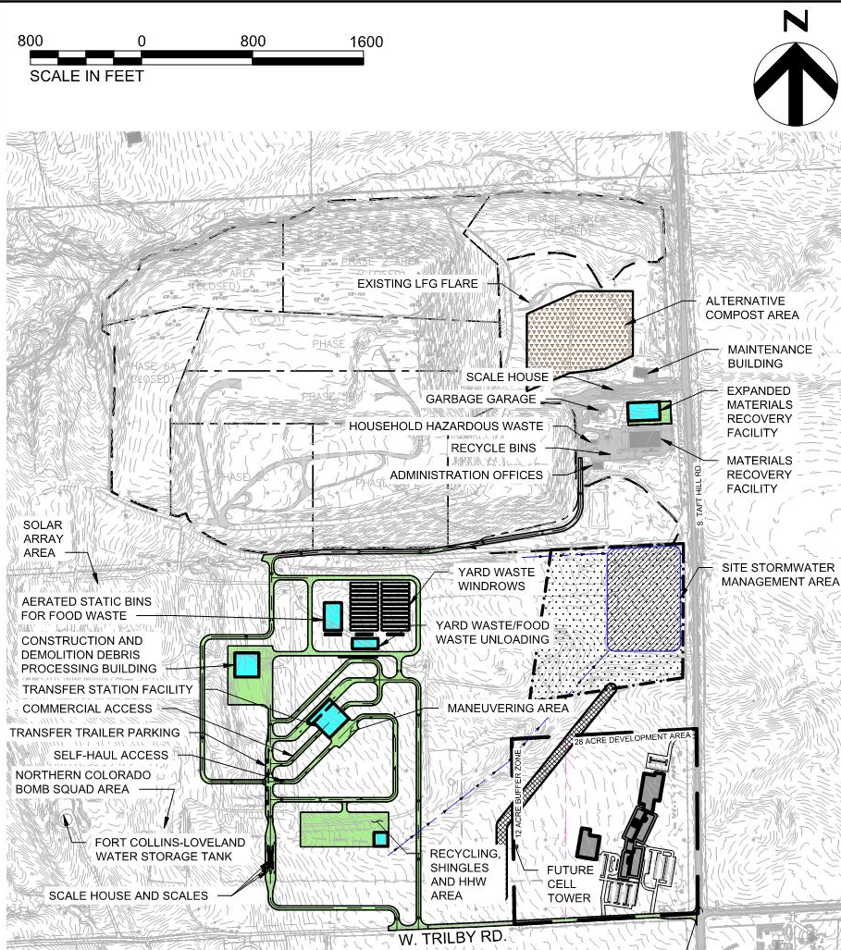
Site Plan Draft

Slide 28
Preliminary Haul Route

Slide 29
Public-Private Opportunities
Anticipated Public-Private Services:
  Trucking/Haul to Landfill
  C & D Processing Facility
  Upgraded Recycling Center
Additional Potential Public-Private Opportunities:
  Yard/Food Waste Composting
  New Landfill Operations
  Central Transfer Station Operations

