Slide 1

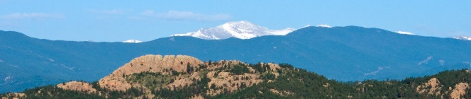
Larimer County: The Ranch events complex
Larimer county college 101
May 10, 2018

Slide 2

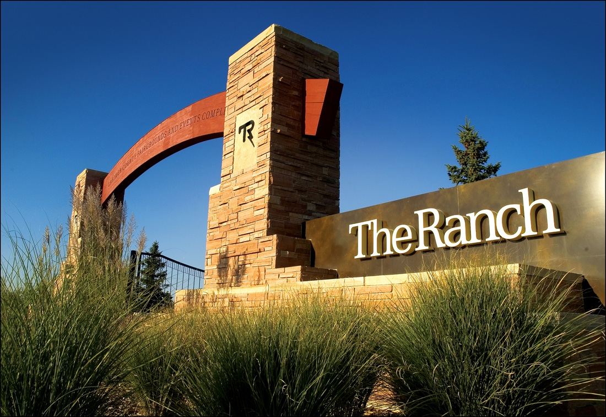
The ranch events complex

Slide 3
The ranch events complex
About us:
County owned and operated facility
  Opened in September 2003
  243 acre site
  Four buildings on campus
  Over 800,000 event attendance
Facility creates over 350 full and part time jobs
  Event sales and planning
  Event operations
  Sales and marketing
  Concessions and banquet
  Administration

Slide 4

The ranch events complex
madWire Holiday party in Exhibition Hall

Slide 5
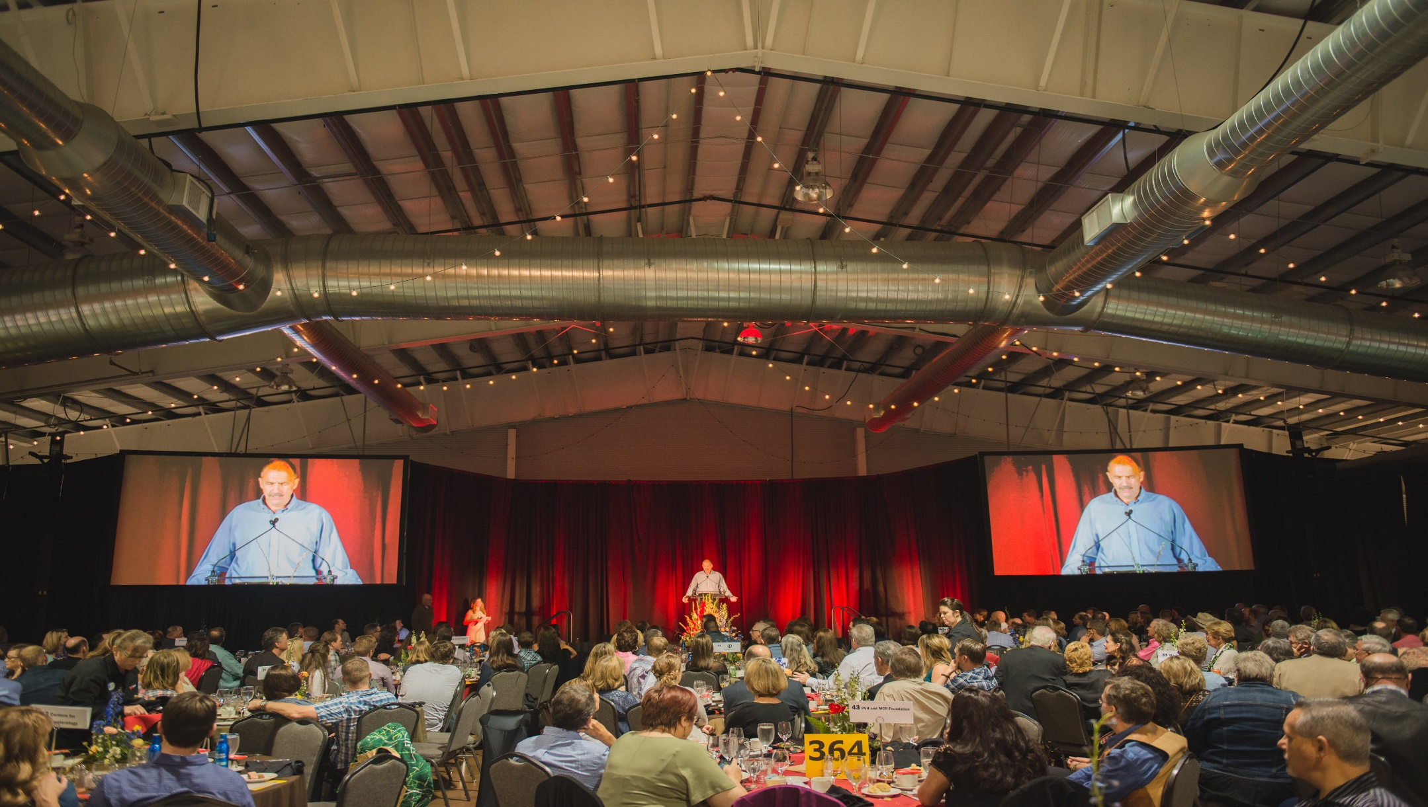
The ranch events complex
Water users meeting in exhibition hall

Slide 6

The ranch events complex
Colorado eagles hockey

Slide 7
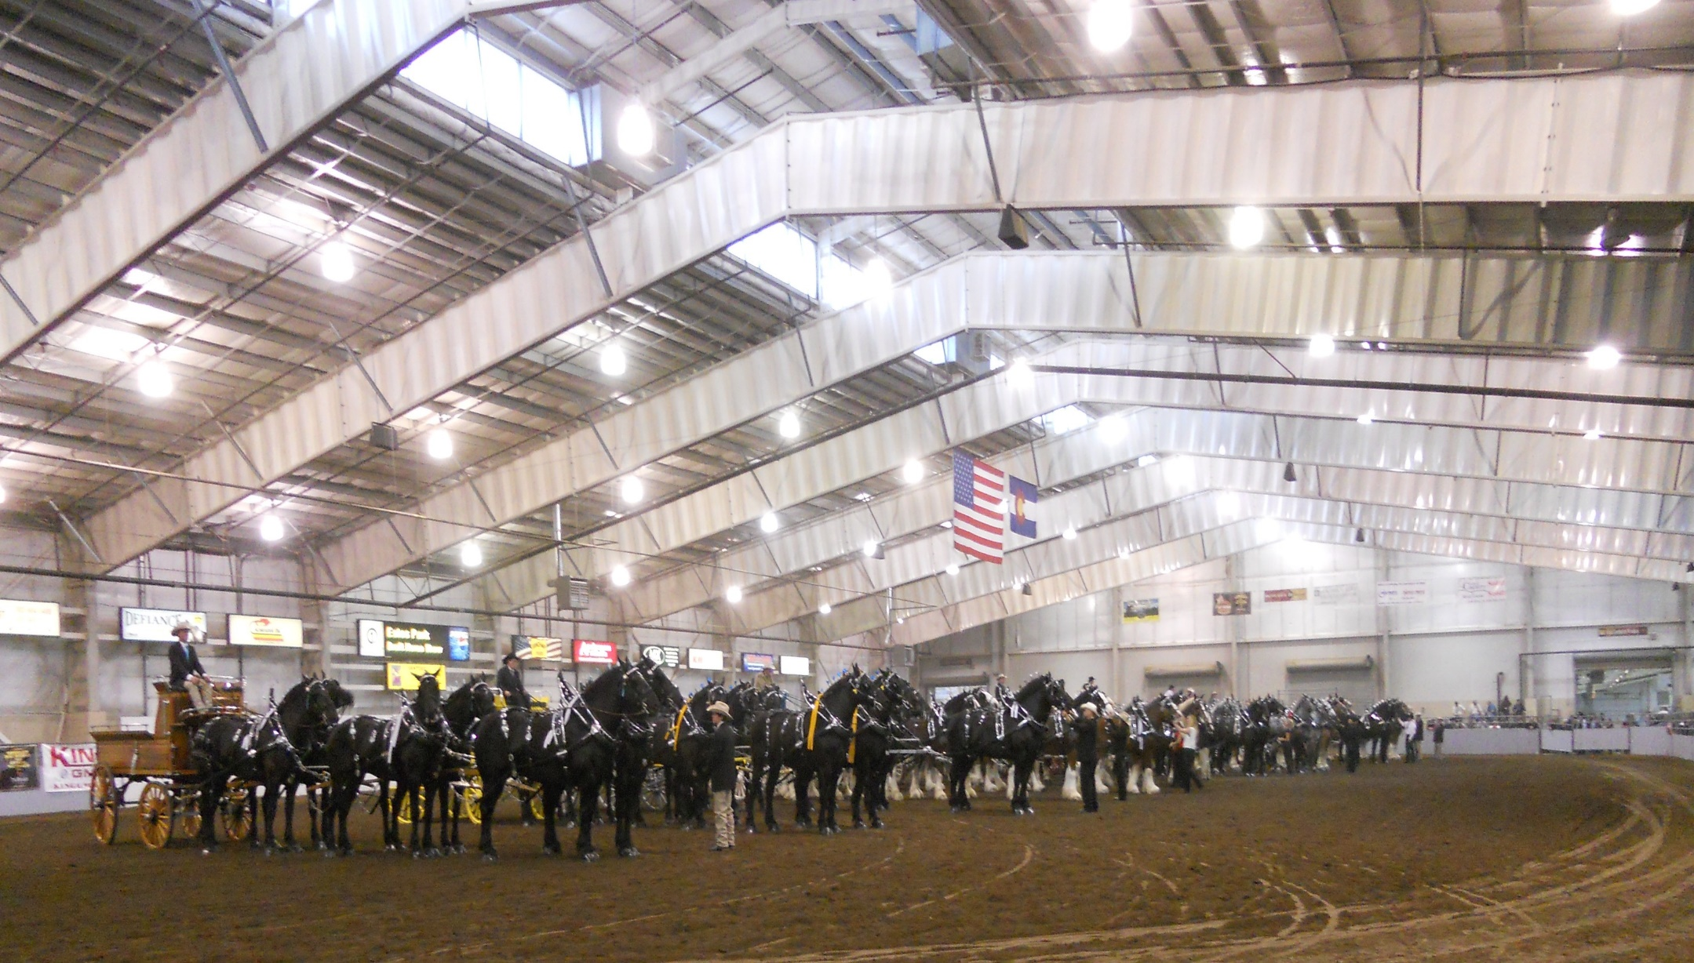
The ranch events complex
Big thunder draft horse show

Slide 8
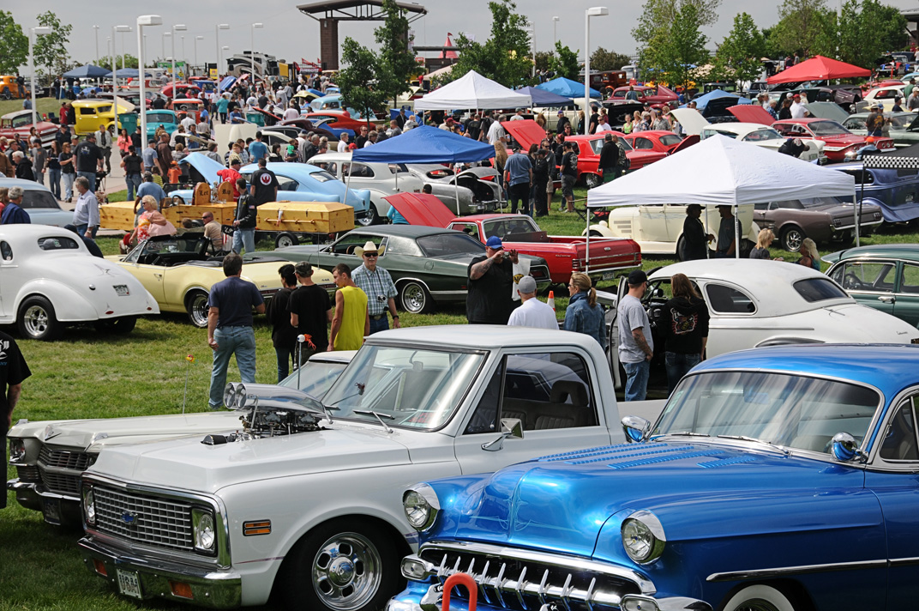
The ranch events complex
Good guys car show

Slide 9
The ranch events complex
Marketing, sponsorship, Foodservice
Sponsorship $1,708,894 in cash and trade
Marketing media, print and social media
Facebook – 35,001
Twitter – 1,775
Instagram – 776
Spectra Foodservice
  Concessions $2,428,576
  Catering $1,051,056

Slide 10
The ranch events complex
Special Revenue Fund
  Sales tax .015 on every $100
  Generate over $9M in 2017 for bond payment, operations and future capital investment
  Over $11M in reserves for future capital expansion
  Sales tax extended by voters in 2017 for another 20 years
Master plan
  Analysis of options and define schedule
  Impact on future generations

