Slide 1
Larimer County 101
Linda Hoffmann
County Manager
March 21, 2019

Slide 2
Overview of Larimer County
The County by the Numbers
  Our Community
  Government Organization
County Government Structure
  Organizational Structure
  Organizational Wrinkles
Current Initiatives and Challenges

Slide 3
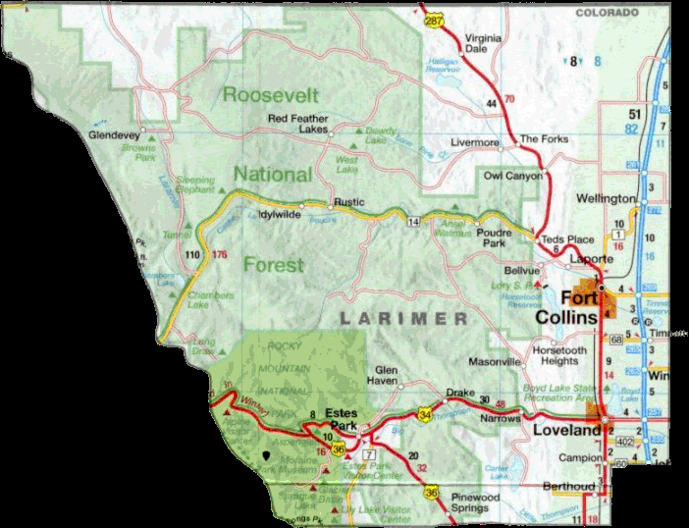
Size: 2,640 sq. mi.
Population:
2018 – 349,079
2030 – 424,052
Municipalities:
Fort Collins
Loveland
Estes Park
Wellington
Timnath (portion)
Berthoud (portion)
Windsor (portion)
Johnstown (portion)
Notes:
Population projections from DOLA.
Percentage of total area in some form of public ownership: ????
1.5% to 2% annual increase expected. Net increase natural about 30-40%; net migration about 60-70%
Percentage of population in incorporated areas: 75%

Slide 4
County Government Facts
2019 Assessed Valuation : $5.802 Billion (Includes $313 million in value diverted by tax increment financing)
2019 County Mill Levy : 21.653 (Includes abatement levy but excludes 0.75 mills for Foothills Gateway)
2019 County Net Operating Budget : $261 million (Total 2019 Budget: $495 million with capital projects, disaster recovery and non-operational accounts)
2019 County FTE Employees: 1,908 (About 5 positions per 1,000 residents. Approximately 100 positions are vacant at any given time)
Notes:
Mill levy has not changed (except for adding Foothills) since 1992

Slide 5
County Government Services
Public Safety Services
Human and Economic Health Services
Community Planning, Infrastructure and Resources Services
Public Records and Information Services
Strategic Leadership and Administration Services
Notes:
Mill levy has not changed (except for adding Foothills) since 1992

Slide 12
Guiding Principles
Larimer County will add value to the lives of its citizens today and in the future by:
Being good stewards of our public resources
Promoting innovation and continuous improvement
Providing quality customer service
Empowering people to take responsibility
Cultivating partnerships
Being a fulfilling and enjoyable place to work

Slide 13
2019-23 Strategic Plan https://www.larimer.org/strategicplan
Community Vision: Larimer County is a great place to be: an innovative community to live, work and play for everyone.
Organizational Mission: Larimer County government upholds and advances the community’s health, well-being and quality of life.

Slide 14
2019-23 Strategic Plan https://www.larimer.org/strategicplan
Goal 1: Larimer County works collaboratively to ensure adequate public infrastructure is available to support the needs of our growing community.
Goal 2: Everyone in Larimer County has access to economic opportunities and a vibrant quality of life.
Goal 3: Larimer County government is ready to support the future service needs of our residents and visitors.

Slide 15
Significant Challenges on Horizon
Continuing threats to property tax revenue growth
  Gallagher adjustments
  Tax increment financing
Looming infrastructure replacement and expansion needs
  Regional Transportation: $12 million annually
  $582 million for County facilities over next 20 years
Demographic shifts
State and Federal funding and mandates

Slide 16
How can I help you?
Linda Hoffmann
County Manager
970-498-7004
lhoffmann@larimer.org

Slide 17
Significant Challenges on Horizon
Population growth and demographic changes are increasing demand for County services
Property tax is County’s primary source of discretionary funding
Frozen by TABOR Amendment
Property Actual Value
X
Assessment Rate
=
Assessed Value
Assessed Value
X
=
Tax Revenue
Mill Levy
Controlled by Gallagher Amendment

Slide 18
Significant Challenge on Horizon
Gallagher Amendment passed in 1982
State-wide
Residential
45%
State-wide
All Else
55%
Larimer Co.
Residential
55%
Larimer Co.
All Else
45%
Assessment Rate for All Other Uses: Fixed at 29%
Assessment Rate for Residential: 7.96% since 2003
Residential Assessment Rate to Drop 2018: 6.1-6.5%
Impact on Larimer County: Approximately $12M/yr

