Slide 1


LARIMER COUNTY ASSESSOR
LC101
March 28, 2019

Slide 2

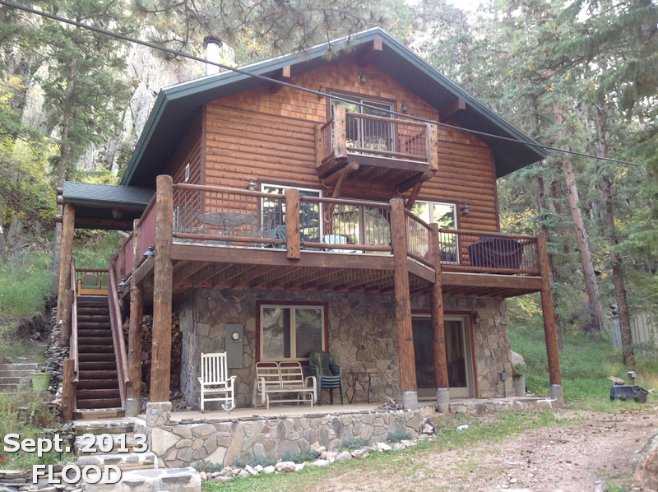


Slide 3

DISCOVER - LIST - CLASSIFY - VALUE
DISCOVER
The discovery of property may be accomplished by field inspections; examining the records of the county clerk and recorder; reviewing building permits; and interaction with the property owners or inhabitants. This would also include assisting in Emergency Damage Assessments after natural disasters such as the 2013 Flood and the High Park Fire in 2012.
LIST
Listing includes the maintenance and updating of records to link properties to respective owners so that a current assessment file is created.
CLASSIFY
  Classification consists of determining the correct class for all property located in the county according to its use on the assessment date. The proper classification will have a bearing on both the method used to value the property and the assessment rate applied. Classification is also important when properties are compared in both the appeals and the valuation processes.
VALUE
  Property is valued by the assessor according to criteria specified by state statute. This includes notifying the taxpayer of the value and the administrative remedies that must be followed if the taxpayer disagrees with the assessor's valuation.
The assessor coordinates with all the issuing authorities within the county to make sure we are receiving building permit data in a timely manner; from Berthoud to Wellington and Windsor to Estes Park.
The Assessor’s job is defined by Colorado State Statute with guidelines published in the Assessor’s Reference Library from the Colorado Division of Property Taxation and the Assessor must pass an independent audit every year.

Slide 4

ASSESSMENT CALENDAR
REAPPRAISALS – This is typically when you will hear the most about what the Assessor does and updated property values.
All residential and commercial real properties are reappraised every 2 years in the odd-numbered year. Values for the 2019 reappraisal are based upon sales that occurred during the 24 months prior to June 30, 2018.
January 1st is the assessment date – Properties are assessed as of that date.
If a property was vacant January 1st but a house was built in March the Notice of Value sent in May will be for the Vacant Land. It is typically not prorated according to any Certificate of Occupancy or Permit Date.
Business Personal Property Schedules are sent out January 1st and are due back no later than April 15th.
The Treasurer’s Office mails tax bills in January.
Current tax bills (2018 taxes due in 2019) are based on the 2017 Reappraisal cycle. These values are based on an appraisal date of June 30, 2016.
Notices of Value are sent to owners on or before May 1st. Notices will also be available online at that time. Protests can be heard by the assessor's office from May 1 through June 1. Protests can be filed either in person, by letter, by fax or using the Online Protest System.
A protest will include a review of the facts on the property record; noting any discrepancies. For residential property items that may affect the value include the living area of the home, the presence or absence of a garage or finished basement, proximity to a lake or golf course, etc.

Slide 5

Besides the most obvious stuff…
The Assessor is responsible for the following:
Process recorded title conveyance documents
Administer senior and veteran exemptions
Process annexations, subdivisions, plats, and similar
property changes
Process changes of address (both site and mailing)
Update assessment maps and process parcel and taxing entity boundary changes
Assessment of property damage and ownership verification in the event of a natural disaster

Slide 6
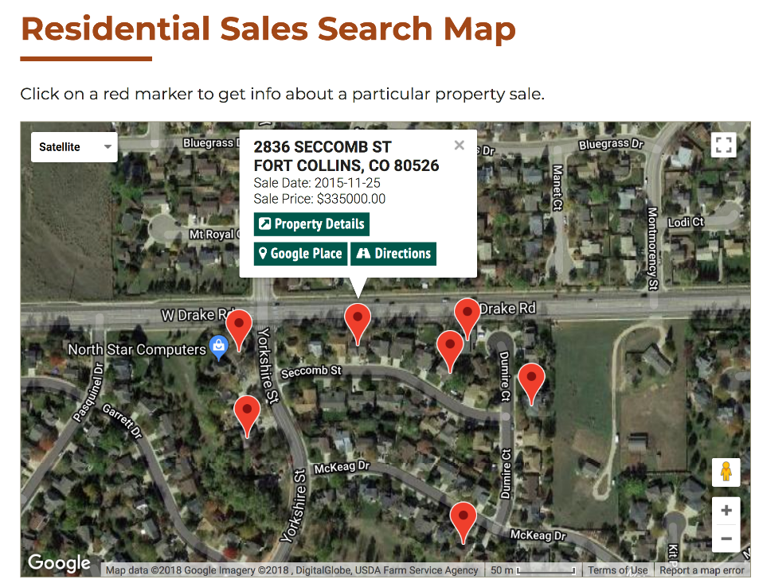
But exactly HOW does the Assessor do all that…
Let’s focus on the valuation of residential improved property.
Characteristics that may impact residential property values:
Classification (Residential versus Agricultural property)
Location of property - Eco Area, Neighborhood, Subdivision
Square feet of living area
Square feet of basement
Square feet of finish in basement
Square feet of garage (attached and detached)
Design of home (Ranch, Two Story, Modular, Cabin, etc.)
Quality of home
Locational attributes (Golf Course, Lake, Park, River, Railroad, Traffic, View, Greenbelt)
Items that may be inventoried but do NOT typically impact residential value for assessment purposes:
Fixtures (sinks, showers, etc)
Sprinkler systems
Finished garage vs unfinished garage
Porches, decks or balconies
Bedroom and bathroom counts
Appliances
Updated roof or minor interior remodels

Slide 7
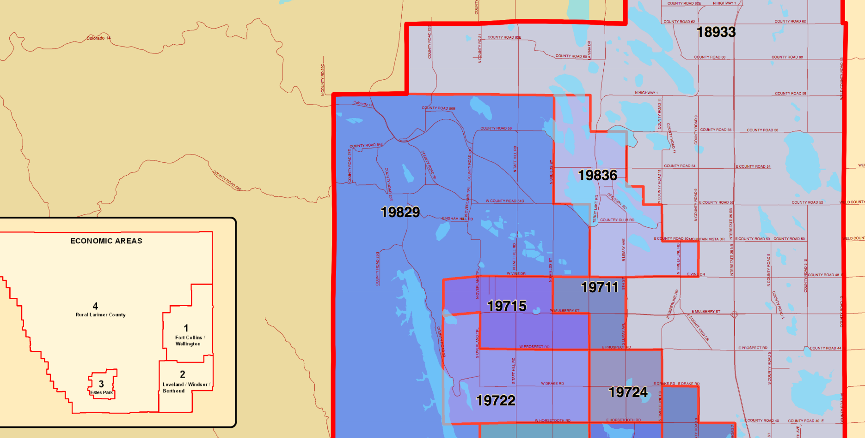
Where is my neighborhood?
NBHD 19711 goes from Vine and Shields down to Mulberry and College then down to Prospect and Lemay and back up to Vine.
Maps showing the Nbhds are available on our website.

Slide 8
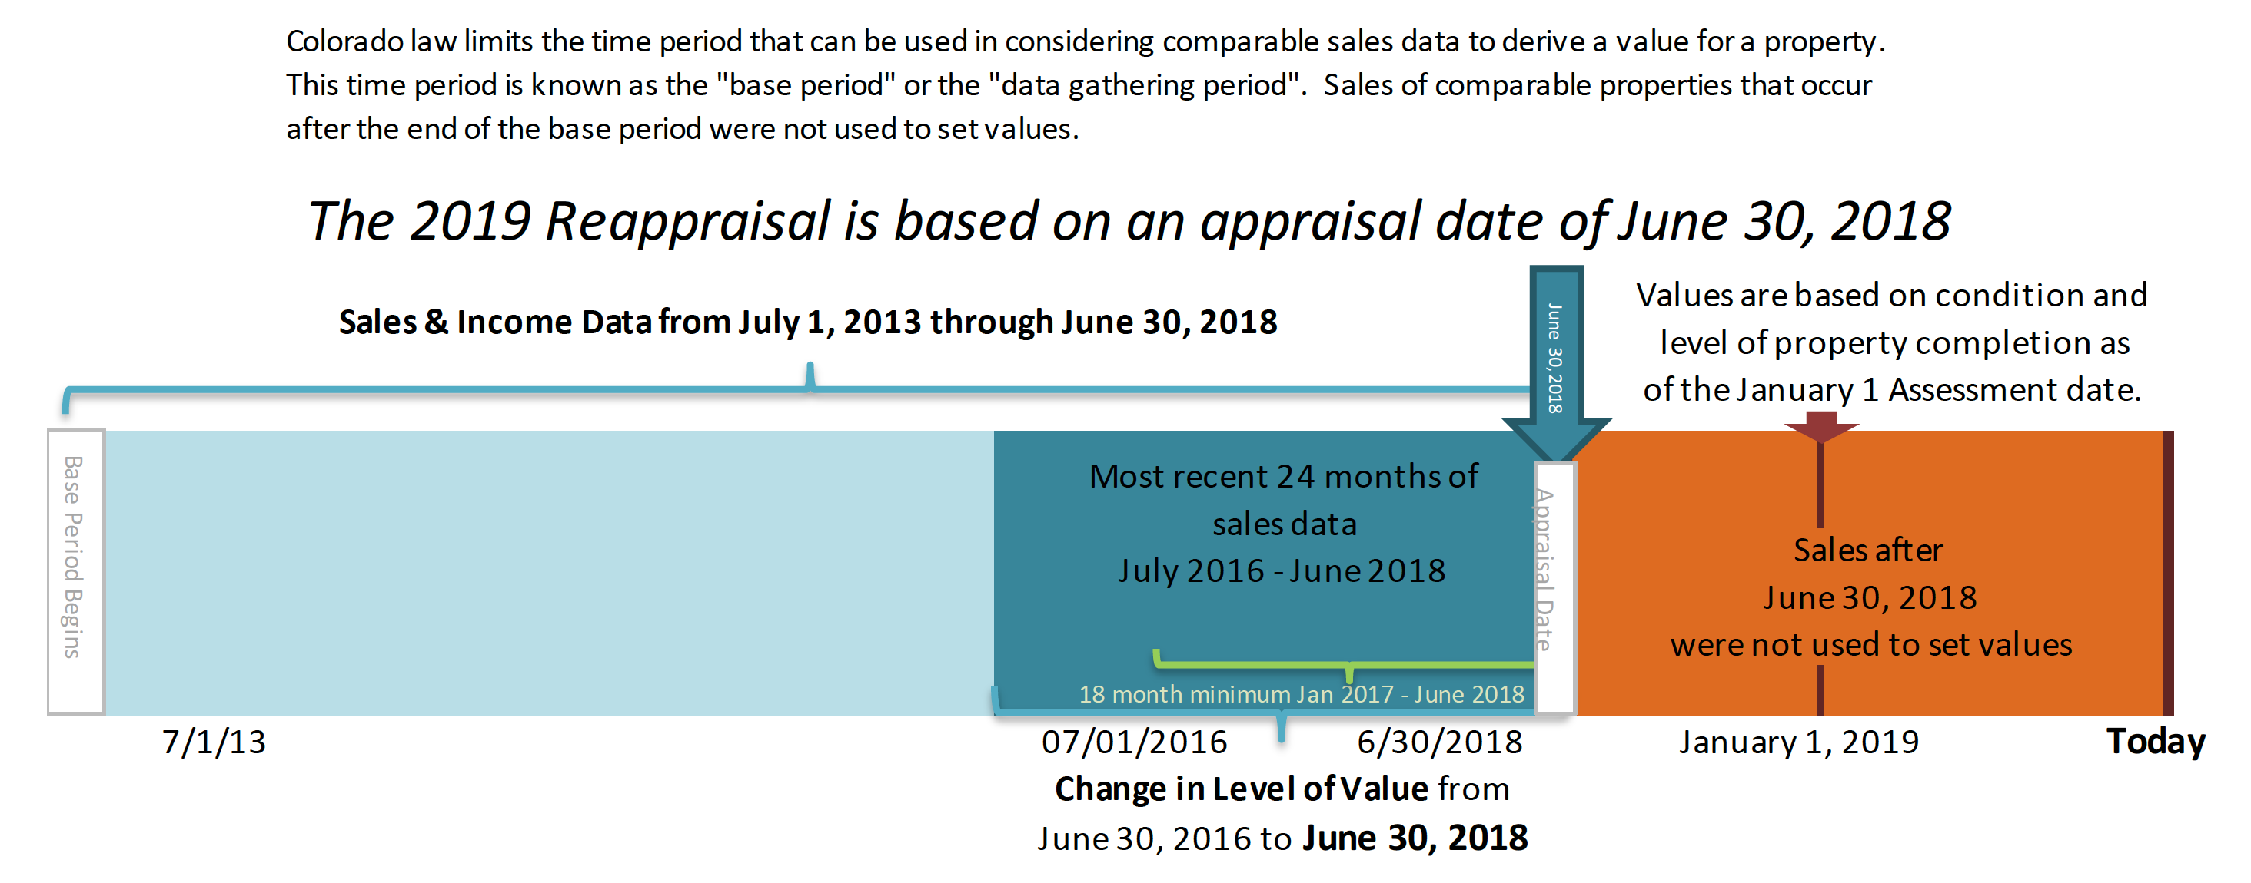
Understanding the level of value of the 2019/2020 assessment cycle

Slide 9
How does property value relate to property taxes?
The following calculation is used to determine your property tax:
Actual Value x Assessment Rate x Mill Levy / 1000 = Property Tax
$240,000 Actual Value x 7.20% Assessment Rate = $17,280 Assessed Value
$17,280 Assessed Value x 86.49 mills/1000 = $1,495 tax bill
*The 7.20% assessment rate applies to residential improved properties
and may change based on statewide studies

Slide 10

LaRimer County assessor
COMPARISON COMMERCIAL VS RESIDENTIAL
Commercial (29% rate) Residential (7.2%)
$500,000 actual value $500,000 actual value
$145,000 assessed value $ 36,000 assessed value
86.38 county-wide average mill levy
$145,000 x .08638 = $36,000 x .08638 =
$12,252.10 $3,109.68
tax dollars tax dollars

Slide 11
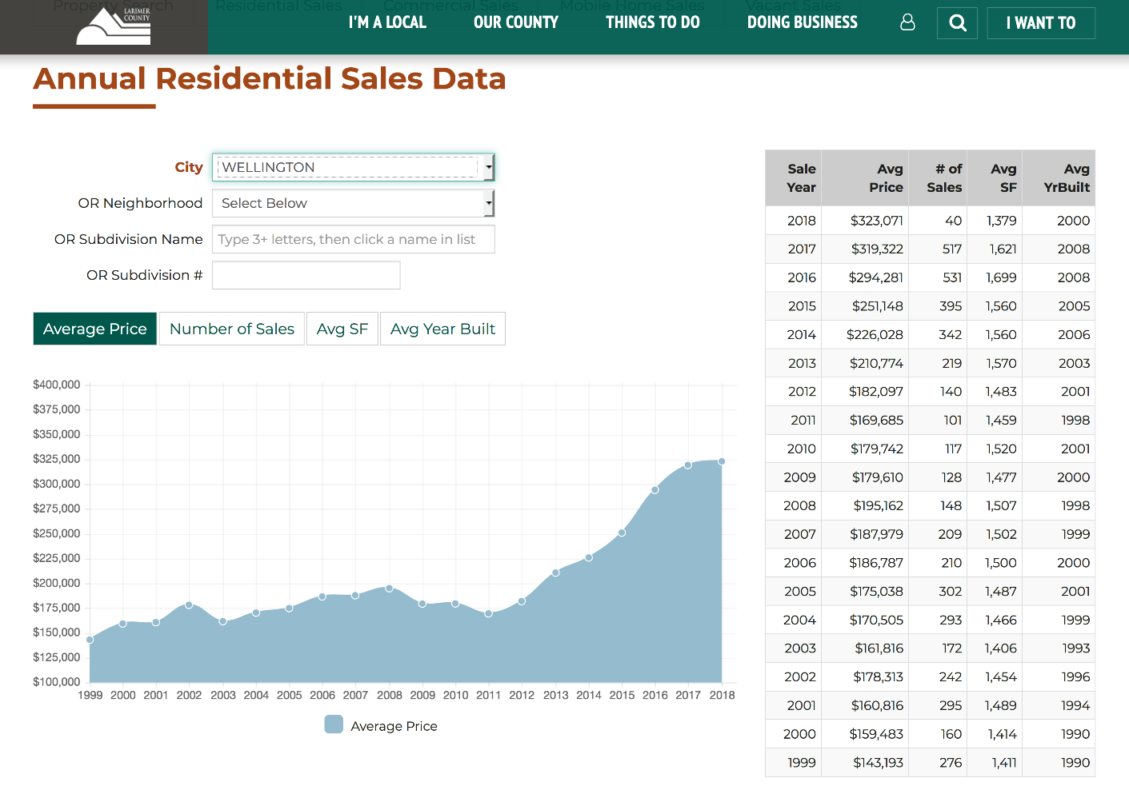
How can I see sales data in my area?

Slide 12
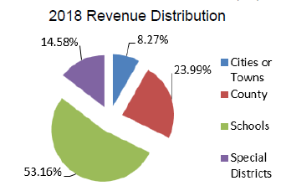
Where does all that money go?
The goal of all assessors is the equalization of assessed
valuations so that the entire property tax burden is evenly
distributed in accordance with the value of taxable
property owned by each taxpayer.
The State Legislature sets the percentage used to calculate
assessed values upon which levies and taxes are
determined.
County tax is levied by the Board of County
Commissioners. School tax is levied by School Boards,
City and Town tax is levied by City and Town officials.
Water and Sewer taxes are levied by Water and Sanitation
Boards.
After the levies are certified it is then the duty of the
Assessor to extend the tax roll to the Treasurer, whose
duty is to collect those property taxes.

Slide 13
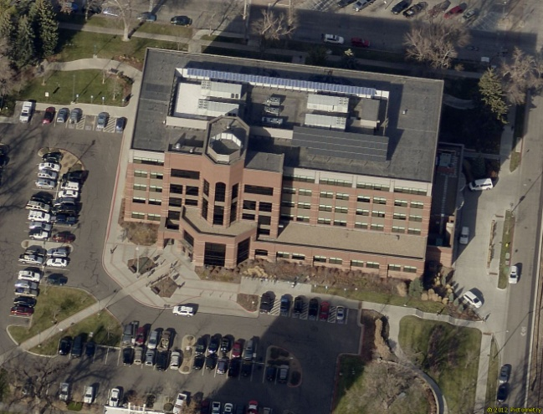
Larimer County Assessor
Questions

