Slide 1
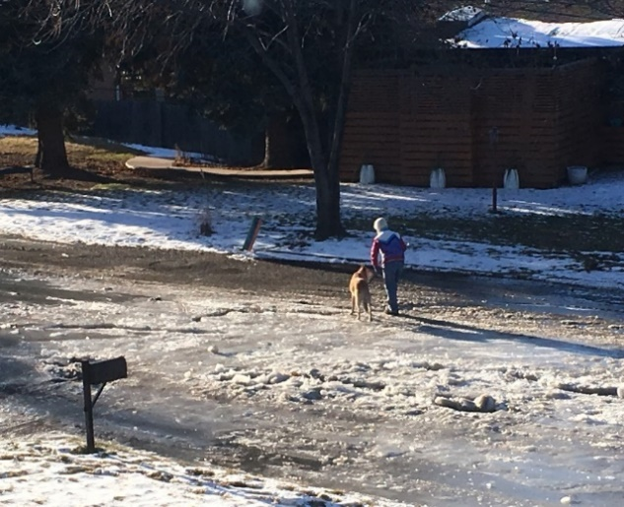
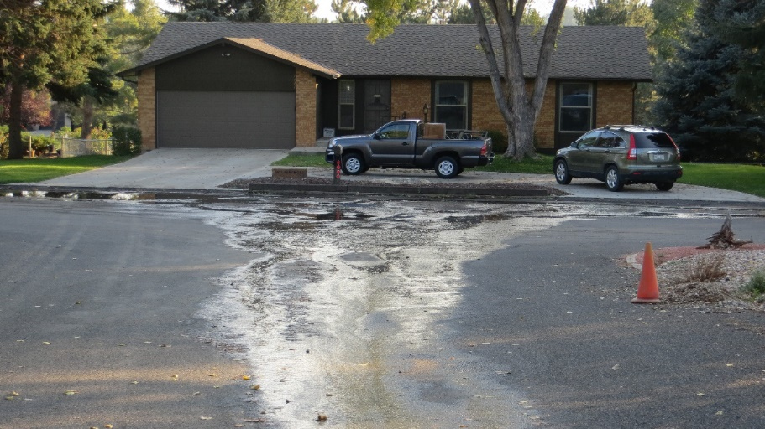
Larimer County: engineering
BCC hearing FOR Creation OF:
HILLSIDE DRIVE LOCAL Improvement district #2019-2
Country club estates drainage improvements
AUGUST 28, 2019

Slide 2
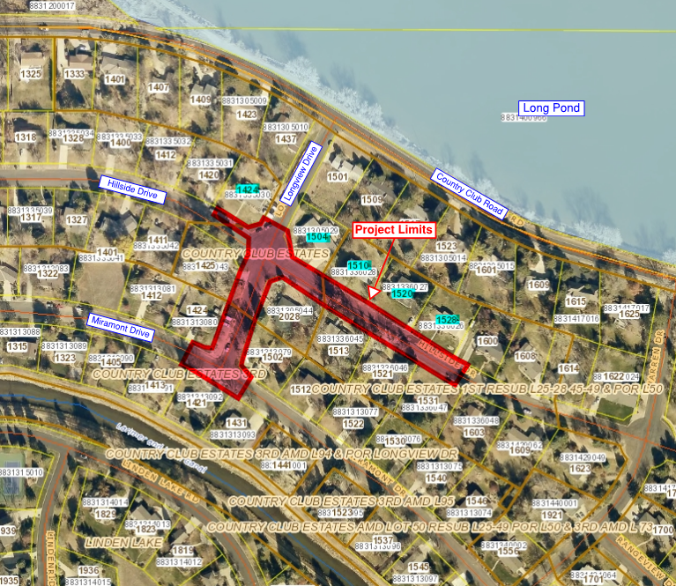
HILLSIDE DRIVE LOCAL IMPROVEMENT DISTRICT #2019-2
Overview and PROJECT LIMITS Map - 5 Lots included
Country Club Estates is a County maintained subdivision.
5 lots with addresses highlighted in teal on map to be included in Local Improvement District (LID).
1504, 1510, and 1528 have private subdrains which discharge water into street.
1424 has water seeping from front yard into street at several locations.
1520 does not currently have subsurface drainage problems.
Notes:
Meeting Notices, Google Group, and County efforts to communication information and be transparent

Slide 3
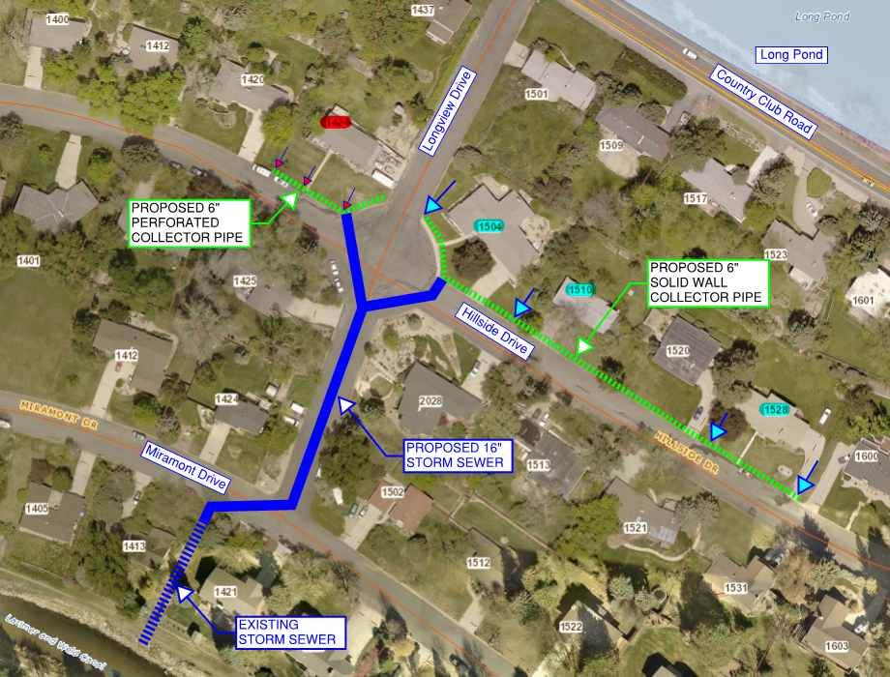
HILLSIDE DRIVE LOCAL IMPROVEMENT DISTRICT #2019-2
Design LAYOUT
This project is solely intended to improve localized drainage issues.
It is not a road or pavement repair project.
Longview Drive Storm Drain System
County funded and maintained
Hillside Drive 6-inch collector pipe
Privately funded through LID
Final Design is Complete.
Notes:
Meeting Notices, Google Group, and County efforts to communication information and be transparent

Slide 4
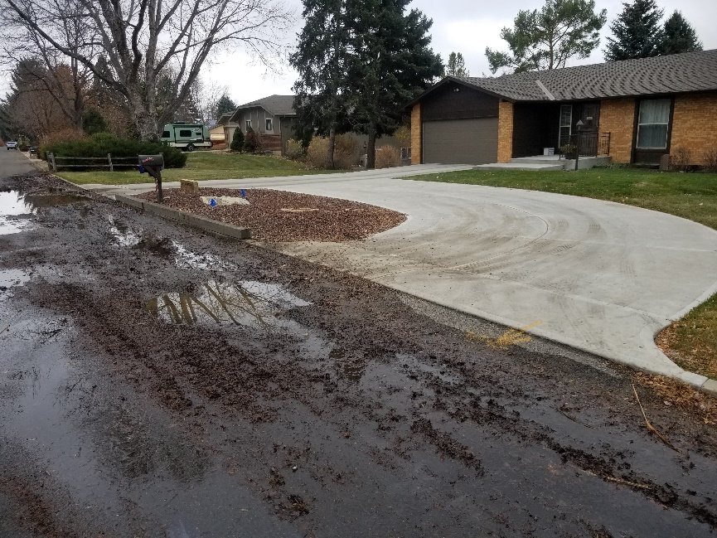
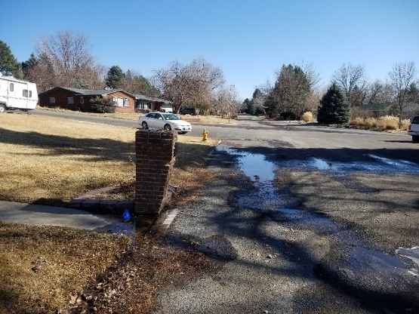
HILLSIDE DRIVE LOCAL IMPROVEMENT DISTRICT #2019-2
Project PROPOSAL
If Project is Constructed:
Localized drainage and resulting nuisance and safety problems on the neighborhood roadways will be mitigated.
460 feet of new storm sewer for county maintenance on Longview Drive will be added.
Continuation of roadway pavement failure will be lessened.
Required utility relocations may cause unintentional road damage.
Plan to begin construction in September and complete project by end of 2019.
If Project is NOT Constructed:
Drainage / Safety problems will persist
Pavement will continue to deteriorate faster
County will continue to receive complaints from residents
Notes:
Meeting Notices, Google Group, and County efforts to communication information and be transparent

Slide 5
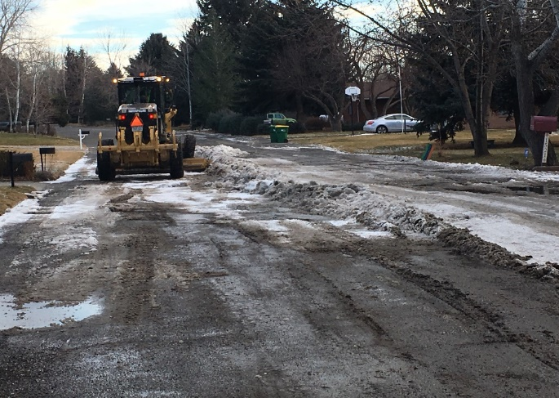
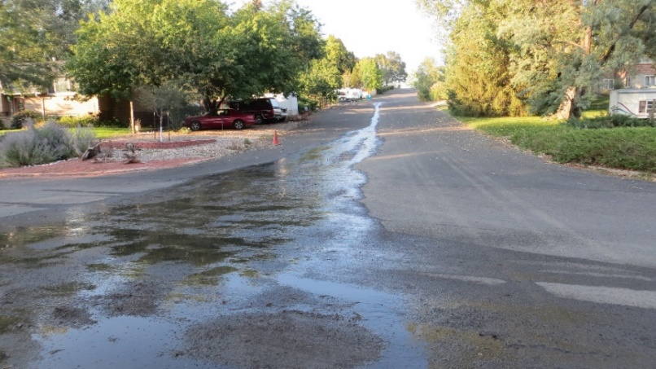
HILLSIDE DRIVE LOCAL IMPROVEMENT DISTRICT #2019-2
public/private funding and LID
Total Construction Cost Estimated at $281,000 and MAY INCREASE
Recommendation that the 5 Hillside Drive property owners be included in a Local Improvement District to financially contribute $55,000 toward the total project cost.
County to provide a 4-year loan
Individual property owners can pay off in a one-time up-front assessment to avoid interest or in installments with interest at 3.47% beginning in 2020 ($2,993 per year).
1.01% County Treasurer’s Fee if paying in installments.
4 out of 5 owners have expressed support for an LID.
Remaining portion funded by LC Road & Bridge which is approximately $226,000 and MAY INCREASE due to possible enlargement of necessary pavement replacement limits or unsuitable road subgrade material.
Notes:
Meeting Notices, Google Group, and County efforts to communication information and be transparent

Slide 6
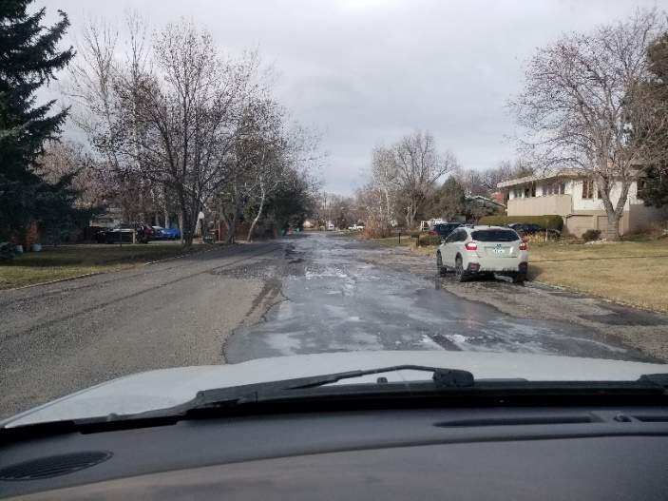
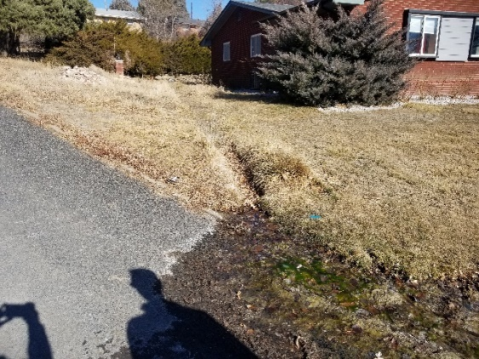
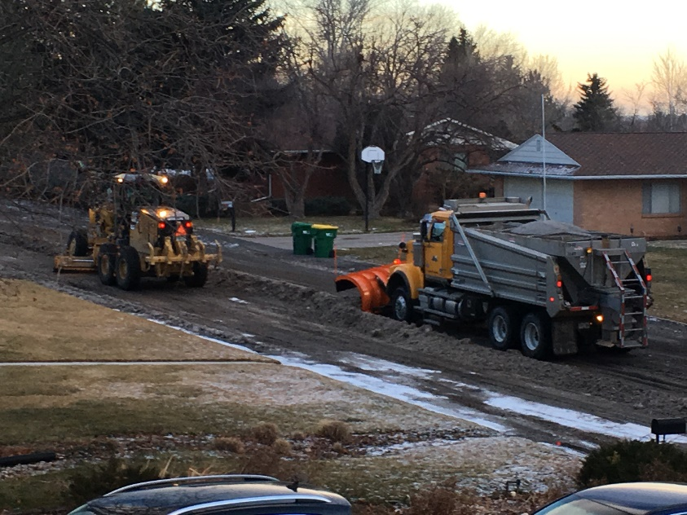
HILLSIDE DRIVE LOCAL IMPROVEMENT DISTRICT #2019-2
Questions?
Notes:
Meeting Notices, Google Group, and County efforts to communication information and be transparent

