Slide 1
Behavioral Health Services Laurie Stolen Larimer County Behavioral Health Director

Slide 2
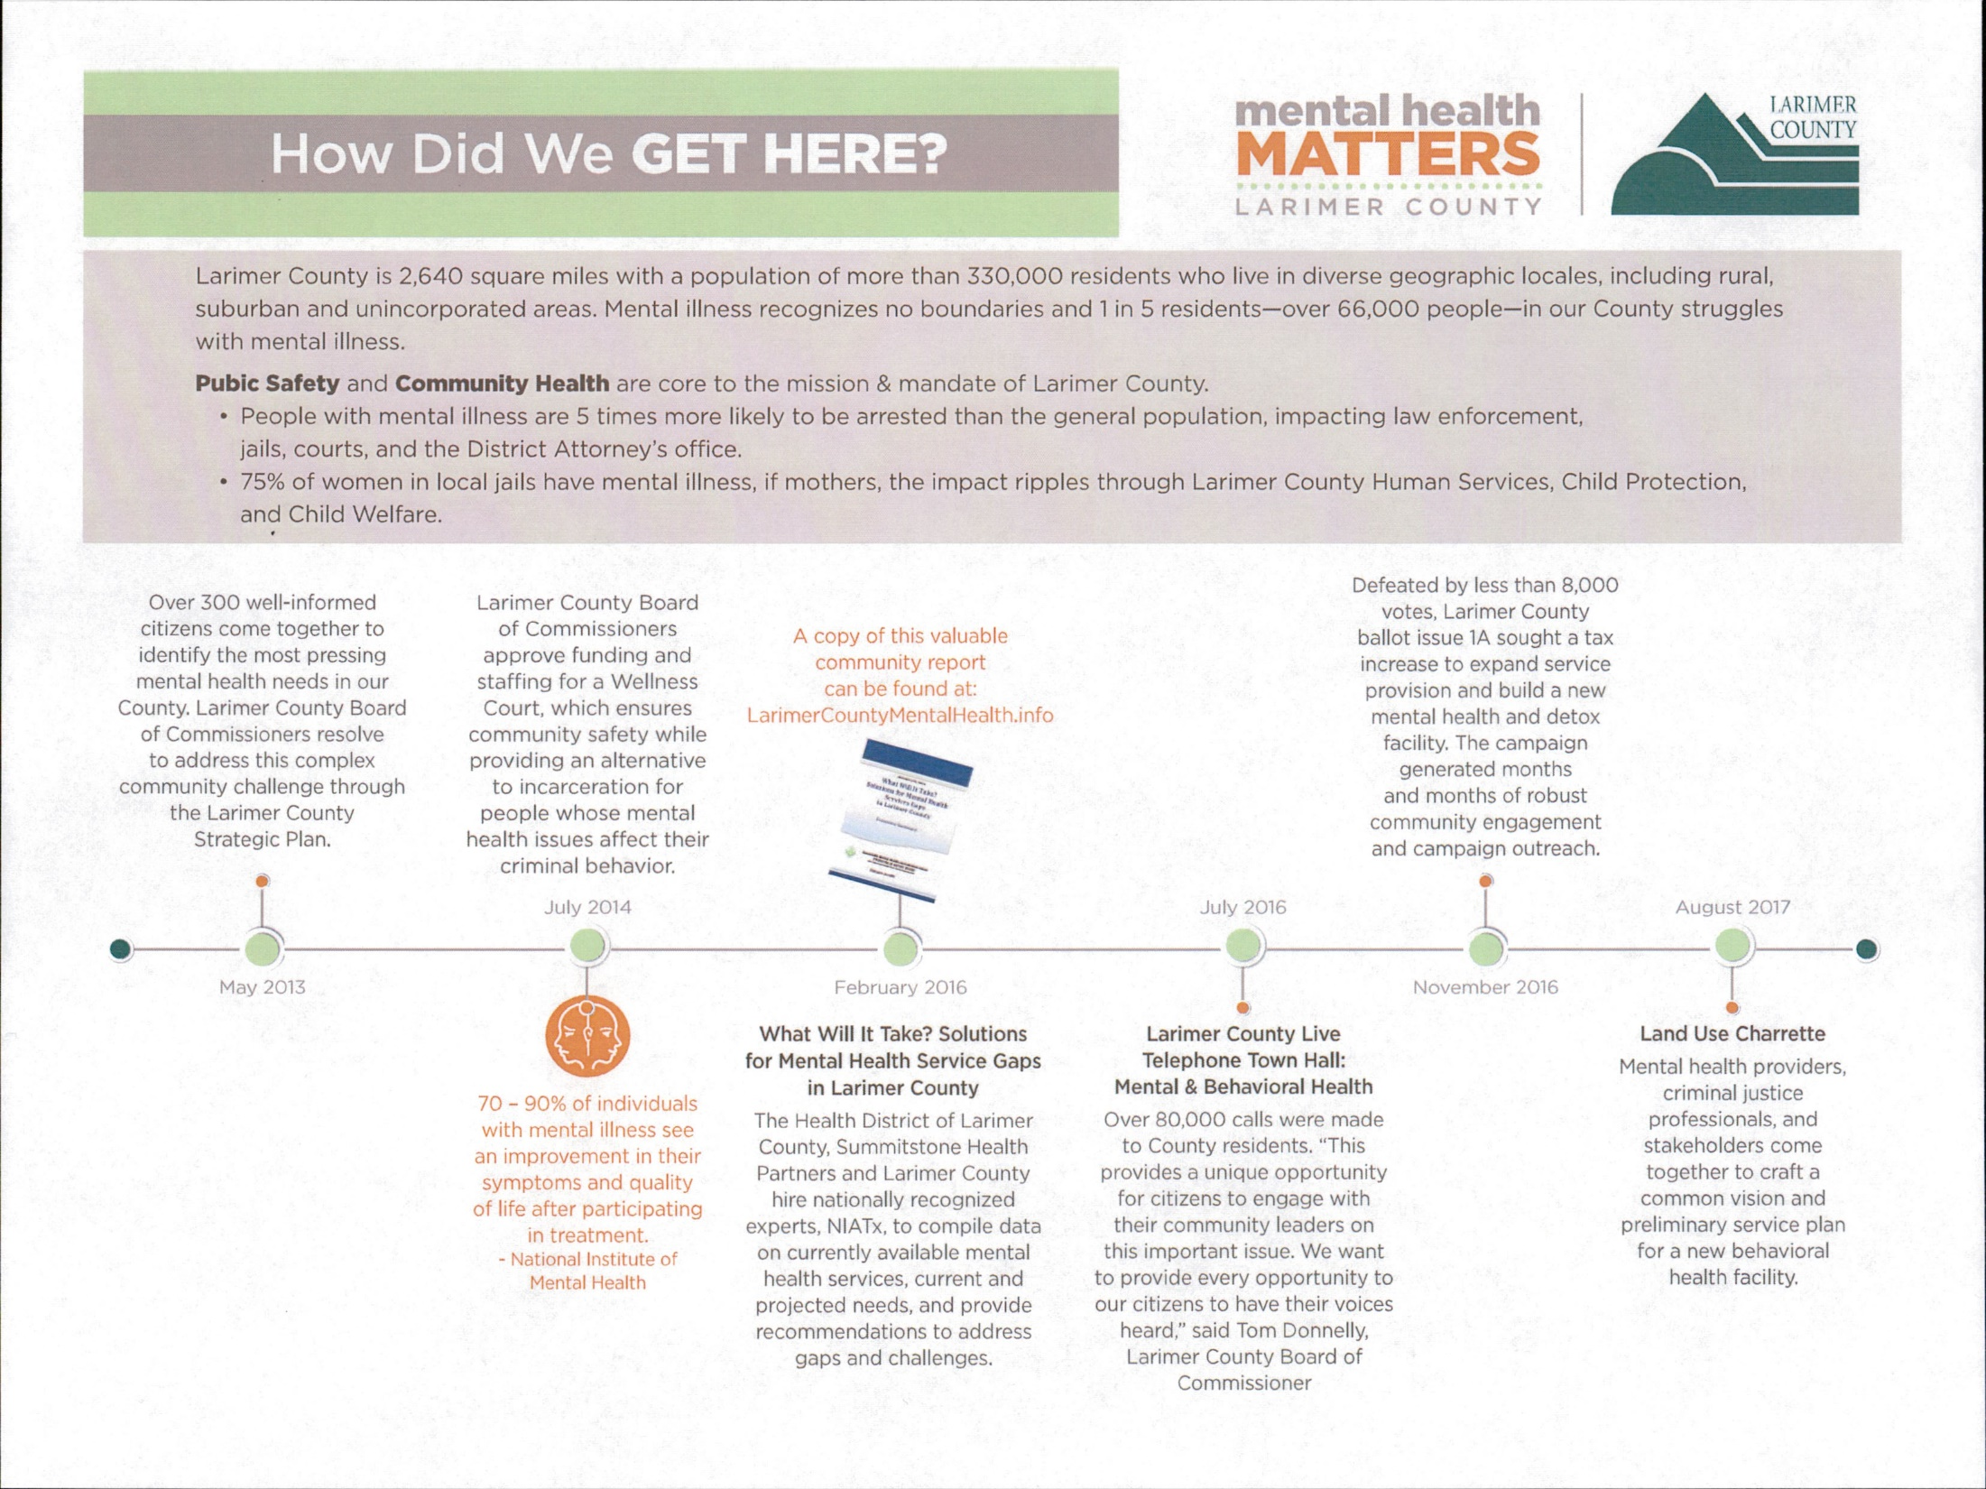

Slide 4
Timeline 2016-Failed ballot initiative 2017-community engagement/listening/awareness building 2018-Successful ballot initiative 2019-Here we go!

Slide 5
The Solution is Community Wide
Our work is informed by national experts and local professionals:
The solution has a dedicated funding stream, and is 3-pronged:
Expand & enrich local behavioral health services throughout the County through distributive services and oversight.
2. A community behavioral health facility to provide crises care, detox and residential treatment services.
Coordinated care from crisis care to community care for
long-term success.

Slide 6
Behavioral Health Services Funding Pathways
BOCC
Board of County Commissioners
Behavioral Health Services
Increase access to appropriate, affordable care
Distributed Services
Grant funds to expand existing community services
Client Assistance Fund
Special fund to decrease barriers & coordinate care
Facility
Funds for design, construction, & contracted services for facility AND monies for designated community services

Slide 7
Future Behavioral Health Team Collaboration
Director
Behavioral Health Department vision, directives, and oversight
Behavioral Health Program Director
Business Operations Manager
Behavioral Health program support and community outreach
Behavioral Health financial processes, grant and contract support, structure, and reporting
Behavioral Health Planner and Eval. Spec.
Behavioral Health data collection, research, and evaluation

Slide 8
Distributed Services
TAC
Technical Advisory Committee
Manage grant proposals & present to PAC
PAC
Policy Advisory Committee
Set objectives & distribute grant funds
Distributed Services
Grant funds awarded to expand existing community services
2021
$2.6M
2020
$2.5M
2019
$1M

Slide 9
Client Assistance Fund
Client Assistance Fund
Special fund to decrease barriers & coordinate care
Transportation
MAT
Medically Assisted Treatment
PSH
Staffing for Permanent Supportive Housing
Co-Pays/Deductibles
IOP
Intensive Outpatient
2021
$4M
2020
2019

Slide 10
Facility
Facility Budget
Funds for design, construction, & contracted services for facility AND monies for designated community services
Facility Operations
Community Operations
Laundry
On-Site Clinical Services
EIEI
Early identification, Early intervention
2019
$2.7M
Design
Med Triage
Food
Telehealth
Assessment
2020
$19.5M
Design & Construction
Sober Living
Transportation
Detox
2021
$7.6M
Construction & Facility Operations
PSH
Permanent Supportive Housing
STIRT
Security
Crisis Stabilization Unit
MAT
Medically Assisted Treatment
MAT

Slide 11
A Community Master Behavioral Health Plan
Includes:
MHSU Alliance Road Map Report
Site Design and Land Planning Report
Community Health Improvement Plan
Municipal Partnerships
School District (PSD/TSD/EPSD) Partnerships
Community priorities

Slide 12
What this Initiative ISN’T
It’s not a hospital-all care proposed is below hospital level of care or community based services.
It’s not competitive or duplicative of any services already provided in our community, it is intended to bridge the gaps between what we currently have and what we don’t.
It’s not going to be a County service. The services will be provided by providers in our community.

Slide 13
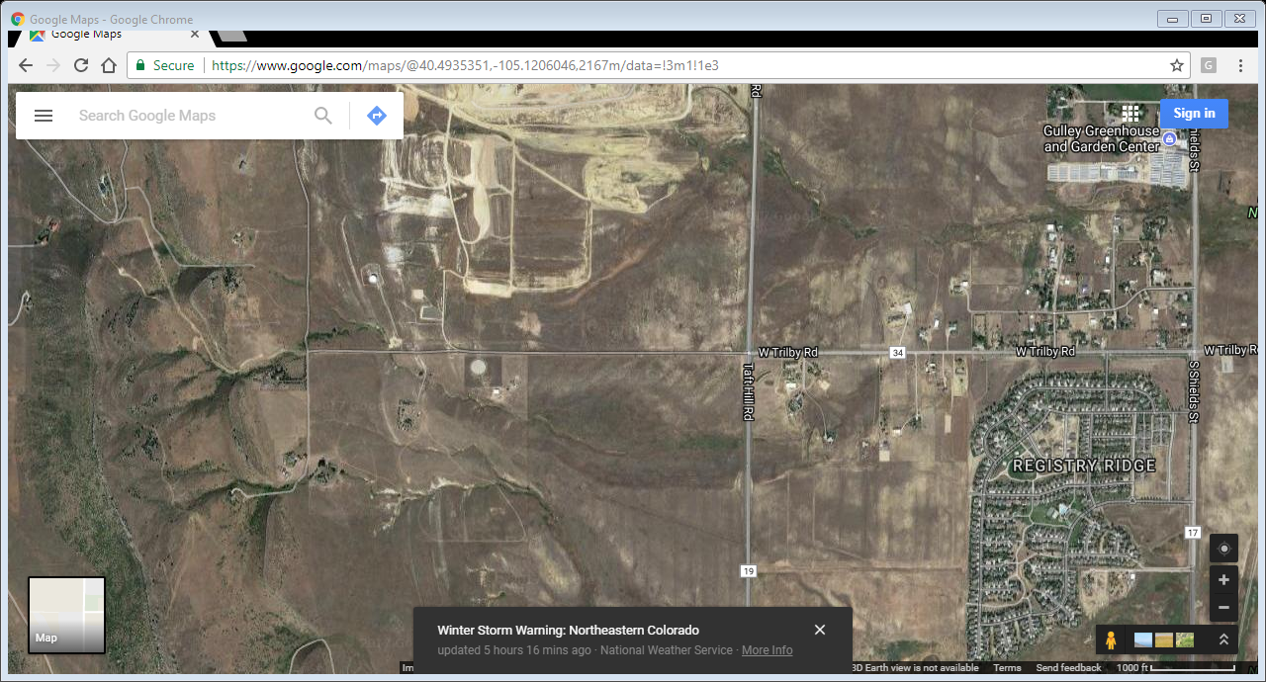
Available County Land: 40 acres of land to the northwest corner of the intersection of South Taft Hill Road and Trilby Road
between Fort Collins and Loveland

Slide 14
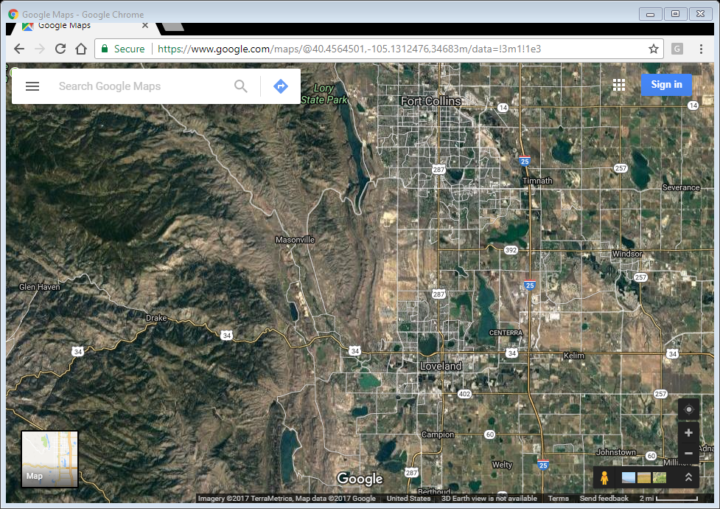
Available County Land: 40 acres of land to the northwest corner of the intersection of South Taft Hill Road and Trilby Road
between Fort Collins and Loveland

Slide 15
Questions?

Slide 16
Laurie Stolen
Larimer County Behavioral Health Director
2601 Midpoint Dr.
Fort Collins, CO 80525
stolenle@larimer.org
970-498-7126

