Slide 1
Larimer County 101
Budget office overview
March 28, 2019

Slide 2
Larimer county 101 – budget office overview
contents
What does the Budget Office do?
What is the Budget?
How is the Budget developed?
How is the County funded?
Where does your tax money go?
What did You Think the County Budget should fund?
What does the County Budget actually fund?
Questions?

Slide 3
Larimer county 101 – budget office overview
What does the budget office do?
Project the Future
What is the economy doing? What will it do?
What are the County’s long-term needs for service and assets?
Is the County sustainable?
What will the State and Federal governments do to us?
Notes:
Josh Slide

Slide 4
Larimer county 101 – budget office overview
What does the budget office do?
Project the Future - What’s out there?
Significant asset needs to provide services:
Transportation Network & Maintenance Capabilities
Jail Expansion
Justice Center Expansion
Human Services
Community Corrections
The Ranch
Continued Population Growth
Recession?
State/Federal Mandates & Funding
Natural Disasters
Notes:
Linda slide

Slide 5
Larimer county 101 – budget office overview
What does the budget office do?
Develop the Annual Budget
Advise County Manager and BOCC on Budget Targets
Review Budget Requests
Assist County Manager in developing a Proposed Budget
Assist BOCC in Adopting a Budget
Notes:
Josh Slide

Slide 6
Larimer county 101 – budget office overview
What does the budget office do?
Monitor the County’s Finances
Review last year
Monitor, amend, and project the Current Year
Notes:
Josh slide

Slide 7
Larimer county 101 – budget office overview
What is the budget?
It’s a big table of numbers, sure…
Notes:
Josh slide

Slide 8
Larimer county 101 – budget office overview
What is the budget?
Those numbers:
Show how much money is available to spend
Sets limits on how much money may be spent
Allows for employees to be hired
Shows how much a service or program costs
Covers a calendar year
The County should receive about $526.5 million in 2019
The County should spend about $495.5 million in 2019
Notes:
Josh slide

Slide 9
Larimer county 101 – budget office overview
What is the budget?
The Larimer County Budget includes two parts:
Operating – Annual Budget with 5-Year Forecast
Employees that provide service to the public
Contractors that provide service to the public or the County
Supplies used to provide service
Maintenance of assets
Capital – Annual Budget with 5-Year Plan
Generally, physical assets used to provide services
Buildings and land
Large software programs
Vehicles
Equipment
Notes:
Josh slide

Slide 10
Larimer county 101 – budget office overview
What is the budget?
The Budget is also a Statement of Priorities:
On what MUST the money be spent?
On what CAN the money be spent?
On what will the money NOT be spent?
What results are we purchasing?
How much service will be provided?
How well will the service be provided?
Who will pay?
How much will they pay?
Notes:
Josh slide

Slide 11
Larimer county 101 – budget office overview
What is the budget?
Notes:
Josh slide

Slide 12
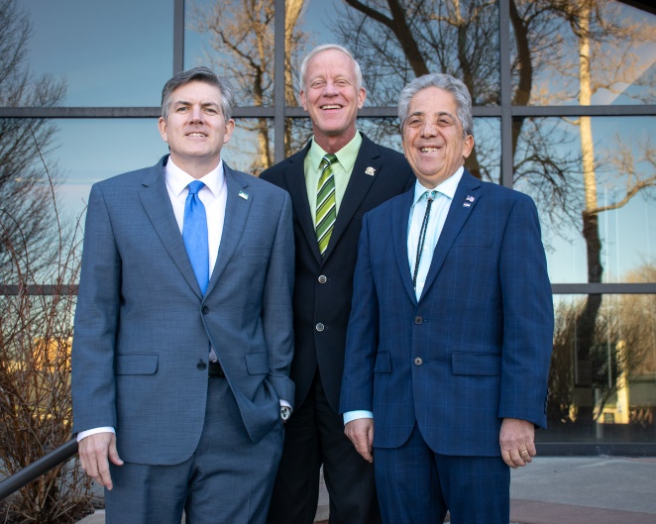
Larimer county 101 – budget office overview
How is the budget developed?
Federal & State
Mandates
Voter Approvals/
Expectations
Economics,
Projections & Plans
Department Requests
Notes:
Josh slide

Slide 13
Larimer county 101 – budget office overview
How is the budget developed?
January: Carry over expenses from prior year
Jan-March: Forecasting, SWOT Analysis, 5 & 20 year projections
May: Develop County Support (General Fund) Targets
July: Compensation is determined
Mid August: Capital requests are turned in
Notes:
Josh slide

Slide 14
Larimer county 101 – budget office overview
How is the budget developed?
Mid-August: Assessor provides initial value estimates
Late August: Operating budget requests are submitted
September & October: Review budget requests
October 15: County Manager submits Proposed Budget to BOCC
Early December: Assessor certifies final values
By December 22: BOCC adopts budget and certifies mill levies (tax rates)
Notes:
Josh slide

Slide 15
Larimer county 101 – budget office overview
How is the county funded?
Four primary sources:
Larimer County and Visiting Taxpayers
The State of Colorado and the Federal Government
People who use County services
The County itself
Notes:
Josh slide

Slide 16
Larimer county 101 – budget office overview
How is the county funded?
2019 Revenues by Category:
Notes:
Josh slide

Slide 17
Larimer county 101 – budget office overview
How is the county funded?
Property Taxes – 25% of the County’s Revenue:
Governed by State Law and the State Constitution: Taxpayers’ Bill Of Rights (TABOR) and the Gallagher Amendment
TABOR: County may retain excess revenues (referendum in 1999), but may not raise tax rates or issue debt without vote of the people
Gallagher Amendment: Requires that property taxes on residential property not exceed 45% of Statewide total.
Residential Property currently assessed at 7.2% of actual value for tax purposes (RAR); all others at 29%
Notes:
Linda slide

Slide 18
Larimer county 101 – budget office overview
How is the county funded?
* = Not including tax-exempt property such as schools, churches, government-owned, etc.
Notes:
Linda slide

Slide 19
Larimer county 101 – budget office overview
How is the county funded?
Budget Year | RAR | County Mill Levy
1990 | 15.0% | 18.974
1995 | 10.4% | 21.571
2000 | 9.7% | 21.571
2005 | 8.0% | 21.571
2010 | 8.0% | 21.571
2017 | 8.0% | 21.571
2018 | 7.2% | 21.571
2020 | 6.95%* | 21.571
* = State estimate as of January; final rate proposed by April 2019
Notes:
Linda slide
Drop to 6.95% will cost County approximately $2.7 million (with 12% value growth)

Slide 20
Larimer county 101 – budget office overview
How is the county funded?
Notes:
Linda slide

Slide 21
Larimer county 101 – budget office overview
How is the county funded?
Larimer County receives about 25%* of your Property Taxes
Larimer County receives about 11*% of your Sales Taxes
* = City of Loveland, Thompson School District
* = City of Fort Collins
Notes:
Josh slide

Slide 22
Larimer county 101 – budget office overview
What did you think the budget should fund?
Service Category | Group Low | Group High | Group Average
Public Safety | $4 | $40 | $24
Community Planning, Resources & Infrastructure | $10 | $50 | $27
Human & Economic Health | $10 | $40 | $23
Public Records & Information | $5 | $20 | $12
Support Services | $5 | $30 | $14
Notes:
Josh slide

Slide 23
Larimer county 101 – budget office overview
What does the county budget actually fund?
Service Category | Group Average | Real Amount
Public Safety | $24 | $34
Community Planning, Resources & Infrastructure | $27 | $20
Human & Economic Health | $23 | $28
Public Records & Information | $12 | $6
Support Services | $14 | $12
Notes:
Josh slide

Slide 24
Larimer county 101 – budget office overview
What does the county budget actually fund
2019 Expenditures by Service Category (in millions):
Notes:
Josh slide

Slide 25
Larimer county 101 – budget office overview
What does the county budget actually fund
2019 Expenditures by Type as % of Total:
Notes:
Josh slide

Slide 26
Larimer county 101 – budget office overview
questions?
Thanks!

