Slide 1
LARIMER COUNTY 101
THE CORONER/ MEDICAL EXAMINER

Slide 2
“CORONER” VS. “MEDICAL EXAMINER”
In Colorado, each county must have an elected Coroner. The requirements for Coroner are:
  Must live in the County
  Must be 18 years old or older
  Not a felon
  Anyone fulfilling the above 3 requirements may be elected Coroner. Coroners need almost no training; (although this is beginning to change).

Slide 3
When a Forensic Pathologist is elected or appointed as the Coroner, that jurisdiction is considered a MEDICAL EXAMINER system.
  Larimer County is considered a Medical Examiner county, as our elected Coroner is a medical doctor/ forensic pathologist.
  Larimer County is one of only 4 Counties in Colorado to be recognized as a certified Medical Examiner system, and is the smallest in the US! We have held this certification since 2002, but would lose it if we did not have a Pathologist in charge of the office.
  Since the 1930’s, large jurisdictions across the US have recognized the benefit of having a medical doctor to oversee death investigation practices. This office should be medical, not political.
  Efforts are being made to make Colorado a Medical Examiner State.

Slide 4
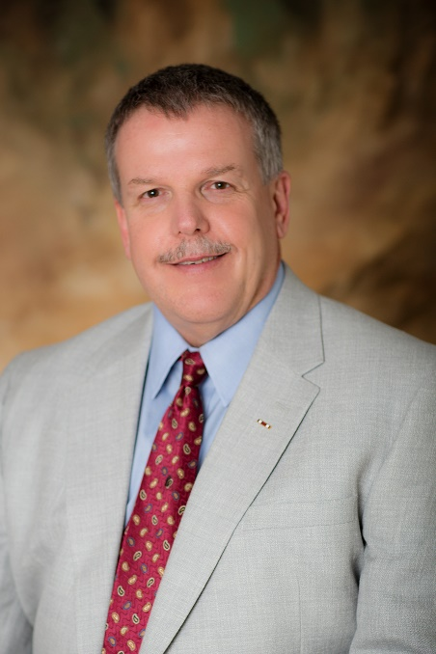
Forensic pathologists in Colorado
Approximately 400 in United States (& declining)
Approximately 14 currently in Colorado
Larimer County has access to Dr. Wilkerson’s partnership, which includes 4 experienced forensic pathologists!

Slide 5

Training to become a Forensic Pathologist/ Medical Examiner
Approximately 12-13 years of schooling after high school!
  College, specializing in medical fields (4 yrs)
  Medical school (4 yrs)
  Specialized training in Pathology, including Clinical and Anatomical (2-3 yrs)
  Specialized training in Forensic Pathology with Forensic Fellowship and Boards (1-2 yrs)

Slide 6

Credentials OF OUR ELECTED CORONER
Due to the extreme amount time and cost of schooling, numbers of forensic pathologists across the US are decreasing, in spite of the demand.
Dr. James Wilkerson, IV, MD, Forensic Pathologist:
Nearly 30 years experience
Partner in Pathology group of northern Colorado since 2008
Elected Larimer County Coroner/ Chief Medical Examiner in 2014

Slide 7
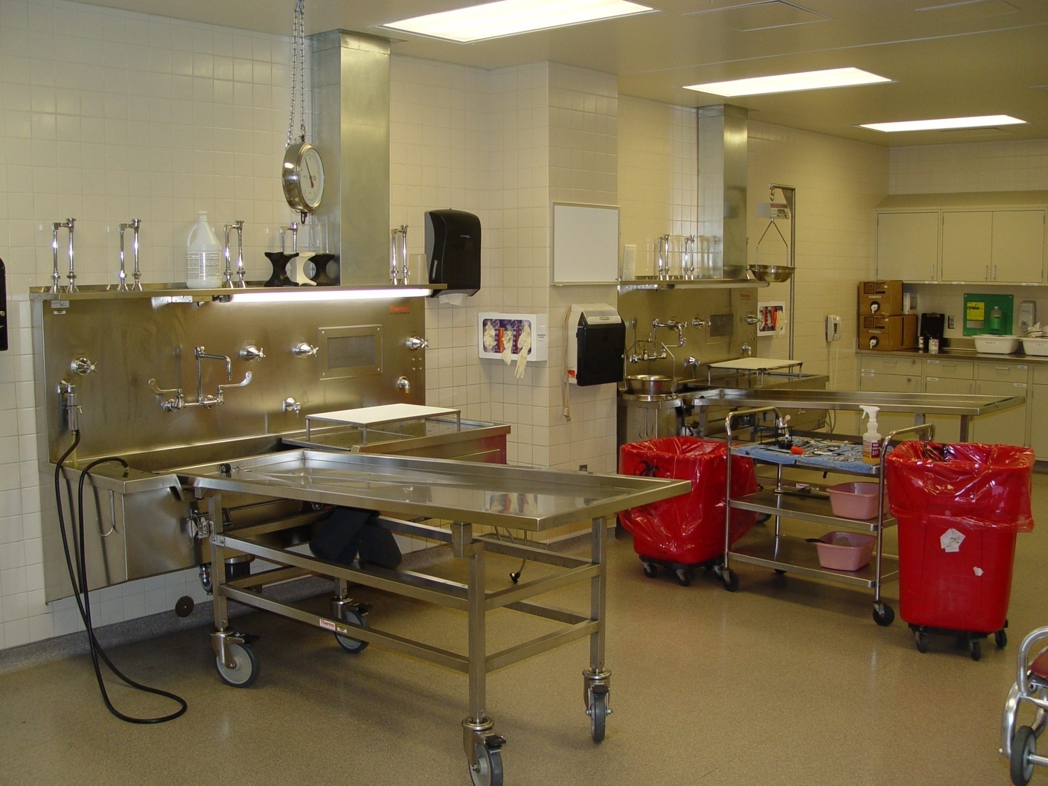
Forensic Autopsies include:
External exam w/ clothing in place
  Documentation of clothing, jewelry, personal items, and traumatic patterns on clothing
External exam w/ clothing removed
  Documentation of scars, tattoos, injuries
Evidence collection from clothing and body
Internal exam (surgical procedure)
  Documentation of any internal injury
  or disease
Toxicology
Histology
Microbiology
Radiology

Slide 8
WHAT HAPPENS WHEN A DEATH OCCURS?
Typically, 911 is called;
Once death is verified by responding EMS and police, the Coroner’s Medical Investigator is paged.
Two Investigators are always on call, 24/7/ 365. One is primary and one is back-up, in case something else occurs somewhere else at the same time.
The investigator responds to the scene immediately.
The Investigator takes photographs, conducts interviews, and collects evidence pertaining to the death, that will help determine:
  What medically shut down the body (Cause of death)
  Manner of death (Homicide, Suicide, Accident, Natural, and Undetermined)
  Date and Time of Death, as closely as possible
  Evidence to Positively Identify Victim
Investigators also must find the Next-of-Kin and ensure proper and timely notification

Slide 9
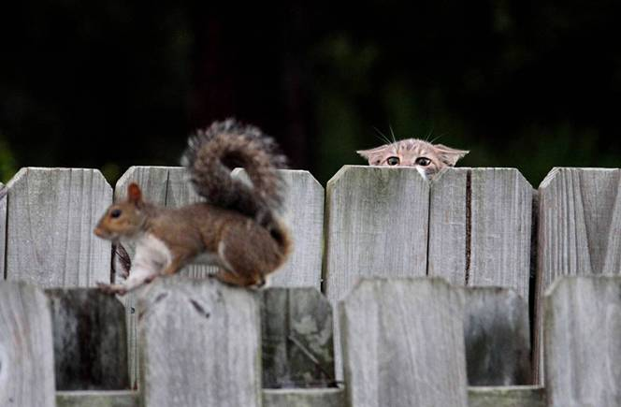
Criminal Investigation for Law Enforcement
DIFFERENCE BETWEEN POLICE AND CORONER INVESTIGATIONS:
Prove a crime was committed
Identify the person(s) responsible for the crime
Locate and charge the suspect with the crime
Successful prosecution

Slide 10
Death investigation (coroner)
Coroner’s Statutory Responsibilities
CRS 30-10-606
We are a neutral, separate law enforcement agency, set up by Colorado Statute, and required to investigate:
  Any death that occurs under non-natural circumstances, including:
    All suspected homicides
    All suspected suicides
    All suspected accidents
    Any death occurring in law enforcement custody
    Skeletal remains
    Any child death
    Any person who dies within 24 hours of hospital or nursing home admission

Slide 11

Education for Medico-legal Death Investigators in Larimer County
(currently 7 investigators covering Larimer county 24/ 7 / 365)
  Colorado P.O.S.T. (Police Officer Standards Training) Certification
  College degree in Forensics, Criminal Justice, or Medical
  Medical training
  (A & P, EMT, Pre- Med, Nursing)
  State and National Death Investigator Certification
  Continuing education in medical and legal courses.

Slide 12
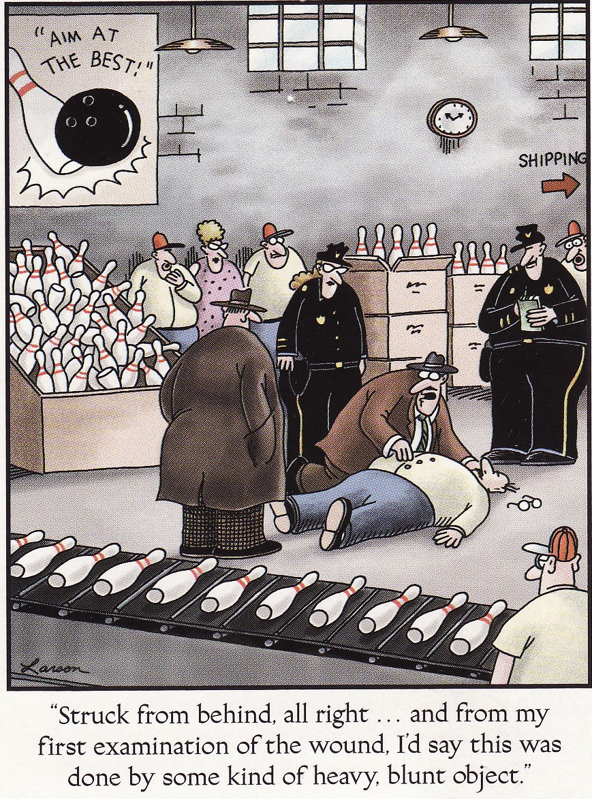
investigators MUST HAVE CONTINUING EDUCATION in………
Forensic Photography
Blood Spatter
Pattern Injuries
Ballistics/ Gunshot wounds
Grief Counseling
Anatomy, Physiology & Medical
Toxicology
Motor Vehicle Accident Reconstruction
Forensic Report Writing
Evidence Collection
Forensic Anthropology
Forensic Entomology
Interviewing Techniques/ Body Language

Slide 13

What determines if an autopsy is necessary?
Natural deaths with no extenuating circumstances, (choking, falls, suicidal threats, etc.) AND the person has a documented medical history that corresponds to the circumstances of the death will usually NOT warrant the need for an autopsy.
HOWEVER, if there are any “red flags” on scene or in the history that the death may not be due to disease alone, an autopsy will be done to answer those questions.
Since our autopsies are paid for by taxpayer dollars, we are very conservative and will not do unnecessary or “medical curiosity” autopsies.
At the same time, we must legally answer questions and document non-natural deaths, so we WILL do autopsies if there is a need.

Slide 14
In Larimer County in 2017, nearly 2,800 deaths were reported to us; we performed around 250 full and partial autopsies.
Drug overdoses and suicides are both on the rise in Larimer and across the country.
Following is one example of informed decisions we make and how we can aid law enforcement…………………

Slide 15
91 YO MALE W/ TERMINAL CANCER DX, DIED AT HOME.
We were told that he fell at a local gas station 1 one week prior and sustained some minor cracked ribs

Slide 16
Autopsy showed fingerprint bruises and a fractured hyoid bone
(manual strangulation)

Slide 17
Due to the information about cracked ribs, and the possibility of a lawsuit against the convenience store, we elected to do an autopsy.
At autopsy, this case quickly went from a terminal cancer case………..
To a possible accident from a fall…………….
To a confirmed homicide.

Slide 18
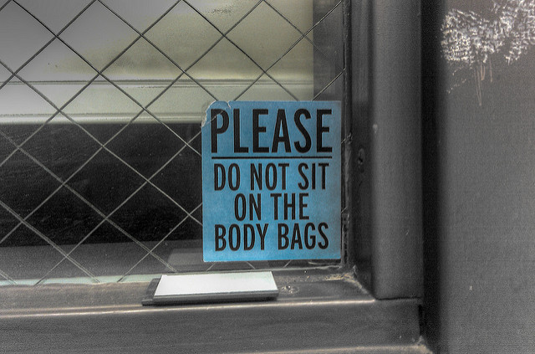
QUESTIONS?
Dianne Fairman
Chief Deputy Coroner/
Chief Investigator
For more information: www.Larimer.org/coroner

