Slide 1
Larimer County
Solid Waste Fund Analysis

Slide 2
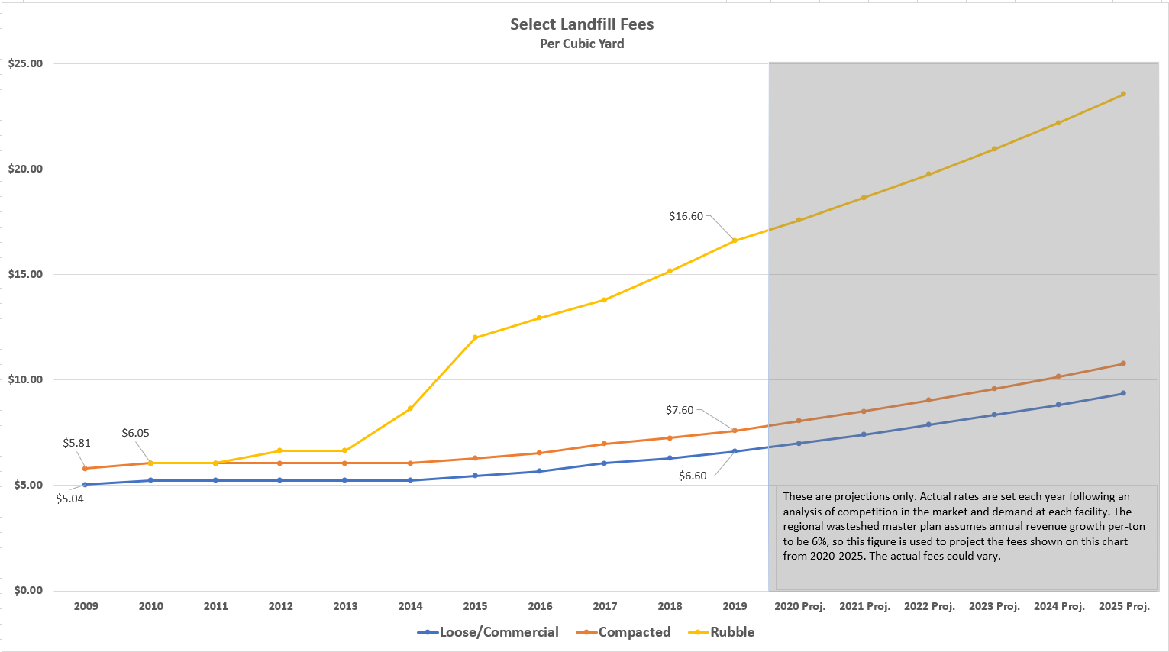
Larimer county 2020 budget
Fee History

Slide 3
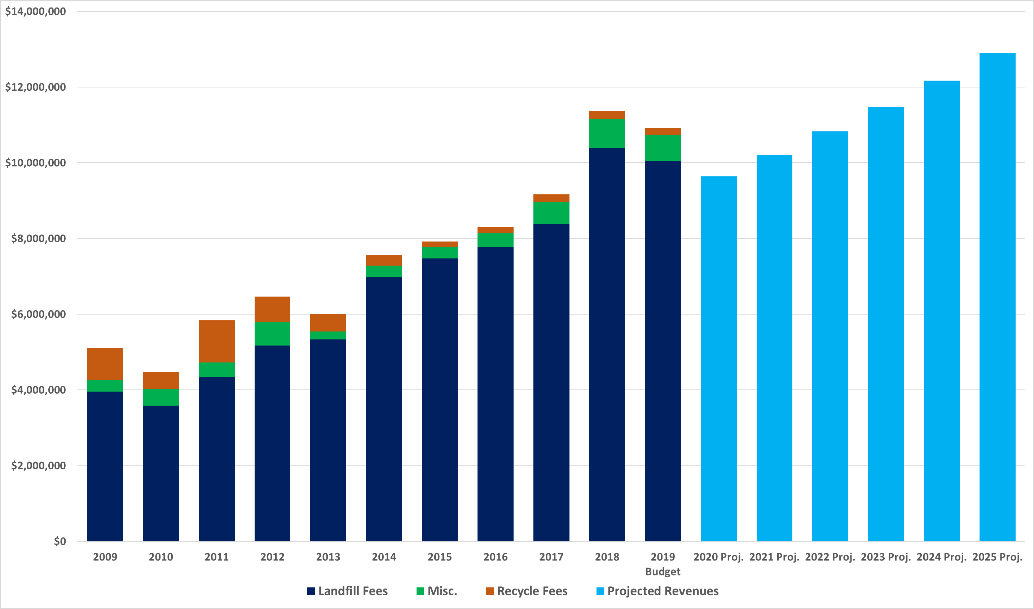
Larimer county 2020 budget
Actual and Projected Revenues

Slide 4
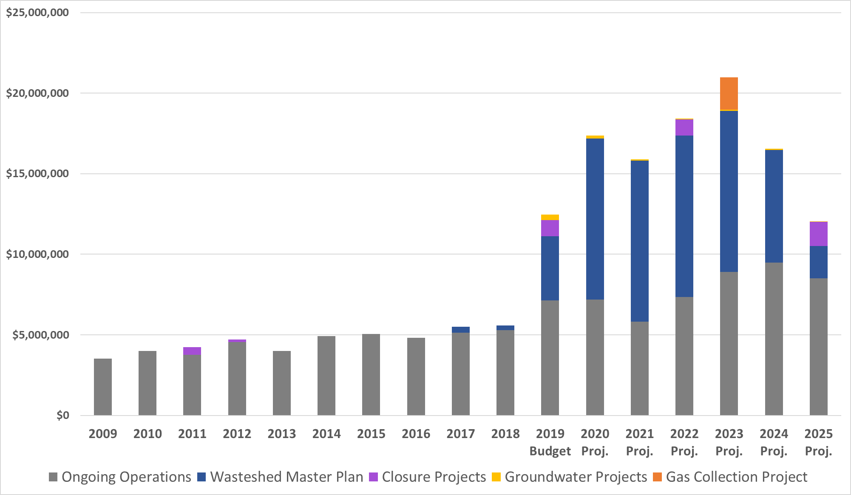
Larimer county 2020 budget
Actual and Projected Expenses

Slide 5
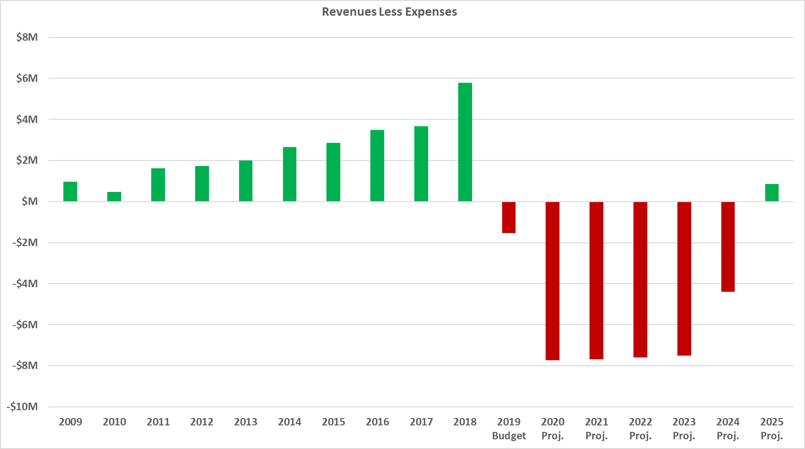
Larimer county 2020 budget
Net Profit / (Loss)

Slide 6
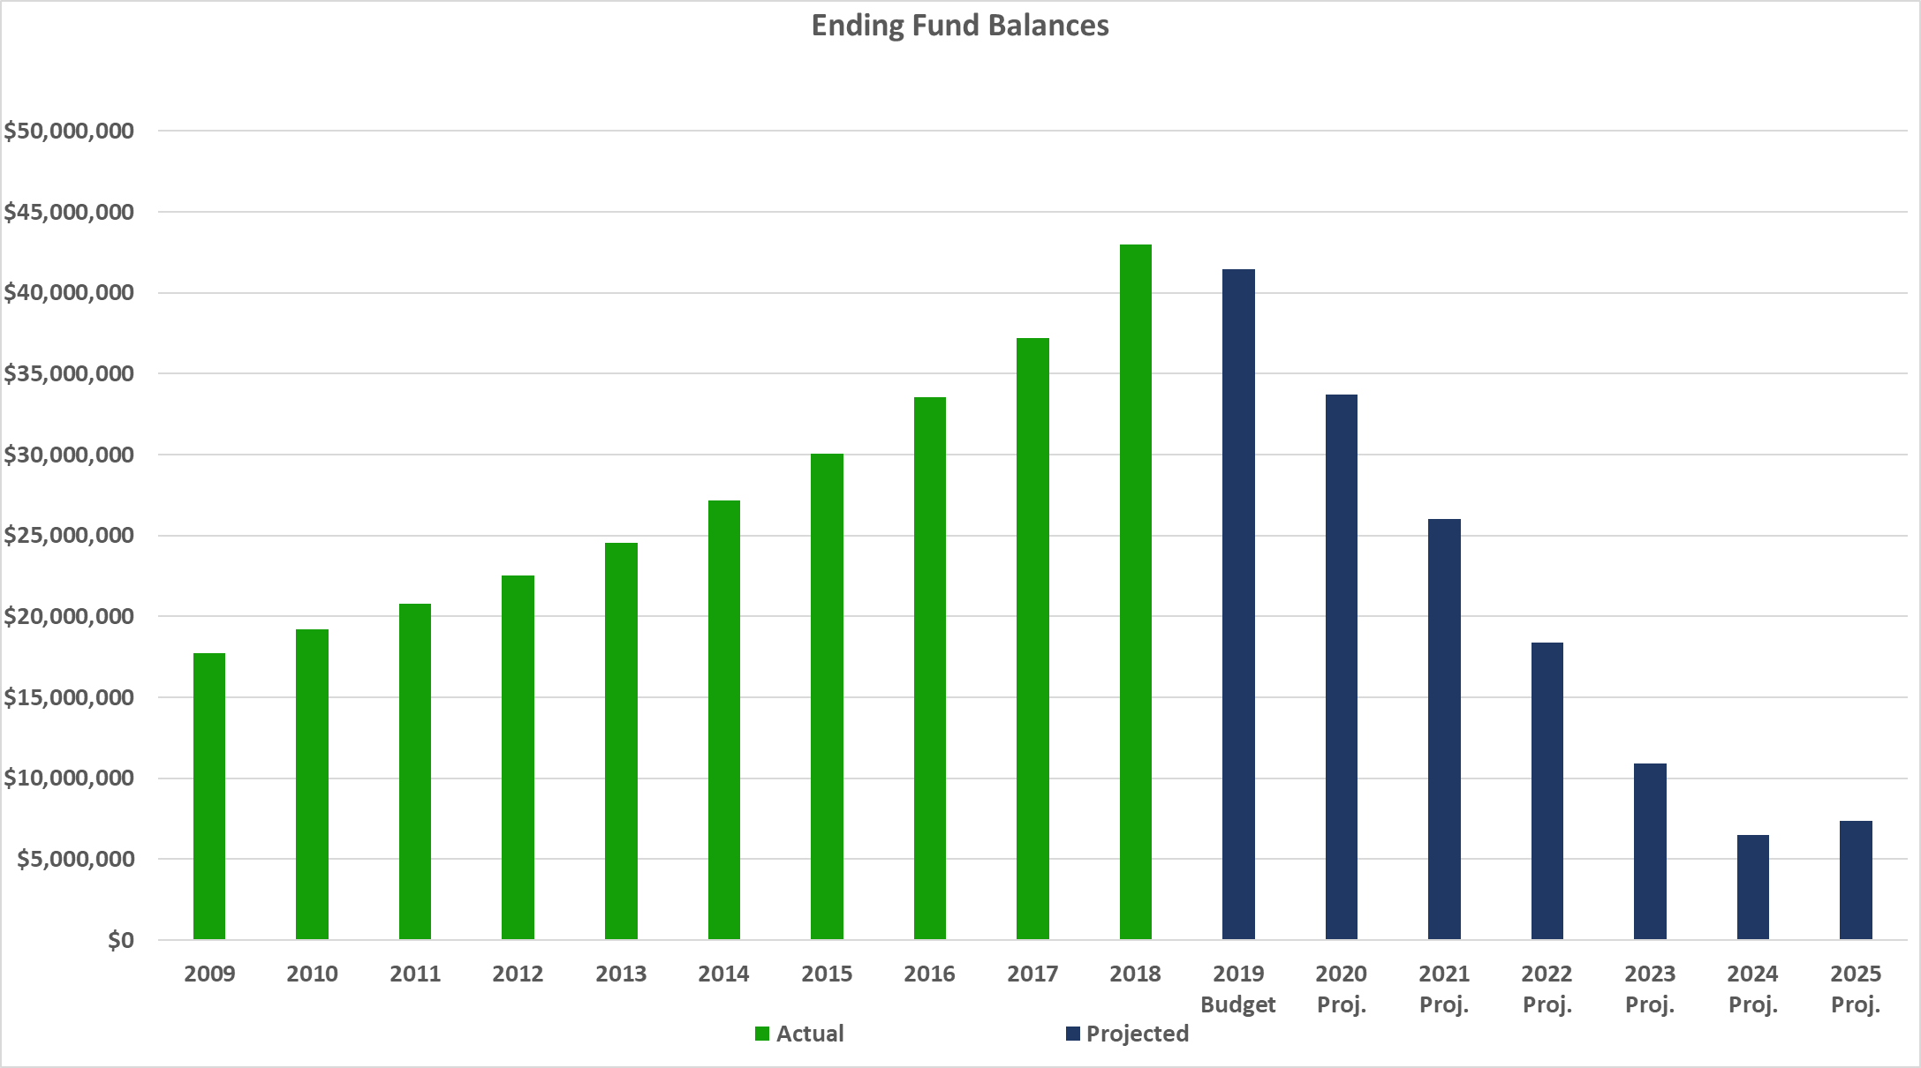
Larimer county 2020 budget
Fund Balance

