Slide 1
LARIMER COUNTY: Human Services
Larimer 101 Department of Human Services
April 11, 2019

Slide 2
Larimer 101 Department of Human Services
Mission Statement
Department of Human Services
Mission Statement:
To provide safety and support for children and vulnerable citizens.

Slide 3
Larimer 101 Department of Human Services
Agenda
Opening Statement: Laura Walker
Child, Youth and Family Division
Benefits and Community Support Division
Program Integrity and Investigations
Accounting

Slide 4
Larimer 101 Department of Human Services
What is Abuse and Neglect?

Slide 5
Larimer 101 Department of Human Services
Child Protective Services

Slide 6
Larimer 101 Department of Human Services
RED Team: Review, Evaluate and Direct
RED Team is:
•Group process for decision making using an applied framework that starts us in the direction of a balanced assessment
•Evaluation of available information
•Critical Thinking in Action
•Direction regarding agency response
•Addresses the following…
•Does reported information meet the threshold for intervention?
•If situation doesn’t require a response, should it be referred for Family Visitor Program?
•Does accepted report require traditional forensic assessment?
•Does report present a child concern that can be addressed through a FAR?
Established in Olmstead County, Minnesota – 1999

Slide 7
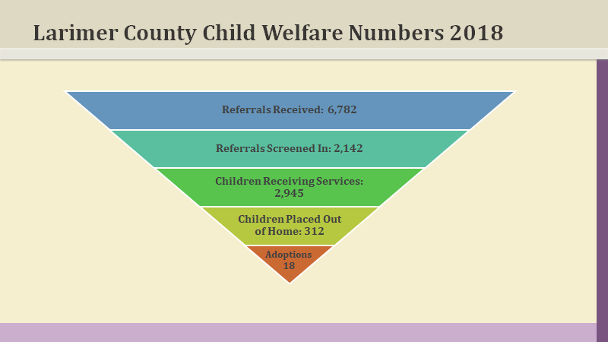
Larimer 101 Department of Human Services
Larimer County Child Welfare Numbers 2018

Slide 8
Larimer 101 Department of Human Services
Benefits and Community Support Division
Food Assistance (SNAP)
(11, 582 cases. Average benefits per person $119, per household $231)
Eligibility for food assistance, or the Supplemental Nutrition Assistance Program (SNAP), is determined by income limits set by the Federal Government. The assistance funds vary depending upon the household.
Health First Colorado
(Family Medicaid 38, 293 , Adult Medicaid 6,161 participants Medicare Savings programs 3, 544)
3 types of health plans: Physical health plan (which includes vision and prescription drugs), Dental health plan, Behavioral health plan
Medicare Savings Program (MSP) Programs that may pay for your Medicare A & B premiums and/or co-pays and deductibles
Colorado Works (TANF) (869 households)
Colorado Works/Temporary Assistance to Needy Families (TANF) is a federal program that provides cash assistance to qualifying families of at least one parent and one child while they are preparing for, looking for and/or maintaining employment.
Grandparents or other relatives may qualify to receive TANF cash assistance for children under their care.
Child Care Assistance Program (CCAP)
(Open cases 448 serving 423 children. Enrollment freeze in place with 227 children on the waitlist)
The Colorado Child Care Assistance Program (CCCAP) provides child care assistance to families who meet the income guidelines and are working, searching for employment, or are in training, teen parents, and families who are enrolled in the Colorado Works program and need child care services to support their efforts towards self-sufficiency.
CCAP provides access to reduced cost child care at licensed child care facilities or qualified (unlicensed) providers.

Slide 9
Larimer 101 Department of Human Services
Benefits and Community Support Division
Child Support
(Collected in 2018= $19 Million, January 2019 = 1,482,2381.48)
Child Support assists in establishing legal paternity and initiating or modifying child support orders using the Colorado Child Support guidelines.
Child support enforces orders by locating non-custodial parents and obtaining financial support for their children.
Paternity test scheduling, collection and payment process is available through our program at a minimal cost
Adult Financial Services (189 cases)
Aid to the Needy Disabled (AND)
Cash assistance for individuals under age 60, living with a disability lasting six months or longer that prevents them from working.
Old Age Pension (OAP)
Provides assistance and health care benefits for low-income individuals age 60 and over.
No Wrong Door
No Wrong Door is a team of agencies in Larimer County working to develop a way to help the​ ​individuals in need of supportive services to remain in a community setting. They are focusing on barriers people must​ ​navigate when someone needing help figuring out how to move around the system to find the​ ​specific service they need.

Slide 10
Larimer 101 Department of Human Services
Benefits and Community Support Division
Long Term Care
Eligibility for all programs is based on financial need as well as functional disability criteria.
Applicants must apply for Medicaid/Health First Colorado.
A case manager must assess the applicant's functional eligibility.
Applicants under age 65 must meet federal disability requirements.
Options for Long Term Care (OLTC)
Options for Long Term Care (OLTC) provides access to publicly funded programs, providing support to people with disabling functional conditions and limited finances. These programs are designed to help people continue to live in their own homes or in other community settings, as alternatives to nursing home care.
Office on Aging
One of sixteen Areas on Aging in Colorado.
Receive funding from the Federal Older Americans Act and the Older Coloradans Fund to provide services to Larimer County residents who are 60 and older, and to serve as the lead agency for planning and coordinating those services.
Included in the Office on Aging service area are the communities of Berthoud, Estes Park, Fort Collins, LaPorte, Loveland and Wellington, as well as the rural areas of the county.
The Office on Aging provides funding to agencies that provide services for seniors in Larimer County, including congregate meals, transportation, legal assistance, caregiver support and many more. These agencies are referred to as our funded community partners. In addition, the Office on Aging staff provides direct services and programs to older adults.

Slide 11
Larimer 101 Department of Human Services

Slide 12
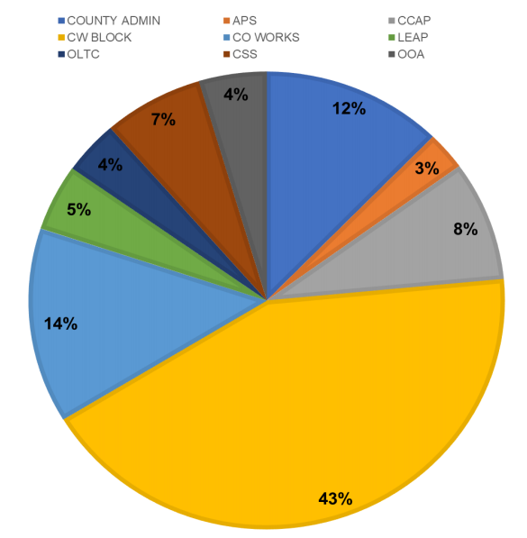
Larimer 101 Department of Human Services
Funding Sources for Human Services
Funding for the Department of Human Services is complex and made up of many different funding sources.
Our overall budget is approximately $49 million; with approximately 80% of our funding coming from State and Federal dollars and 20% from local funding.

Slide 13
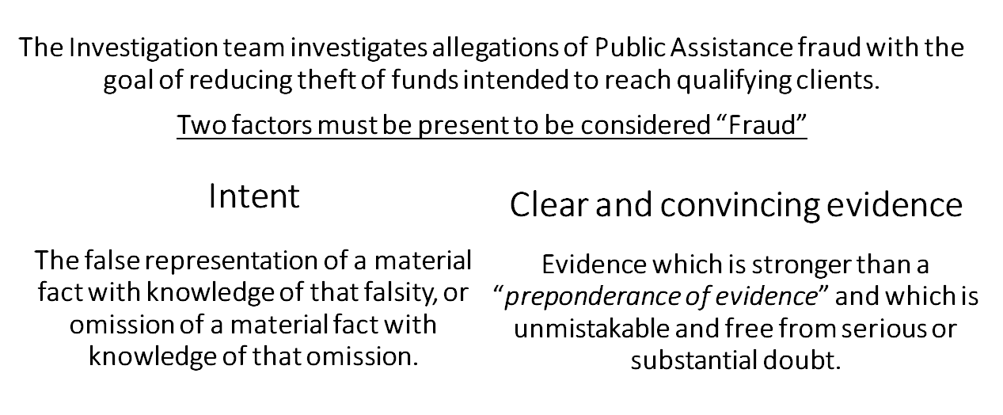
Larimer 101 Department of Human Services
Investigations Unit (Program Integrity)
Online form available at https://www.larimer.org/humanservices/recovery-fraud

Slide 14
Larimer 101 Department of Human Services
Methods of Committing Fraud
Unreported or Misreported Resources
Misreported Household Composition
Unreported or Misreported Income
Dual
Participation
EBT Trafficking
Identity Theft*
*Identity Theft cases are forwarded to Law Enforcement

Slide 15
Larimer 101 Department of Human Services
Investigative Process
Unfounded or
Client Education
Referral accepted
Investigation is conducted
Case assigned to Investigator
Case Staffed with PIU Manager
Case Staffed with PIU Manager
Intentional Program Violation
Investigators have 25 assigned cases at any given time.
Impartial discussion which includes remainder of team in order to ensure appropriate outcome. This serves as a final Quality Assurance check to ensure nothing was missed.
Accepted referrals go into case queue based on priority.
Team goal is for all investigations to be complete within 3 months. Complex cases can take much longer.
Referred for State or Federal Prosecution

Slide 16
Larimer 101 Department of Human Services
Possible Case Outcomes
Unfounded or
Client Education
Intentional Program Violation
Referred
to DA Prosecution
Unfounded or
Client Education
Intentional Program Violation
Intentional Program Violations can be issued one of two ways;
Client opts to accept the IPV and waives their right to an Administrative Disqualification Hearing (ADH), subsequently accepting a disqualification period.
As determined by an Administrative Law Judge during an ADH.
Unfounded are cases which were investigated but no indication that fraud had occurred or is occuring.
Client Education are cases where questionable activity may have occurred, however the circumstances did not rise to the level of an IPV or prosecution In these instances Investigators educate the client reviewing program rules and reporting requirement. This also lets them know that we are monitoring for compliance.
Cases with egregious circumstances will be forwarded for screening and acceptance by either the District Attorney for prosecution.
If the case is not accepted by the DA it will be reduced to an Intentional Program Violation.

Slide 17
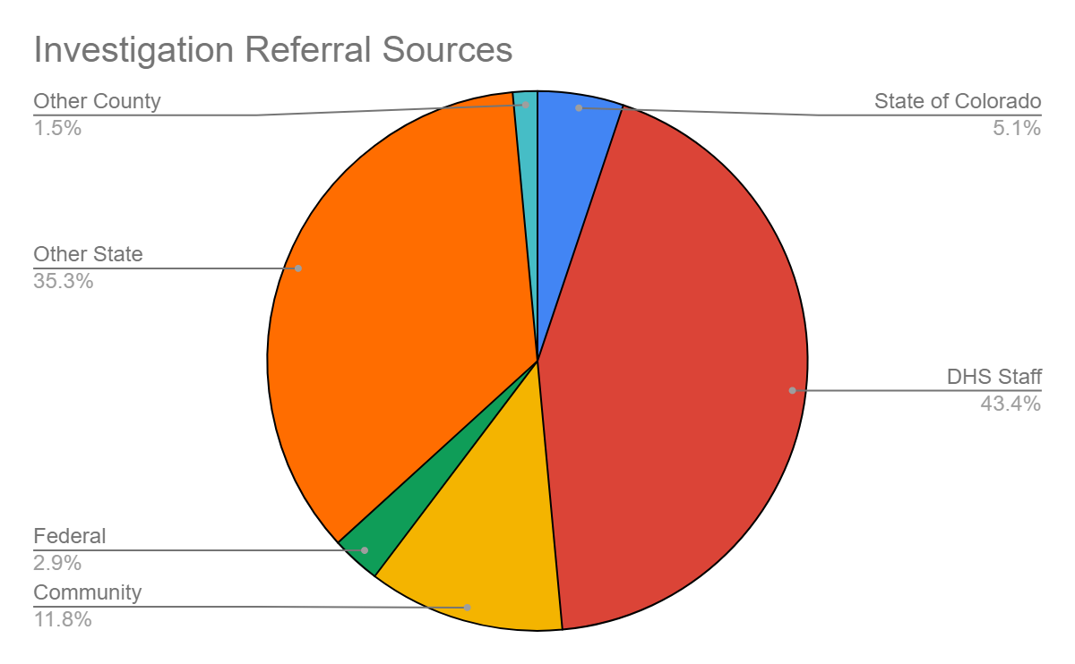
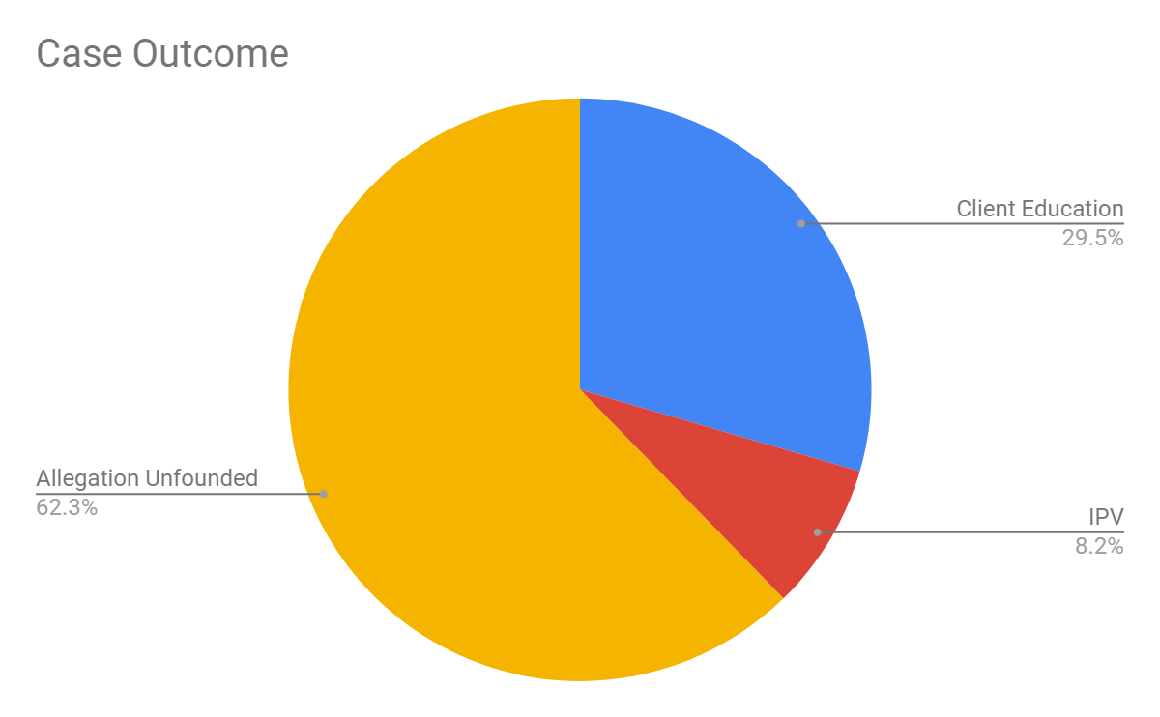
Larimer 101 Department of Human Services
Investigation Data
Referral Sources
DHS Staff | 59
Other States | 48
Community | 16
State of Colorado | 7
Federal | 4
Other County | 2
11/1/2018 - 3/31/19 Data
Total Referred Cases: 136
Total Cases Accepted for Inv.: 100
Case Outcome Data
Allegation Unfounded | 38
Client Education | 18
IPV | 5
DA | 0

Slide 18
Larimer 101 Department of Human Services
Contact Information
Katie Heckman heckmaa@co.larimer.co.us
Sue Statz statzxsr@co.larimer.co.us
Milissa Carlson carlsomj@co.larimer.co.us
Carri Ratazzi ratazzcj@co.larimer.co.us
Liz Chippendale chippeea@co.larimer.co.us

