Slide 1

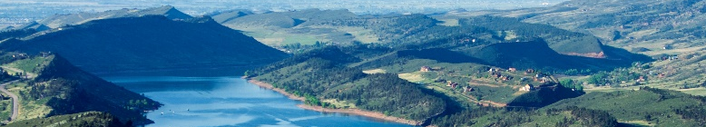
Larimer County: community development department
Mock planning commission hearing
LC 101
April 19, 2018

Slide 2

Larimer County Community Development Department
Who are we, & What do we do?
Larimer County Community Development Department
  Administration of County Land Use Code
  Emphasizes community involvement
  Ensure Larimer County is a quality and safe place to live.
  Planning Section
    Pre-develop plans that shape how the community grows.
  Building Section
    Ensure International Building codes are met.
    All buildings are properly permitted.
  Code Compliance Section
    Enforces the County Land Use Code
    Deals with Code violations

Slide 3
Larimer County Community Development Department
Larimer county land use code
Zoning Code
Details land division procedures
Details other planning processes
  Site Plan Review
  Special Review
  Variances
  Appeals
Details standards for all types of development (commercial & residential).
Regulates special uses
  Signs
  Special Events
  Cell Towers

Slide 4
Larimer County Community Development Department
How do we do this?
A Larimer County citizen comes to us with an idea on a specific Larimer County property.
Applicant meets with a Planner
  What’s the best avenue to accomplish the idea, if possible?
Applicant makes a formal application for the Planning process.
Time passes…
Planning Commission hears the idea & public testimony.
Planning Commission makes a recommendation to the Board of County Commissioners.
County Commissioners make the final decision with conditions of approval.

