Slide 1

Larimer County Sheriff’s Office
K-9 Unit
Notes:
Corporal Jackie Knudsen & K-9 “Grendel”
Deputy Dave Feyen & K-9 “Tovan”
Deputy Aaron Hulme & K-9 “Ryker”
Deputy Jamie Smith & K-9 “Cash”
Larimer County Sheriff’s Office
K-9 Unit

Slide 2
Handlers and their K-9’s
Sergeant Jackie Knudsen & K-9 “Negan”
Deputy Dave Feyen & K-9 “Dox”
Deputy Aaron Hulme & K-9 “Ryker”
Corporal Jamie Smith & K-9 “Cash”
Deputy Mike Gurwin & K-9 “Taz”
Corporal Joe Pugliese & K-9 “Raven”
Deputy Chriss Hebbeler & K-9 “Maizey”
Deputy Mitchell McGuinnis & K-9 “Tyr”
Deputy Jeff Kaley & K-9 “Lukin”

Slide 3
What is the LCSO K-9 Unit?
We are a specialized division consisting of 5 dog-handler teams
The focus of the LCSO K9 unit is to reduce the number of man hours spent on calls and increase the safety of officers involved on calls.
Each K9 team can save between 800 and 1,000 man hours per year.
Notes:
WHAT IS THE LCSO K9 UNIT?
We are a specialized division consisting of 4 dog-handler teams
The focus of the LCSO K9 unit is to reduce the number of man hours spent on calls and increase the safety of officers involved on calls.
Each K9 team can save between 800 and 1,00 man hours per year.

Slide 4
What is the LCSO K-9 Unit?
The handlers are still deputies who respond to calls for service
We are also called to assist other units such as SWAT, Northern Colorado Drug Task Force, FBI, DEA, ATF, etc.
LCSO K9’s are on call 24/7
Notes:
WHAT IS THE LCSO K9 UNIT?
We are a specialized division consisting of 4 dog-handler teams
The focus of the LCSO K9 unit is to reduce the number of man hours spent on calls and increase the safety of officers involved on calls.
Each K9 team can save between 800 and 1,00 man hours per year.

Slide 5
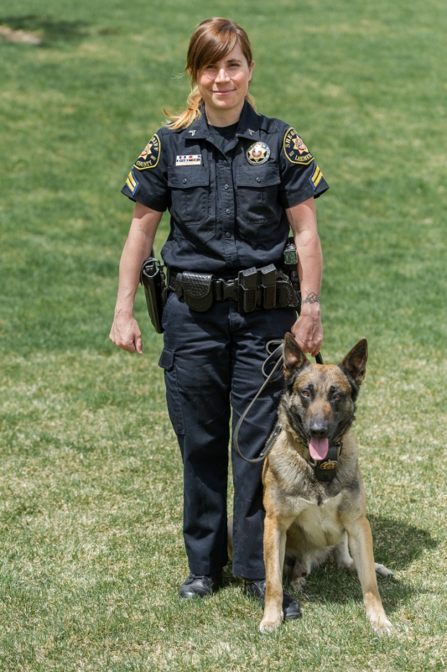
LARIMER COUNTY SHERIFF’S OFFICE
K-9 Unit Handlers
SERGEANT JACKIE KNUDSEN
                Handles K-9 Negan
                Works Blue Side, Day Shift
                K9 Narcotics Detector Instructor and Judge
                K9 Patrol Instructor and Judge
                Field Training Officer (FTO)

Slide 6
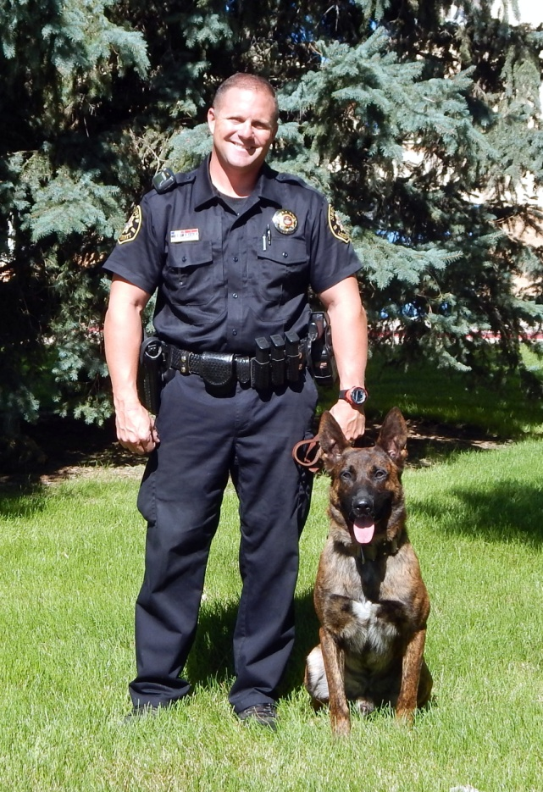
LARIMER COUNTY SHERIFF’S OFFICE
K-9 Unit Handlers
DEPUTY DAVE FEYEN
                Handles K-9 Tovan
                Works Blue Side, Day Shift
                K9 Patrol Instructor and Judge
                Field Training Officer (FTO)

Slide 7
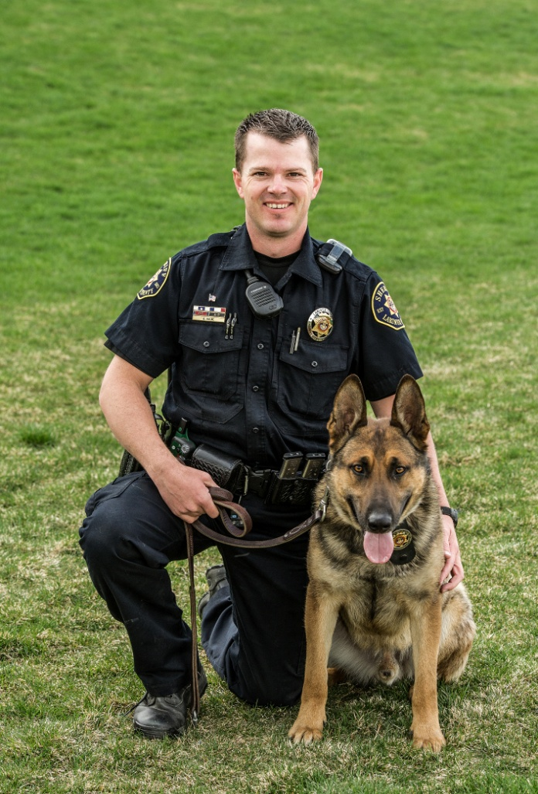
LARIMER COUNTY SHERIFF’S OFFICE
K-9 Unit Handlers
DEPUTY AARON HULME
                Handles K-9 Ryker
                Works Red Side, Day Shift
                Field Training Officer (FTO)

Slide 8
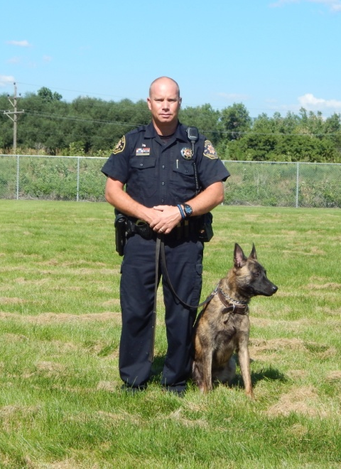
LARIMER COUNTY SHERIFF’S OFFICE
K-9 Unit Handlers
CORPORAL JAMIE SMITH
                Handles K-9 Cash
                Works Red Side, Swing Shift
                Field Training Officer (FTO)

Slide 9
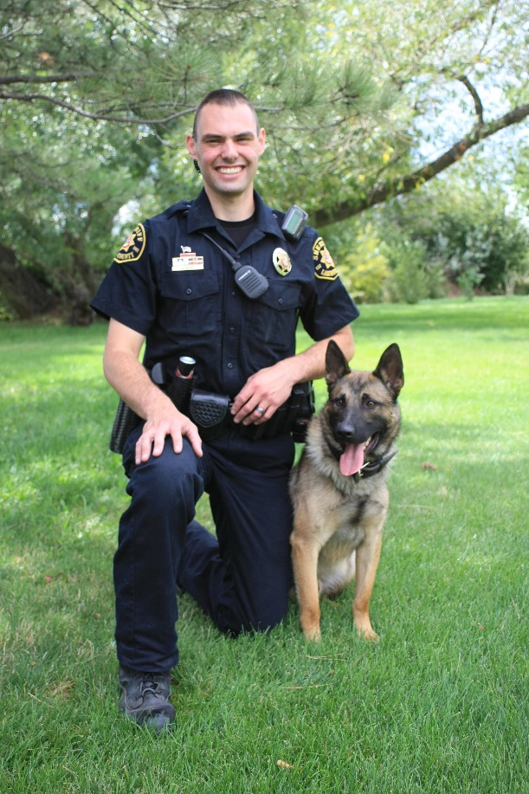
LARIMER COUNTY SHERIFF’S OFFICE
K-9 Unit Handlers
DEPUTY MIKE GURWIN
                Handles K-9 Taz
                Works Blue Side, Mid Shift

Slide 10
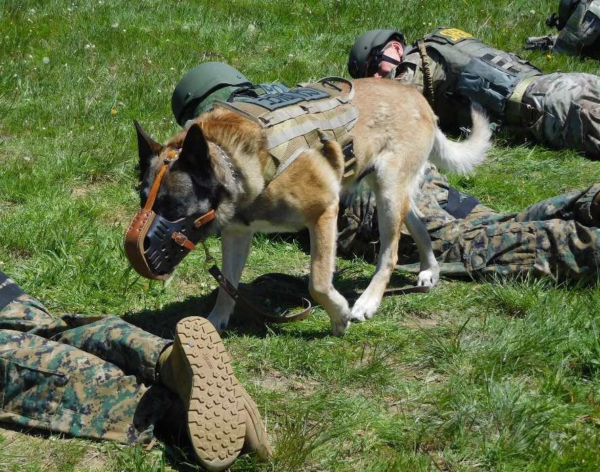
LARIMER COUNTY SHERIFF’S OFFICE
K-9 Unit K-9s
K-9 “GRENDEL”
Handled by Corporal Knudsen since 2009
Ten-year old Belgian Malinois
Imported from Holland
Dutch commands
Dual purpose (patrol & narcotics)
Aggressive indicator in narcotics
Certified yearly in narcotics and patrol

Slide 11
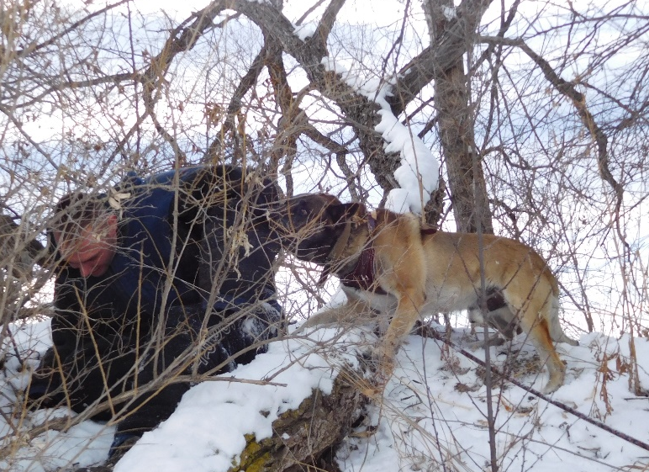
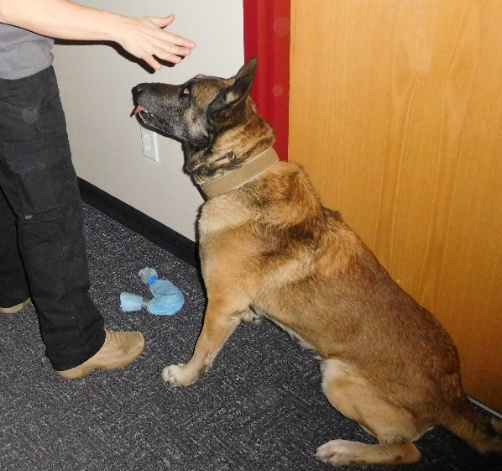
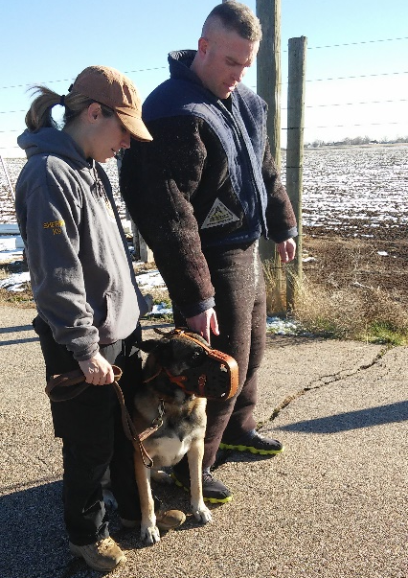
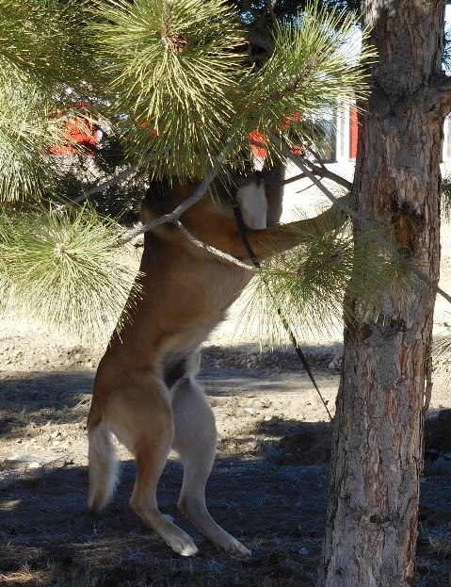
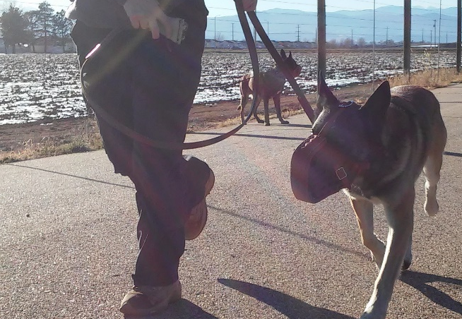
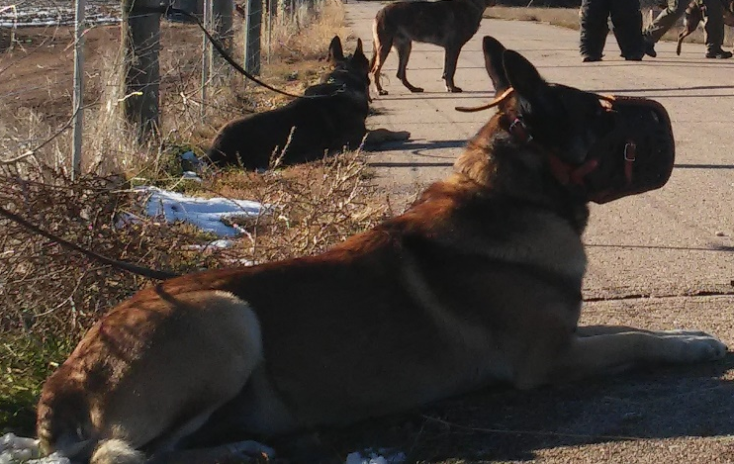
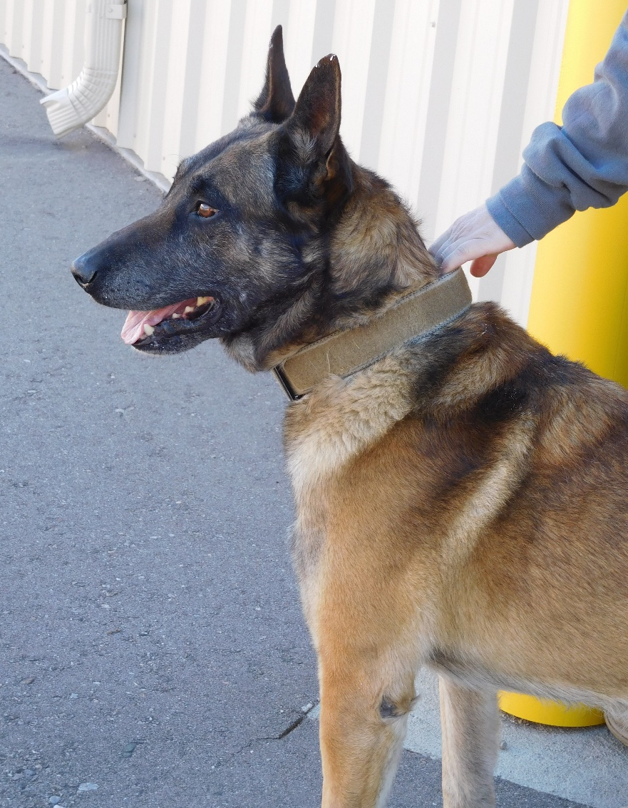
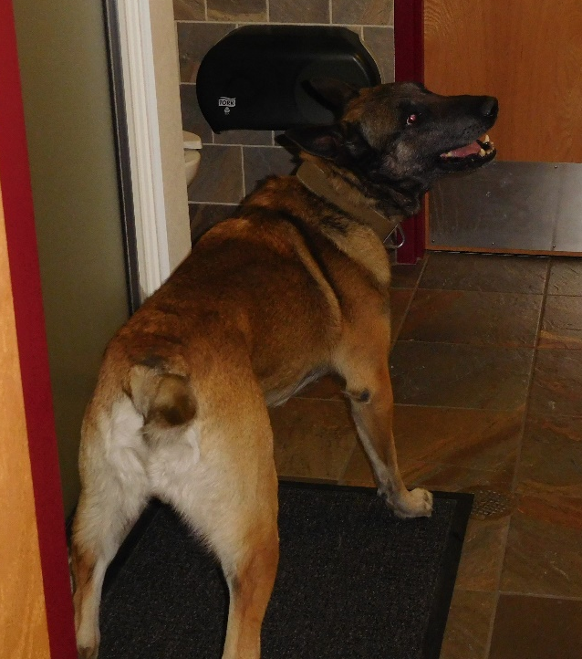
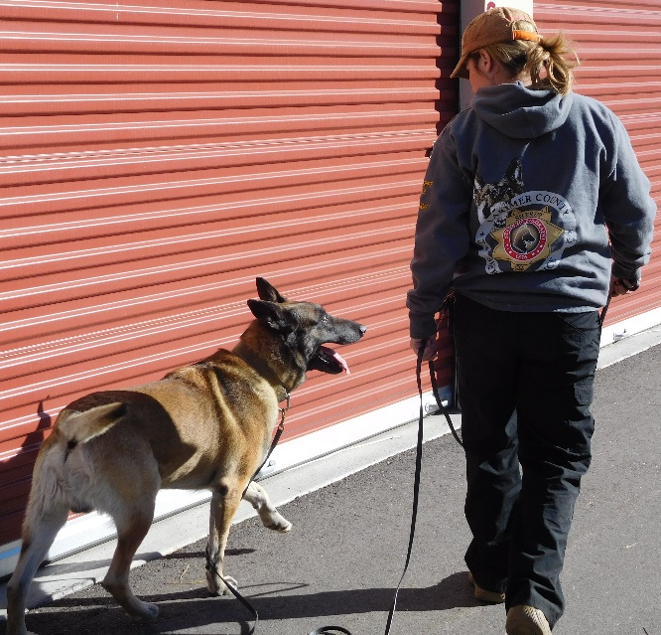

Slide 12
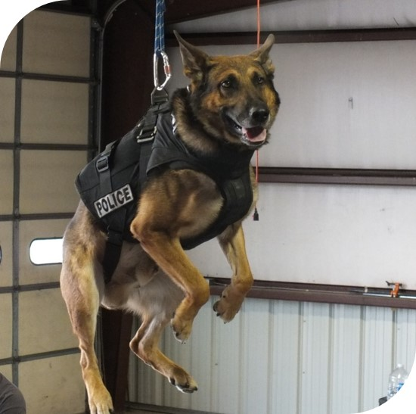
LARIMER COUNTY SHERIFF’S OFFICE
K-9 Unit K-9s
K-9 “RYKER”
Handled by Deputy Hulme since 2012
Six-year old German Shepherd
Imported from Holland
Dutch commands
Dual purpose (patrol and narcotics)
Aggressive indicator in narcotics
Certified yearly in narcotics and patrol

Slide 13
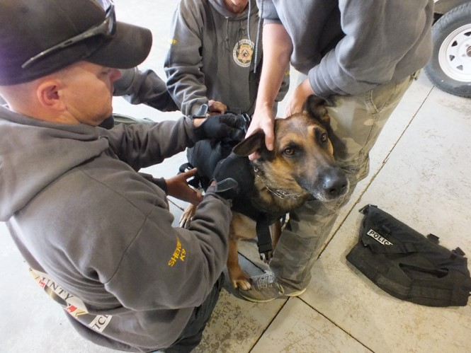
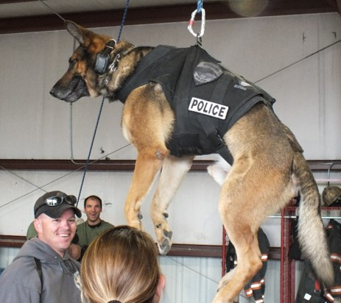
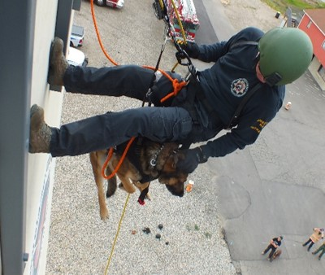
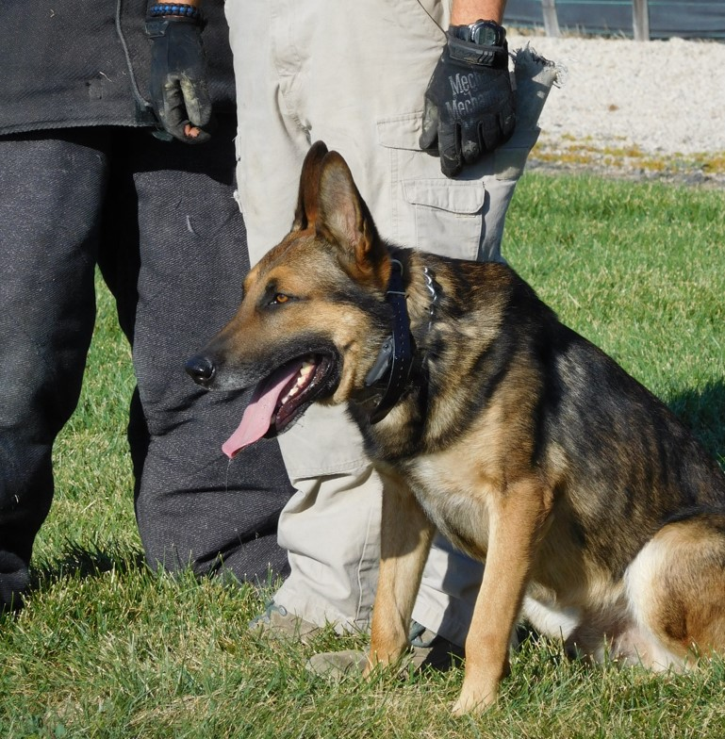
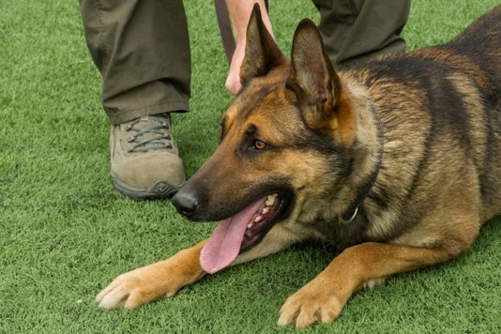
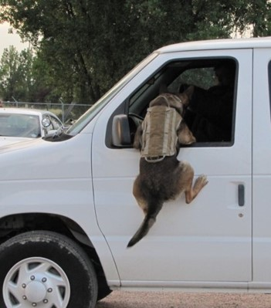
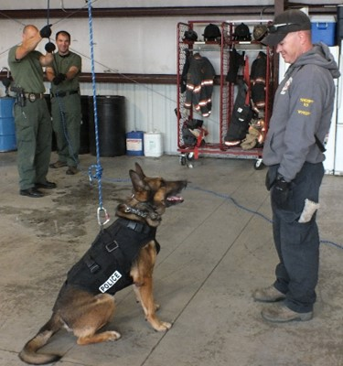
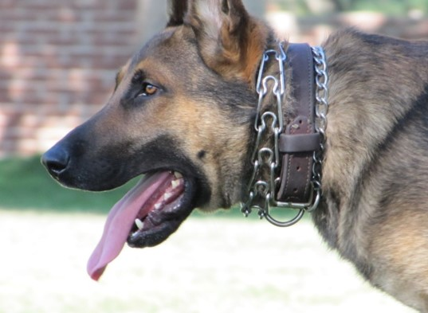

Slide 14
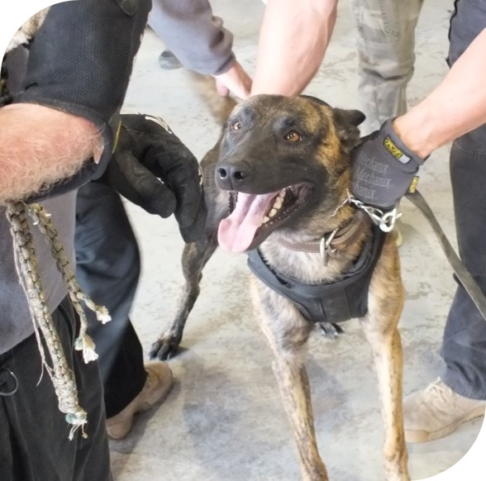
LARIMER COUNTY SHERIFF’S OFFICE
K-9 Unit K9s
K-9 “Cash”
Handled by Deputy Smith since 2015
3 year old Dutch Shepherd
Imported from Holland
Dutch commands
Dual purpose (patrol & narcotics)
Aggressive indicator in narcotics
Certified yearly in narcotics and patrol
SWAT Dog

Slide 15
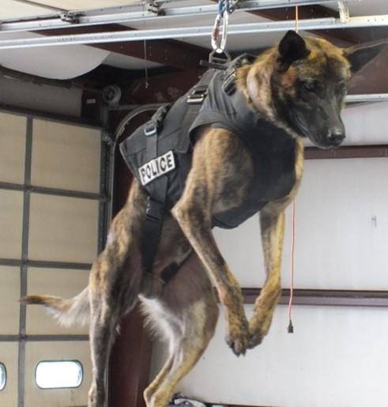
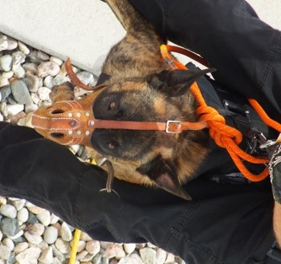
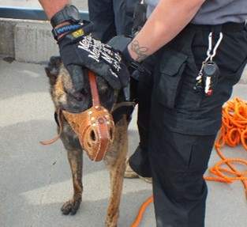
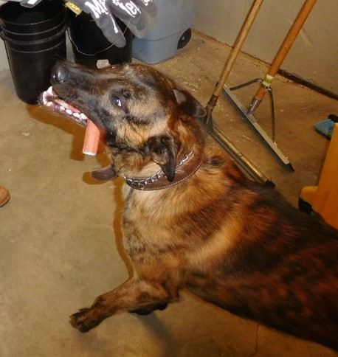
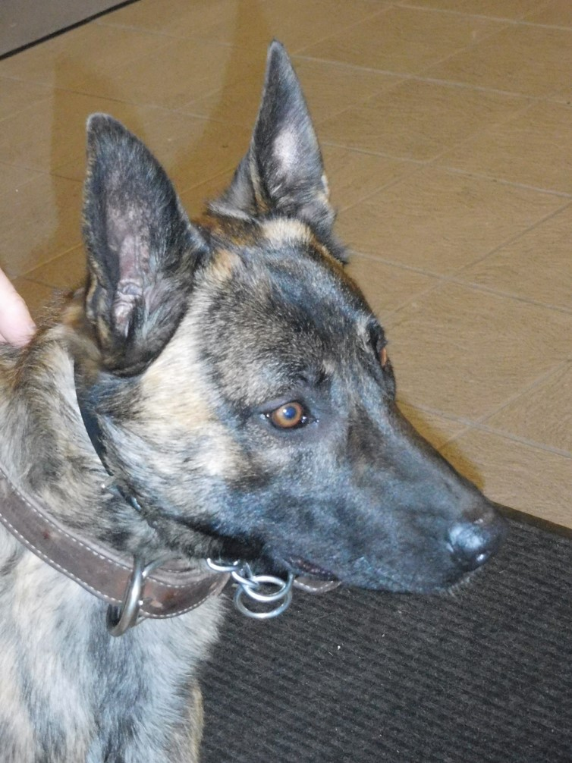
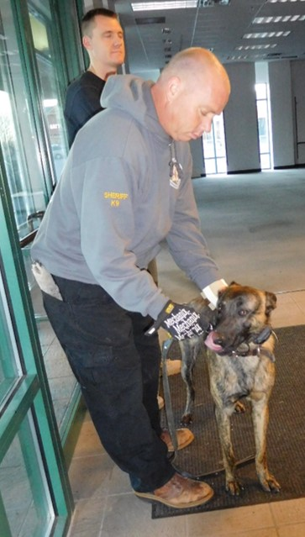
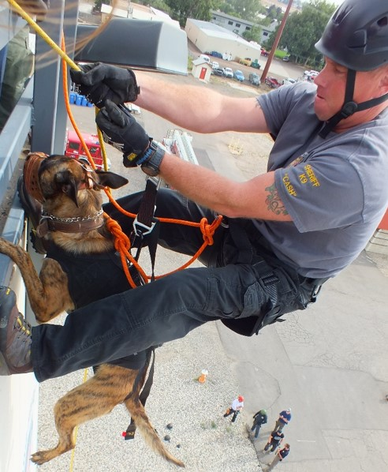

Slide 16
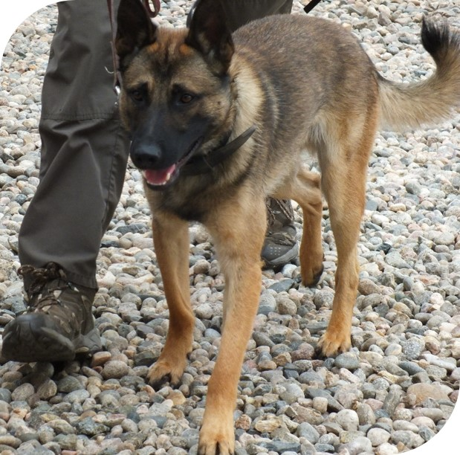
LARIMER COUNTY SHERIFF’S OFFICE
K-9 Unit K9s
K-9 “Taz”
Handled by Deputy Gurwin since 2016
2 year old Belgian Malinois
Imported from Slovakia
Dutch commands
Dual purpose (patrol & narcotics)
Passive indicator in narcotics
Certified yearly in narcotics and patrol

Slide 17
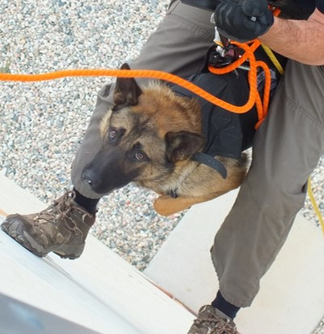
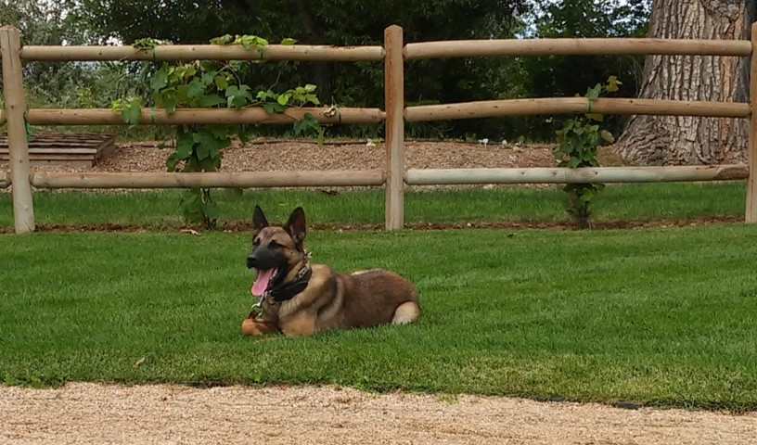
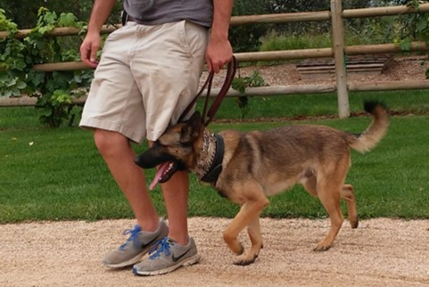
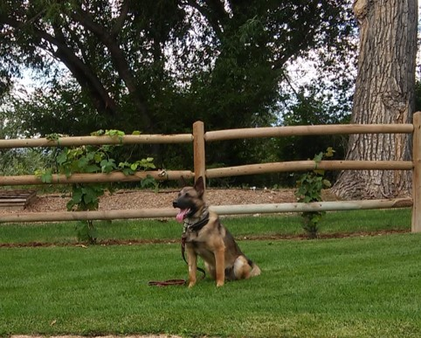
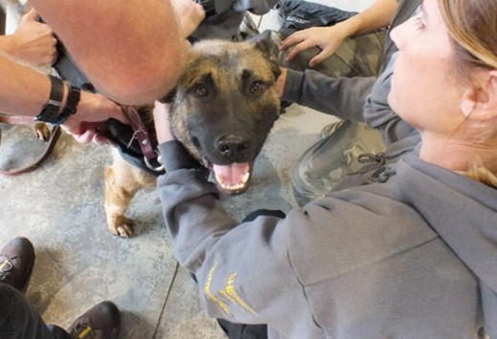
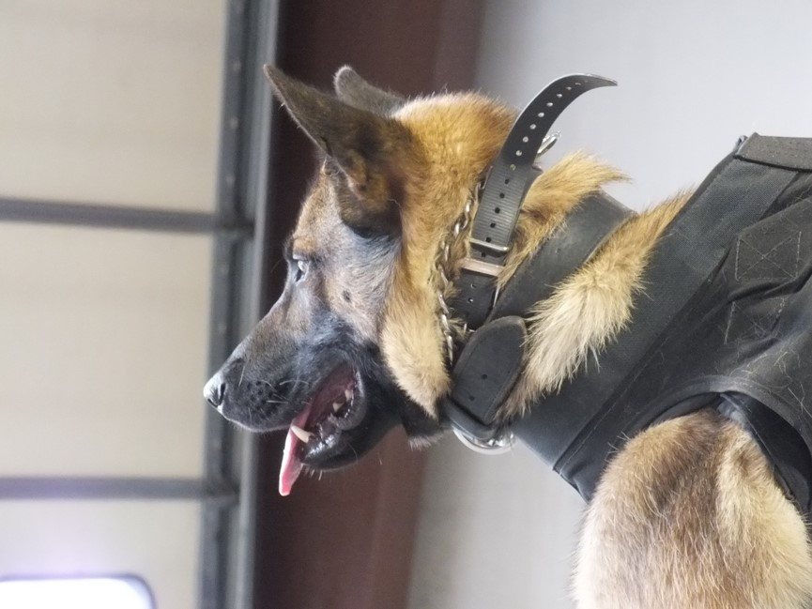
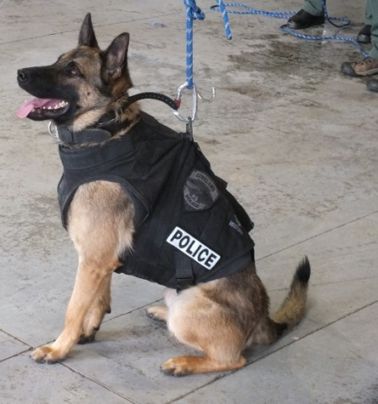
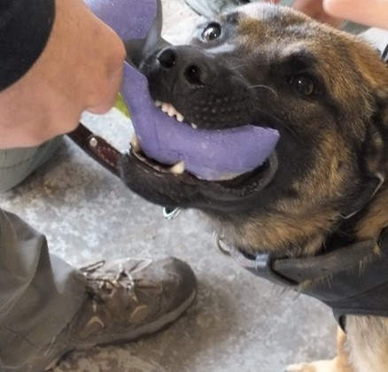

Slide 18
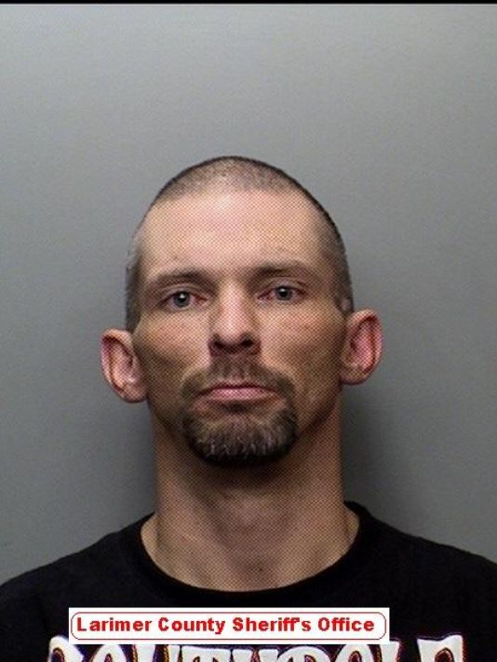
Deputies arrest man who set self ablaze, tried to flee
K-9 Success

Slide 19
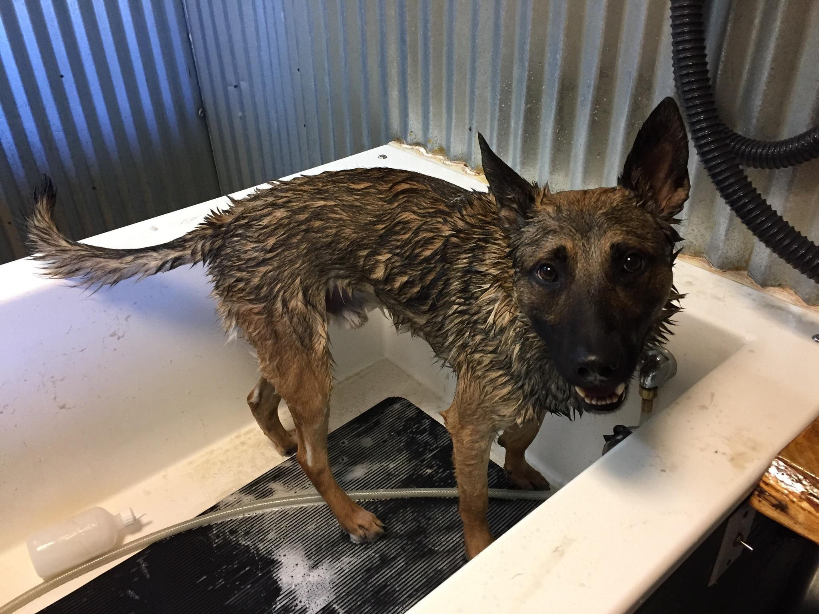
K-9 Success

Slide 20
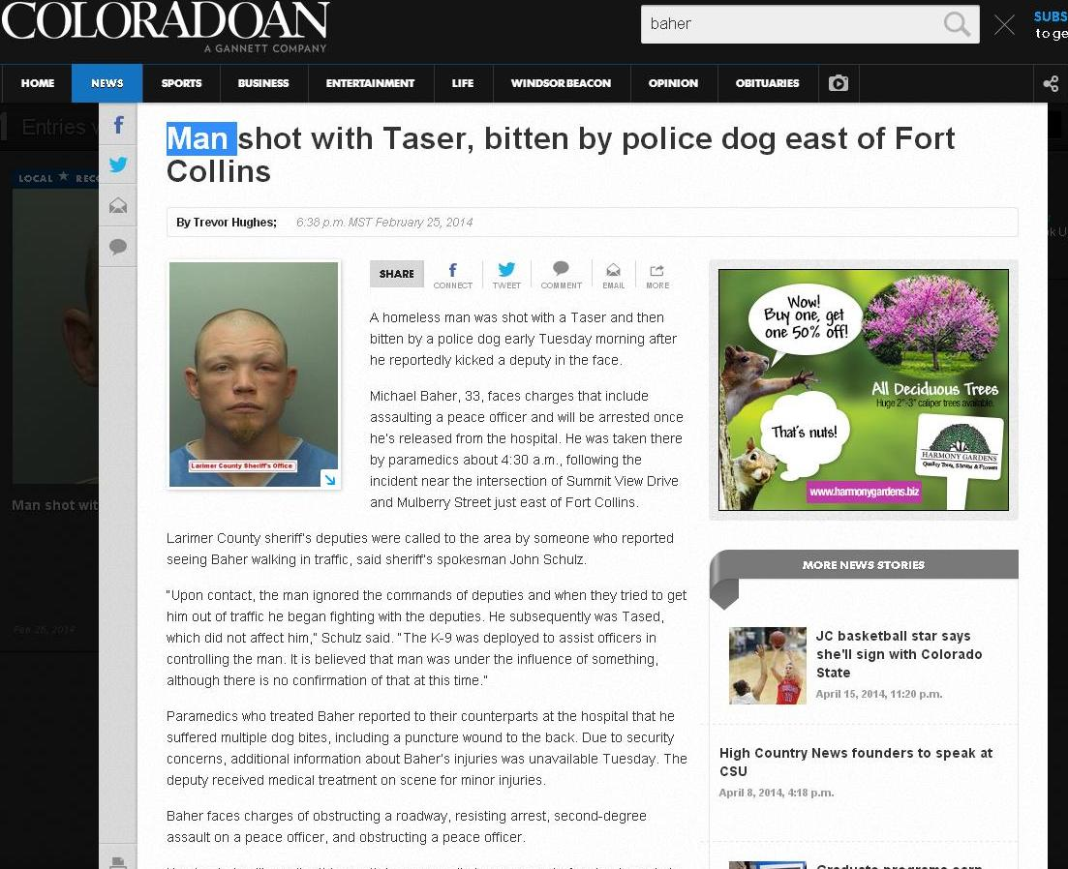
K-9 Success

Slide 21
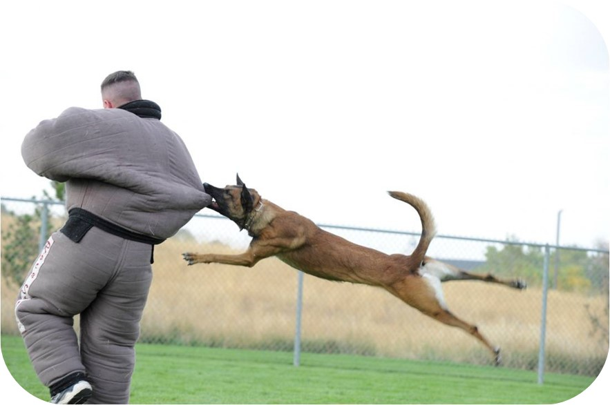
Meet the K-9 Unit Agitators
(the guys in the suits)

Slide 22
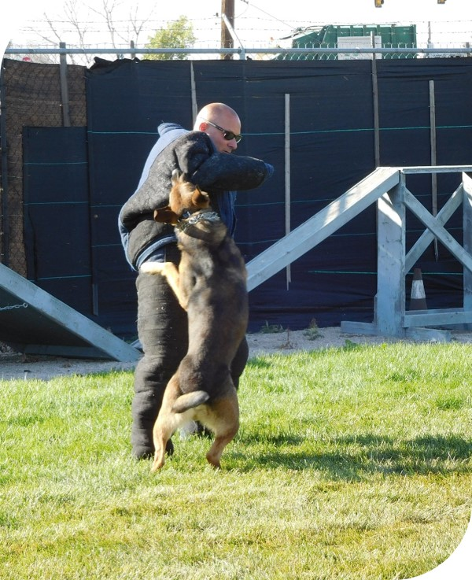
LARIMER COUNTY SHERIFF’S OFFICE
K-9 Unit Agitators (the guys in the suits)
    Investigator Steve Gates
    Patrol Deputy Billy Gentry
    Front Desk Deputy Ryan Armagost
    Patrol Deputy Aaron Hawks
    Street Crimes Deputy Tyson Russell
    Patrol Deputy Evan Brush
    Patrol Deputy Brian Drissel
    Corrections Deputy Bryce Hinrichs
    Patrol Deputy Stephen Niswender
    Patrol Deputy Kurt Solomon

Slide 23
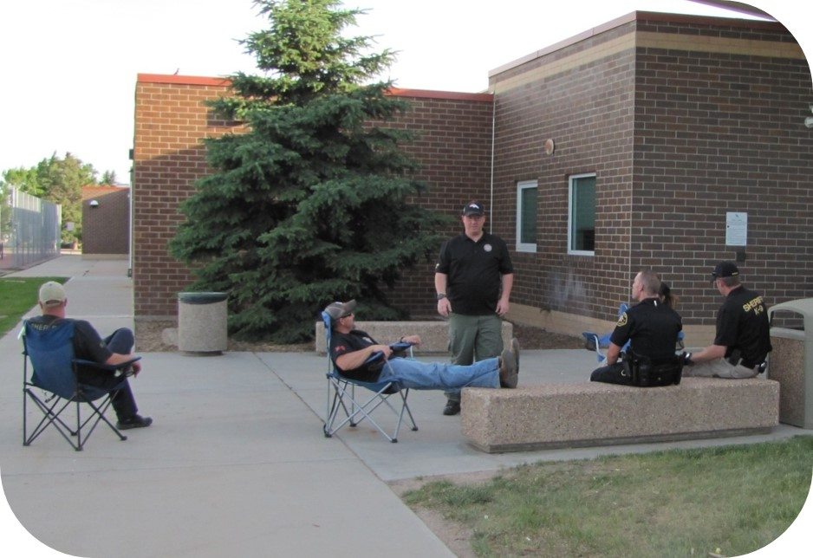
WHAT DO WE DO?

Slide 24
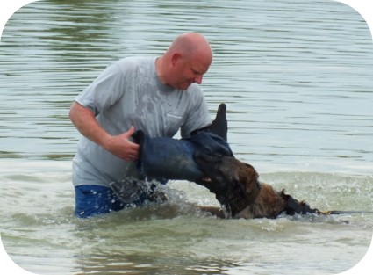
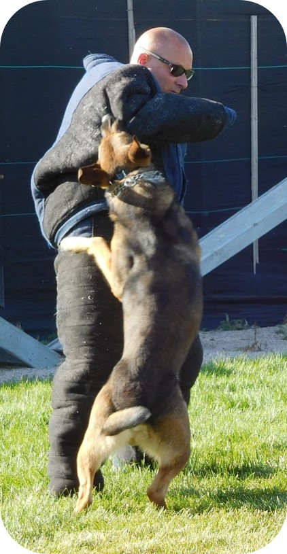
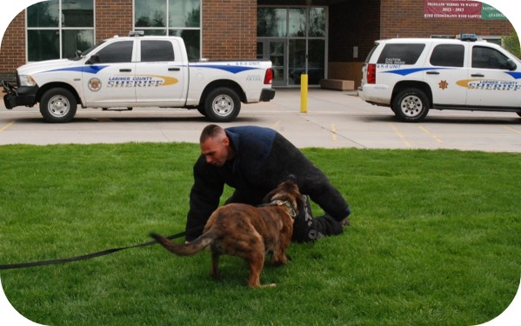


We make training fun for the K-9s

Slide 25



K-9 Unit Agitators
- We provide a safe environment to train the K9’s
- We help ensure the K9’s drives do not diminish
- We hide training aids and lay tracks for the K9’s
- We are integral in the success of each K9.

Slide 26

QUALIFICATIONS FOR AGITATORS
A passion for animals

Slide 27

QUALIFICATIONS FOR AGITATORS
A passion for animals
The ability to work as a part of a team

Slide 28


QUALIFICATIONS FOR AGITATORS
A passion for animals
The ability to work as a part of a team
The willingness to sacrifice yourself for the dog and his safety

Slide 29

QUALIFICATIONS FOR AGITATORS
A passion for animals
The ability to work as a part of a team
The willingness to sacrifice yourself for the dog and his safety
Many hours of training, even in harsh weather conditions

Slide 30



WE ARE A TEAM . . .
Agitators and Handlers work closely to schedule trainings
If a K-9 is deployed on a track, a patrol agitator will go with the handler if they are available
All agitators have a vested interest in the success of the K-9

Slide 31







EQUIPMENT

Slide 32








EQUIPMENT

Slide 33


Slide 34





THANK YOU!

Slide 35
Larimer County Sheriff’s Office
K-9 Unit
Handler
&
K9 Selection

Slide 36
Larimer County Sheriff’s Office
K-9 Unit
HANDLER SELECTION PROCESS
1. Criteria (Patrol for four years, no substantiated use of force incidents, demonstrated ability to work in team/tactical environments, “crap magnet”)
2. Application/Interview
3. Physical Fitness Test
4. Home Visit

Slide 37




LARIMER COUNTY SHERIFF’S OFFICE
K-9 Unit
K-9 SELECTION
Choose vendor/kennel
Breeds used (GSD, Belgian Malinois, Dutch Shepherd)
Traits/Drives
Selection Tests

Slide 38

TRAINING
Foundational training for dog and handler (Basic K9 Academy – 10 weeks to 4 months long)
Bi-Monthly Trainings
(Training at various sites and facilities, working on narcotics and patrol, training with other agencies)
Yearly certifications

Slide 39

K9 NARCOTICS SNIFFS

Slide 40


Slide 41



K9 NARCOTICS SNIFFS
Passive Indication
  Sit
  Stare
  Point
  Lay Down

Slide 42



K9 NARCOTICS SNIFFS
  Aggressive Indication
  Bark
  Bite
  Scratch

Slide 43






Slide 44


FEDERAL GUIDELINES
U.S. v. Place 462 U. S. 696 U.S. Supreme Court (1983).
“A dog sniff is NOT a search . . .”

Slide 45
ARIZONA v GANT
Limitations on Scope of Search
Arizona v. Gant 07-542 U.S. Supreme Court (2009).
Warrantless searches "are per se unreasonable“
Why does Arizona v Gant actually benefit K9 handlers?
Because a dog sniff is not a “search” and therefore can,
based on a positive alert/indication, allow a search of the car.

Slide 46


COMPARTMENTS
Another reason to call a dog…

Slide 47



Center Console

Slide 48




Dashboard
Firewall
Grill

Slide 49




Back Seat

Slide 50


Would you have found this on your own?

Slide 51


Spare Tire

Slide 52


Bumper
Speakers

Slide 53


Tire

Slide 54


Gas Tank

Slide 55


Undercarriage
Trailer

Slide 56


Side Panel

Slide 57

See any reason to stop this truck?

Slide 58

Really Cool Compartment

Slide 59

NARCOTICS DEMO
BREAK

Slide 60

What other circumstances besides narcotics sniffs can you call out a K9?

Slide 61
K9 PATROL DEPLOYMENTS
High Risk Stops
Building searches
Open area searches
Tracks
Riot control
Agency assists (Federal, local agencies)
Public demos
Article/evidence searches
Officer safety/handler defense
High risk arrests/tactical deployments (SWAT)

Slide 62



HIGH RISK STOPS

Slide 63


BUILDING SEARCHES

Slide 64

AREA SEARCHES
The canine is using air scent while doing an area search. The canine is looking for the scent cone of the suspect to help them centralize the source of the odor. The scent cone is made up of the suspect’s body odor which the canine can detect and forms a cone shape away from the suspect as the odor moves through the air.

Slide 65



Slide 66


HIGH RISK ARRESTS/SWAT

Slide 67

PUBLIC DEMONSTRATIONS

Slide 68



RIOT CONTROL

Slide 69



Slide 70
TRACKING
The canine follows a ground disturbance made by the person as they fled from an area.
Can be used over grass, dirt or hard surfaces. The suspect leaves a trail and the trail is a disturbance to the ground. The weight of the person crushes the vegetation and as the biological matter decomposes it has a different odor than the ground around it that the canine can detect.
Canine’s sense of smell is said to be 100,000 to 1,000,000 times more sensitive than a humans.
Ideally handlers like to start a track of a person within 30 to 45 minutes of the track being set. This is the optimal time for a successful outcome. Wind is really the only adversary of a tracking canine. In heavy wind gusts the odor is blown away from the tracks origin and is difficult to follow.

Slide 71


TRACKING

Slide 72



When a dog retires:
The officer gets to purchase their dog for $1
They get to live relaxed and comfortable with their handler and their families
Thanks to the Retired K9 fund these dogs get medical support through their aging years
If you would like to contribute any additional support please contact Barb Bennett at
970-682-0597

Slide 73



Slide 74



Slide 75



Slide 76


Slide 77


Slide 78


