Slide 1





North Front Range Regional Wasteshed Solid Waste Policy Council
Solid Waste Infrastructure Master Plan Update
Oct 3, 2019

Slide 2

Today’s Agenda
Welcome and Opening Remarks
Wasteshed Background & Overview
Solid Waste Infrastructure Project Overview
  Tier-1 Infrastructure
  Tier-2 Infrastructure
  Tier-3 Infrastructure
Timeline
Closing Remarks

Slide 3
Wasteshed Process Overview
1963
2014
2019
2024
Service
Planning
Implementation
Foundation & Direction
  Unified Coalition Goals & Objectives
Plan Development
    Infrastructure Feasibility Study
    Market and Triple Bottom Line Analysis
    Governing Agreement Development
    Solid Waste Infrastructure Master Plan

Slide 4
Wasteshed Coalition Goals
Establish a regional materials management system
Implement programs and facilities
Develop waste diversion/reduction goals for all parties
Conduct strong, consistent public education and outreach

Slide 5
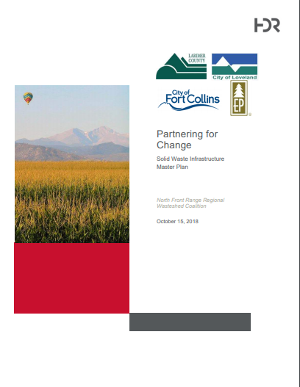


Wasteshed Coalition
Technical Staff
Elected Officials
(Policy Advisory Committee)
Stakeholder Advisory Group
Master Plan For Solid Waste Infrastructure

Slide 6


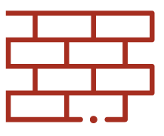


Larimer County Capital Investments
New Landfill
Central Transfer Station
Yard Waste Composting Facility
Construction & Demolition Debris Processing Facility
Food Waste Composting Facility
Recycling Center Improvement
$50+ million investment
No tax revenue needed
Potential to divert 40% of landfilled waste

Slide 7
Wasteshed Process Overview
1963
2014
2019
2024
Service
Planning
Implementation
Unified Programs & Policies
  Adoption of Intergovernmental Agreement
  Local policy consideration
  Public education alignment
Logistical Framework for Infrastructure
  Funding Mechanisms & Partnerships
Infrastructure Delivery
  Facility Design & Construction

Slide 8
Intergovernmental Agreement
Obligations of Larimer County:
  Fund, build, own, and manage new facilities
Obligations of All Parties:
  Explore code changes for solid waste diversion
  Participate in a solid waste Policy Council
  Coordinate data tracking and education
IGA does not obligate Parties to enact new policy
  Minimum standards for waste hauling expected

Slide 9
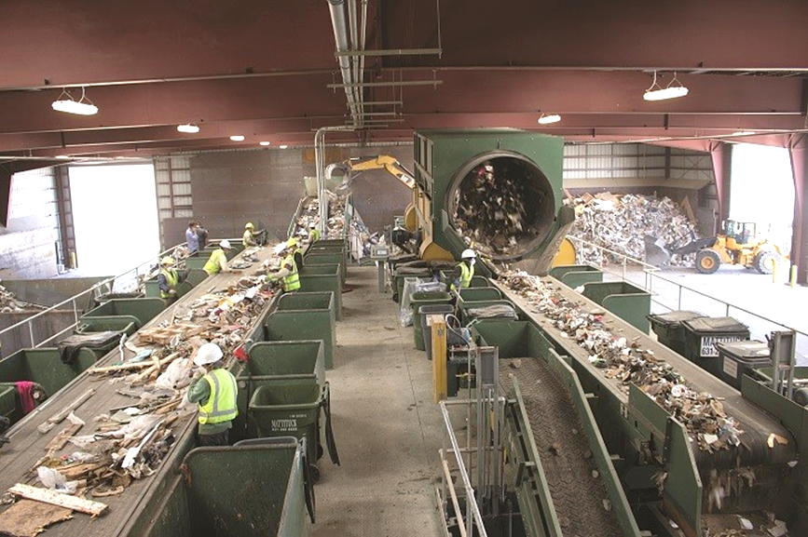
Supportive Local Policies
Loveland green waste commitment
Fort Collins flow control ordinance for mixed construction waste

Slide 10
Implementation
Next Steps for Wasteshed Process:
  Wellington joining expanded and formalized Policy Council
  Facility design & development
  Municipal and County policy and program exploration
  Periodic review of Tier 2 Infrastructure
  Continued coalition collaboration
    …as directed by Policy Council

Slide 11
Update Solid Waste Infrastructure

Slide 12
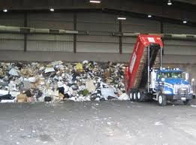
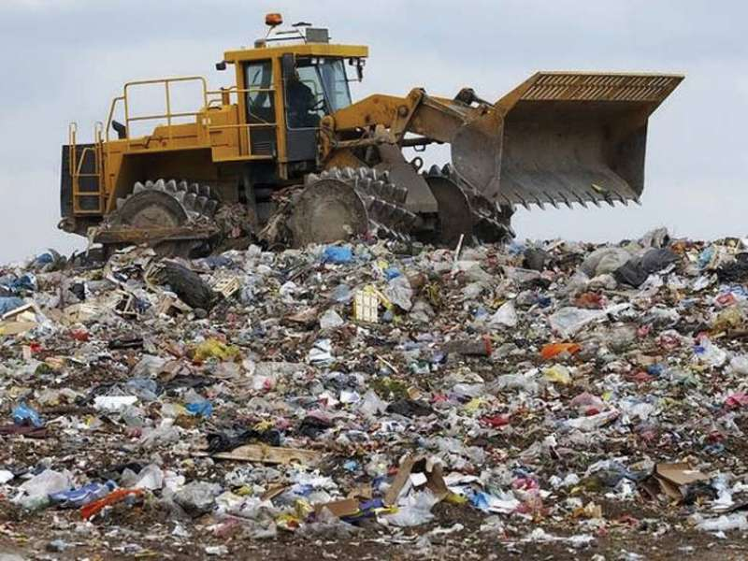
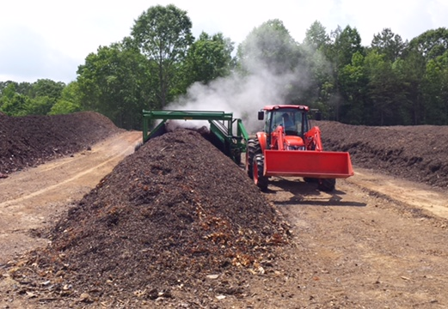
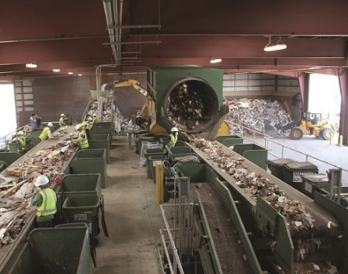
Tier-1 Infrastructure Under Development
Central Transfer Station
New County Northern Landfill
Yard Waste Organics Windrow Processing
Construction and Demolition
(C&D) Processing Facility
Notes:
Relist all options under consideration.

Slide 13
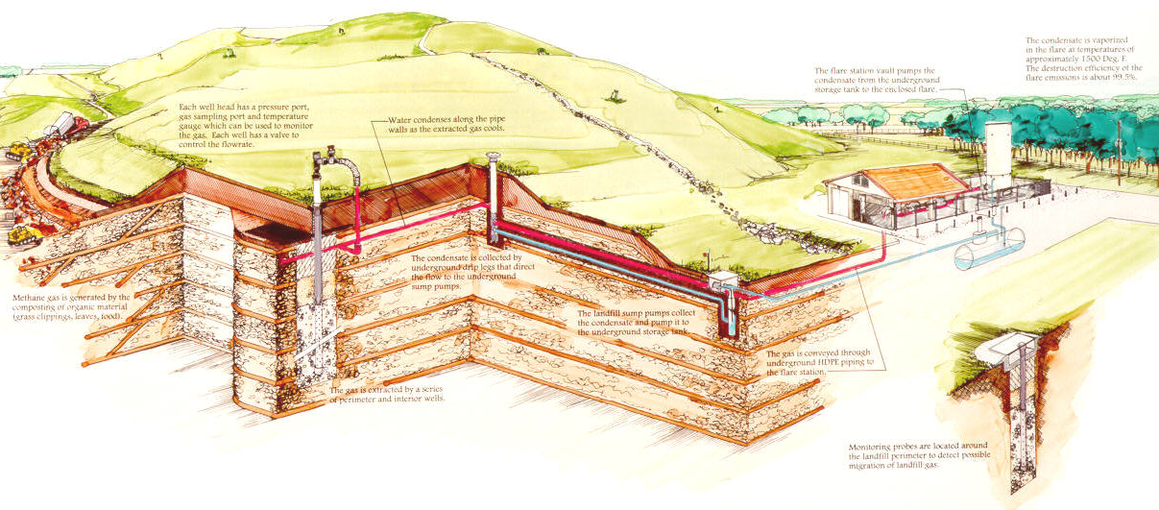
New Northern Landfill
Built to Federal Subtitle D Standards
Synthetic Liner / Ground Water Monitoring / Leachate Collection / Financial Assurance / Regulatory Oversight

Slide 14
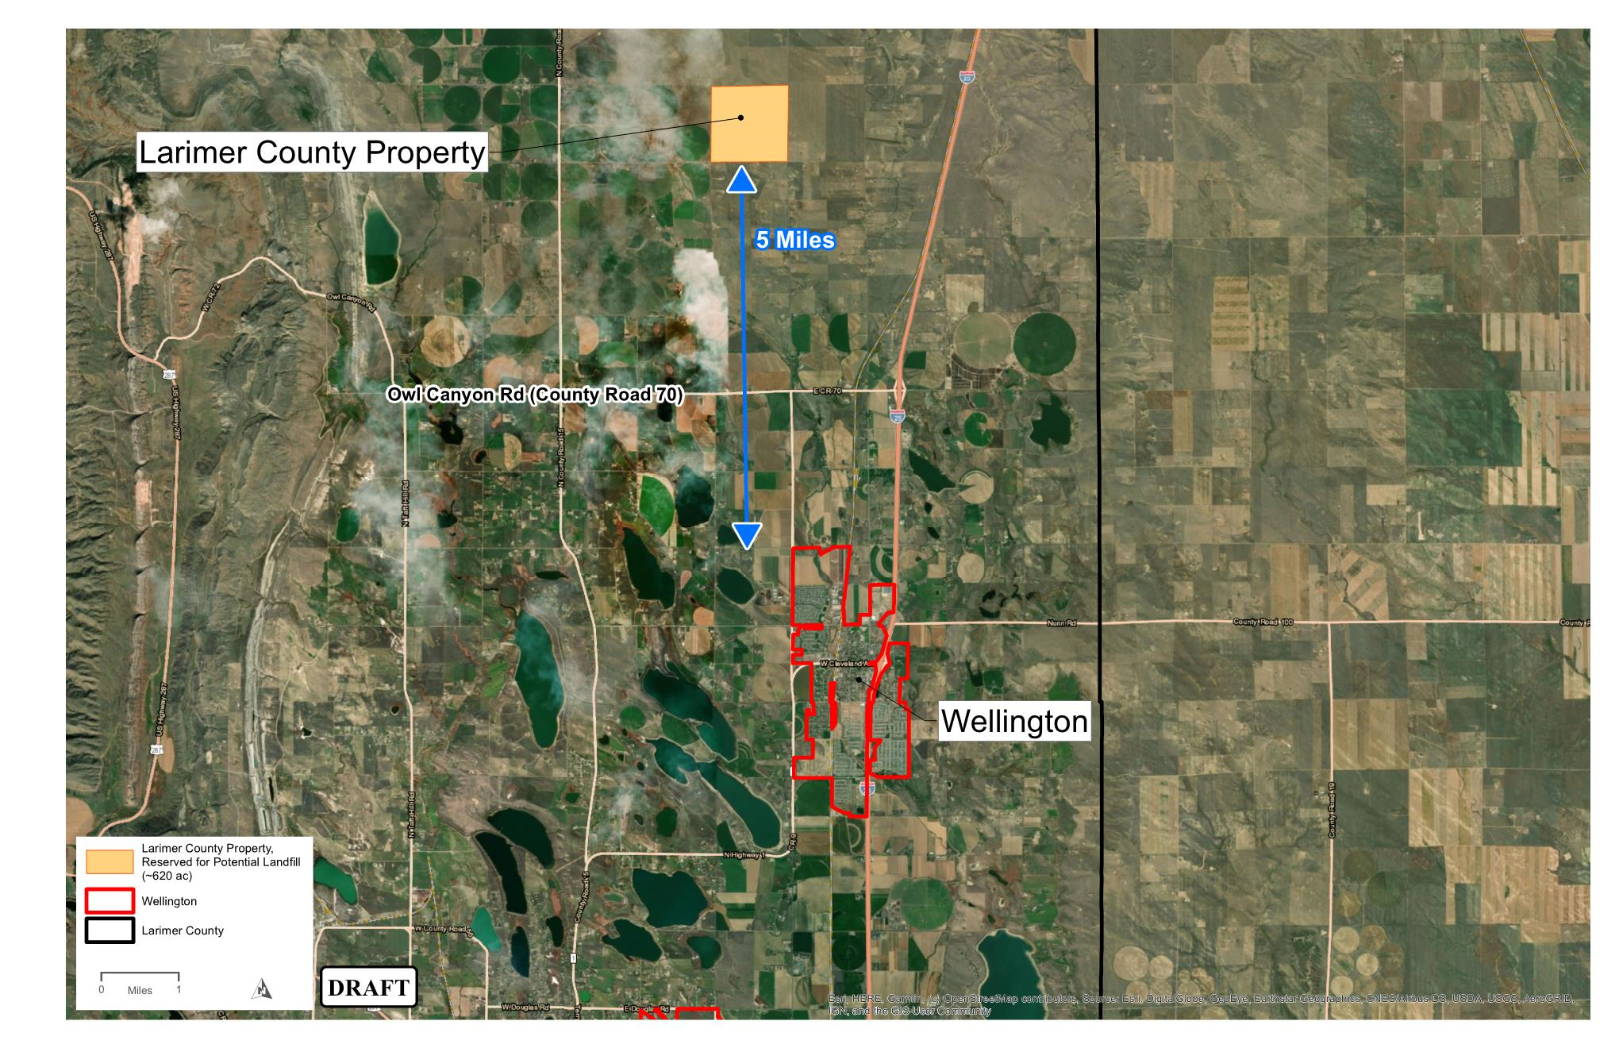
Northern Landfill Location

Slide 15
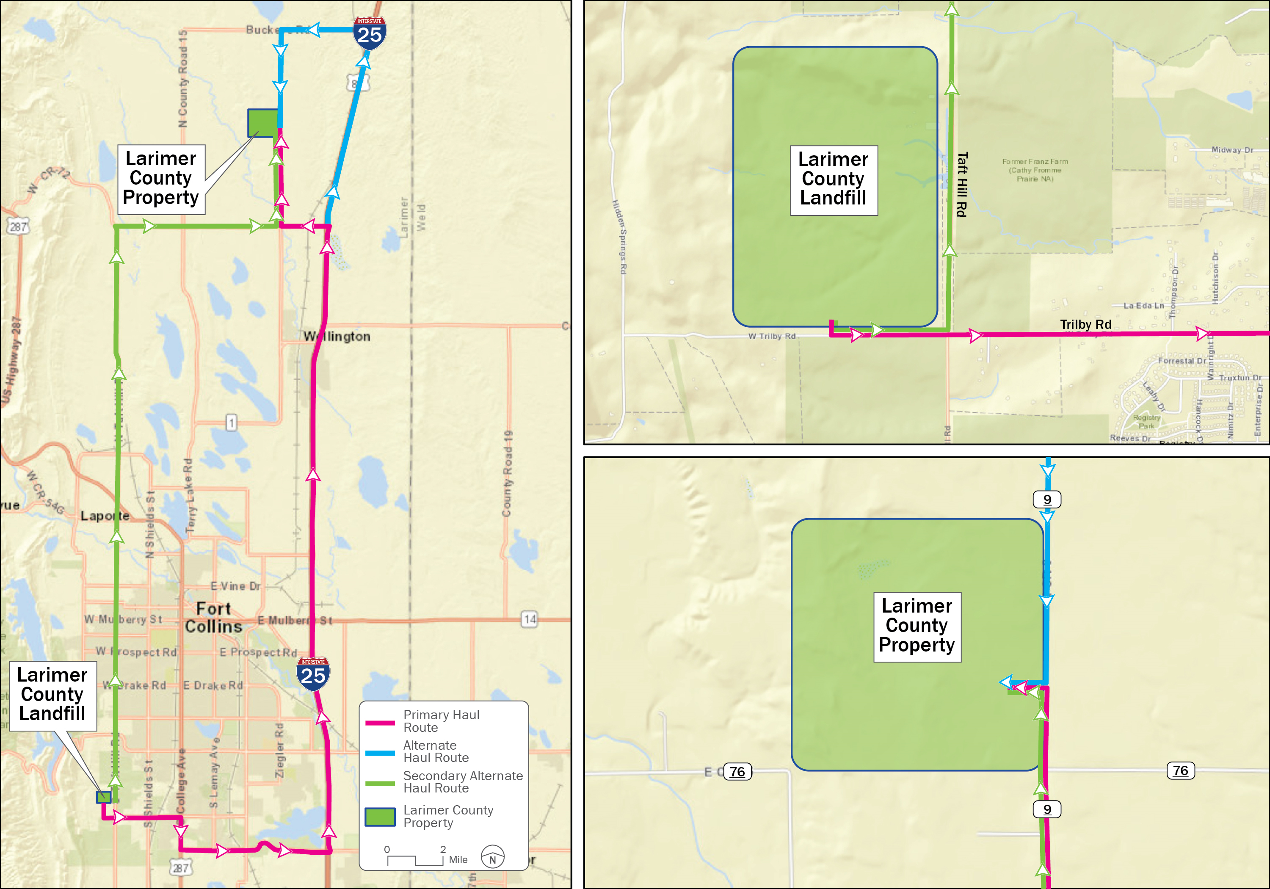
Primary and Alternate Haul Routes

Slide 16
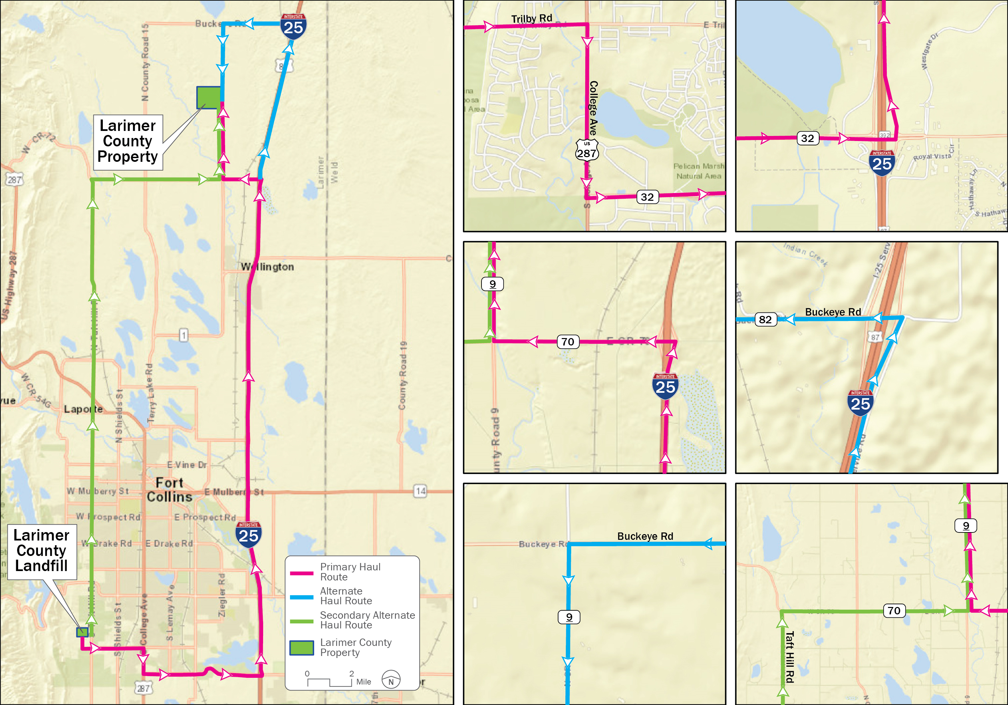
Continue... Primary and Alternate Haul Routes

Slide 17
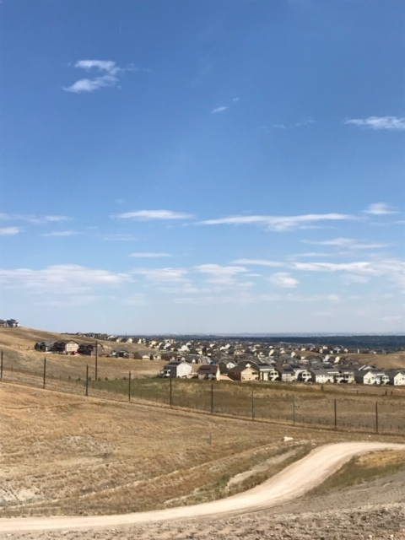
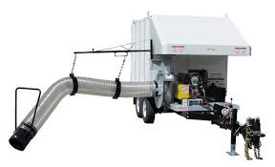
Protection to Homes and External Property
Internal perimeter fencing along working areas
Large border fencing along outer perimeter
Protective berms
Daily cleanup with work crews and X-TREME LITTER VACUUM
On site weather control station to monitor wind direction and speed.

Slide 18
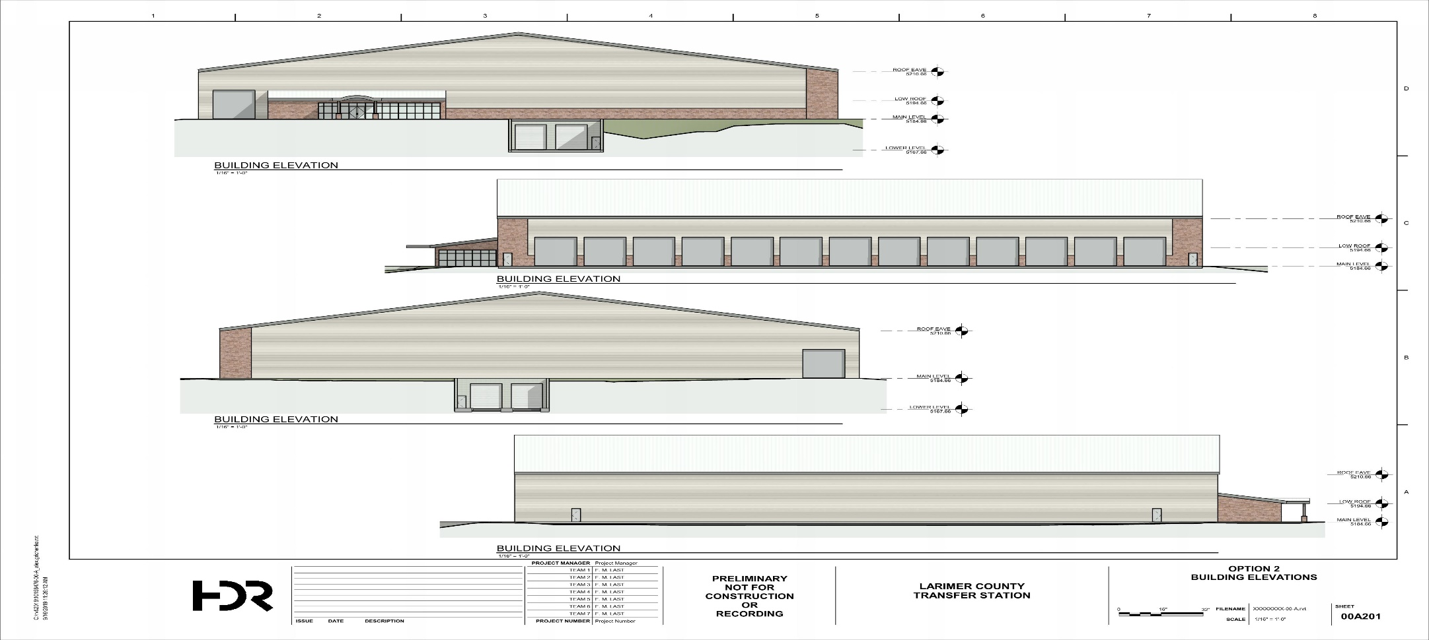
New Transfer Station
Design, public review process, bid preparation
Feb 2020 – April 2020 Construction design & bid process
May 2020 – November 2021 Construction
2022 Ready for operations as needed

Slide 19
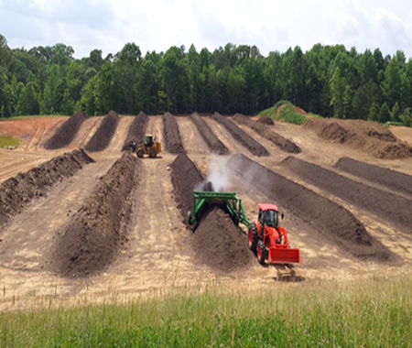
New Yard Waste Compost Operation
02/20 Class 1 Permit submittal and CDPHE review.
03/20 – 06/20 Final Design and Bid process.
09/20 – 04/21 Construction Class 1 Compost Operation
06/21 – Start Operations

Slide 20
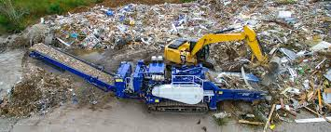
Construction & Demolition Facility
2019 Market Development Overview
2020 Potential Pilot Project

Slide 21
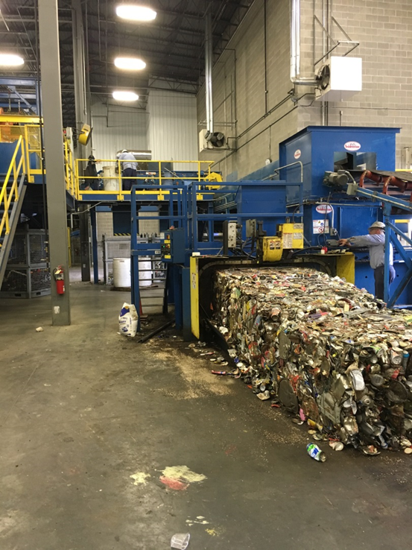

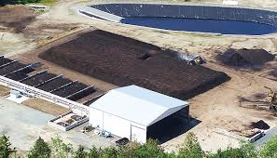
Tier-2 Infrastructure Future Development
Material Recovery Facility (Clean)
Aerobic Composting Including Food Waste

Slide 22
Tier- 3 Future Consideration
  Future Consideration
Energy from Waste Facility (Direct Combustion & Conversion Technology)
Refuse Derived Fuel (RDF) Processing
  Not Currently Viable
Mixed Waste Processing (Dirty MRF)
Anaerobic Digestion

Slide 23
Facility Development Timeline
 | 2019 | 2020 | 2021 | 2022 | 2023 | 2024
Central Transfer Station (Jan 2019 – Feb 2022)
Public Landfill (Jan 2019 – June 2023)
Yard Waste Composting Open Windrow (Nov 2019 – June 2021)
Construction and Demolition Waste Processing (Jan 2020 – Jan 2023)
Food Waste Composting Static Aerated Bin (May 2020 – Feb 2023)

Slide 24
Closing Remarks
Thank You
&
Next Steps

