Slide 2
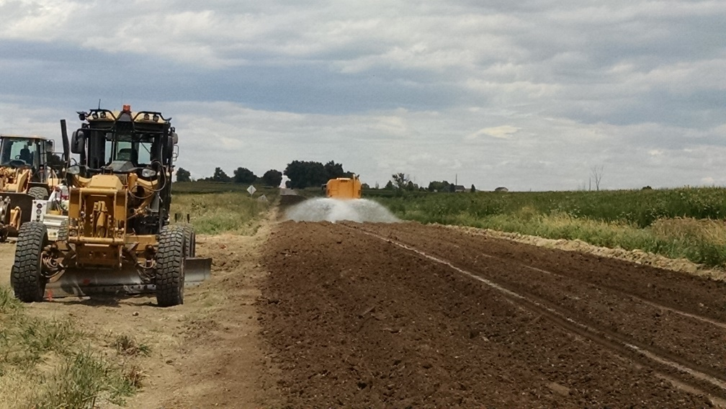
OUR MISSION
Provide a safe, effective transportation network allowing for the efficient movement and mobility of citizens, goods, services, and emergency service providers.

Slide 3
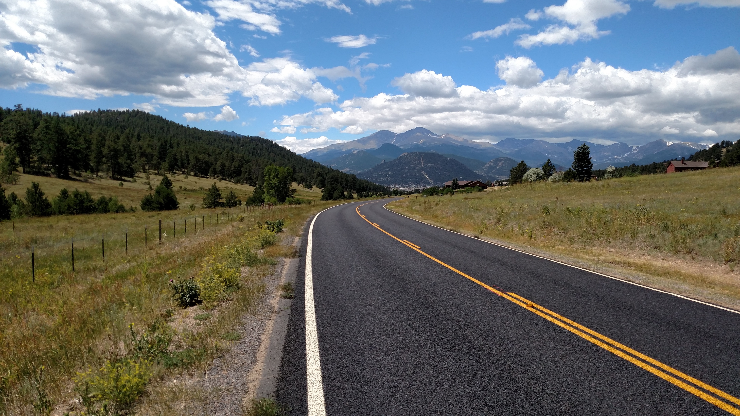
WHAT IS ROAD AND BRIDGE RESPONSIBLE FOR?
466 Miles of Paved Roads
437 Miles of Gravel/Native Surface Roads
126 Miles of USFS Road (Schedule A)
217 Major Structures (>20ft span)
481 Minor Structures (>4ft, < 20ft span)
4,000+/- Culverts

Slide 4
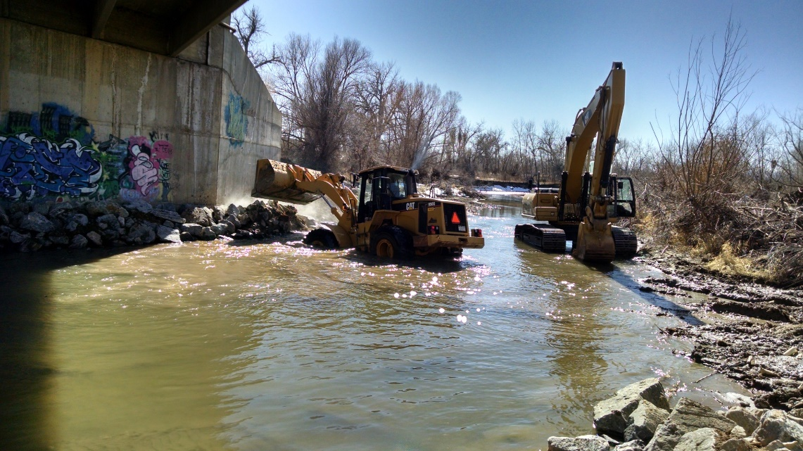
WHO ARE WE?
41 Equipment Operators
17 Team Leaders
5 Functional Group Managers
4 Administrative Staff
1 Assistant Director
1 Director
69 FTE’s
Additionally, we utilize:
10 Seasonal CDL Drivers
19 Seasonal Laborers

Slide 5
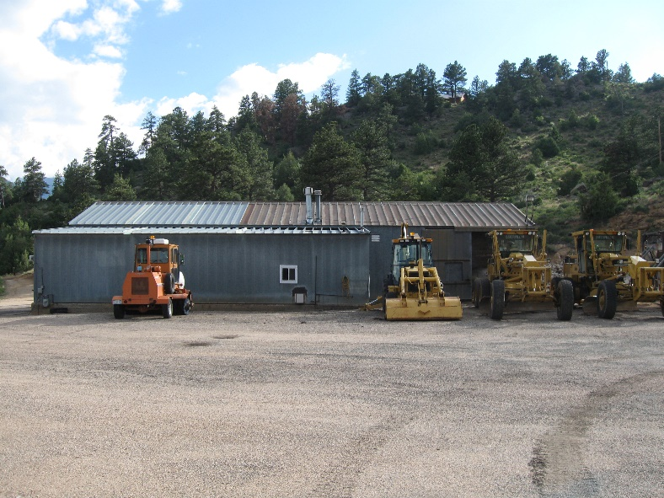
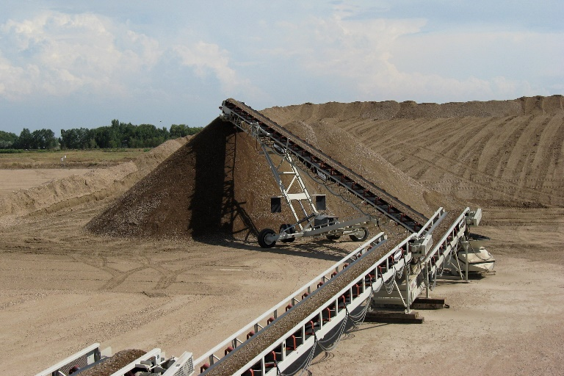
WHERE DO WE WORK?
Larimer County covers 2,640 square miles
We have 7 shop facilities spread throughout the county.
Estes Park
Loveland
Fort Collins
Stove Prairie
Waverly
Livermore
Laramie River
Additionally, Larimer County owns and operates a 160 acre gravel quarry known as the Strang Pit

Slide 6
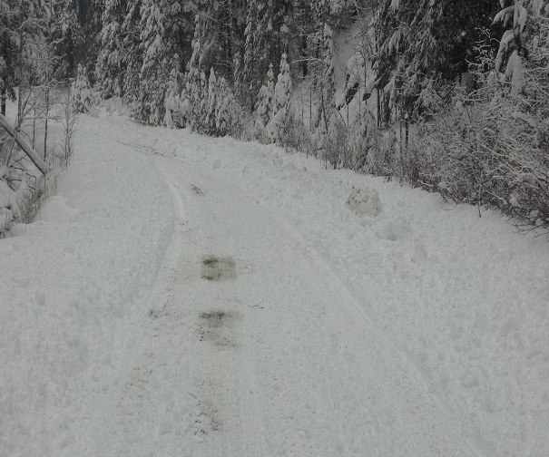
ROUTINE WORK WE SELF PERFORM
Snow and Ice Control
Gravel/Native Road Grading
Culvert Repair & Installation
Roadside Ditch Maintenance
Guardrail Repair
Bridge Maintenance
Sign Manufacture, Installation & Maintenance
Roadway Striping
Chip Seal
Crack Seal
Roadside Mowing
Structural Hot Mix Patching/Pothole Patching
Hazard Tree Removal
Mine and Crush Gravel
Roadway Construction and Reconstruction

Slide 7
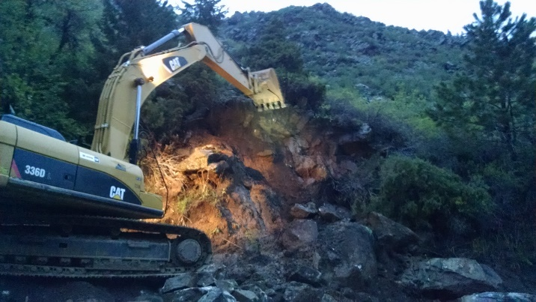
MISCELLANEOUS DUTIES
Dead Animal Removal
~50 Deer/year
~3 Antelope/year
~2 Elk/year
Trash Removal - ~100 Responses/year
Household Trash
Couches
Tires
Camper Shells
Meth Lab Chemicals
Rock/Mud Slides - ~50 Responses/year
Debris Removal – Storm Events

Slide 8
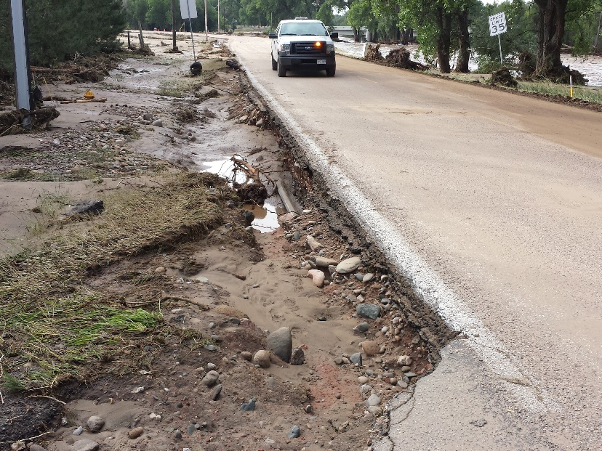
AFTER HOURS RESPONSES
Road and Bridge is on call 24/7/365
We utilize lead rotations to coordinate response.
Our after hours call outs are typically dispatched by the
Larimer County Sheriff’s Department and are
for issues such as:
Flooded Roads
Tornado Response (debris)
Snow – Slick Road Conditions
Traffic Accidents – Damaged Infrastructure
Rock/Mud Slides
Damaged or Destroyed Signs – Stop Signs
Downed Trees
Estimated # of After Hours Pages – 150/year
Estimated # of After Hours Deployments – 50/year

Slide 9
Road and Bridge Budget 2019
Maintenance $24.4 million
Capital $ 8.7 million
*Total $31.6 million
*Excludes Flood Repairs and I-25 Improvements

Slide 10
Maintenance Budget 2019 $24.4 million
REVENUE
EXPENSE

Slide 11
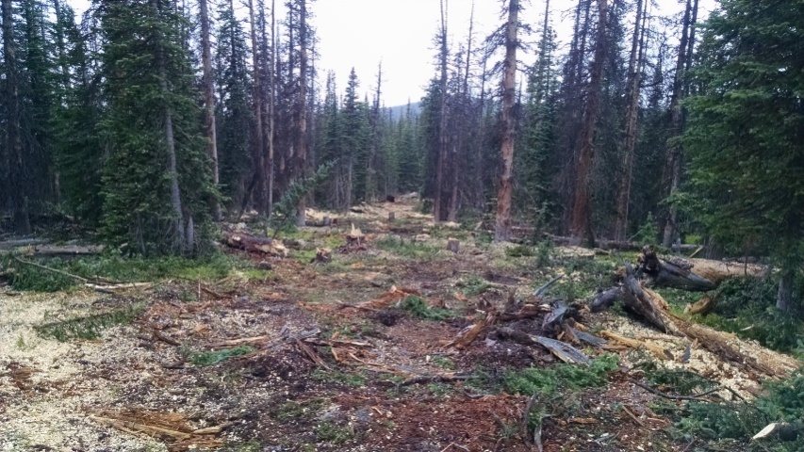
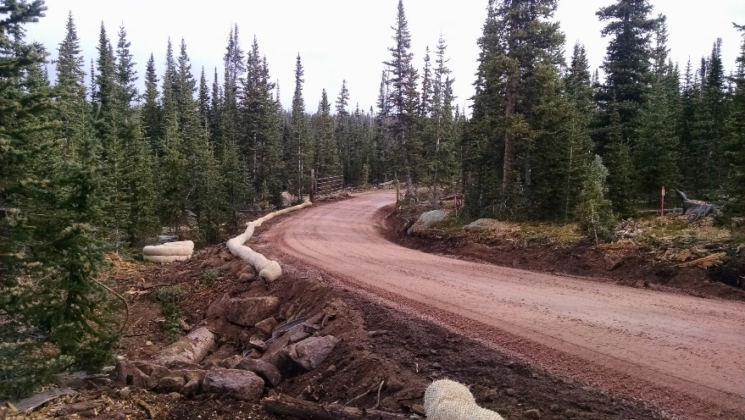
COLLABORATION WITH OTHER ENTITIES
Natural Resources
Road Maintenance and Snow Removal (Hermit Park, Red Mountain, Eagles Nest)
Fleet
Haul Equipment
The Ranch
Help with Snow and Ice Control Occasionally
Loan Equipment
Solid Waste
Loan Equipment
Sheriff's Department
Construct Killpecker Access Road – Comm. Tower Rd
City of Fort Collins
Chip Seal
Maintenance Swaps
City of Fort Collins
City of Loveland
Town of Windsor
Town of Timnath

Slide 12
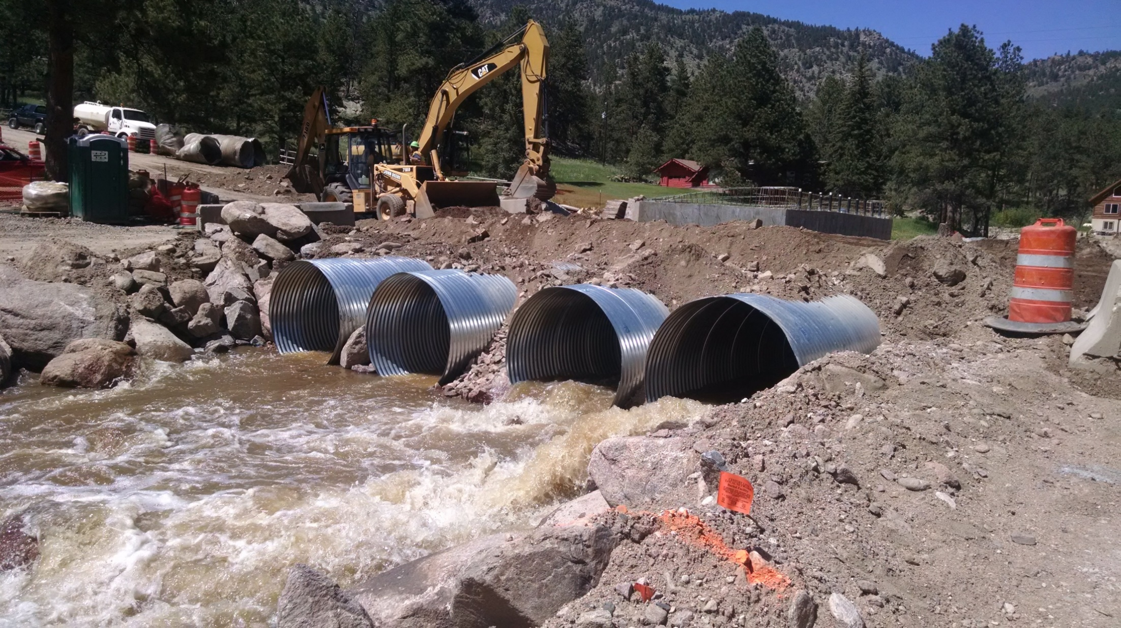
THANK YOU!

