Slide 1
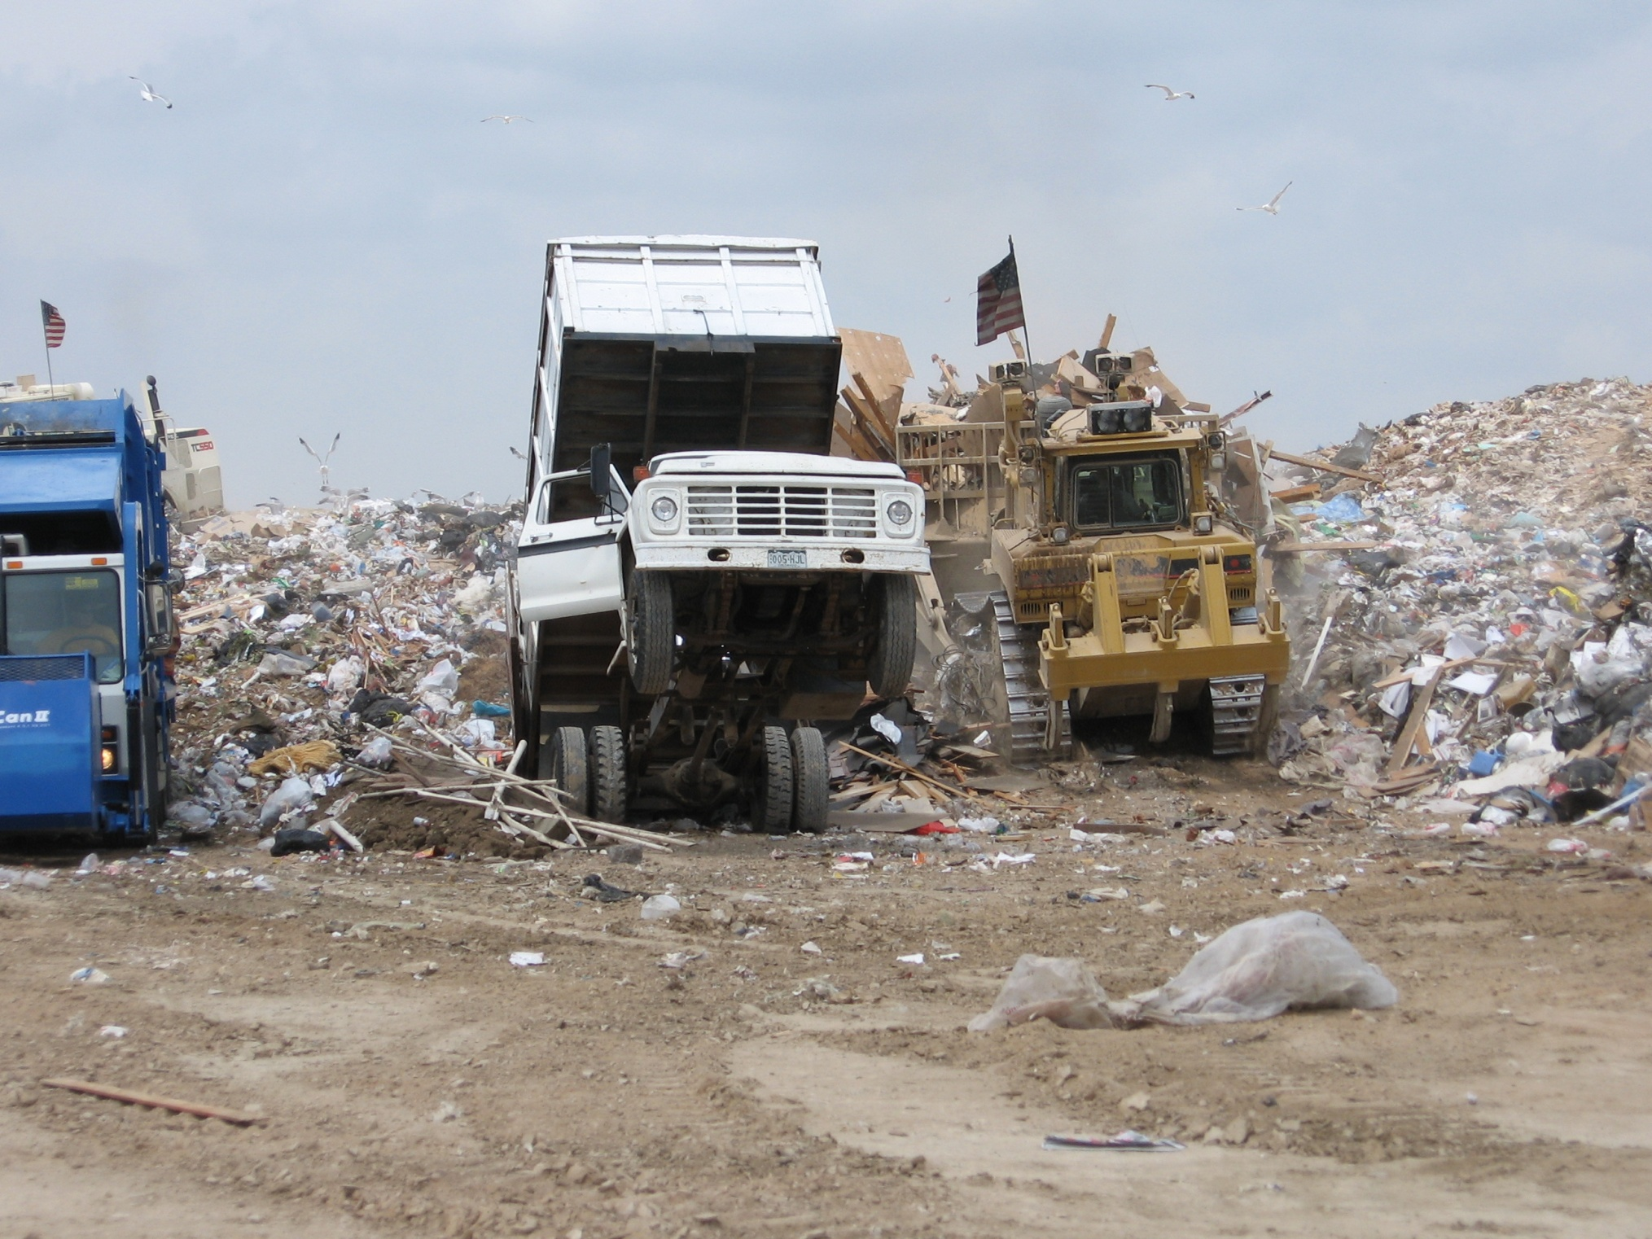
Solid Waste in Larimer County
Yesterday – Today – and Tomorrow
???

Slide 2
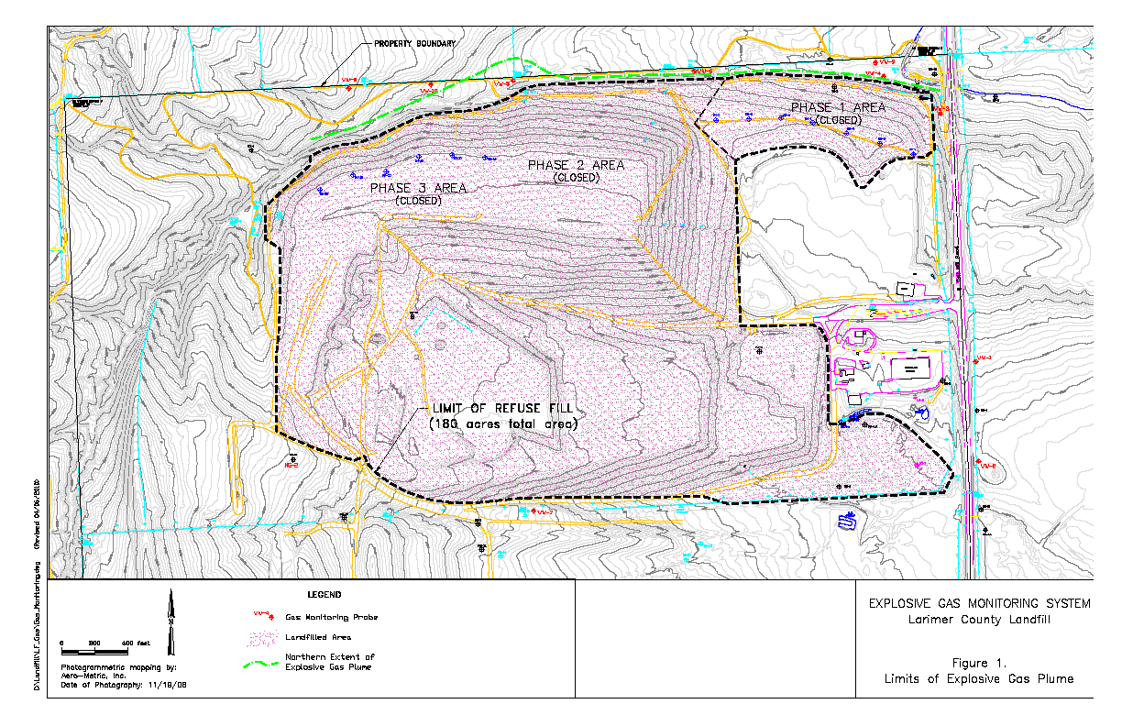
Phase 1
Phase 2
Phase 3
Phase 5A
Phase 6A
North ½ of Section 9
T 6N, R 69W
Notes:
180-acre footprint established by 1993. Vertical expansions approved by CDPHE and Board of County Commissioners.
Landfill divided into phases. From 1996 thru 2004, Phases 1, 2,3 completed and capped. Phase 6A completed/capped in 2011.
Phase 5A (20 acres) will be completed and capped this spring. 80 acres remaining, about 6 years.

Slide 3
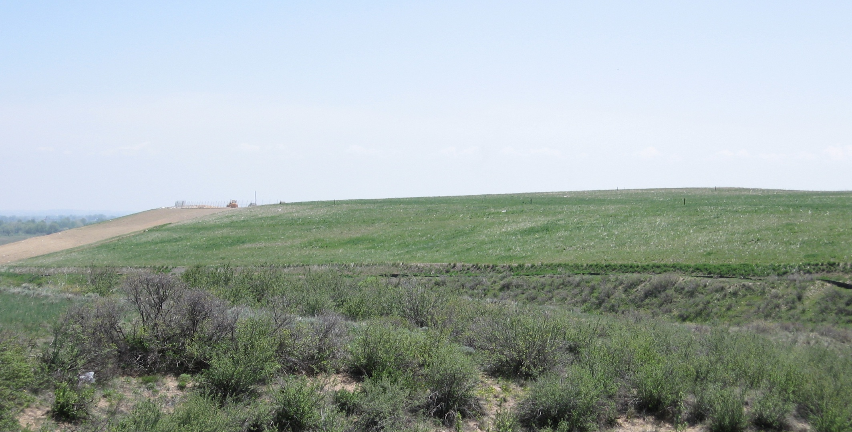
Landfill Closure & Post-Closure

Slide 4
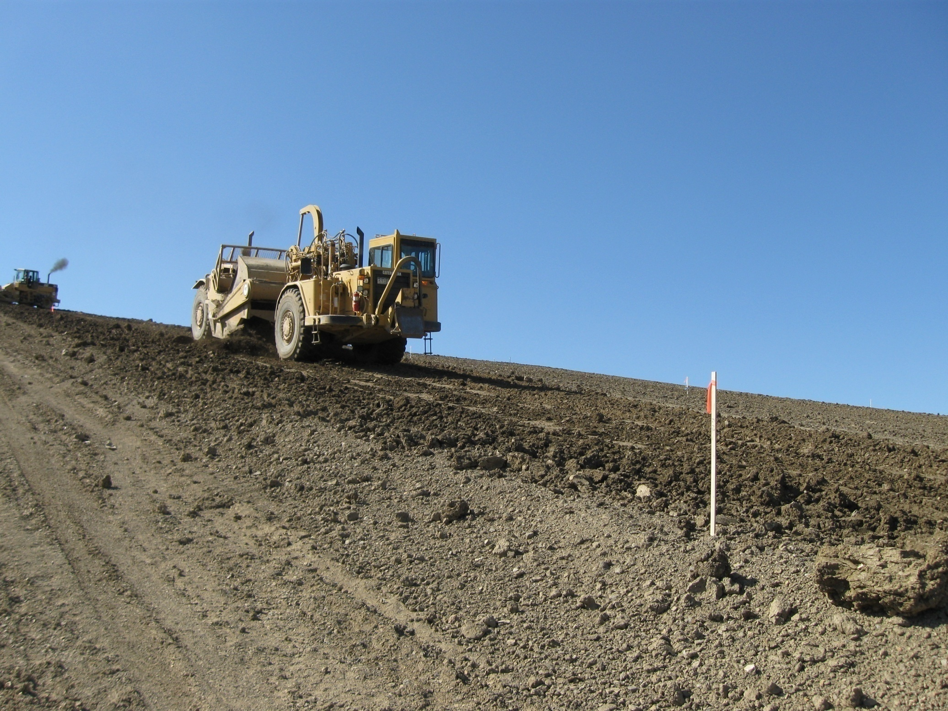
LANDFILL CLOSURE
Phase 5A Final Cover Construction – spring 2019
Construction Quality Assurance (CQA)
Construction Certification Report

Slide 5
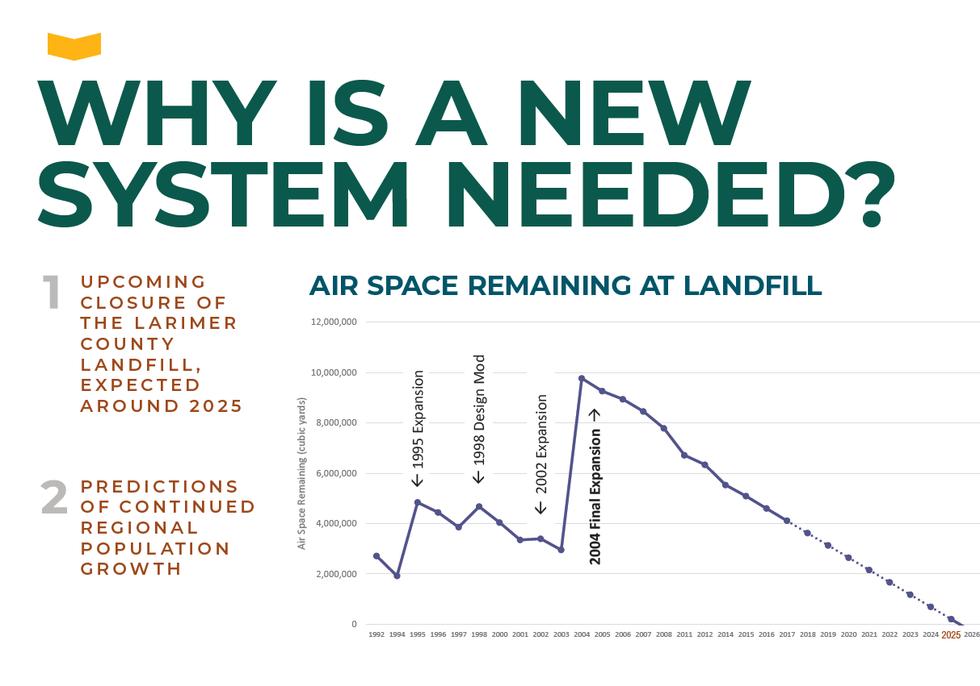
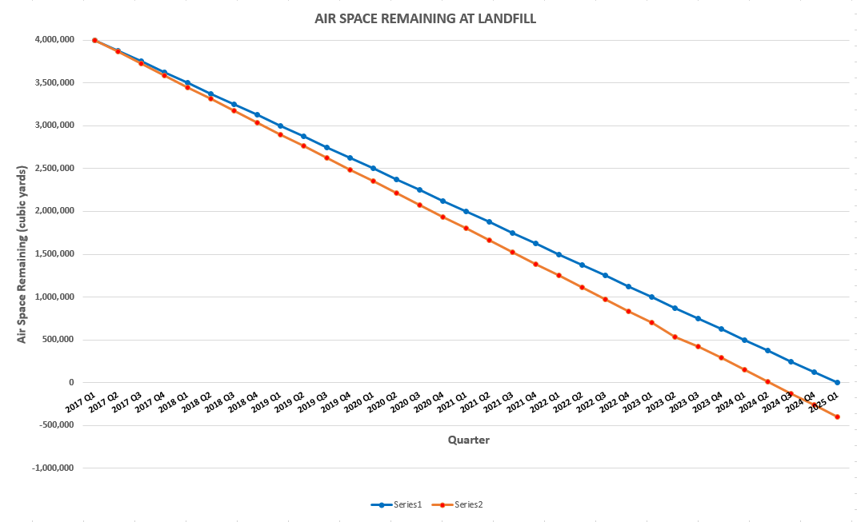

Slide 6
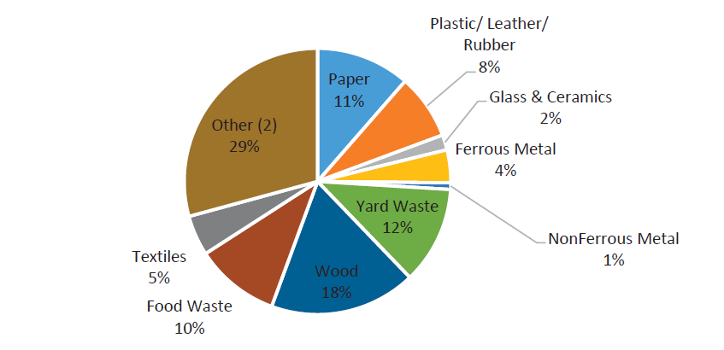
Larimer Co. 2016 Waste Composition & Characterization Analysis
Percent by Weight, All Wastes Delivered to Landfill (Other = construction and demolition debris and other materials)

Slide 7
Tier 1 Recommended Options
Solid Waste Process Control Assumptions Adopted
Estimated Tipping Fees including Overhead Expenses
 | Capital Costs (2017 $) | Tons Captured (2025) | Tipping Fee (2017 $)
New Landfill | $11.7M (1st Phase) $11.7M (Equity) $0.0M Finance | 344,800 | $14.09 / Ton
Central Transfer Station (Transferred Materials/Direct Haul Zone) | $15.8M $15.8M (Equity) $0.0M Finance | 321,600 | $29.29 / Ton
Construction & Demolition (C&D) Processing | $13.7M $13.7M (Equity) $0.0M Finance | 150,000 | $37.17 / Ton
Yard Waste & Food Waste Composting | $11.8M $0.0M (Equity) $11.8M Finance | 72,200 | $37.92 / Ton

Slide 8
Costs of Recommended Facilities
Public Landfill | $11.7M (Equity – 1st Phase)
Central Transfer Station | $15.8M (Equity)
Yard Waste & Food Waste Composting Facilities | $11.8M (Finance)
Construction & Demolition Debris Processing Facility | $13.7M (Equity)
Recycling Center Upgrades | $3.0M (Finance)
Total: | ~$56M
Notes:
Stephen

Slide 9
Facility Development Timeline
 | 2019 | 2020 | 2021 | 2022 | 2023 | 2024
Central Transfer Station (Jan 2019 – Jan 2023)
Public Landfill (Jan 2019 – Jan 2024)
Yard Waste Composting Open Windrow (Jan 2020 – Jan 2023)
Construction and Demolition Waste Processing (Jan 2020 – Jan 2023)
Food Waste Composting Static Aerated Bin (Oct 2023 – Feb 2025)

Slide 10
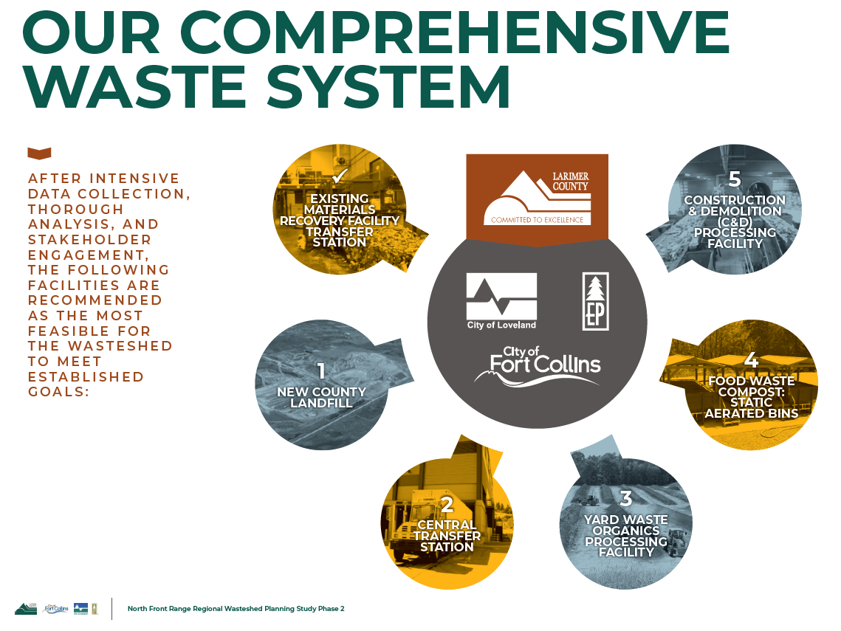

Slide 11
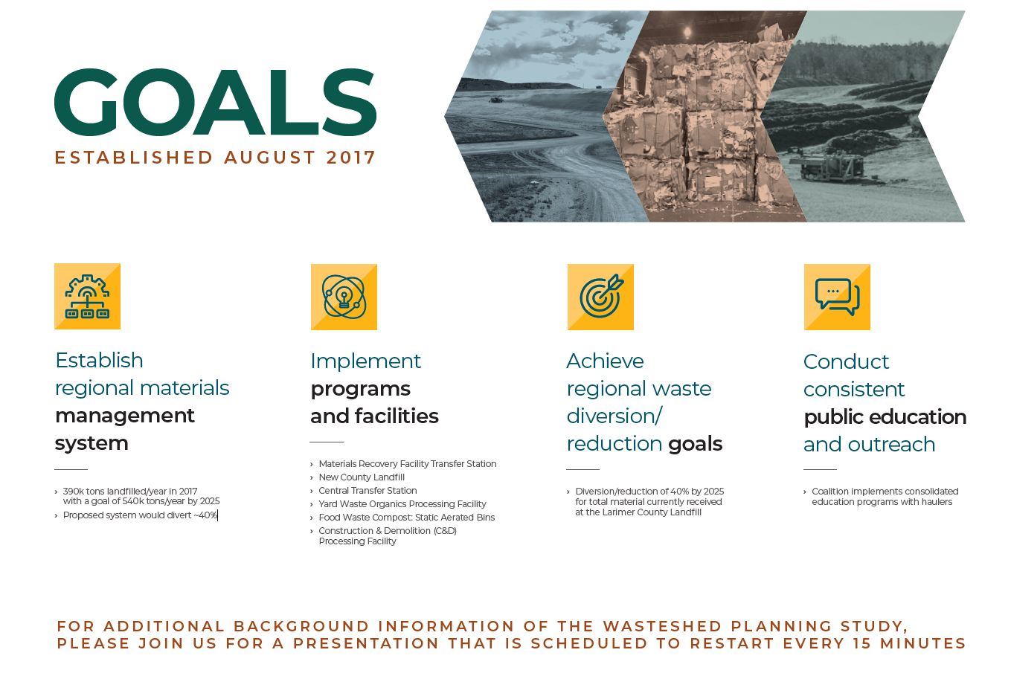

Slide 12
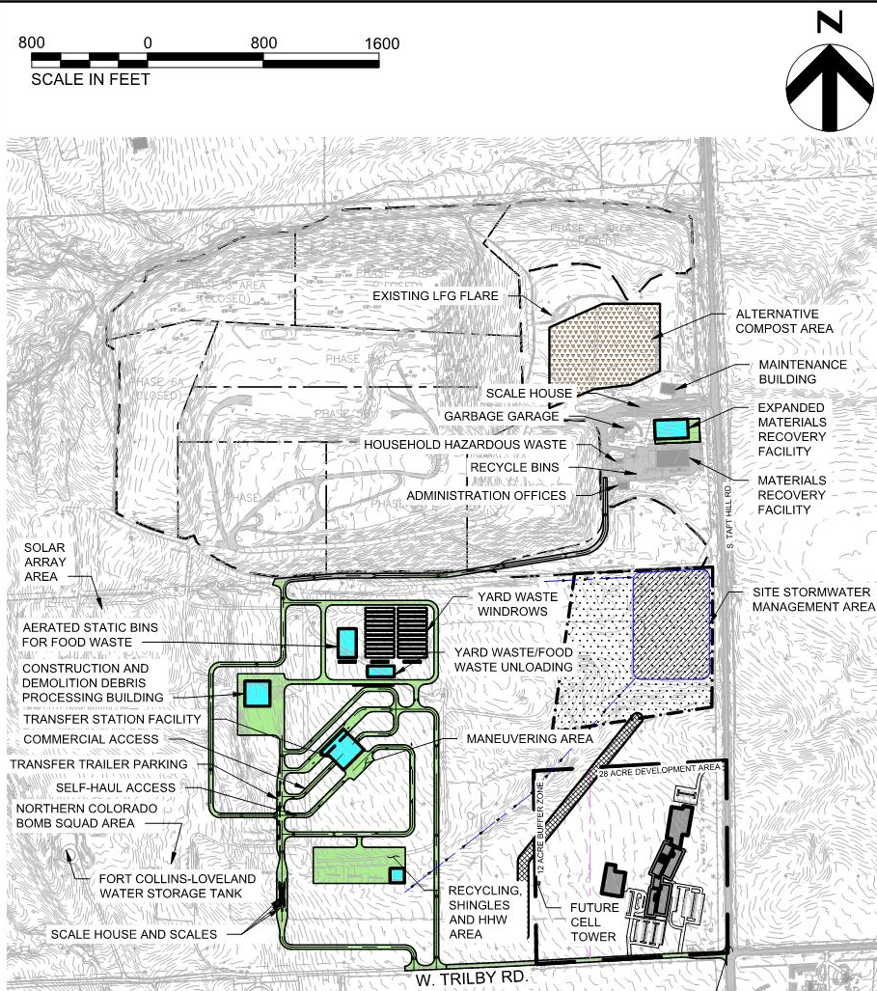
Site Plan Draft

Slide 13
Preliminary Haul Route

Slide 14
LARIMER COUNTY LANDFILL NEIGHBORHOOD
Northern Aquifer
Southern Aquifer
Notes:
Bedrock ridge divides uppermost aquifer into two zones – northern and southern.

Slide 15
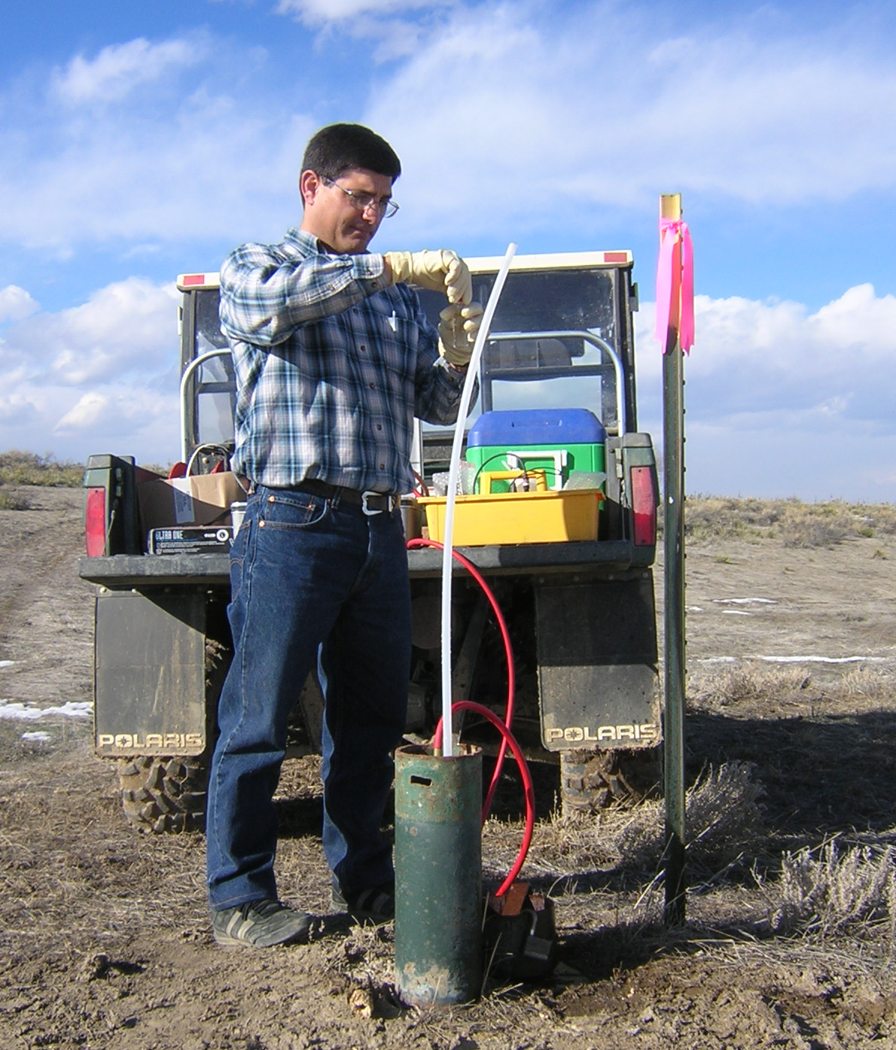
Groundwater Monitoring
Groundwater sampling 2-4 times/year
Testing for 47 VOCs + metals and inorganic compounds
VOC concentrations decreasing (due to Biodegradation)
Extent of contamination not increasing
No downgradient receptors
Monitored Natural Attenuation (MNA)
Notes:
Quarterly/semi-annual groundwater sampling for the past 25 years.

