Slide 1
Key Features – Yard Waste Compost Site
23.6 Acres of Non-landfill area
Phase – 1 will use 13 acres
Compost site is underlain by 10 – 18 feet of thick claystone layer
WE HAVE A 2 ½ INCH WATER TAP SOURCE ON THE SITE NEAR MAINTENACE SHOP
WE HAVE COMPLETED PERLIMINARY SITE GRADING
GROUND WATER MONITORING WELLS
FINANCIAL IMPACT IS POSITIVE
A $680,000 GRANT WAS AWARDED FOR A COMPOST SHREDDER

Slide 2
Design Criteria – Yard Waste Compost Site
26,000 tons/yr from city of Loveland & 1.8 tons/yr from existing operations
Compost pad is designed to hold 40,000 annual tons
$5,800,000.00 project
utilizing windrow compost technology
LARIMER COUNTY WILL OPERATE PHASE - 1
LARIMER COUNTY WILL NEED FINISHED COMPOST FOR LANDFILL VEGETATIVE COVER
EXPANSION CAPABILITY FOR FOOD WASTE INTERGRATION

Slide 4
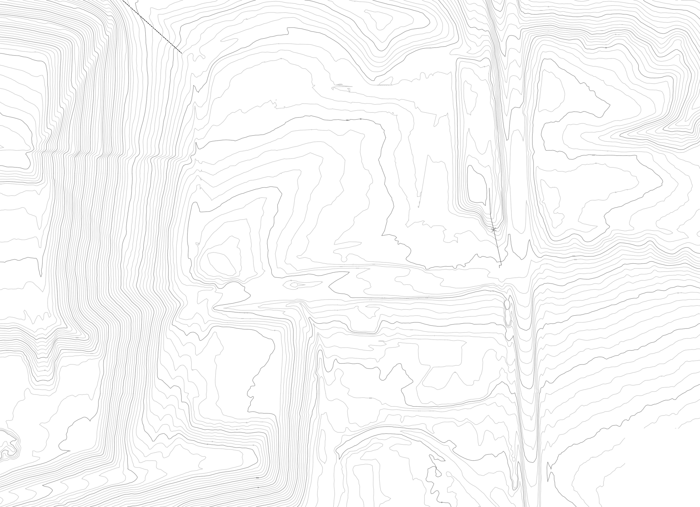
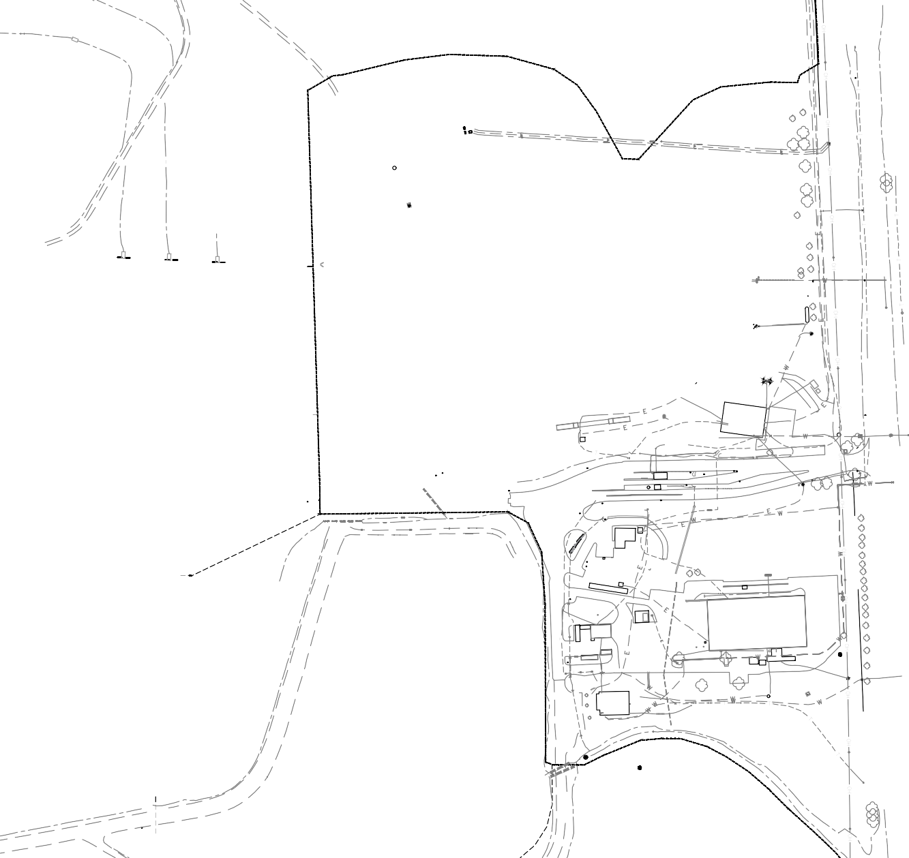

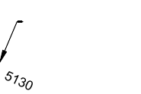
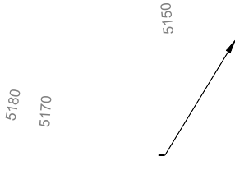

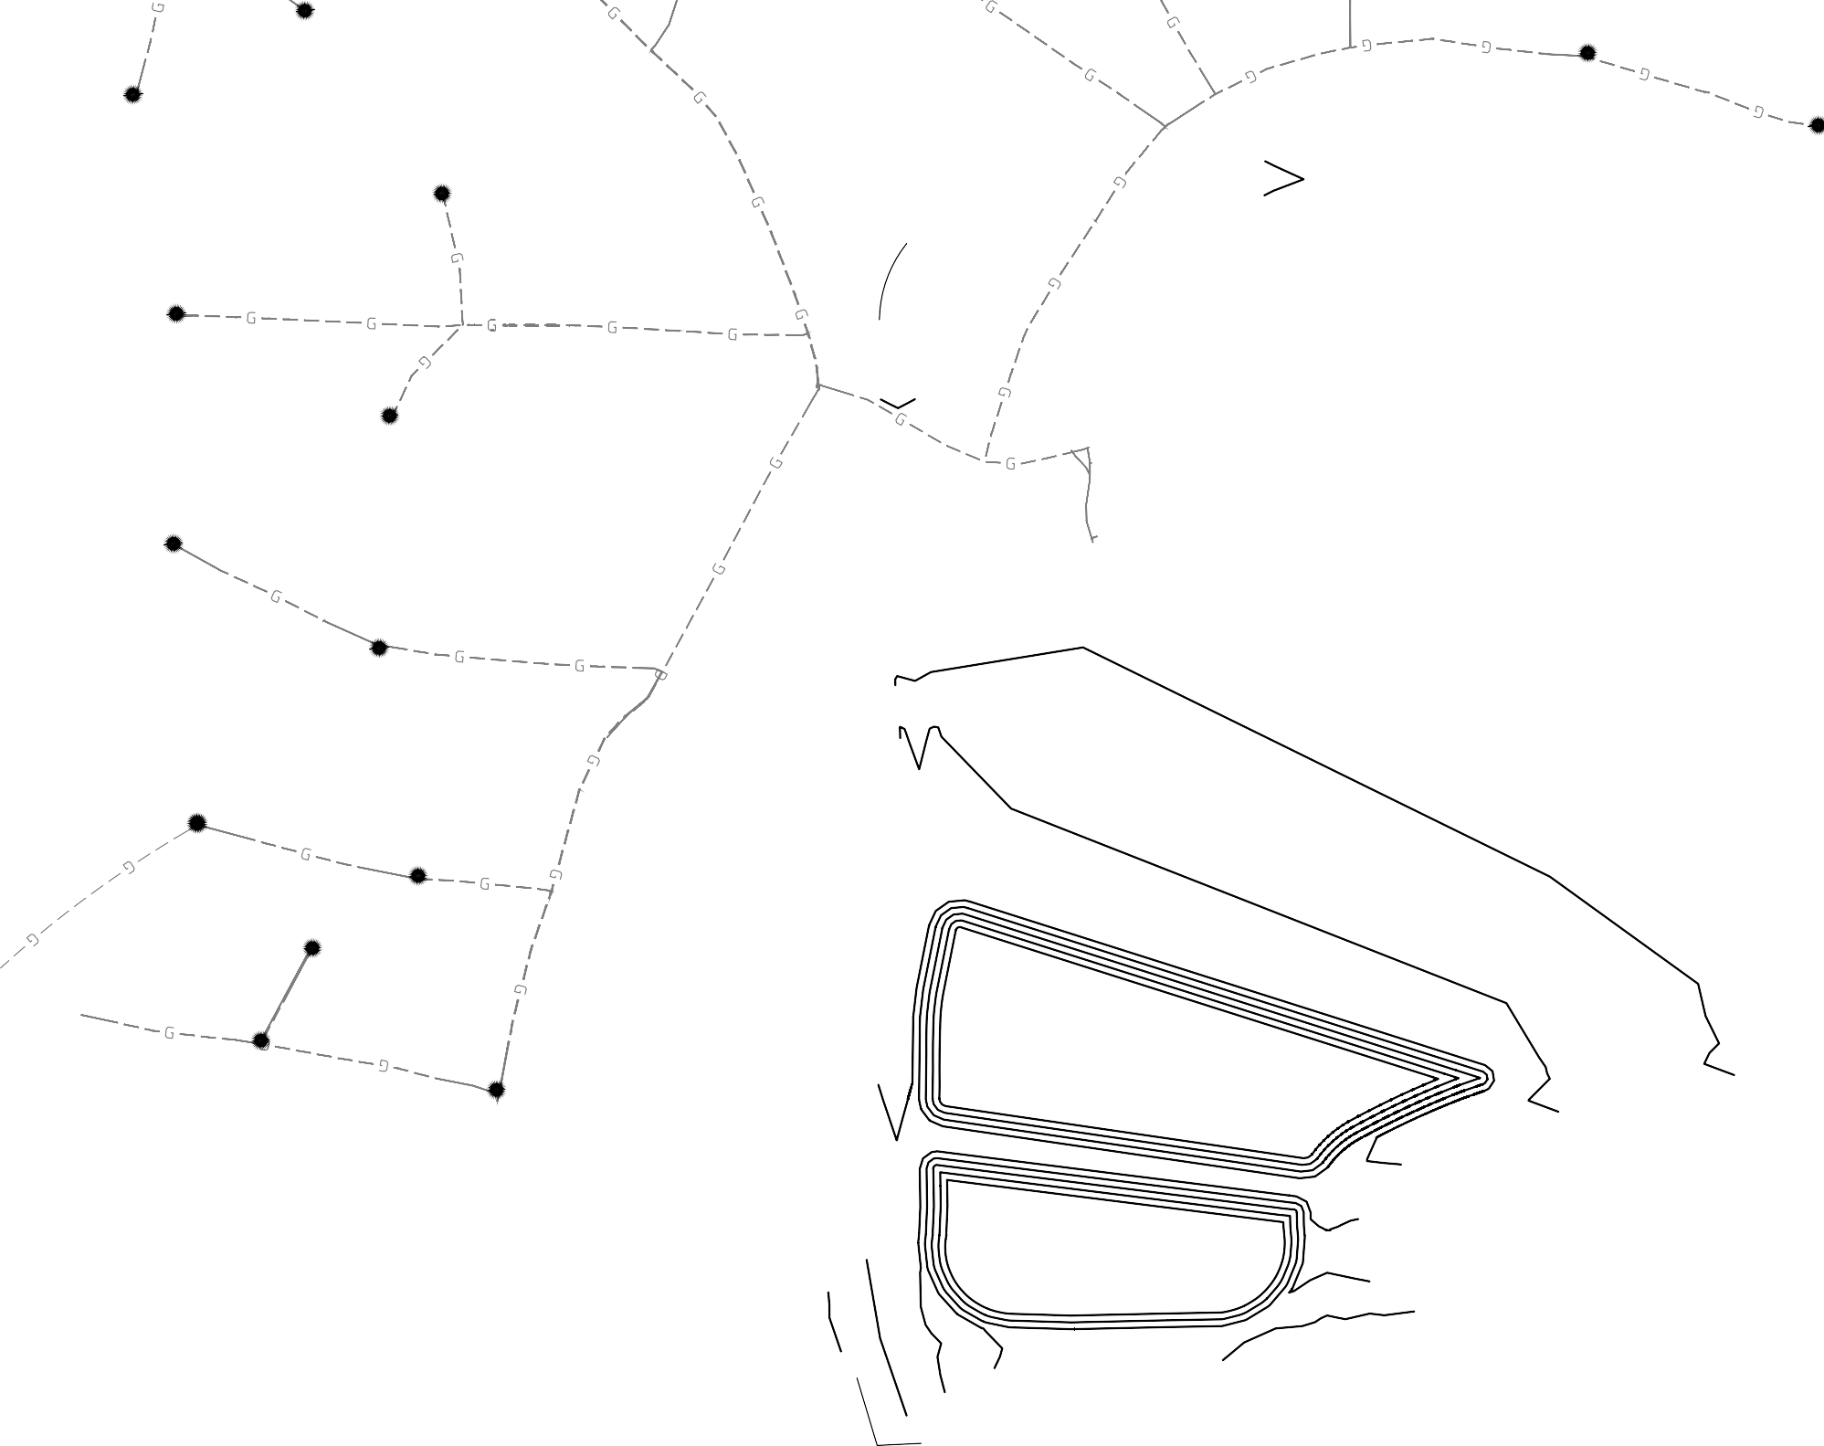
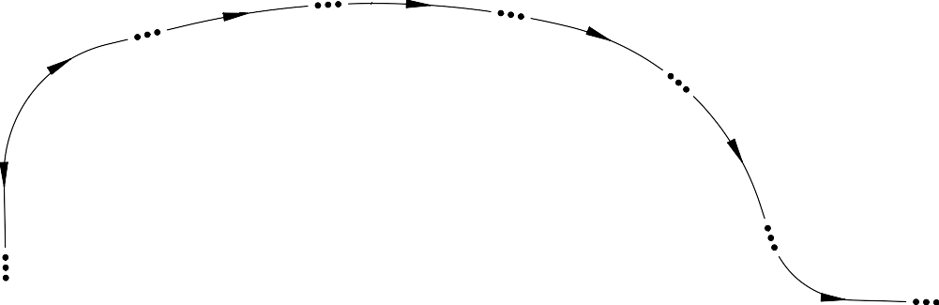





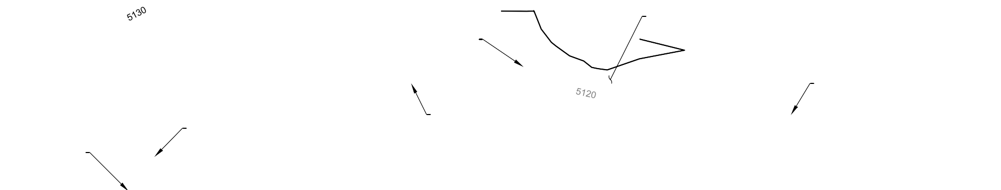
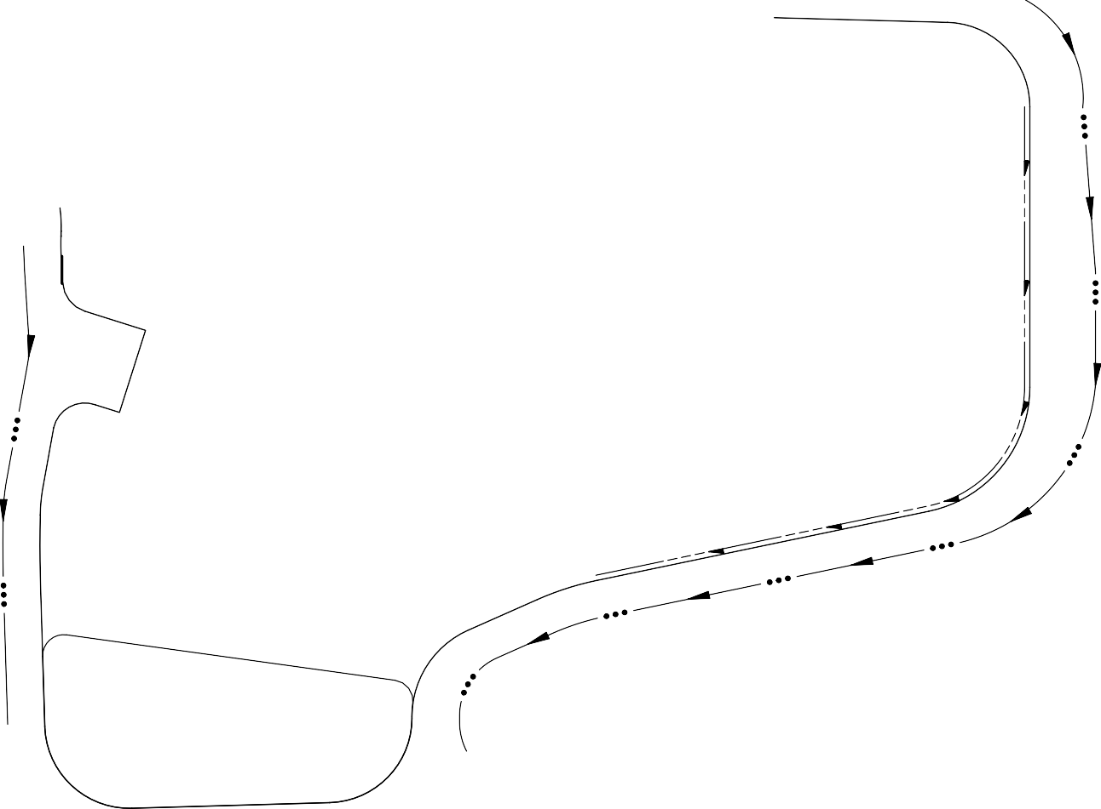




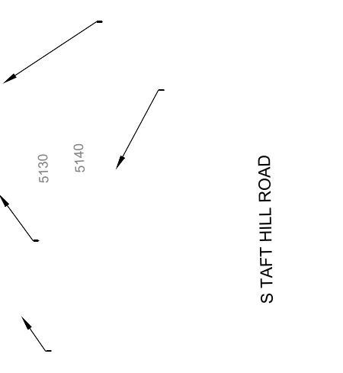






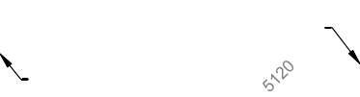



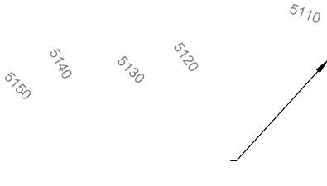

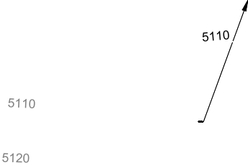
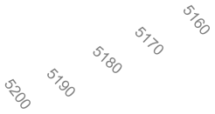



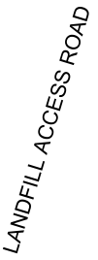







1
2
3
4
5
6
7
8
9
10
11
12
13
no. date by ckd description
NEW STORMWATER CHANNEL
(SEE SHEET CI101)
PHASE 1 AREA (CLOSED)
A 5/25/20 SJF
_{JLL} INTERMEDIATE
EX. LANDFILL LIMITS
T
NOTES:
DESIGN
EX. GAS WELL (TYP.)
T
1. FINAL GRADING OF CONTACT POND BOTTOM TO PROVIDE DRAINAGE TO A LOW POINT TO BE COMPLETED IN FINAL DESIGN.
LANDFILL PHASE
BOUNDARY
CP-3008
A
WASTE TO ENERGY FACILITY (0.6 AC)
CP-3002
T
PHASE 2 AREA (CLOSED)
NEW STORMWATER CHANNEL
(SEE SHEET CI101)
SB-6
LIGHT PAVEMENT SECTION (SEE SHEET CS102)
MW-28
NEW CULVERT (SEE SHEET CI101)
T
B
NEW STORMWATER CHANNEL (SEE SHEET CI101)
NEW CONTACT WATER CHANNEL (SEE SHEET CG101)
EDGE OF WORKPAD
T
EX. GROUTED
RIPRAP
EX. FIRE HYDRANT
PHASE 5A AREA
NEW CONTACT WATER CHANNEL (SEE SHEET CG101)
T
EX. 12,000 GALLON WATER TANK
C
EX. SLOPE
DRAIN
FILL STATION
SB-4
SB-5
WINDROW
PROCESSING AREA
8.8 AC
T
MW-29
SB-7
EX. OVERHEAD FILL PORT
Millimeters
T
D
HEAVY PAVEMENT SECTION
(SEE SHEET CS102)
EX. 1,000 GALLON PROPANE TANK
T
EX. MAINTENANCE
BUILDING
EX. SCALE
EX. FIRE HYDRANT
Scale For Microfilming
T
T
T
PHASE 5B AREA
T
T
T
T
T
NORTH
E
EX. GATEHOUSE
CP-003
T
PZ-21
T
0
100'
200'
CP-2005
T
SCALE IN FEET
Inches
NEW CULVERT (SEE SHEET CI101)
NEW CULVERT (SEE SHEET CI101)
T
T
PRELIMINARY - NOT FOR CONSTRUCTION
F
T
T
T
ADMINISTRATION
BUILDING
T
T
VW-1
9785 Maroon Circle, Suite 400
Centennial, CO 80112
303-721-9292
G
FIRE HYDRANT
date
detailed
S FOREMAN
checked
B COLEMAN
PHASE 5E AREA
HG-5
MAY 2020
designed
S FOREMAN
COPYRIGHT © 2017 BURNS & McDONNELL ENGINEERING COMPANY, INC.
LC-2
H
EX. 42" Ø CMP CULVERT
(TO REMAIN)
MW-1
HS-2
MW-12
LARIMER COUNTY, COLORADO
LARIMER COUNTY COMPOST FACILITY PHASE 1 CONSTRUCTION
EX. 48" Ø CMP CULVERT (TO REMAIN)
I
project
OVERALL SITE PLAN
contract
BM-20-01
rev.
A
sheets
121363
drawing
CS101
of 14
OVERALL SITE PLAN
sheet 4
Z:\CLIENTS\ENS\LARIMERCNTY\121363_2020COMPOSTFAC\DESIGN\CADD\DWGS\121363CS101.DWG, 5/27/2020 4:09 PM, schmidt, tyler j
SCALE 1" = 100'
file 121363CS101.DWG

Slide 5
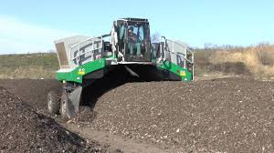
COMPOST WINDROW TURNING MACHINE

Slide 6
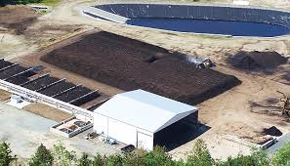
FUTURE FOOD WASTE OPERTION

Slide 7
Yard Waste Compost - Phase - 1
2020 | Task
Completed | Completed 60% Design and Site Conceptional Structure
 | Permitting Process
March 6 - Sept 2 | - Air Permit - Modification to existing Title V
June 5 - July 23 | - Stormwater Construction Permit
July 17 - Nov 19 | - CDPHE Class I Facility Registration
July 17 - Nov 20 | - Landfill EDOP Modification (TBD)
July 17 - Nov 20 | - Location and Extent application submitted by County
July 31 - Sept 24 | Complete 100% Design
Aug 17 - Sept 24 | Bid Process for Construction and Award
Oct | Start Phase - 1 Construction
Oct 2020 - Jun 2021 | Construction Period
2021
Jan - Jun | Phase - 1 Construction Completion
June 1 | Phase - 1 yard waste operations begins

Slide 8
Food Waste Compost - Phase - 2
2020 | Task
June - Dec | Food Waste Conceptual Design with Operator 30%
2021
Jan - July | EDOP Development
July - Dec | Food Waste Composting Facility Intermediate (70%) Design
2022
Jan - July | Food Waste Composting Facility Final (100%) Design
Aug - Nov | Submit EDOP Compost Class III application CDPHE
Dec | CDPHE Technical Review (7 - 9 months)
2023
Jan - Aug | EDOP technical review CDPHE / address comments
Sept - Dec | C/D Process potential modification to existing Landfill C/D
2024
Jan - Feb | Planning Commission Approval
March - May | Phase - 2 design bid process - construction & operations
June | Award construction bid and Operations bid
June - Dec | Start Phase - 2 Construction (10 -12 months)
2025
June | Phase - 2 food waste operations begins

