Slide 1
Wasteshed Coalition:
Charter, Goals, Objectives
(approved previously) versus
Solid Waste Policy Council:
Vision, Mission, Values, Outcomes
(new???)
February 13, 2020

Slide 2




Coalition Charter
As stewards of the public trust, the charter and charge of the North Front Range Regional Wasteshed Coalition is to responsibly address current solid waste management and resource recovery needs of the region, while considering infrastructure and policy that will meet community needs in the future.
*Stakeholder group reviewed the charter and goals on May 31, 2017.

Slide 3
Goal #1
Establish a comprehensive, regional solid waste management system that is implemented in an economically, environmentally and socially sustainable manner.
Objectives
 Upon completion of the Phase 2 Study in 2018, the Coalition has identified and documented specific solid waste programs, facilities and infrastructure that deliver the optimum balance between economic, environmental and social costs.
 The proposed solid waste system addresses future customer service demands in the region over the next 40 years or more, and provides long-term funding to address capital and operating costs.
 Coalition members are prepared to begin implementing solid waste programs and constructing solid waste facilities and infrastructure by January 2020.

Slide 4
Goal #2
Provide a system and facilities that reflect the future needs and desires of its users based on comprehensive materials management and disposal.
Objectives
 The development of solid waste programs and facilities shall utilize a comprehensive approach for material management, reuse, recycling and disposal; examining how materials are used throughout their life cycle; and finding opportunities to promote reduction of material consumption, environmental impacts, costs, and conserve resources.
 The next generation of solid waste programs and facilities provides solid waste management services at affordable rates, and customer costs are competitive compared to national and regional averages.
 New solid waste programs and facilities result in the increasing application of innovative technologies and produce a substantial reduction in the amount of material being transferred to landfills.
 New solid waste programs and facilities are convenient and accessible for citizens, customers and private solid waste haulers in the County and region.

Slide 5
Goal #3
Develop unified diversion goals that are adopted and implemented by all municipalities in the Wasteshed and emphasizes a solid waste system focused on diversion and supported by shared and consistent data.
Objectives
 The Coalition establishes consistent definitions and methods for measuring the rate of solid waste diversion within the wasteshed by the year 2019.
 Solid waste diversion is evaluated on a two-year recurring cycle beginning in the year 2020.
 A Policy Advisory Committee and private solid waste representatives review the results of solid waste diversion evaluation, current diversion programs, and unified diversion goals on an annual basis to identify potential program adjustments.
 Municipalities adopt and implement consistent regulatory measures to support solid waste diversion efforts by the year 2022.

Slide 6
Goal #4
Develop a strong public education and outreach program that is unified and consistent across all municipalities.
Objectives
 Public education and outreach programs convey a consistent message and effectively influence the behavior of citizens regarding the reduction, reuse and recycling of materials that would otherwise be destined for landfill disposal.
 Educational activities support a vision for community and environmental benefits of reducing, reusing and recycling materials.
 Public education materials convey consistent guidelines for recycling and solid waste diversion within all municipalities.
 Municipal and private solid waste company representatives meet on a routine basis to coordinate solid waste educational programs and outreach efforts.

Slide 7
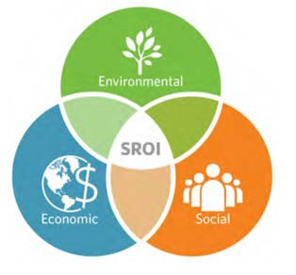
Supporting Factors for all Goals
 Not one element (economics, environment or social) can be maximized; need to balance among the three to achieve a realistic diversion goal
 Everyone has a voice and treated fairly (stakeholders, private sector and public)
 Diversion goals and policy need to be supported by the PAC and enacted consistently across all local agencies
 Equal opportunity for resource recovery, compared to a landfill
 Consistent policy, effective two-way communications and an inventory and assessment of current infrastructure and resources

Slide 8
4 Goals
Establish a comprehensive, regional solid waste management system that is implemented in an economically, environmentally and socially sustainable manner.
Provide a system and facilities that reflect the future needs and desires of its users based on comprehensive materials management and disposal.
Develop unified diversion goals that are adopted and implemented by all municipalities in the Wasteshed and emphasizes a solid waste system focused on diversion and supported by shared and consistent data.
Develop a strong public education and outreach program that is unified and consistent across all municipalities.

Slide 10
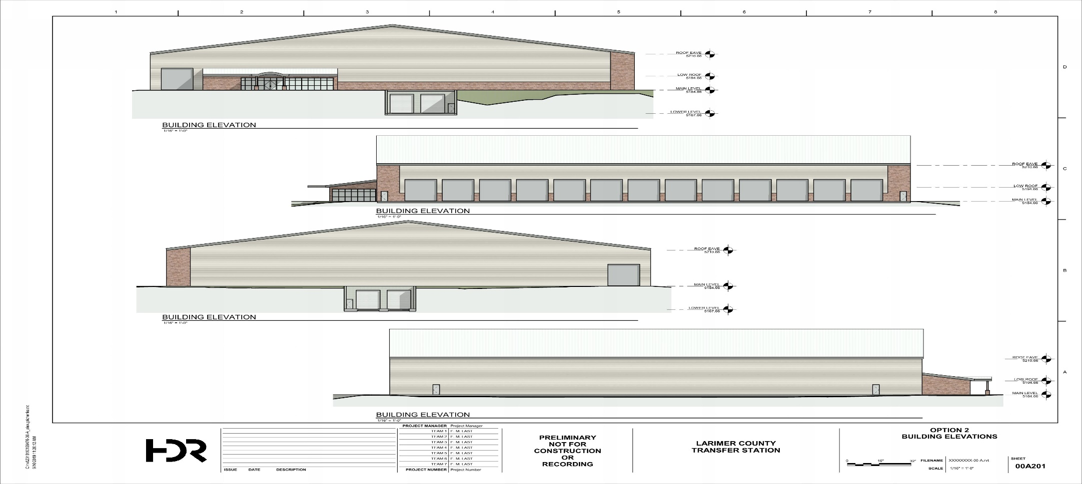
New Transfer Station

Slide 11
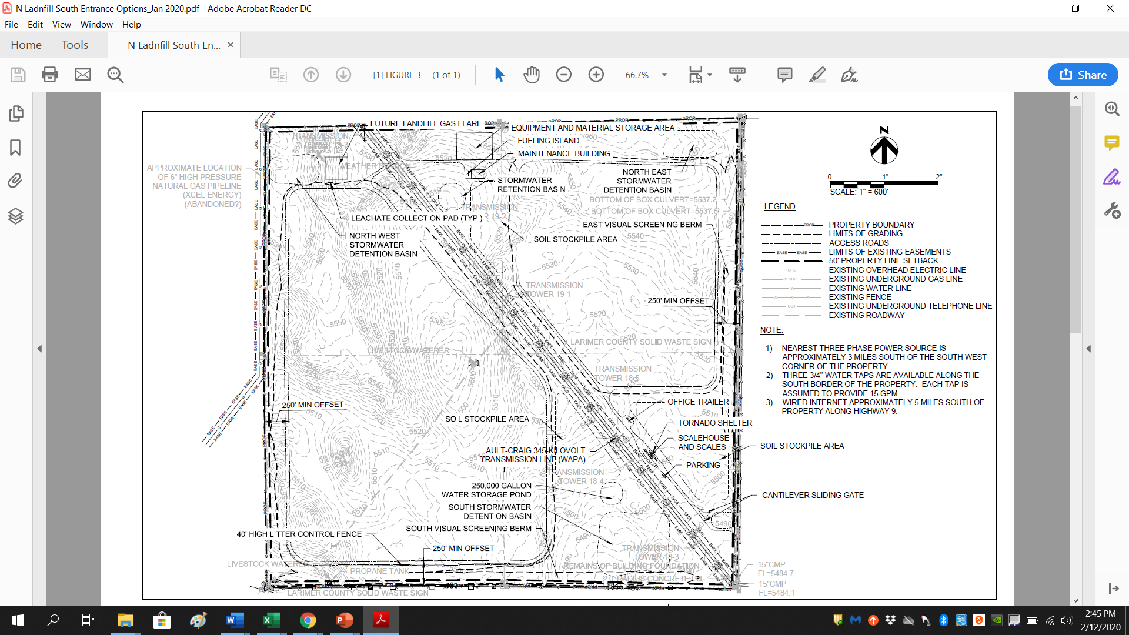
Northern Landfill

Slide 12
Project Time Tables
Northern Landfill
Submit EDOP to CDPHE |  |  |  | Week of 3/09/20
Completeness Review |  |  |  | 3/10/20 - 4/8/20
County C/D Process |  |  |  | 6/1/20 - 12/31/20
EDOP Technical Review |  |  |  | 4/9/20 - 9/10/20
Transfer Station
60% Design Review |  |  |  | Current - 2/18/20
90% Design |  |  |  | 2/19/20 - 3/13/20
County Review |  |  |  | 3/16/20 - 4/10/20
Bid Package |  |  |  | 5/11/20 - 7/3/20
Bid & Review Process |  |  |  | 7/6/20 - 10/09/20
Award Construction Contract |  |  |  | Week of 10/12/20

