Slide 1





Policy Advisory Committee Project Update Oct 2020

Slide 2
Key Features -Transfer Station
64,000 SF building
Improved entry to the Scale houses
Administration building
Approximately 30-40 transport truck trips per day
Has a three-day holding capacity for windy days
Improved disposal AREA for ALL customers
Estimated PROJECT cost $ 27,000,000.00

Slide 3










R

Slide 4
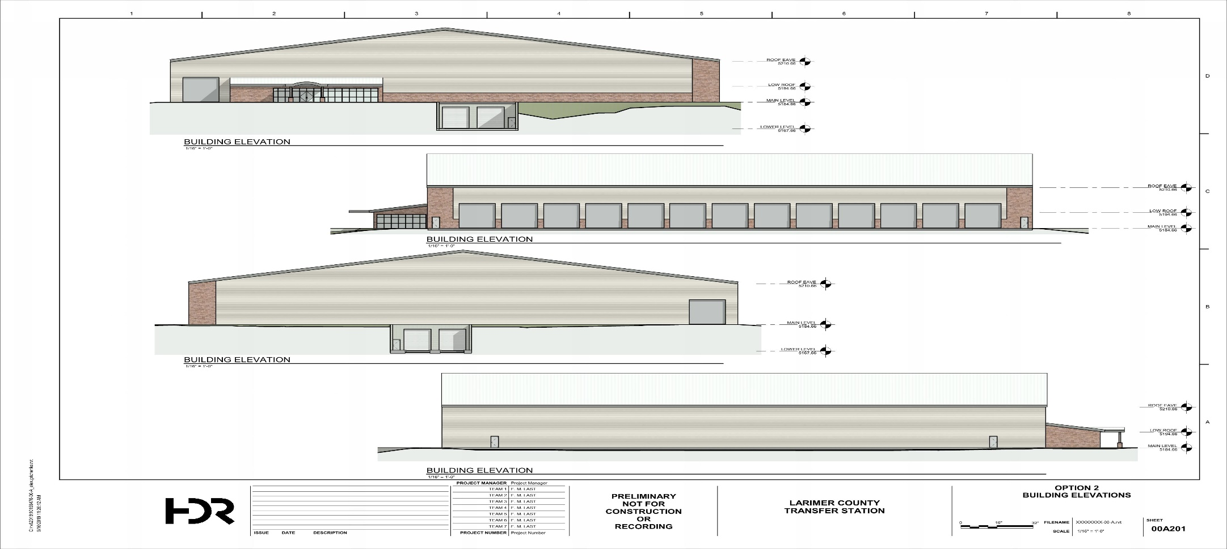
New Transfer Station

Slide 6
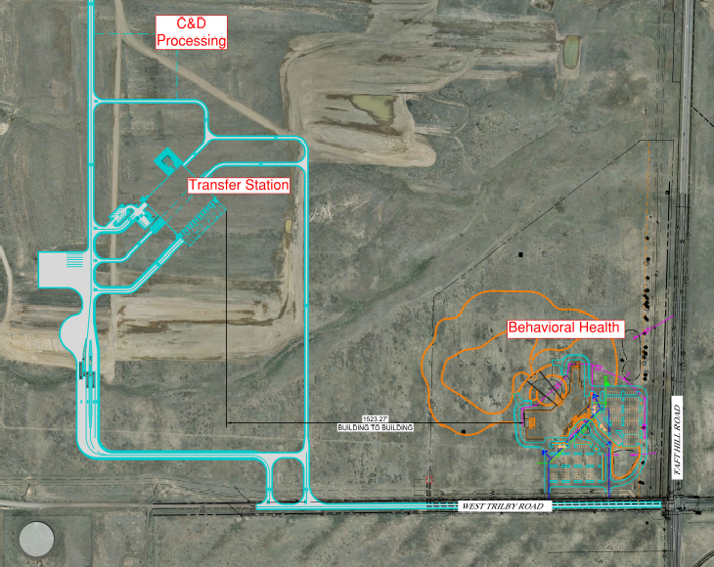

Slide 7
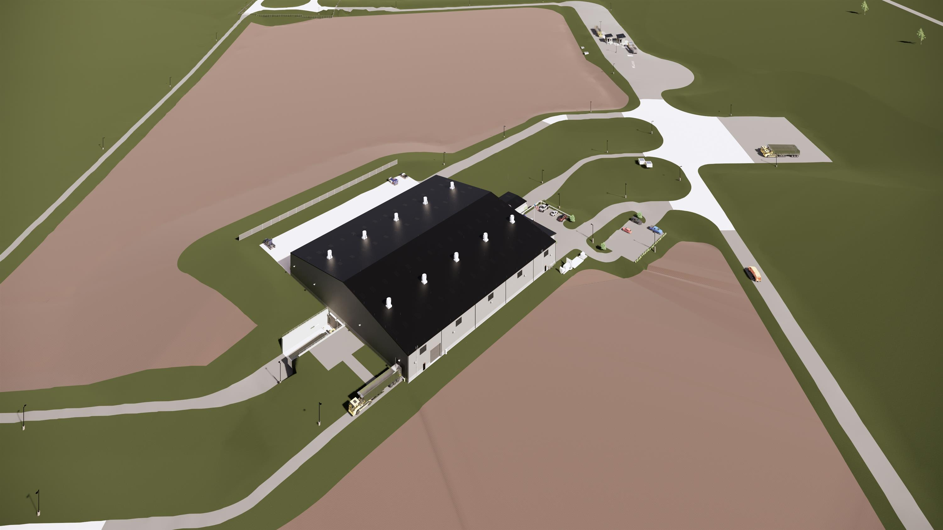

Slide 8
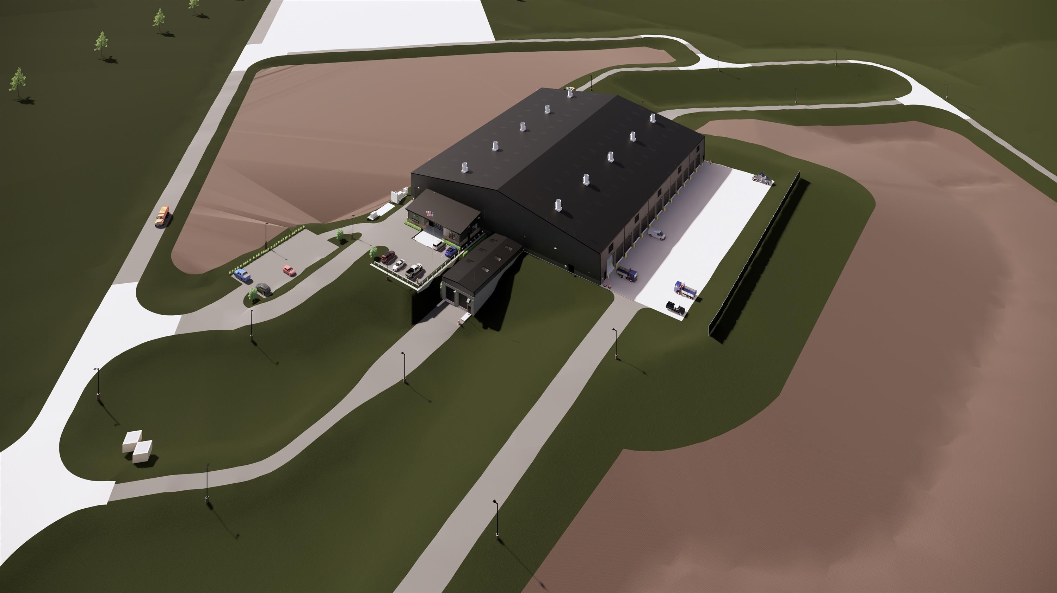

Slide 9
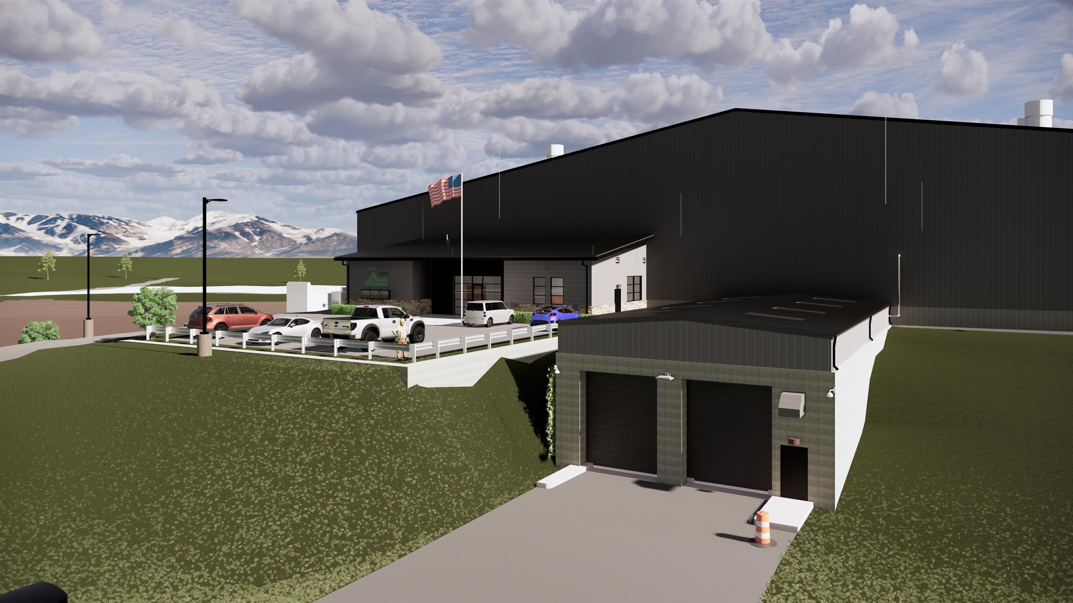

Slide 10
Central Transfer Station Timetable
2020 | Task
Completed | Transfer Station 65% Design Review (Drawings, Front- ends, Specifications, Engineering Analysis and Calculations)
Completed | Transfer Station 90% Design Review (Drawings, Front- ends, Specifications) & Location and Extend Review
July - Oct | CMaRBid Proce ss for Construction | GC Selection / Construction Contract / Sub-contractor bids
Nov - Dec - 2021 | Sub Contactor & Pre-Infrastructure Construction Phase | Final selection and contract phase
2021
Jan 2021 - Dec,2021 | Civil Work / General Construction / Building and Scale House Construction
June 2022 | Start Operations

Slide 11
Key Features –Northern Landfill
TWO UNITS WITH 75 AND 26 YEARS OF LIFE CAPACITY
    Unit 1 - 51,074,700 cyds / Unit 2 - 17,956,300 cyds
Receive materials from new transfer station and northern routes
626 Acre Site: unit (#1) 211 acres / Unit (#2) 105 – fill Footprint
Expanded Traffic study and road improvements under review
commercial customer no public drop-off
Utilizing industry operational best practices
Estimated PROJECT cost $ 25,000,000.00

Slide 13
Northern Landfill Timetable&
2020 | Task
Completed | Submittal EDOP
Completed | Transfer Station 30% Design Review (Drawings, Front- ends, Specifications) & Location and Extend Review
Oct - Nov | Review and Respond to Comments from CDPHE | In process
Nov - Dec - 2021 | EDOP Review Process | Continued Development
2021
Jan 2021 – April 2021 | Final Draft and Review | Hoping to receive approval in Q1 2021
June 2022 - 2023 | C/D Process & Construction | Pending Permitting Cycle

