Slide 1

Significant I-Code Changes from 2018 to 2021
Larimer County

Slide 2
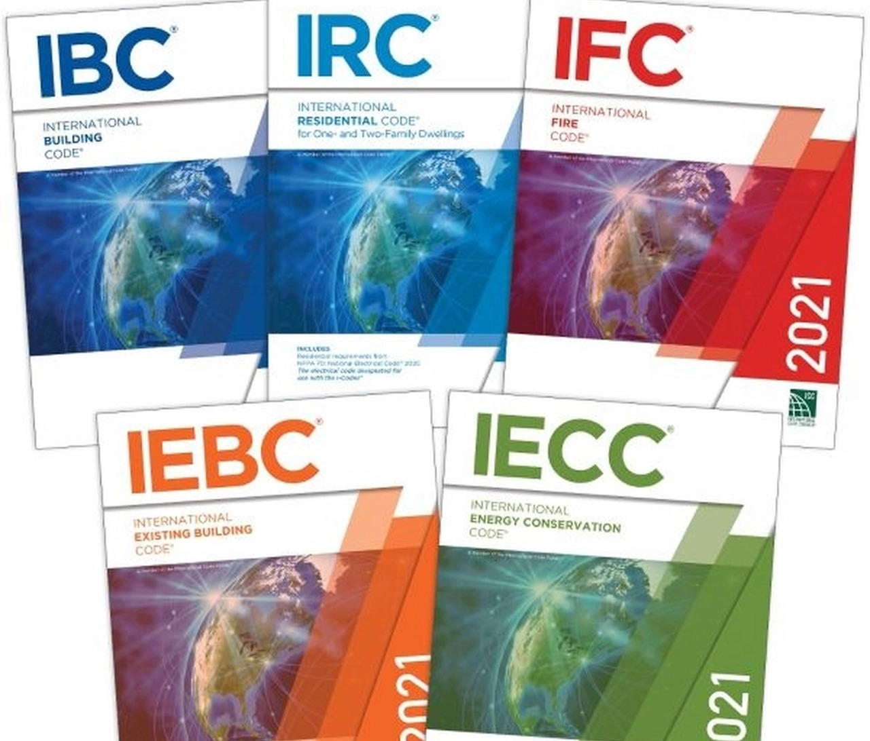


Major 2021 Code Adoptions
IRC,IBC,IECC,IEBC,IFGC,IMC,IPC,IPMC
Additions:
ISPSC Pool and Spa Code
(Non-Residential except barriers)
2020 NEC Administrative Amendments
Codes adopted Jan. 10, 2022, by Board of Larimer County Commissioners, effective March 1, 2022 in UNINCORPORATED Larimer County only (not inside 2 incorporated city/6 town limits).

Slide 3


Code Change Overview
Adopted one set of Administrative rules for all commercial codes + NEC admin rules
Swimming Pool and Spa Code adopted for first time
Vacation Homes, Short-term Rentals, B&Bs, Resort Lodge Cottages
Wildfire Hazard Mitigation
Residential Fire Sprinklers
Electric Vehicle and Renewable Energy-Ready Homes
Radon Mitigation System/Testing Requirements
Engineered Foundation Requirements put into code
Roof Coverings
Energy Code Updates
Appliance Venting
Accessibility

Slide 4
Items we won’t cover in detail but worth mentioning
Mass timber – see IBC Sections 202 (definition), 602.4 (Type V Construction, now includes A, B, C & HT), 508.4.4.1, 509.4.1.1, 703.7, 722.7, 1705.5.3, 1705.20, Tables 601, 504.3, 504.4, and 506.2 (Fire-rated Building Elements, Height, Stories and Area),
Atrium Changes – IBC Section 404
Required Floor Slope in Occupancy Group S-2 Parking Garages – IBC Section 406.2.4
Occupancy Group I-2 Corridor Doors, Domestic Cooking Appliances, Care Suites – IBC Section 407
Puzzle Rooms (new) – IBC Section 411.5, Definition at IBC 202
Cooking in Ambulatory Care Facilities – IBC Section 422
Play Structures – IBC Section 424
Occupied Roof Allowances – IBC Section 503.1.4
Live/Work Units – Moved from IBC Section 419 to IBC 508.5 – no editorial changes
Water/wastewater treatment plants are an F-1 occupancy if not H-Hazardous (IBC Section 306.2 caught up with us)
Distilling, brewing, storage of beer, wine and spirits is NOT an H occupancy (F-1/2, S-1/2 depending on alcohol content) per IBC Section 307.1.1 #s 18 & 19 if done per the Int’l Fire Code – but fire sprinklers are mandatory (903.2.4.2, 903.2.9.3)
Building Area Frontage Increases – IBC Section 506.3.2 and Table 506.3.3 – vastly simplified. Check it out.
Intermodal Shipping Containers – see new IBC Section 3115
IEBC – Removed prescriptive and performance compliance paths, everyone will use Work Area Method

Slide 5
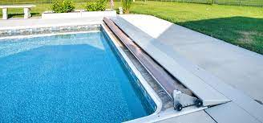
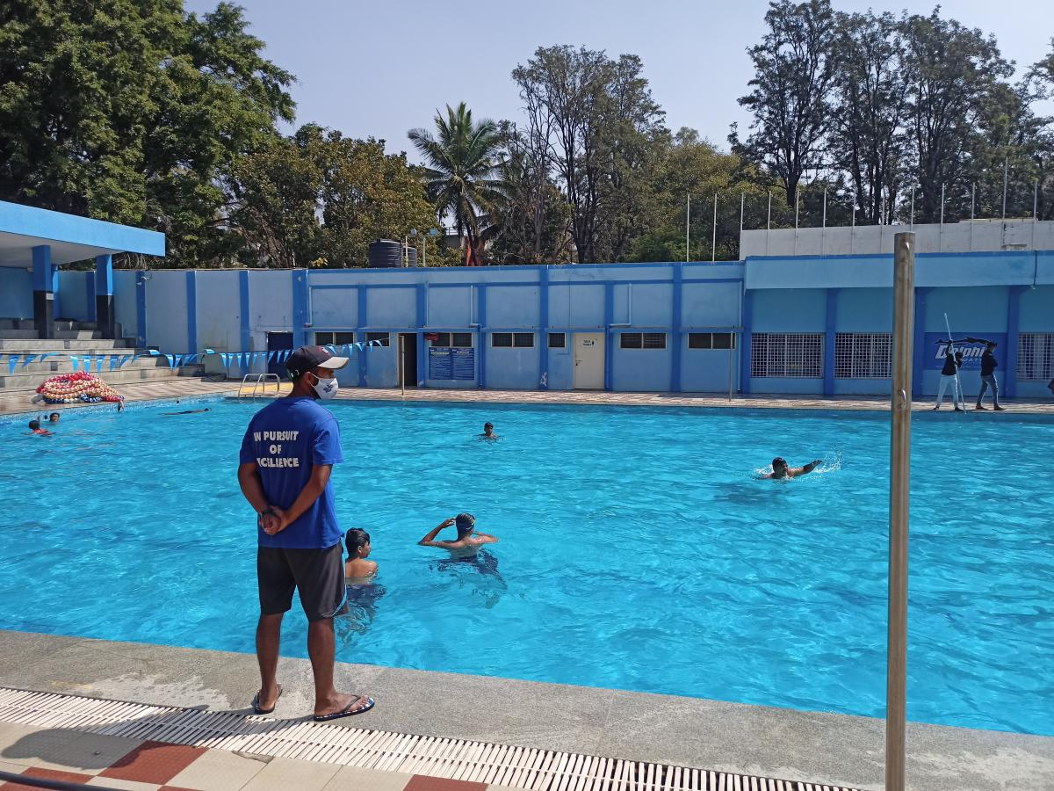
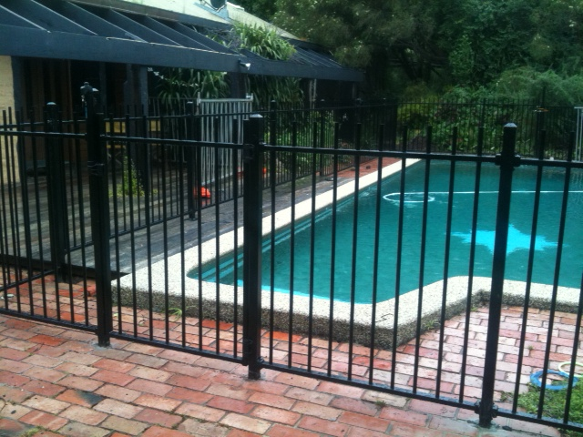
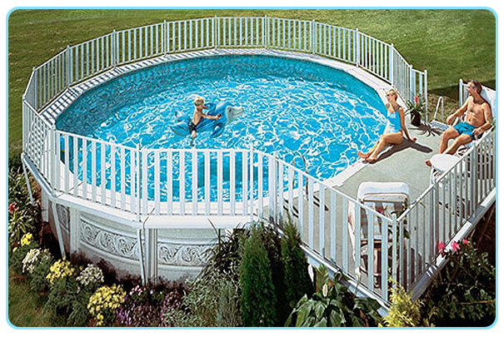
Adoption of the ISPSC
Swimming Pool & Spa Code
Regulations for Pools with a circulation system
Pool barrier requirements also apply to residential pools and spas >24” Deep

Slide 6

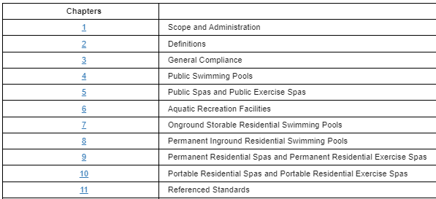
2021 BUILDING CODE SIGNIFICANT CHANGES
Swimming pool and spa code

Slide 7
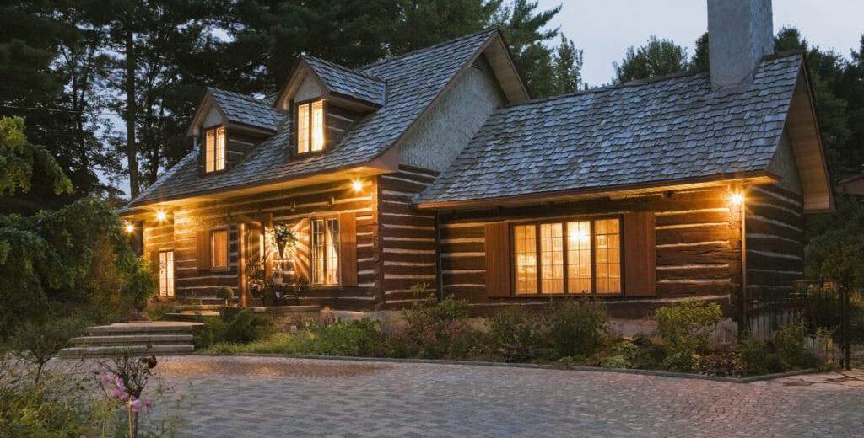
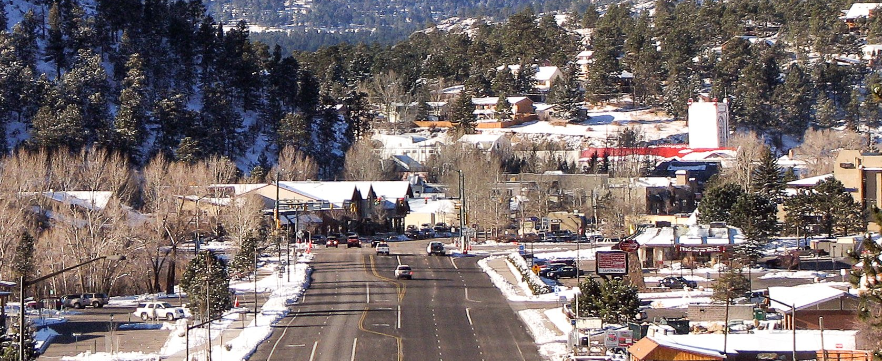
Vacation Homes &
Short-Term Rentals (STRs)
Integrate rules for Estes Valley Vacation Homes into general code rules for Short-Term Rentals.
Amend STRs rules as they relate to fire suppression, “dark sky” exterior lighting, fire extinguishers and exterior solid-fuel burning appliances.

Slide 8
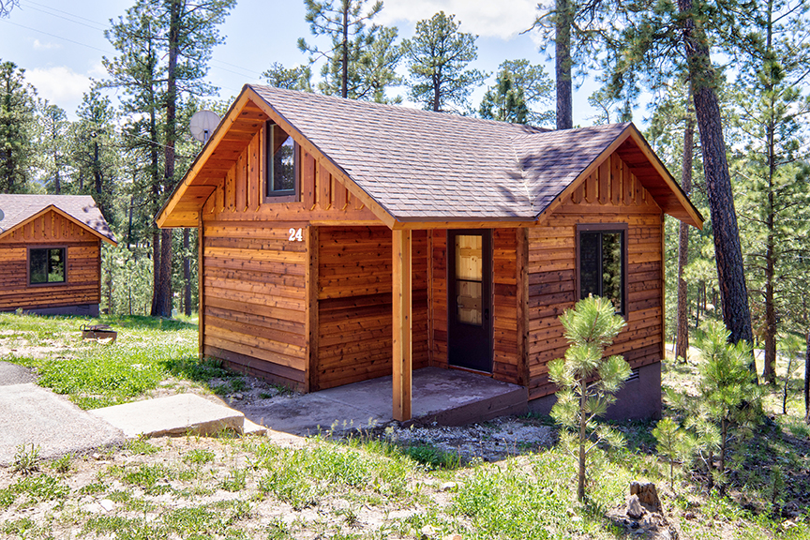
Bed & Breakfasts and Resort Lodge Cottages
Cottages with no more than 10 occupants and Owner-Occupied Lodging Homes with no more than 5 guest bedrooms shall comply with some of the Short-Term Rental requirements. Larger ones, as well as Large Short-term Rentals (11 or more people) shall comply with IBC requirements including fire sprinklers and accessibility.

Slide 9
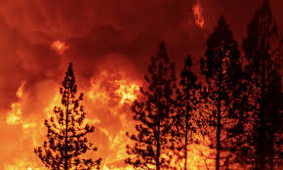
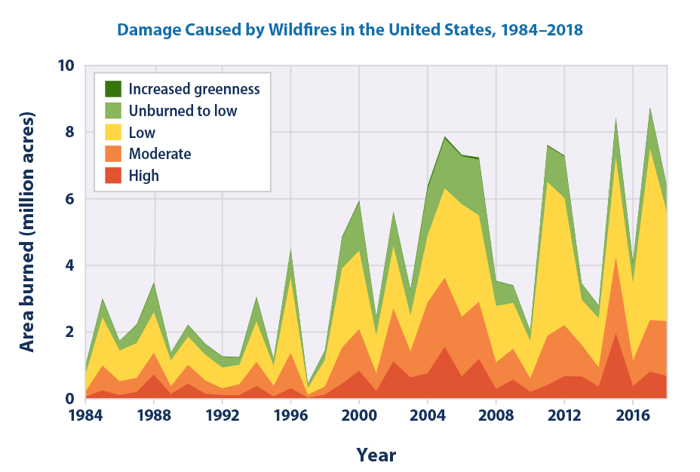
Wildfire Hazard Areas
Amend Wildfire Hazard Area rules in both the IBC & IRC to require the lowest 4’ of exterior cladding OR the first 5’ of ground cover around the structure to be non-combustible and require all additions to provide defensible space
IRC R331.5 Fire-Resistive Construction (IBC Chapter 36). Fire-resistive construction on all new structures shall be one of the following types:
1. One-hour fire-resistive shell providing not less than one-hour fire-resistive construction at all exterior walls, excluding openings and decks.
2. Exterior siding materials with a flame-spread classification of Class C or better. Exterior siding shall be composed entirely of non-combustible materials for a minimum of 4 feet above finished grade.

Slide 10
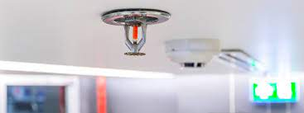
Fire Suppression Sprinklers
Required in newly constructed two-family dwellings, townhouses, and short-term rentals, as well as in IBC
Exempts single-family dwellings, except in fire districts with an adopted fire code requiring such sprinklers as approved by the Board of County Commissioners (such as Lyons).
See IRC Section R313, Larimer County amendments pages 11-12

Slide 11


Electric Vehicle Ready
IBC 420.12 Electrical Vehicle Readiness. All new dwelling units with an attached garage or carport shall be provided with a continuous 50-amp, 208/240-volt dedicated branch circuit for electric vehicle supply equipment that is terminated at a receptacle or electric vehicle supply equipment in a readily accessible location at a likely vehicle parking space in the garage or carport. (same requirement found at irc r333.2)
NOTE: COMMERCIAL PARKING GARAGES ARE REGULATED BY THE LAND USE CODE

Slide 12
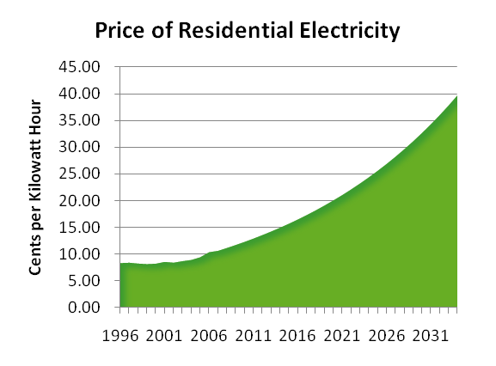


Renewable Energy ready
Wind
Solar
IRC Section R333.3 Renewable energy readiness. All new dwelling units shall be provided with a continuous 50-amp, 208/240-volt dedicated branch circuit installed from the attic space beneath the roof surface most likely to support a rooftop photovoltaic or wind energy system, to a junction box within 12” of the dwelling’s electrical meter or connected directly to the electrical panel board.
(Also found at IBC Section 420.13 for new dwelling units.)

Slide 13
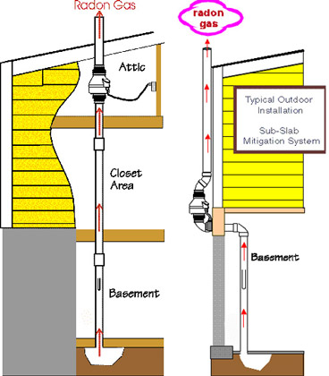
Passive Radon Mitigation System
Installation required for all newly constructed dwellings and for additions exceeding 1,000 sq.ft. in floor area. Design per IRC Appendix AF.
Testing of Radon levels required before final inspection. If levels exceed 4.0 pCi/L (picocuries per liter), a fan must be installed to make the system active.
IRC R333.1 Passive radon mitigation system required. All new dwellings, and additions exceeding 1,000 sq. ft., shall install a passive radon mitigation system. Such systems shall be designed and installed in accordance with Appendix AF “Radon Control Methods.”
(Also found at IBC Section 1811 for new buildings with Institutional or Residential occupancies.)
Note: New state law requires certification of radon mitigation or radon measurement professionals starting 7/1/2022.

Slide 14
Engineered Foundations Required
Generally, almost all foundations must be designed by a Colorado engineer.
IRC R401.1 Application… All foundations shall be designed by a qualified professional licensed in the State of Colorado, in accordance with accepted and approved engineering practices, including considerations for soil load-bearing capacities, surface and subsurface water conditions, adequate foundation and floor drainage, adequate ventilation of enclosed interior foundation spaces, and foundation waterproofing and damp-proofing.
Exceptions:
In subdivisions where engineered footings and foundations are not required by the conditions of approval.
Outside of subdivisions, except where engineered design is required by Sections R403.1.7 or R403.1.8.
Unenclosed patio covers and porches, decks, one-story agriculture pole buildings under 3000 square feet, and accessory, unheated, detached one-story utility buildings with a maximum depth (truss length) of 24 feet, a maximum width not exceeding twice the depth, and a maximum area of 600 square feet, when following Larimer County’s Prescriptive Design Standards.

Slide 15
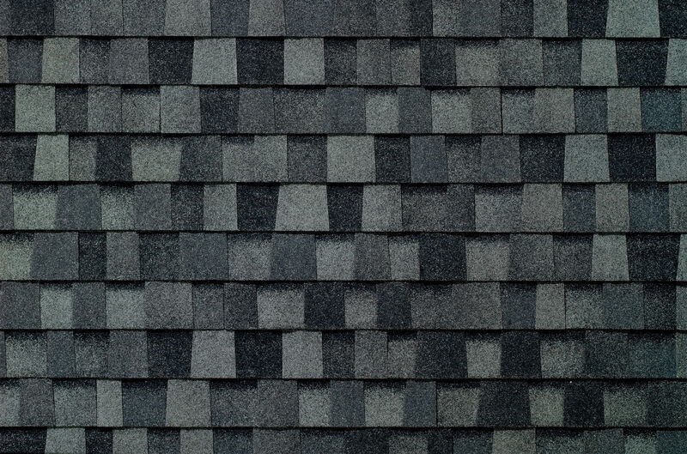
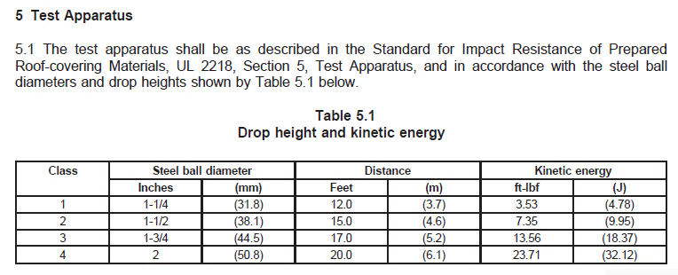
Roof Coverings
All roof coverings county wide must be Class A fire-rated
New asphalt shingles to be Class 4 impact resistant (hail)
R905.2.4.2 Impact resistance of asphalt shingles. Asphalt shingles shall be Class 4 impact resistant, tested in accordance with UL 2218, and installed in accordance with the manufacturer’s installation instructions. (IBC 1504.8)

Slide 16

Structural Changes (IBC Chapter 16)
1603.1.4 Wind Design Data – Identify component and cladding wind zones in construction documents
Table 1604.5 Risk Category – Non-emergency communications towers are Risk Cat III, emergency communications towers are Risk Cat IV, changes to assembly, educational and institutional occupancies
1606 Dead Loads – clarifications at roof level, fixed service equipment, Photovoltaic panel systems, vegetative and landscaped roofs
1608 Snow Loads – maps updated but we already use SEAC Maps/Study Data
1609 Wind Loads – maps updated but we already use Colorado Front Range Gust Map/SEAC. Exposure C.
1611.1.1 Design Rain Loads. Each portion of a roof shall be designed to sustain the load of rainwater as per the requirements of Chapter 8 of ASCE 7. The design rainfall shall be based on the 100-year 15-minute duration event, or on other rainfall rates determined from approved local weather data. Alternatively,​ a design rainfall of twice the 100-year hourly rainfall rate indicated in Figures 1611.1(1) through 1611.1(5) shall be permitted.
1614.1 – Ice-sensitive structures shall be designed for ½ inch atmospheric ice loads in accordance with Chapter 10 or ASCE 7. (now clarified in the body of the code instead of a working policy)

Slide 17

ENERGY CODE CHANGES
Prescriptive Insulation and Window values
Options for Detached Utility Buildings
REScheck reports
Building Air Leakage
Mechanical Rooms
HVAC Duct Testing
Lighting
Additional Energy Efficiency Packages
Building Commissioning

Slide 18
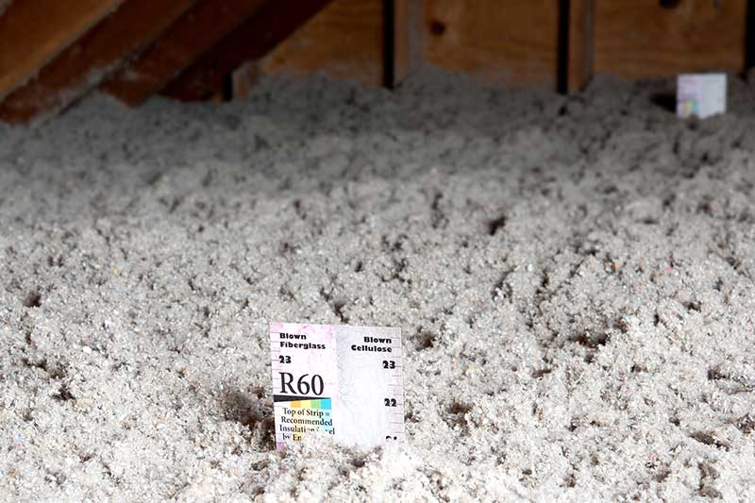
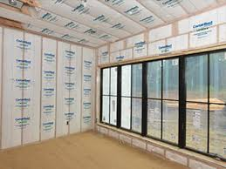
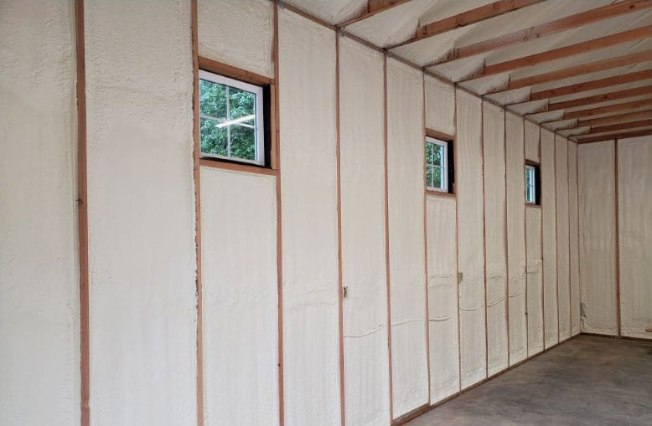
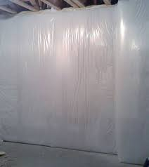
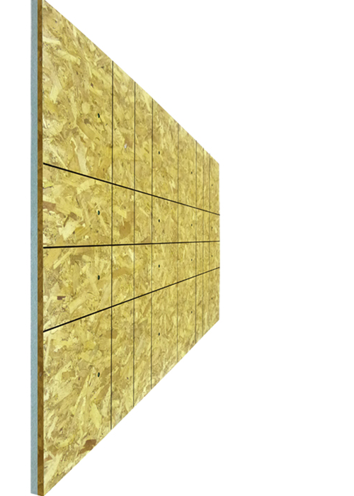
Prescriptive Insulation Requirement Minimums
IRC N1102.1.2
Ceilings - R60
Walls – R30 cavity, R23 cavity +3 continuous insulation (ci),
R20 cavity + 5 ci, R13 cavity + 10ci, or R15 continuous
Basement/Crawl – R19 cavity, R13 cavity + 5 ci, or R15 continuous
Floors – R30

Slide 19

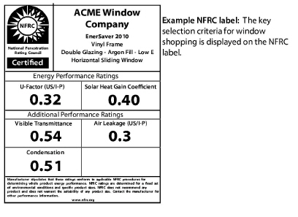
Sample
WINDOWS
Maximum U-value for windows can still be .32
For the first time in our climate zone, maximum Solar Heat Gain Coefficient is .40

Slide 20

(does not apply to habitable space like offices & studios)
Insulation Options for Detached Utility/Ag Buildings
If not heated or cooled by fuel or electrical energy – no requirements
If controlled by a maximum 2-hour time switch – no requirements
If not heated above 50 degrees F – no requirements
Otherwise, use the following thermal design criteria:
Design winter heating for 60 degrees maximum and summer cooling for 80 degrees minimum
Minimum R-15 wall insulation, R-30 roof/ceiling insulation, R-3 door insulation
Maximum U.40 for windows/doors, not more than 10% of floor area
Protect plumbing from freezing
IRC Section N1101.1

Slide 21

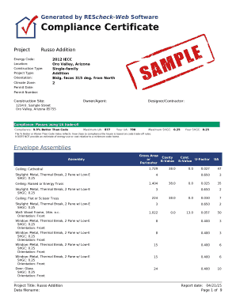
REScheck Reports
Only 2018 or 2021 ResCheck compliance reports will be accepted
N1101.3 (R101.5.1) A REScheck compliance certification verifying the home meets or exceeds 2018 or 2021 International Energy Conservation Code requirements shall be deemed to satisfy the requirements of this code.

Slide 22

Building Air Leakage
Air leakage testers must be involved in the construction process from the beginning, not the end, providing a report on any deficiencies and corrections made. This report must be submitted at the framing inspection and prior to receiving approval to insulate. By making repairs when the air barrier is accessible, buildings should be able to pass the maximum 3 air changes per hour test easily.
NOTE: Air sealing details and the building thermal envelope must be shown on the plans. This is not a new requirement in the 2021 codes.
IRC N1102.4.1.1, IECC R402.4.1.1 & C402.5.2

Slide 23
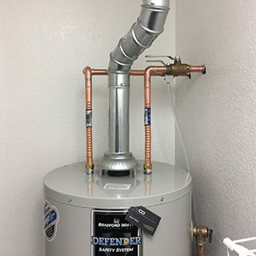
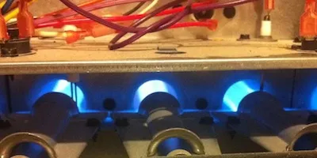
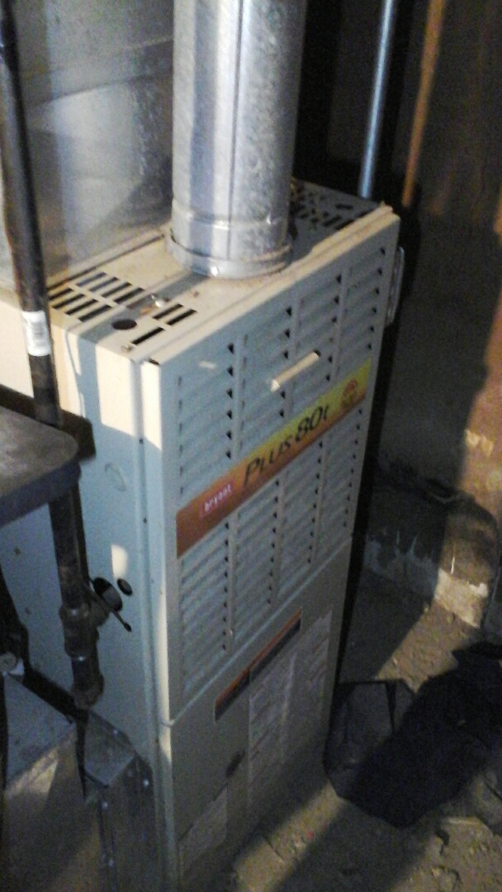

Open Combustion Appliances
All open combustion (non-direct vent) fuel-burning appliances must be installed within an enclosed mechanical room that is isolated from the building thermal envelope
N1102.4.4 (R402.4.4) Rooms containing fuel-burning appliances. In new construction, where open combustion air ducts providing combustion air to open combustion fuel-burning appliances are installed, the appliances and combustion air opening shall be located outside the building thermal envelope or enclosed in a room that is isolated from inside the thermal envelope. Such rooms shall be sealed and insulated…

Slide 24
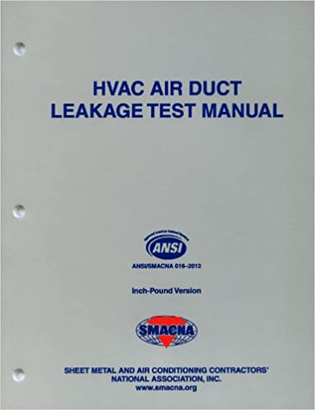
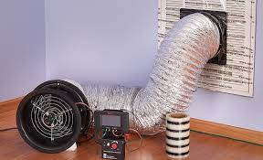
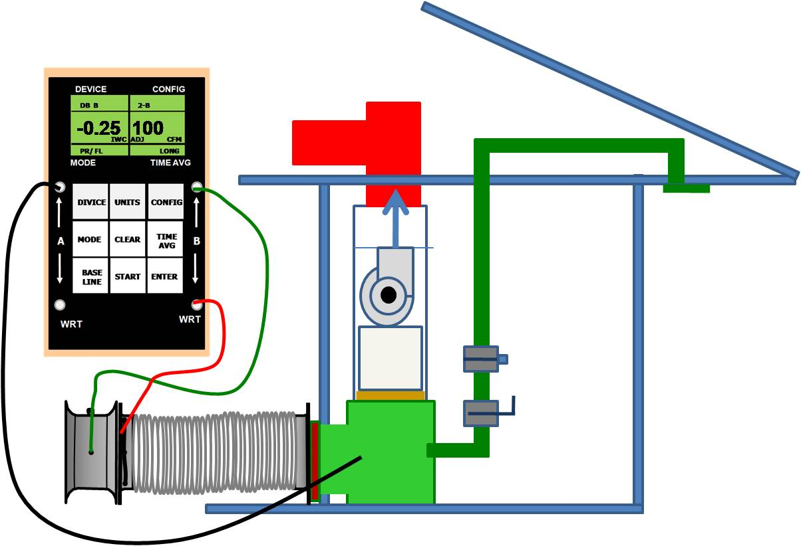
HVAC Duct Testing
ALL ducting, both inside and outside of the thermal envelope, must be pressure-tested
IRC Section N1103.3.5 & 3.6

Slide 25
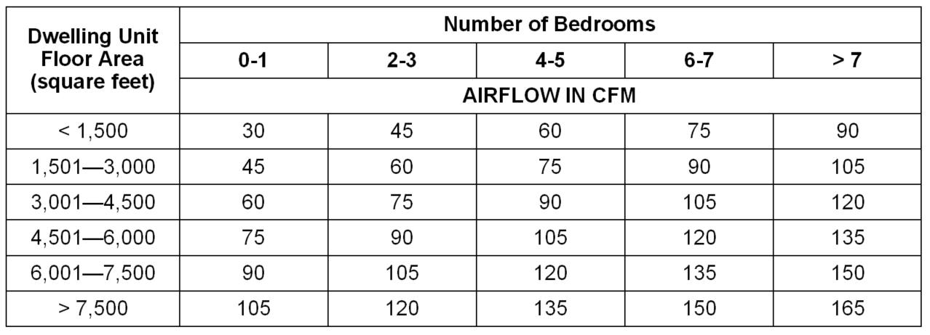
Mechanical Ventilation Testing
Mechanical ventilation systems shall be tested and verified to provide the minimum flow rates.
IRC N1103.6.3 (IECC R403.6.3) Testing.
Mechanical ventilation systems shall be tested and verified to provide the minimum ventilation flow rates required by Section N1103.6. Testing shall be performed according to the ventilation equipment manufacturer's instructions, or by using a flow hood or box, flow grid, or other airflow measuring device at the mechanical ventilation fan's inlet terminals or grilles, outlet terminals or grilles, or in the connected ventilation ducts. Where required by the code official, testing shall be conducted by an approved third party. A written report of the results of the test shall be signed by the party conducting the test and provided to the code official.

Slide 26
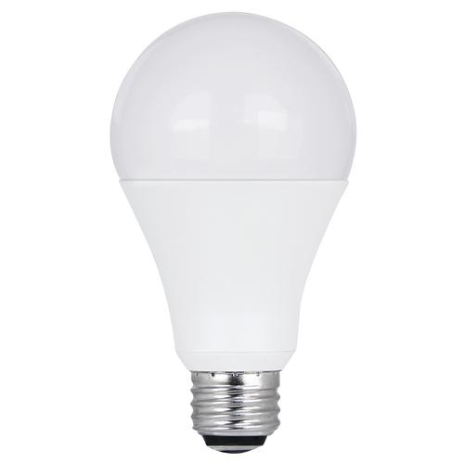
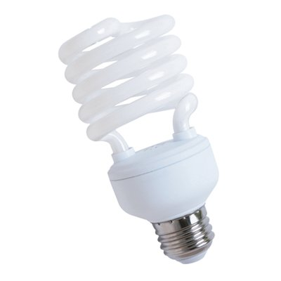
Lighting – Part I
All permanently installed lighting fixtures, excluding kitchen appliance lighting fixtures, shall contain only high-efficacy lighting sources. (IRC N1104.1)
High-efficiency lighting includes lamps and fixtures that have earned the ENERGY STAR label (or meet the ENERGY STAR requirements)

Slide 27

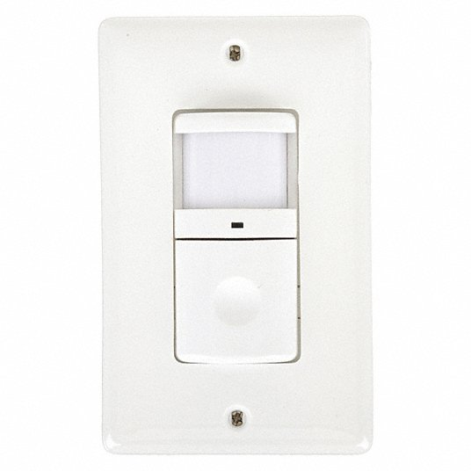
Lighting – Part II
All permanently installed light fixtures shall be
controlled with a dimmer, occupant sensor control
or another built-in or installed control (IRC N1104.2)
Exceptions: bathrooms, hallways, exterior lighting fixtures, safety or security lights. Exterior light systems over 30 watts total need automatic daylight shutoffs.

Slide 28

Additional Energy Efficiency Package Options
Every residential building must pick one of the following options to install:
Better Building Envelope
Better HVAC Equipment
Better Water Heater
Better Duct System
Better Air Sealing with a Heat or Energy Recovery Ventilator Installed
IRC N1101.13.5 & N1108

Slide 29
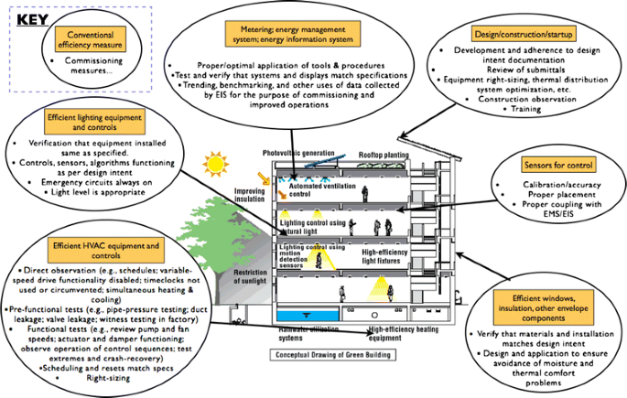

Commercial Systems Commissioning
X
15,000 s.f.
10,000 s.f.
Lowers the system commissioning requirements from 15,000 to 10,000 sq. ft.
IECC C408.2 Exception 3. Systems in new buildings or additions not exceeding 10,000 sq. ft. gross floor area.

Slide 30
Commissioning Requirements
Note: The IBC has no commissioning exemption based on building size. Larimer County added a size exemption, which was 15,000 sq. ft. in 2018, and is now lowered to 10,000 sq. ft. in the 2021 code. We also added an exemption for existing buildings undergoing alterations.
IECC C408.2 Mechanical systems and service water-heating systems commissioning and completion requirements.
Prior to the final mechanical and plumbing inspections, the registered design professional or approved agency shall provide evidence of mechanical systems commissioning and completion in accordance with the provisions of this section.
Construction document notes shall clearly indicate provisions for commissioning and completion requirements in accordance with this section and are permitted to refer to specifications for further requirements. Copies of all documentation shall be given to the owner or owner’s authorized agent and made available to the code official upon request in accordance with Sections C408.2.4 and C408.2.5.
Exceptions:
The following systems are exempt:
1. Mechanical systems and service water-heating systems in buildings where the total mechanical equipment capacity is less than 480,000 Btu/h (140.7 kW) cooling capacity and 600,000 Btu/h (175.8 kW) combined service water-heating and space-heating capacity.
2. Systems included in Section C403.5 that serve individual dwelling units and sleeping units.
3. Systems in new buildings or additions not exceeding 10,000 sq. ft. gross floor area.
4. Alterations to existing buildings.

Slide 31

For more information/training on 2021 Energy Codes,
go to the Colorado Energy Office
https://energyoffice.colorado.gov/climate-energy/energy-policy/building-energy-codes/energy-code-adoption-toolkit
Recorded webinars include:
Electric Vehicles and Electrification (10/28/2020)
Residential Ventilation (3/17/2021) + slides
Residential Testing (3/10/2021)
Significant Residential Changes - Part 1 (2/17/2021) + slides
Functional Testing for Lighting Controls (5/12/2021)
IECC 2021 vs. ASHRAE 90.1-2019 (4/28/2021)
Commercial Lighting / Daylighting (2/3/2021)
Commercial Architectural (1/27/2021)
Commercial Mechanical and Plumbing (1/20/2021)
COMcheck Overview (5/1/2020)
REScheck Overview (4/24/2020)

Slide 32

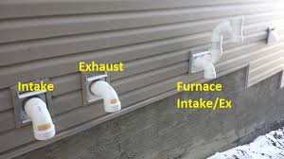
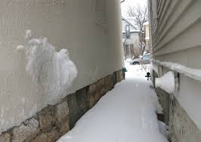
Appliance Venting
Appliance vents shall terminate a minimum of 22” above grade and at least 12” above anticipated snow level (whichever is greater)
Min.
22”
OR
12”
Anticipated Snow Level
Grade
IFGC 503.1 Venting system terminal clearances. Vents shall terminate 12” minimum above anticipated snow level and a minimum of 22 inches above the surface or grade directly below. Also at IRC G2427.8

Slide 33

Plumbing code CHANGES
All private on-site wastewater treatment, graywater, non-potable water reuse, and rainwater systems must comply with Larimer County Health Dept. regulations
IPC 421.7 Shower head location. Shower heads shall be so located on the sidewall of shower compartments or be arranged so the shower head does not discharge directly at the entrance to the compartment and the bather can adjust the valve prior to stepping into the shower spray.
IBC P2902.1.1. (new) Exception 2 – Where multiple-user facilities are designed to serve all genders, the minimum fixture count shall be calculated 100 percent, based on total occupant load. In such multiple-user user facilities, each fixture type shall be in accordance with ICC A117.1 and each urinal that is provided shall be located in a stall.​

Slide 34

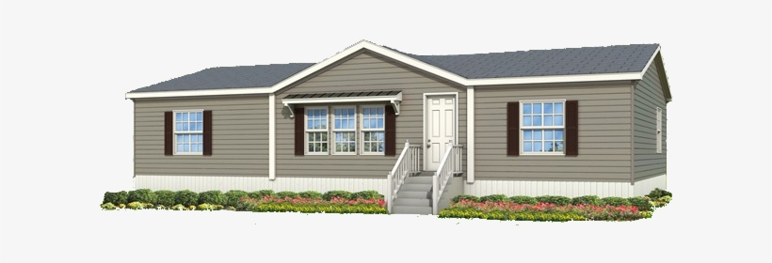
Manufactured (HUD) Homes
IRC AE102.6 Relocation and AJ 102.11 Moved manufactured or mobile homes.
Manufactured homes installed at or above 6,000 ft. elevation
or in High Wind Areas must install snow and wind mitigation
measures pre-approved by the County Building Division.
Such measures may include:
  approved snow removal plans
  engineered wind fences, or
  other engineered site-specific designs considering prevailing winds, exposure, topography, trees and other relevant natural features
  independent, engineered structural roof systems capable or resisting the site design snow load

Slide 35

Accessibility for New Construction*
  IBC Chapter 11 defines the scope of required accessibility
  ICC A117.1-2017 standard has the technical requirements
  2017 ICC standard was not referenced in the 2018 IBC to allow more time to get ready. Now it is the standard.
Bigger/motorized wheelchairs need more space
Circular turning space increased from 60”to 67”diameter
T-shaped turning space added options, size also increased (existing buildings can use smaller 2009 turning spaces)
Increased space required at turns, passing space, corners, etc.
NEW: At least 5% of EV charging stations at commercial buildings must be accessible per IBC Section 1107.2.1 (van-accessible size).
*Existing buildings being altered can still use the 2009 ICC standard.

Slide 36
References and Contact Information
Current Building Codes and Handouts
https://www.larimer.org/building/codes
Building Staff On-Call Line: (970) 498-7660
Chief Building Official: Eric Fried efried@larimer.org
(970) 498-7705
Lead Plans Examiner: Juan Mancha jmancha@larimer.org
(970) 498-7665
Lead Building Inspector: Mark Tewsley mtewsley@larimer.org
(970) 498-7703

