Slide 1
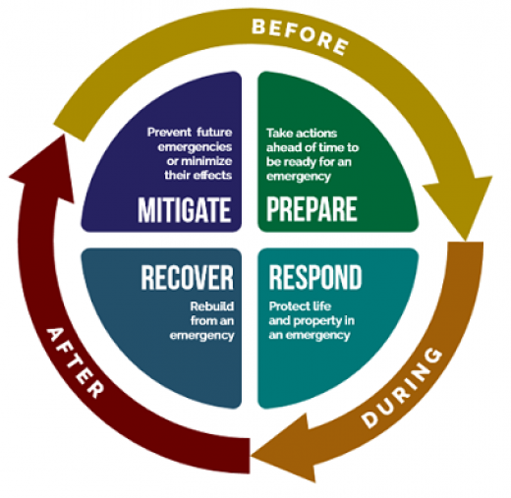
Comprehensive Emergency Management Plan Review
Lori R. Hodges
Director of Emergency Management
January 10, 2022

Slide 2
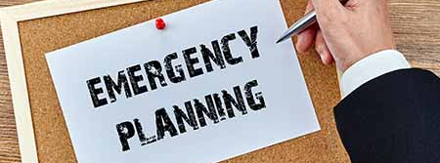
Objectives
Provide an overview of the Comprehensive Emergency Management Plan and its components
Provide new planning considerations
Discuss next steps and final approval

Slide 3
Major Plan Components
Preparedness Plan
Multi-Jurisdictional All-Hazards Mitigation Plan
Emergency Operations Plan
Recovery Plan
Continuity of Operations Plan
Continuity of Government Plan

Slide 4
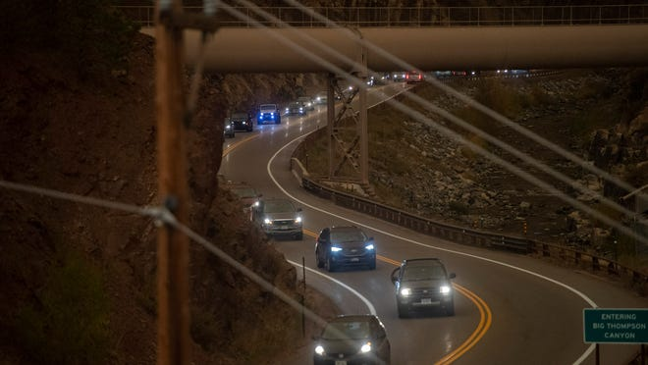
Functional and Process-Driven Annexes
Each major plan in the CEMP has additional planning components
These come in the following forms:
Functional Annexes
Emergency Support Function Documents
Recovery Support Function Documents
Operational Annexes (Evacuation, Re-Entry, Mass Casualty, Debris Ops, etc.)
Process-Driven Annexes (Financial Management of Disasters, Resource Mgmt, EOC Management, Volunteer Management, Donations Management, etc.)

Slide 5
Agreements and Resolutions
BCC will sign a resolution approving the CEMP for 2022 on February 8th
The BCC will update the National Incident Management System (NIMS) Resolution for Larimer County
All other Resolutions and Agreements are up-to-date and do not require additional signature. They can be found on our website.

Slide 6
Preparedness Plan
Purpose: Outline the disaster planning, training and exercise goals and requirements for Larimer County.
Additional Components:
Training and Exercise Annex
Public Awareness and Education Annex

Slide 7
Multi-Jurisdictional All-Hazards Mitigation Plan
Purpose: Outlines the process for identifying actions to reduce or eliminate threats to life, property and the economy due to any type of hazard, human-caused or natural.
This plan was approved by the Board of Commissioners and all Larimer County jurisdictions in 2021.
NEW: Mitigation Implementation Plan

Slide 8
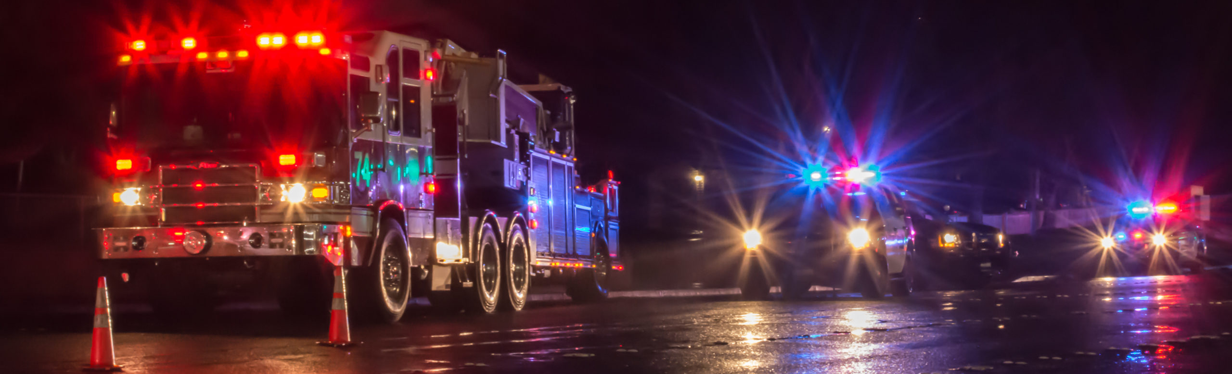
Emergency Operations Plan
Purpose: Provides the structure and processes that Larimer County utilizes to respond to and initially recover from an event.
Components:
Emergency Support Functional Annexes
Emergency Response Operational Annexes and Plans

Slide 9
Emergency Operations Plan
Emergency Support Functions
Outline various functional tasks that occur within the Larimer EOC during the response phase of an incident.
Larimer County has 16 Emergency Support Functions identified.
Operational Annexes and Plans
Incident Management
EOC Management
Evacuation and Re-Entry
Resource Management
Public Information Management
Emergency Alert and Warning
Disaster Declaration Process

Slide 10
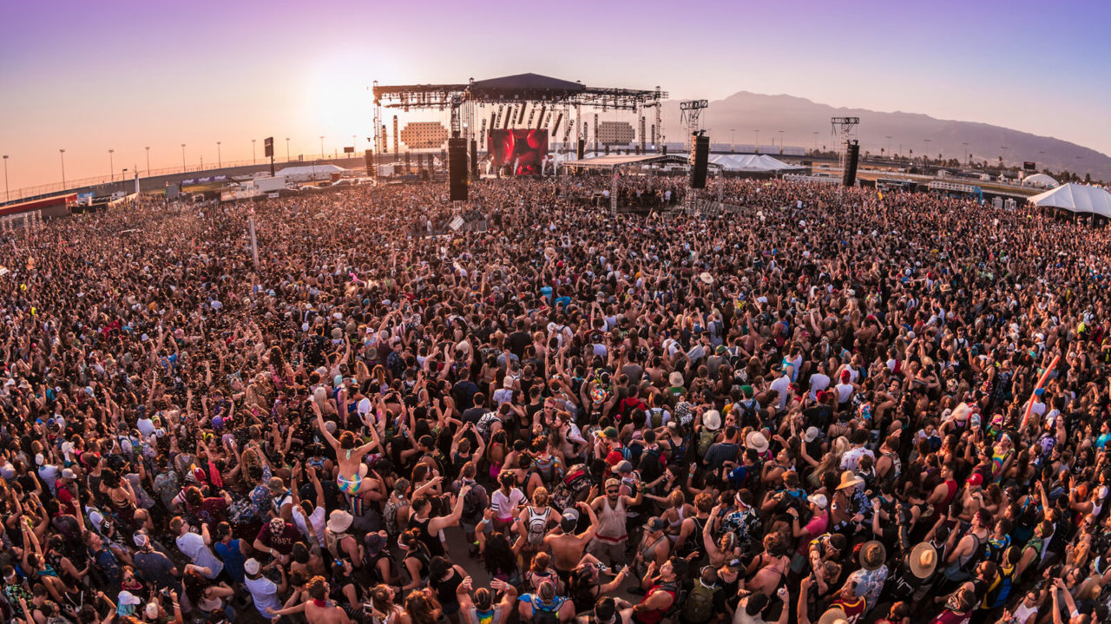
Additional Emergency Operations Plans
Mass Gathering Plan
Mass Casualty Plan
Mass Victim Response Plan

Slide 11
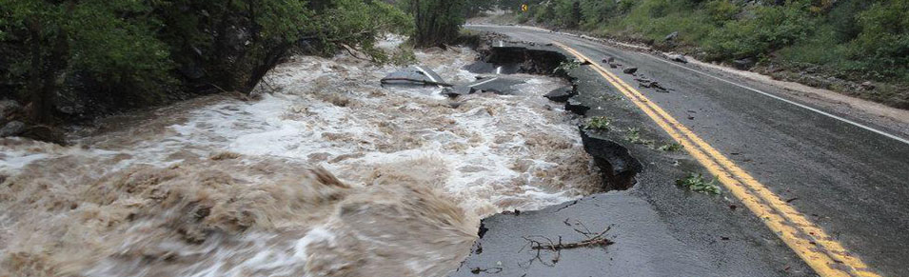
Disaster Recovery Plan
Purpose: Provides a framework for effectively managing county resources to facilitate recovery from emergency and disaster incidents.
Components:
Recovery Support Functional Annexes
Recovery Operational Annexes and Plans

Slide 12
Disaster Recovery Plan
Recovery Support Functions
Outline various functional tasks that occur within the Larimer Recovery Coordination System during the recovery phase of an incident.
Larimer County has 16 Recovery Support Functions identified.
Recovery Annexes and Plans
Damage Assessment
Debris Management
Public Assistance Program and Financial Management
Long-Term Recovery Group

Slide 13
COOP and COG
Continuity of Operations Plan (COOP)
Purpose: Describes how Larimer County will sustain the capability to perform essential functions during and after a disruption in internal operations
Continuity of Government Plan (COG)
Purpose: Establishes the framework to ensure a clear line of succession for each elected office, and the polices and guidance necessary to ensure continued county operations during emergency and disaster events.
These plans are NOT PUBLIC DOCUMENTS

Slide 14
New and Exciting Stuff
Integrated Preparedness Plan
Reunification Plan and Exercise
Resilience Annex and Metrics
Climate Smart Integration with Resilience Framework

Slide 15
Questions?
Lori R. Hodges
Director, Office of Emergency Management
303-656-3214
hodgeslr@co.larimer.co.us

