Slide 1


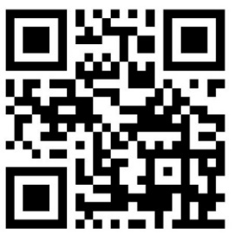
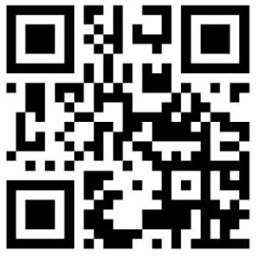
Welcome! We will begin shortly.
Short-Term Rental Regulations Update
Estes Vallet Community Open House
August 15, 2022
Short-term Rental Regulations Update Community Questionnaire and project information:
https://www.larimer.gov/planning/short-term-rentals
Or scan the QR code
Questionnaire is open to the community until Aug.28th
General 5 min. Questionnaire
Detailed 30 min. Questionnaire

Slide 2

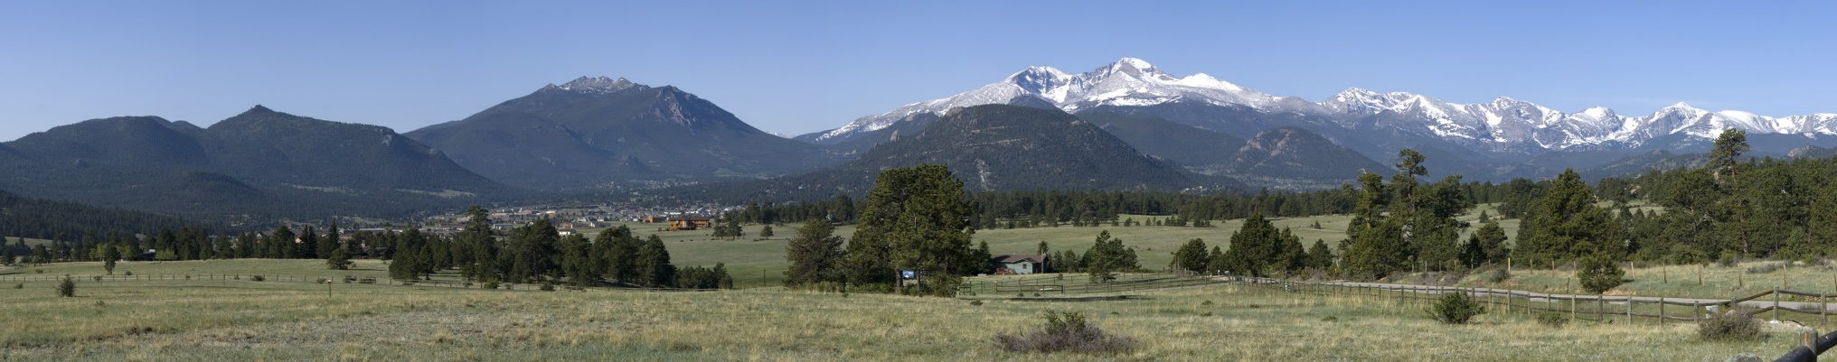
Short-term Rental Regulations Update
August 15, 2022
Open House Agenda
6:00pm – Open House doors open
6:15 – 6:30pm – Brief presentation. Provide background information on Short-term Rentals and on the process and timeline to update the existing regulations.
6:30pm – 7:30pm – Open House participants will be able to move around the room, visiting different tables or stations. Each station will address a different topic of consideration. Team members will be available at each station to provide information and address questions.

Slide 3
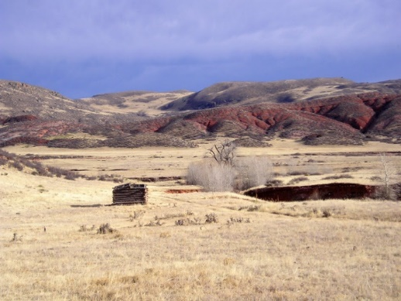
Short-term Rental Regulations Update
August 15, 2022
Intent of Today’s Open House
The intent of today’s Estes Valley Community Open House:
to provide background information on STR regulations,
present ideas on what is being considered, and
gather feedback and ideas from community members and interested parties on STR regulations.
The information gathered at today’s meeting, along with the feedback gathered at last week’s webinar, will help county staff and officials determine what, if any, changes or revisions need to be made to the County’s STR regulations.
Keep in Mind:
*Generally, revisions or updates made to the STR standards would not impact previously approved STRs. Changes made to re-registration or transferability could impact previously approved STRs.
* Changes made to the County’s STR regulations would not impact or change those regulations upheld by local municipalities, such as the Estes Park STR regulations.

Slide 4
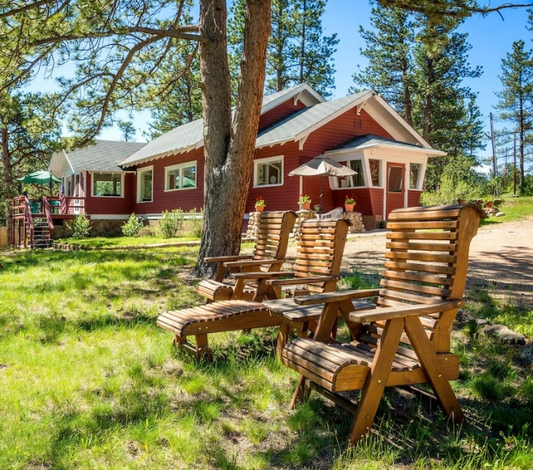
Short-term Rental Regulations Update
August 15, 2022
Short-term Rental Trends
Short-term Rentals have benefits:
supplemental income to property owners
local economy through tourism
second homes not just vacant
community between hosts and renters
And challenges:
adverse impacts to health, safety and welfare of communities
complaints about noise, traffic, loss of sense of place in neighborhoods
concerns about fire safety
increase in housing costs and depletion of supply of housing for local workers
Having administered the current Short-term Rental (STR) regulations for several years, the County recognizes the need to evaluate the effectiveness of these regulations. The intent of this effort is to ensure that community concerns regarding neighborhood impacts are addressed, while maintaining alignment with the ever-changing home sharing and rental industry.

Slide 5
Short-term Rental Regulations Update
August 15, 2022
Updating the Regulations
Process Timeline:
  Approximately 8-9 months
    Currently in the early stages of the process
      gathering community feedback – online questionnaire & open houses
        ** Questionnaire open now until August 28th **
    Next step – September – October
      Summary of all input received
      1st draft of revision options
      Options presented to Planning Commission and Board of County Commissioners for feedback
        Gather additional public input on the options
    Late Fall
      Draft Regulations
      Gather community feedback through additional meetings and open houses
        ** details will be posted to project website as we progress **
    Final draft and adoption of proposed regulations – early 2023
Preliminary feedback from questionnaire suggests that the community may support:
Continuing some level of regulations
Modifying the approval process
Creating a cap on the number of approved short-term rentals countywide (outside Estes Valley)
Allowing more than one STR on commercially zoned properties or properties zoned Accommodations (in the Estes Valley)
Considering some limitation to the transferability of a STR approval to a new property owner

Slide 6

Short-term Rental Regulations Update
August 15, 2022
Questions to Consider
Community Feedback:
Do you think Larimer County is regulating and reviewing short-term rentals at the right level?
Ideas to consider:
Should the regulations remain unchanged?
If not, what could be modified, added, or improved?
Topics to consider –
  Where allowed and at what intensity?
  Review process changed or improved?
  Changes to the standards for health, safety, welfare?

Slide 7

Short-term Rental Regulations Update
August 15, 2022
Background Information
What is a Short-term Rental (STR)?
A Short-term Rental (STR), as currently defined by the Larimer County Land Use Code (LUC), is defined as a dwelling rented to transient guests for 30 or fewer consecutive days, when not occupied by the owner/renter. May be referred to as a ‘Vacation Home’ in the Estes Valley.
Other Definitions -
Bed and Breakfast: is an owner or operator-occupied dwelling where lodging rooms are provided to transient guests for 30 or fewer consecutive days.
Resort Lodge or Resort Cottage: is a building or group of buildings, under single management and ownership, containing rooms and/or units available for temporary rental to transient guests, which serves as a destination point for visitors, and where the primary attraction is major recreational features or activities for persons on vacation. Referred to as ‘Resort Lodge/Cabins’ in the Estes Valley.

Slide 8
Short-term Rental Regulations Update
August 15, 2022
Does the County currently regulate Short-term Rentals?
Yes. Larimer County’s Short-term Rental regulations in the Larimer County Land Use Code (LUC) went into effect September 1, 2019.
Adopted in 2017, the Estes Valley area Short-term Rental regulations for vacation homes pre-date the countywide STR standards, and include a cap on total number of such uses allowed within the residential zoned areas of the Valley. A waitlist established in 2018 for applications beyond the cap still exists today.
Countywide
Estes Valley
Where can STRs be located?
FO – Forestry
A – Agriculture
RR- 1 – Rural Residential
RR-2 – Rural Residential
O – Open
IR – Interface Residential
UR-1 – Urban Residential
UR-2 – Urban Residential
UR-3 – Urban Residential
MU-N – Mixed Use Neighborhood
MU-C – Mixed Use Commercial
CD – Commercial Destination
AP - Airport
EV RE-1 - Estes Valley Rural Estate
EV RE - Estes Valley Rural Estate
EV E-1 - Estes Valley Estate
EV E - Estes Valley Estate
EV R - Estes Valley Residential
EV RM - Estes Valley Multi-Family Residential
EV A – Accommodations/Highway Corridor
EV A-1 – Accommodations/Low Intensity
Short-term Rentals are allowed in certain zone districts in the County. If a property is located within one of the zone districts that allow for the use, the property owner can seek approval to convert their residence to a STR.

Slide 9
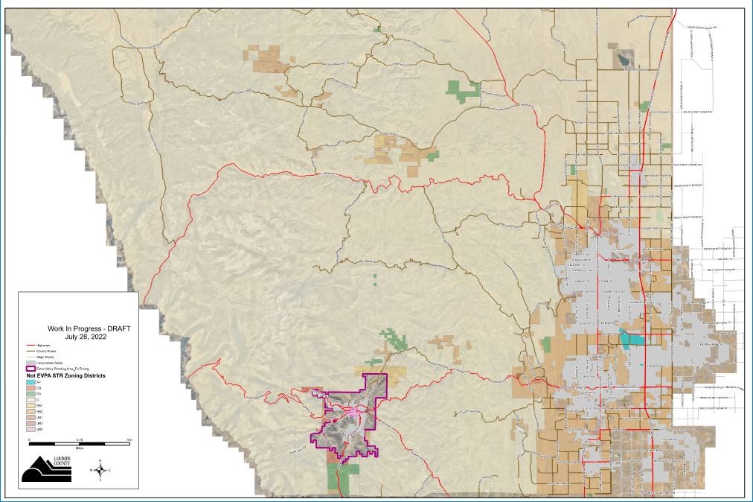
Short-term Rental Regulations Update
August 15, 2022
Countywide Zoning Districts

Slide 10
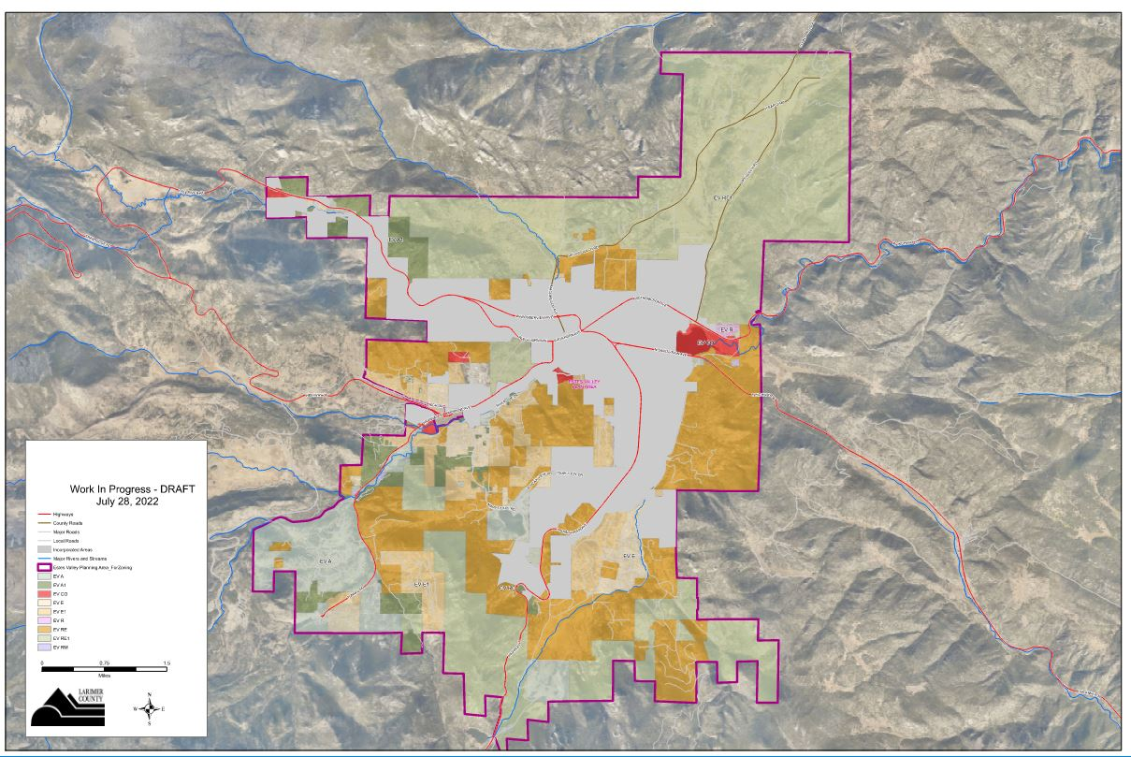
Short-term Rental Regulations Update
August 15, 2022
Estes Valley Zoning Districts

Slide 11
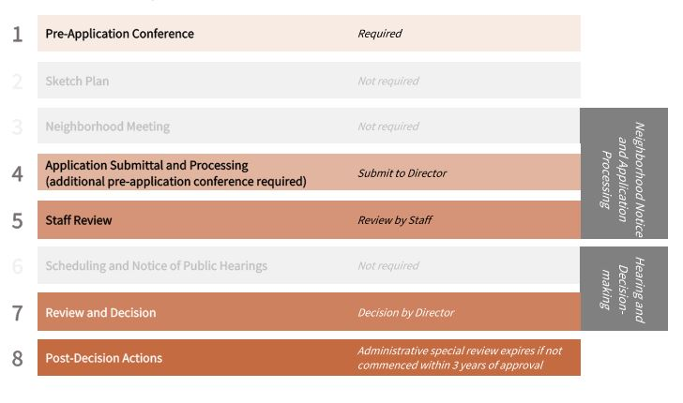
Short-term Rental Regulations Update
August 15, 2022
How does a property owner turn their home into a STR?
In order for a property to be rented as a STR, the property owner is required to obtain approval for the use through the Larimer County Community Development Department. To proceed with the approval process, property owners are required to submit a land use application, including an application fee, and provide evidence that the property can and will meet the requirements for STRs as listed in the Larimer County Land Use Code.
Administrative Special Review Procedure

Slide 12
Short-term Rental Regulations Update
August 15, 2022
Enforcement Ordinance
HB-20-1093 granted Counties authority to approve and regulate STRs.
  Ordinance adopted December 2021
  Unlawful to lease, advertise or permit the leasing without required approvals
  Requires:
    Property Management to be available 24/7 to respond to complains
    Upon approval, requires neighbor notification within 500-feet of subject property of Property Management contact information
    Advertising to contain valid Larimer County approval number (project number)
    Rental activities to cease until determination (approval) is made by the Planning Director
The Larimer County Code Compliance Division assists property owners in bringing their properties into compliance with the adopted land use and building codes, regulations, and ordinances, including Ordinance HB-20-1093.
The community can report concerns or complaints related to STRs to Code Compliance online: https://www.larimer.gov/codecompliance/report

Slide 13

Short-term Rental Regulations Update
August 15, 2022
Topics Under Consideration
Having administered the current Short-term Rental (STR) regulations for several years, the County recognizes the need to evaluate the effectiveness of the STR regulations.
Following conversations with the Larimer County Planning Commission and Board of County Commissioners, some topics of consideration include:
Should the County modify where STRs are allowed and at what intensity?
Should the County modify the review process for certain types of STRs?
Should the County change the standards for health,
safety, welfare based on how the
STR is used?
A ‘one size fits all’ approach may not
work and different standards may apply
to different parts of the County, similar
to STR regulations in the Estes Valley.

Slide 14
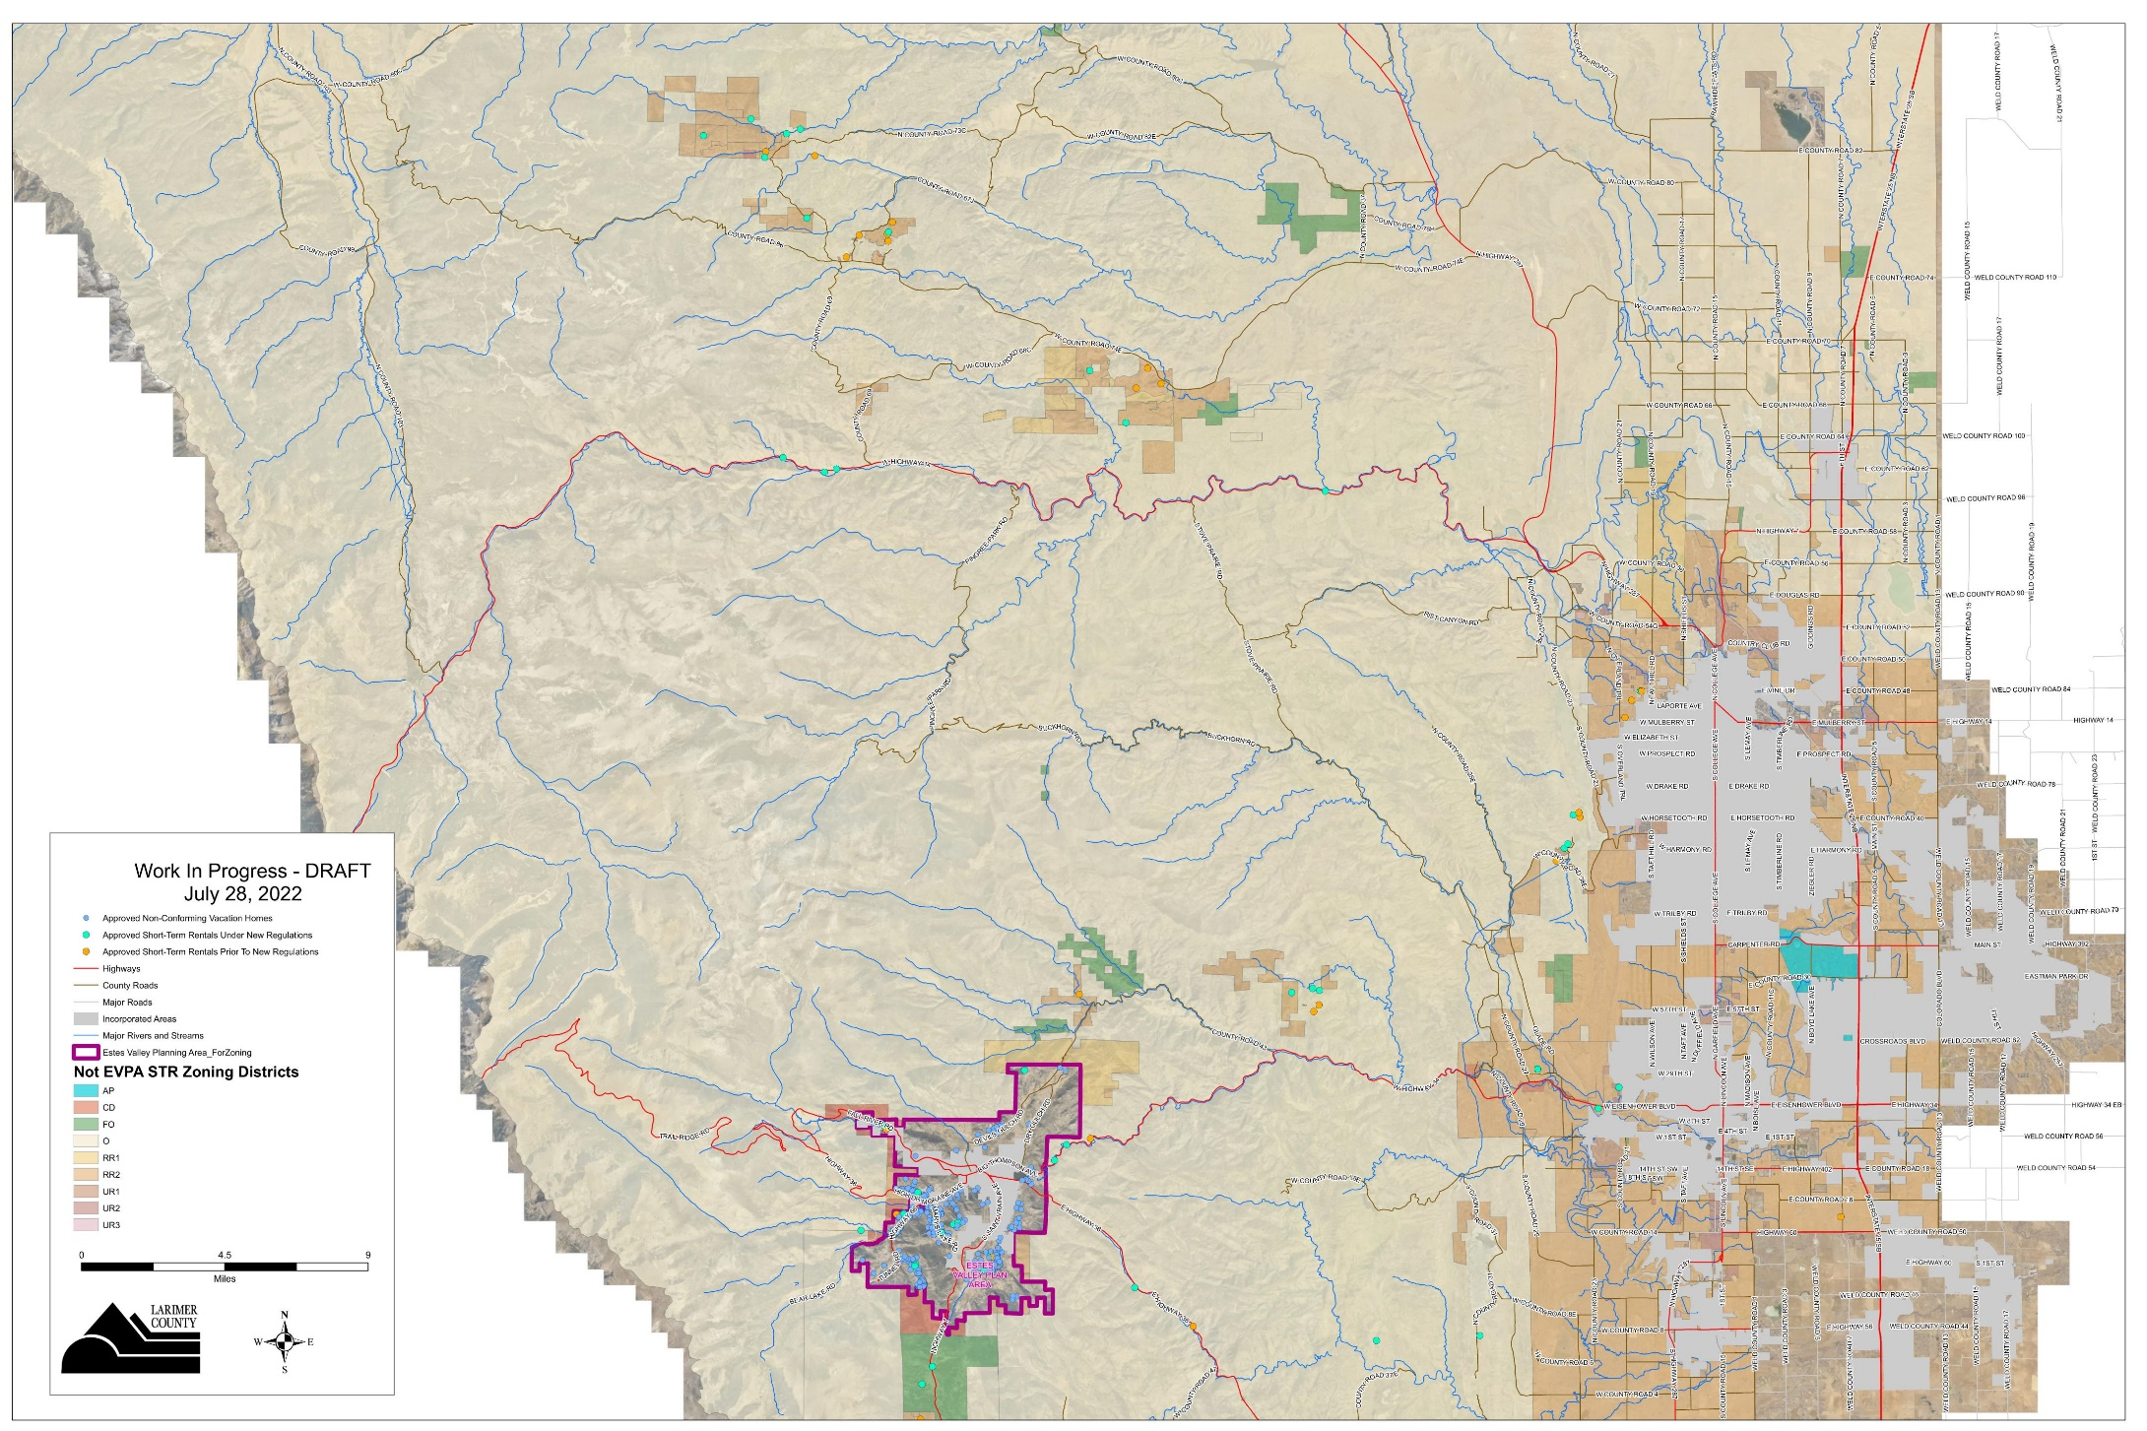
Short-term Rental Regulations Update
August 15, 2022
Countywide – Approved Short-term Rentals

Slide 15
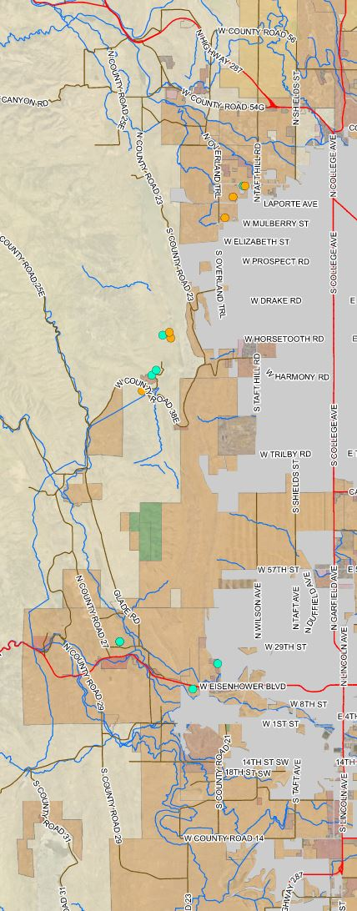
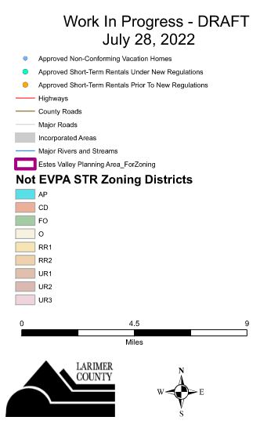
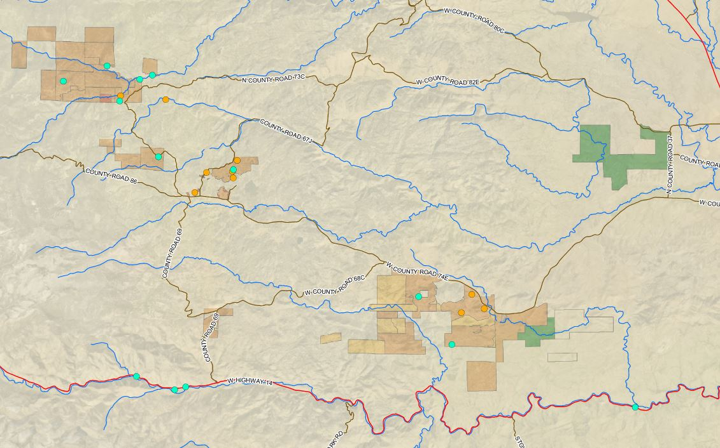
Short-term Rental Regulations Update
August 15, 2022
Red Feather Lakes area
Foothills

Slide 16
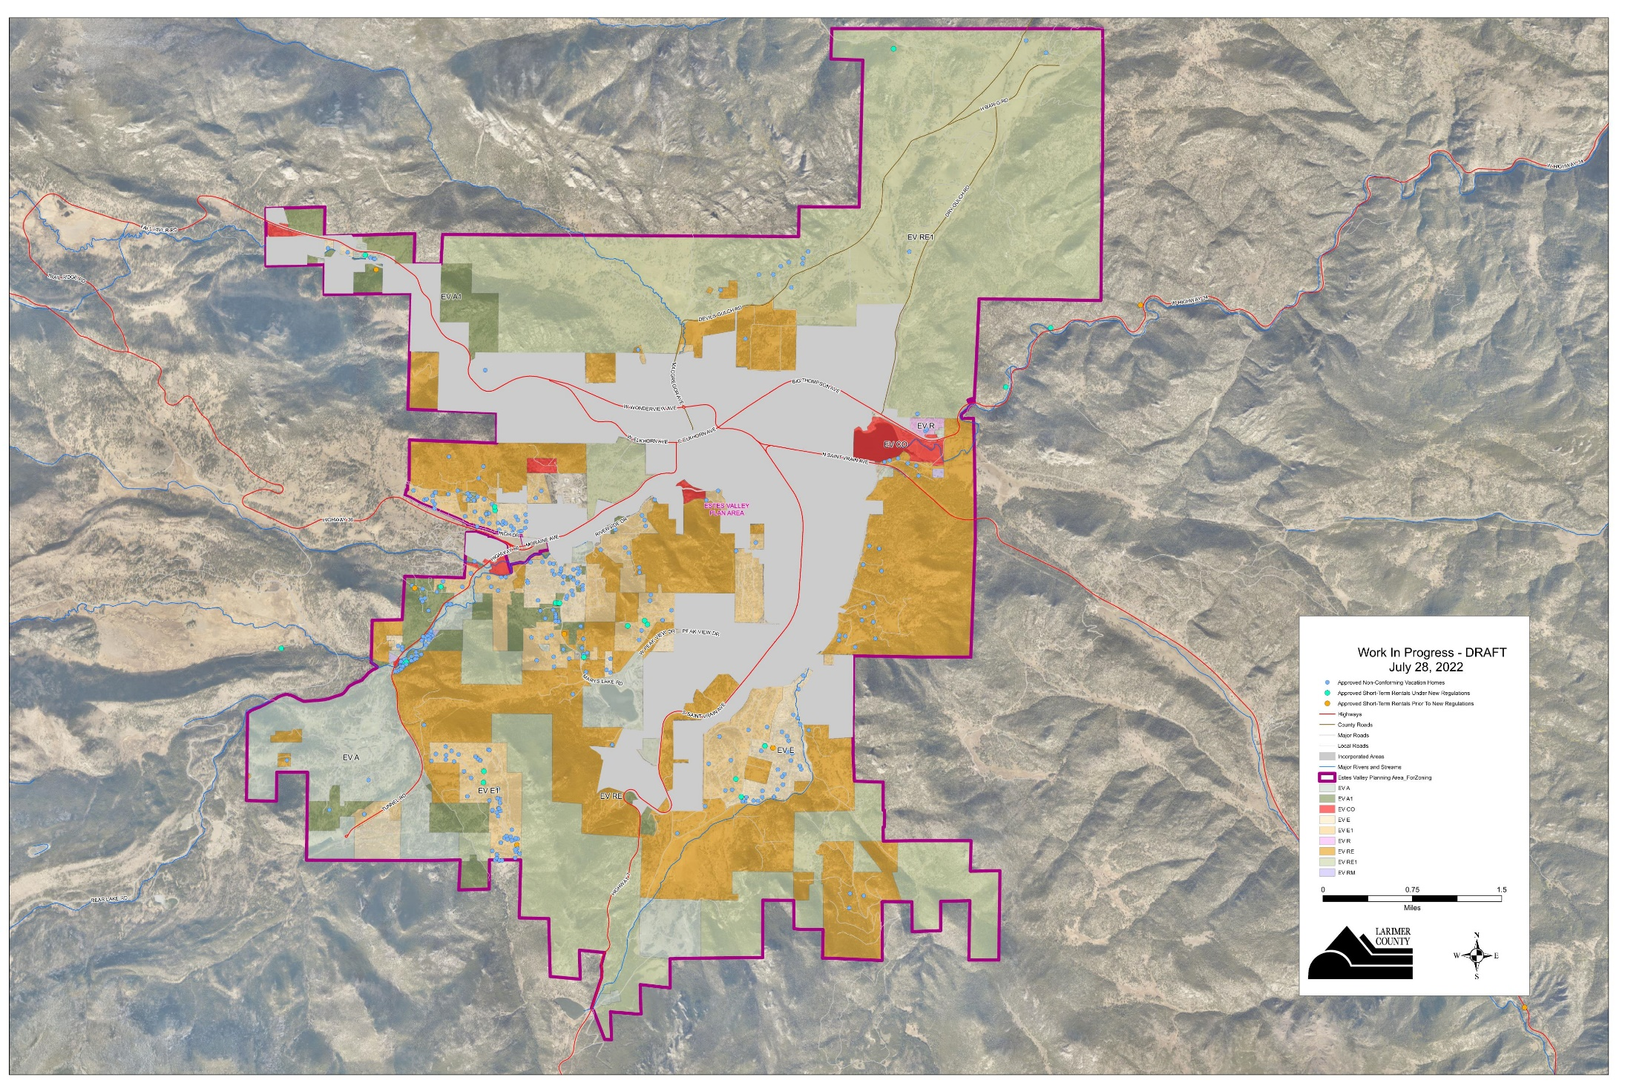
Short-term Rental Regulations Update
August 15, 2022
Estes Valley – Approved Short-term Rentals

Slide 17
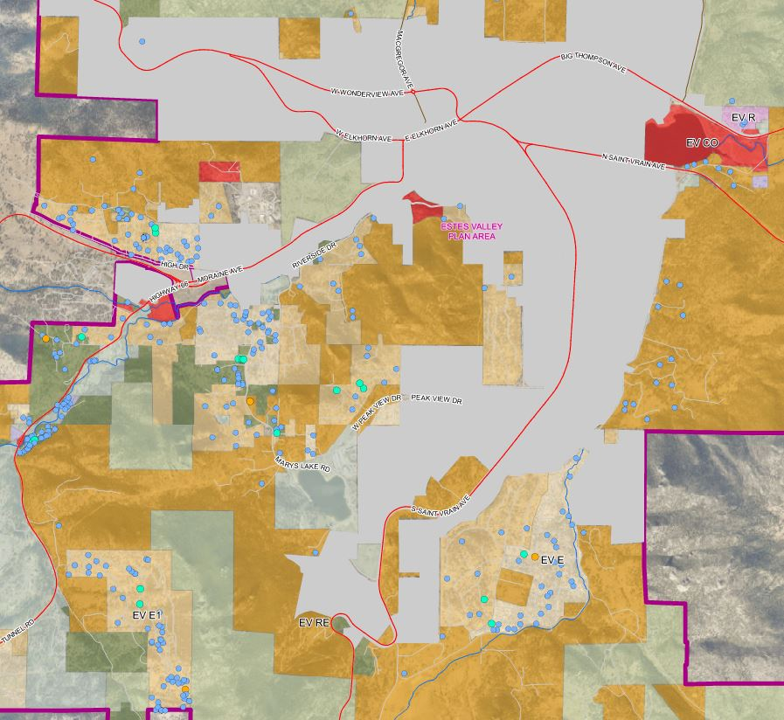
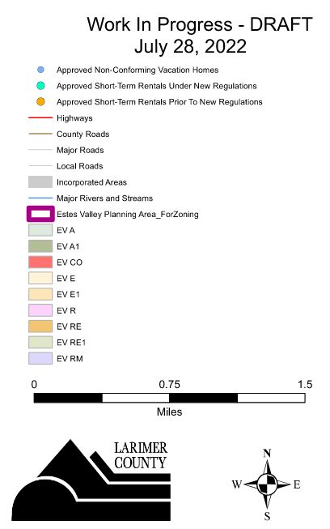
Estes Valley – Approved Short-term Rentals
Short-term Rental Regulations Update
August 15, 2022

Slide 18
Short-term Rental Regulations Update
August 15, 2022
Questions to Consider
Community Feedback:
Do you think Larimer County is regulating and reviewing short-term rentals at the right level?
Ideas to consider:
Should the regulations remain unchanged?
If not, what could be modified, added, or improved?
Topics to consider –
  Where allowed and at what intensity?
  Review process changed or improved?
  Changes to the standards for health, safety, welfare?
Any questions, or if you would like to provide additional feedback, please email Senior Planner Tawn Hillenbrand at LUC2020@larimer.org

Slide 19
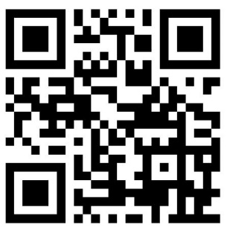
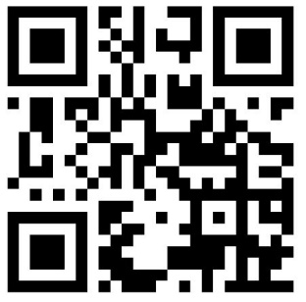
Short-term Rental Regulations Update
August 15, 2022
For project information, feedback, ideas, and project timeline visit:
https://www.larimer.gov/planning/short-term-rentals
General 5 min. Questionnaire
Detailed 30 min. Questionnaire

Slide 20
Short-term Rental Regulations Update
August 15, 2022
Questions
Any questions, or if you would like to provide additional feedback, please email Senior Planner Tawn Hillenbrand at
LUC2020@larimer.org
Lesli Ellis, AICP CEP Community Development Director
Community Development Department 200 W Oak St, Suite 3100 Fort Collins, CO 80521 W: 970.498.7690 ellislk@co.larimer.co.us | www.larimer.gov
Tawn Hillenbrand Senior Planner
Community Development Department 200 W Oak Street, Suite 3100 Fort Collins, CO 80521 W: 970.498.7691 thillenbrand@larimer.org | www.larimer.gov

