Slide 1
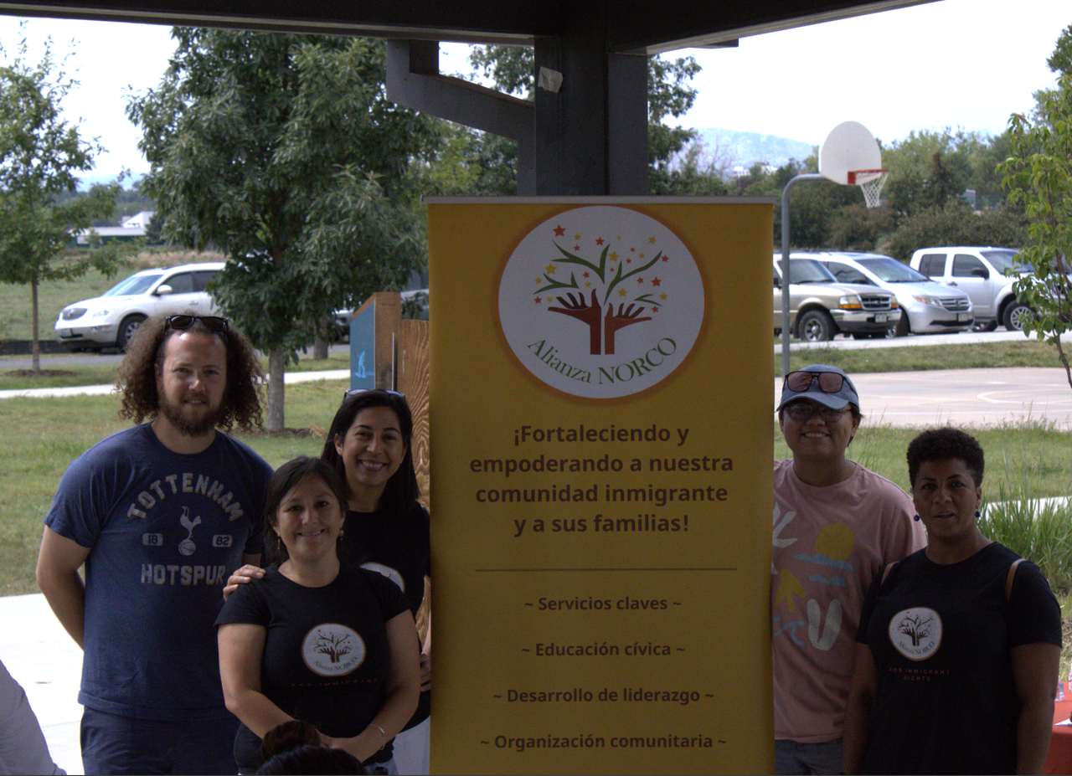
Alianza NORCO: Larimer County Grant
Patricia Miller
Executive Director

Slide 2
Alianza NORCO: Our Vision
Alianza NORCO is a grassroots nonprofit founded and led by a Salvadoran immigrant with a majority immigrant team. Founded in 2017, Alianza NORCO envisions a nation where immigrants are welcomed, are free from oppression and can easily integrate. A nation where immigrants have equitable access to opportunity and our contributions are recognized, valued and celebrated.
Our mission is to strengthen our immigrant community members and their families through key services, resource navigation, community organization, civic education, and leadership development.
Our overarching goal is to work in partnership with multi-ethnic allies and pro-immigrant groups to break down the obstacles we face as immigrants and empower our communities.

Slide 3
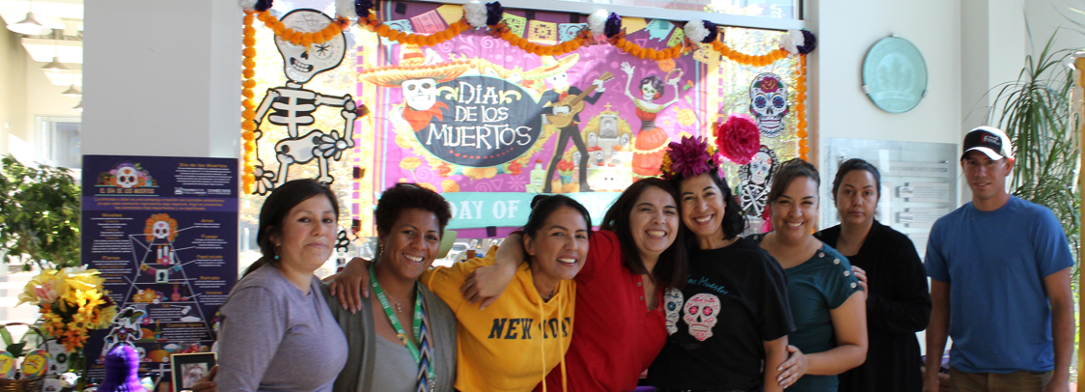
Alianza NORCO: What We Do
We provide pro-bono or low-cost immigration legal services, bilingual navigation services, civic education to increase immigrant engagement, and assistance that promotes empowerment through long-term tangible benefits for our clients.
We strive to affect change and advocate for immigrant rights at local, state, and national levels to increase immigrant safety, social cohesion, and civic engagement. Our approach to implementing direct service programs and community organizing centers and amplifies the voices of our immigrant community.

Slide 4
Alianza NORCO: The Issue
Historically, immigrants have suffered from lack of access to government and non-government services at the local, state and federal levels.
In the last six years, immigrants faced worsening conditions as anti-immigrant sentiment swept across the country and we saw a devastating negative shift in international and domestic immigration policy. Then three years ago, the COVID-19 pandemic began its rampage of infection across our immigrant population, many of whom are essential frontline workers.
Locally, the impacts of these two events were: reduced economic opportunities, worsening mental and physical health, decreased legal services, and a lack of upward mobility for our immigrant population.

Slide 5
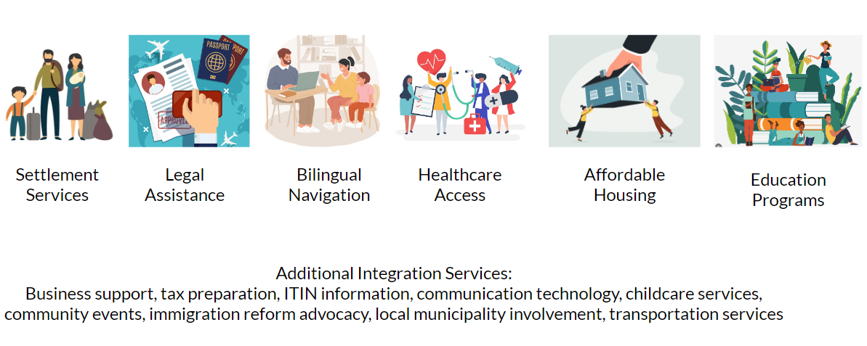
Our Navigation Services

Slide 6
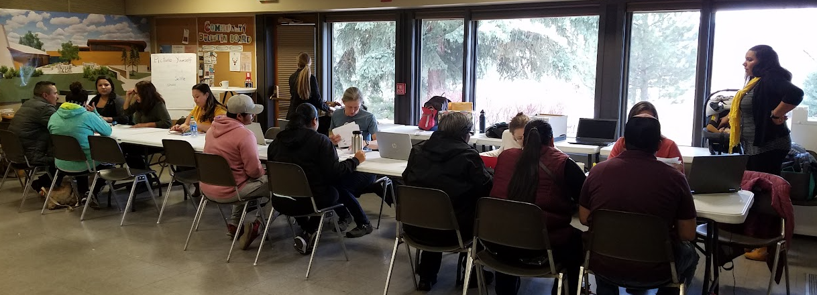
Alianza NORCO: Navigation Program
The Larimer County Immediate Needs Grant funded some of our Navigation program costs.
Alianza’s Navigation program provides bilingual, culturally informed navigation to documented and undocumented people. We provide guidance for Colorado driver’s licenses through the SB13-251 program, notary services, passport appointments, rent assistance, ITIN/tax preparation, and referrals for power of attorney forms and family law.
The guidance that we provide for driver's licenses gives essential agricultural, construction, health aid and service workers access to reliable transportation and promotes safer drivers on our roads.

Slide 7
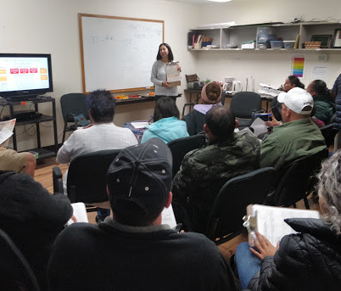
By the Numbers:
With the help of the Larimer County Immediate Needs grant, our grassroots non-profit expanded the scope of our services and we saw a dramatic increase in the number of clients we can assist.
In 2021 and 2022, our Navigation team worked with over 965 clients.
We provided direct financial assistance to over 400 immigrants.
Our staff has grown from two members in 2021 to eight in 2023 and our FY’ 24 operating budget is nearly five times greater that FY ’22.

Slide 8
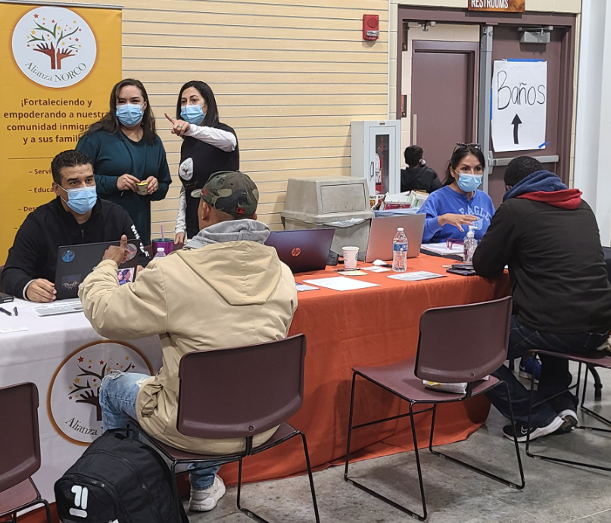
Your Impact
The Larimer Immediate Needs Grant helped fund our Bilingual Navigation Program, primarily in the form of salary reimbursement.
The Grant was a catalyst for Alianza’s growth that helped us launch new programming and reach more residents of Larimer County. The grant was truly instrumental in fueling the growth of our organization and our ability to provide transformational services for our clients.
This growth has put Alianza at the forefront of Northern Colorado’s advocacy coalition for immigrant rights and positioned us to contribute to the cultural vibrancy of the region.

Slide 9
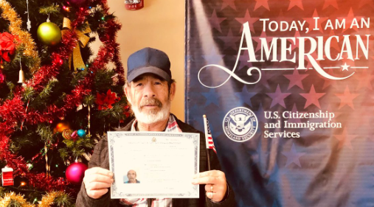
A Testimonial

Slide 10
“Today I am an American!”
Felipe first sought the help of Alianza NORCO in 2022 after he had heard about the resources we provide. He had been trying for decades to become a citizen and really needed the guidance and assistance of Alianza’s Legal and Navigation programs to achieve this goal.
Felipe has said that “lawyers I went to before Alianza only cared about the money, but here they care about my issues.” Felipe faced trials and set backs throughout his journey towards citizenship. When asked about what kept him going and persisting towards his goal, he simply replied “Yenny”. Yenny, our beloved Bilingual Navigation Manager, had helped Felipe since day one with Alianza. Felipe expressed that he felt Yenny’s compassion for him and saw the diligence she poured into her work.
In January 2023, Felipe (accompanied by Yenny) attended his naturalization ceremony and realized his dream of citizenship! We were thrilled for our client and inspired by his hard work and determination. Felipe told us that he now feels safe to walk around town with “this weight being lifted” off his back. Upon asking him what he was most excited for now after he had been granted citizenship, he stated that exercising his right to vote was at the top of his list.

Slide 11
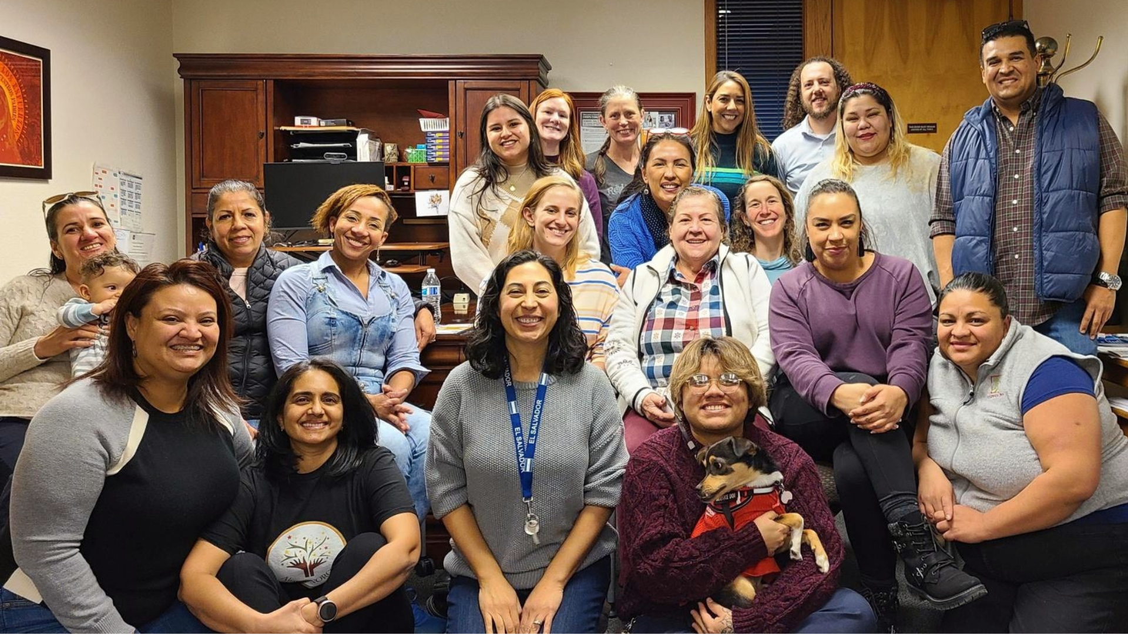
Thank You Larimer!

