Slide 1
Larimer County water Master Plan
Vision and Goals Workshop
November 6, 2023
Notes:
Sarah

Slide 2
Workshop Purpose
WATER MASTER PLAN
The purpose of the vision and goals workshop is to share information about the overall project and issues the county faces related to water use and conservation, support dialog between diverse interested parties, and gather feedback on a vision statement and final set of tiered goals for Larimer County to use in guiding the Water Master Plan development.
Notes:
Sarah

Slide 3
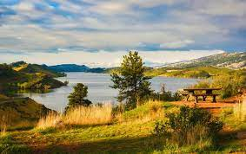
Workshop Objectives
WATER MASTER PLAN
Increase attendees understanding about the Water Master Plan, risks, and project as a whole;
Gather input from attendees regarding their vision for water resources in Larimer County; and
Gather ideas and feedback from attendees on the Water Master Plan goals.
Notes:
Sarah

Slide 4
Workshop Objectives
WATER MASTER PLAN
Increase attendees understanding about the Water Master Plan, risks, and project as a whole;
Gather input from attendees regarding their vision for water resources in Larimer County; and
Gather ideas and feedback from attendees on the Water Master Plan goals.
Notes:
Sarah

Slide 5
Agenda
WATER MASTER PLAN
6:00 p.m. Welcome & Introductions
6:20 p.m. Presentation
6:30 p.m. Facilitated session: Vision and Goals
7:30 p.m. Sharing and Synthesis
7:55 p.m. Closing Remarks
8:00 p.m. Adjourn
Notes:
Sarah
If you can't stay for the full meeting, these materials are online and we will be collecting feedback on the vision and goals up until Nov. 20th

Slide 6
Ground Rules
We welcome everyone’s participation
Respect the speaker
Hard on ideas, soft on people
Headline it!
E-manners
Use the parking lot
Notes:
Sarah

Slide 7
Introductions
Notes:
SWCA Team - Sarah
County Team - Danielle

Slide 8
We want to hear from you!
Notes:
Sarah
PLACEHOLDER – switch to Mentimeter:
Launches Mentimeter Poll #1 (short answer scroll): Why are you here?
Launches Mentimeter Poll #2 (word cloud): In 1 word what is your connection to water in Larimer County?

Slide 9
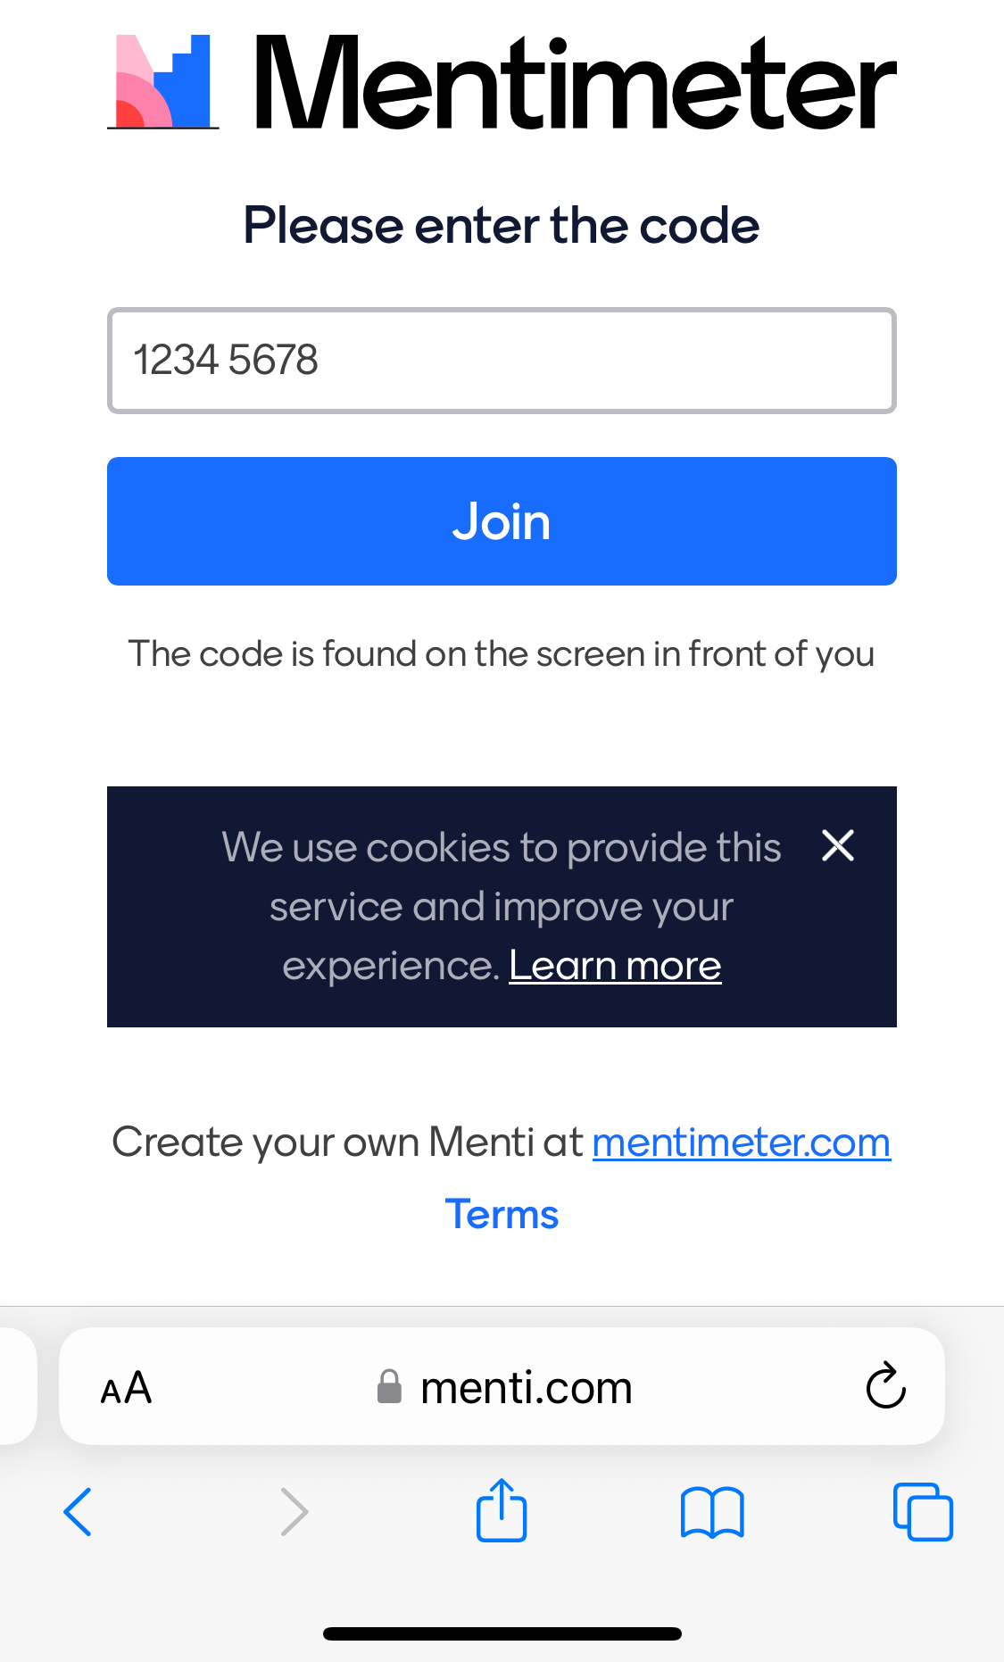
Mentimeter how-to
Go to www.menti.com
2763 1677
Notes:
Sarah
Review Mentimeter steps
Go to Menti.com
Enter 8-digit code from screen
Click JOIN
Type in your short answer or one-word response
Multiple responses per person is okay!
Help your neighbors

Slide 10
Plan, Part 1 – 2022 Foundational Work
WATER MASTER PLAN
Existing Conditions Assessment
Initial Vision and Goal Setting
Scope: Assessed existing conditions related to water supplies and agricultural land and identified risks and vulnerabilities.
Deliverable: Regional Existing Conditions Report.
Scope: County staff work session and stakeholder open house.
Deliverable: Final memo with key findings, action items, and recommendations for developing the water plan.
Posted at: larimer.gov/planning/water
Notes:
Danielle

Slide 11
Top Water Issues in the region
WATER MASTER PLAN
Water is a finite resource, with supply susceptible to water calls.
Long-range water sustainability for the region needs to be defined.
Adequate water supplies and storage are a key consideration that should be considered when evaluating development and planned growth.
Healthy watersheds and rivers are of interest and important.
Productive agriculture lands require water supplies.
Water supply requirements (volumes and costs) vary by water service provider for new developments.
Housing affordability has a nexus with water supply requirements and tap fee costs.
Recreation and tourism rely on water and healthy watersheds and rivers.
Water exports affect the Northern Colorado region.
Understanding the needs of, and impacts to, under-served and disproportionately impacted communities is a regional water issue.
Notes:
Danielle

Slide 12
Top Identified Water Risks
WATER MASTER PLAN
Information and Planning Gaps
Lack of education and awareness*
Risks to economy due to lack of water*
Limitations on agriculture water rental availability
Infrastructure concerns
Natural hazards (drought, wildfire, flood)
Water rights
Demands on the water supply
Lack of watershed protection
Decline in water quality
Water rental market and dialogue limitations*
Notes:
Danielle
Building off from the foundational risks. Mix of both.
* is for risks that have come about recenetly (WAG/TAG/County)

Slide 13
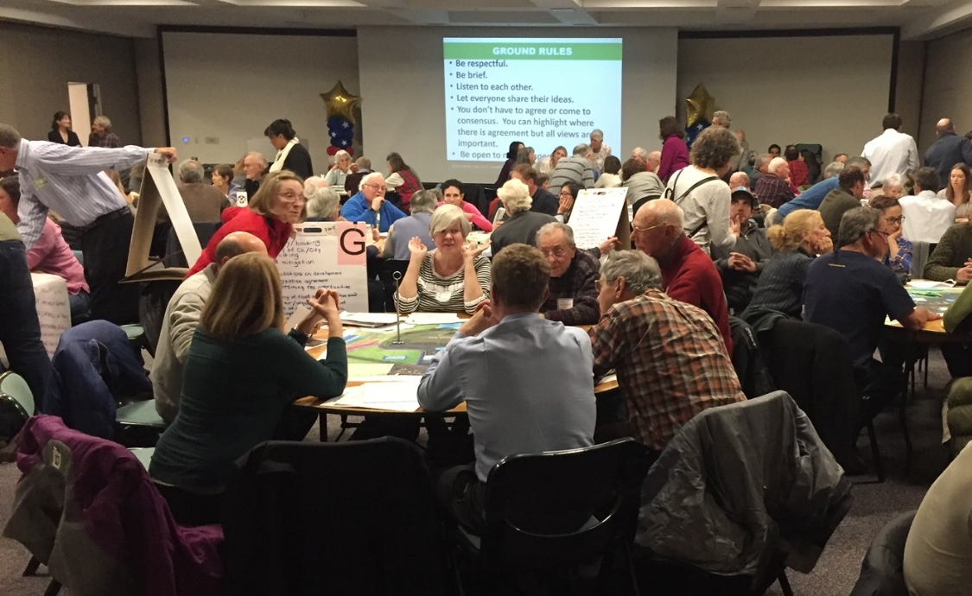
Water Master Plan
WATER MASTER PLAN
Public Engagement Plan, Committee Formation (Oct ‘23)
Inventory Review and Gap Analysis (Feb ‘24)
Refined Vision and Goals (Nov ‘23)
Mapping and Analysis (Apr/May ‘24)
Identify Additional Risks and Vulnerabilities (Jul/Aug ‘24)
Identify Implementation Measures, Mitigation, and Other Strategies (Aug/Sept ‘24)
Compile and Complete Water Master Plan for Adoption (Dec ’24–Jan ‘25)
Update Land Use Code (Dec ’24)
Firms: SWCA and AE2S
Timeline: Through end of 2024
Funding: FEMA and County
Notes:
Danielle:

Slide 14
Ways to be Involved
WATER MASTER PLAN
Public meeting – Vision and Goals (Nov. 6)
Questionnaires on Project website
Water Advisory Group (January 2024)
Three additional public meetings (April, July, October 2024)
Danielle Reimanis
Water master Plan Coordinator
Larimer County
970-498-7710
LCwaterplan@co.larimer.co.us
larimer.gov/planning/water
Notes:
Danielle
If folks want provide feedback on vision and goals until November 20th. Utilize the worksheet, email. Phone call.

Slide 15
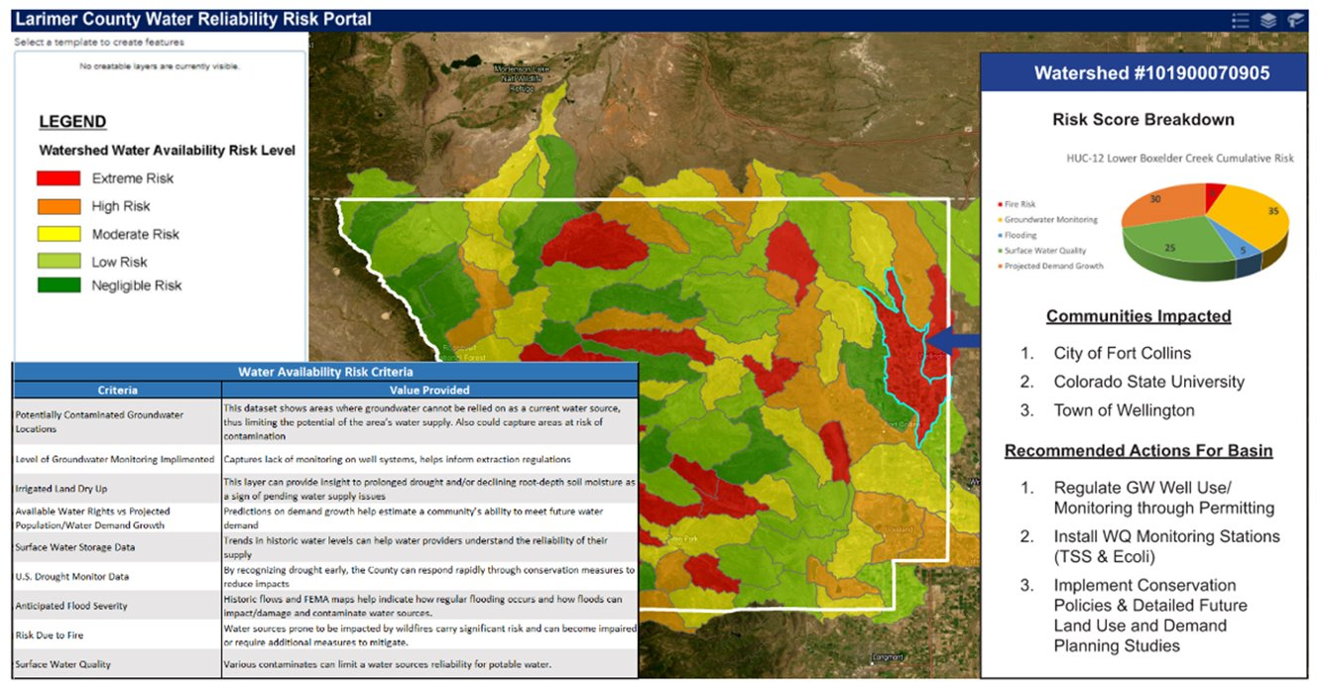
What’s on the horizon?
WATER MASTER PLAN
Larimer County will use the feedback gained from today’s workshop to…
Prioritize the goals
Incorporate into the development of the Water Master Plan
Notes:
Danielle
1) Learn and prioritize what is important to the public and incorporate into the development of the plan.

Slide 16
Round 1: Values
WATER MASTER PLAN
What do you value about water resources in Larimer County that you would like to see continue into the future?
What would you like to see from Larimer County’s water resources that doesn’t exist now?
Notes:
Sarah

Slide 17
Round 2: Vision Statement
WATER MASTER PLAN
How would you improve this vision statement?
“Larimer County’s vision is to have healthy watersheds and resilient water systems.”
Notes:
Sarah

Slide 18
Round 3: Goals
WATER MASTER PLAN
Are there any missing, or any that should be improved or different?
Which goals are the most important in your opinion?
Consult your handout!
Notes:
Sarah

Slide 19
Sharing and Synthesis
Notes:
Sarah
Groups, then individuals

Slide 20
Workshop Objectives
WATER MASTER PLAN
Increase attendees understanding about the Water Master Plan, risks, and project as a whole;
Gather input from attendees regarding their vision for water resources in Larimer County; and
Gather ideas and feedback from attendees on the Water Master Plan goals.
Notes:
Sarah

Slide 21
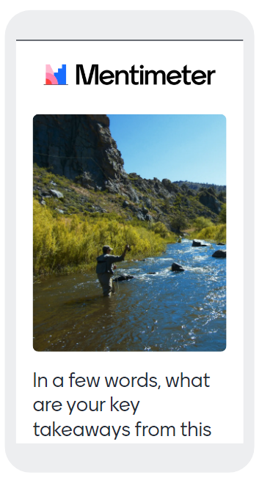
Mentimeter how-to
Go to www.menti.com
82 76 65 0
Notes:
Sarah
Review Mentimeter steps
Go to Menti.com
Enter 8-digit code from screen
Click JOIN
Type in your short answer or one-word response
Multiple responses per person is okay!
Help your neighbors

Slide 22
Closing Remarks
WATER MASTER PLAN
Danielle Reimanis
Water master Plan Coordinator
Larimer County
970-498-7710
LCwaterplan@co.larimer.co.us
larimer.gov/planning/water
Notes:
Sarah: Thank table hosts, thank project team, thank participants
Website for next steps
Please visit posters and team
Safe & pleasant evening
Danielle to do friendly 30 second appreciation.

